Slide 1
智慧型管理決策系統

Slide 2
Machine Learning
Supervised Learning
Supervised learning is the machine learning task of inferring a function from labeled training data. The training data consist of a set of training examples. In supervised learning, each example is a pair consisting of an input object (typically a vector) and a desired output value (also called the supervisory signal).
Unsupervised Learning
In machine learning, the problem of unsupervised learning is that of trying to find hidden structure in unlabeled data. Since the examples given to the learner are unlabeled, there is no error or reward signal to evaluate a potential solution. This distinguishes unsupervised learning from supervised learning and reinforcement learning.

Slide 3
Boosting Algorithm
Boosting is a machine learning ensemble meta-algorithm for reducing bias primarily and also variance in supervised learning, and a family of machine learning algorithms which convert weak learners to strong ones.
Boosting is based on the question posed by Kearns and Valiant (1988, 1989): Can a set of weak learners create a single strong learner? A weak learner is defined to be a classifier which is only slightly correlated with the true classification (it can label examples better than random guessing). In contrast, a strong learner is a classifier that is arbitrarily well-correlated with the true classification.

Slide 4
AdaBoost
AdaBoost, short for "Adaptive Boosting", is a machine learning meta-algorithm formulated by Yoav Freund and Robert Schapire who won the Gödel Prize in 2003 for their work.
It can be used in conjunction with many other types of learning algorithms to improve their performance.
The output of the other learning algorithms ('weak learners') is combined into a weighted sum that represents the final output of the boosted classifier.
AdaBoost is adaptive in the sense that subsequent weak learners are tweaked in favor of those instances misclassified by previous classifiers.

Slide 5
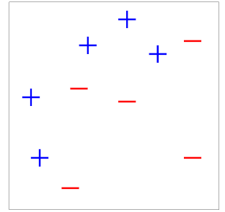
AdaBoost
Freund and Schapire originally proposed the AdaBoost algorithm in 1995 and its journal version was published in 1997

Slide 6
AdaBoost

Slide 7
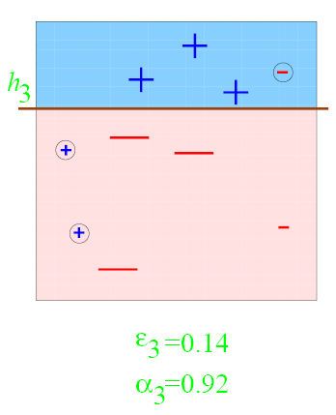
AdaBoost

Slide 8
AdaBoost

Slide 9
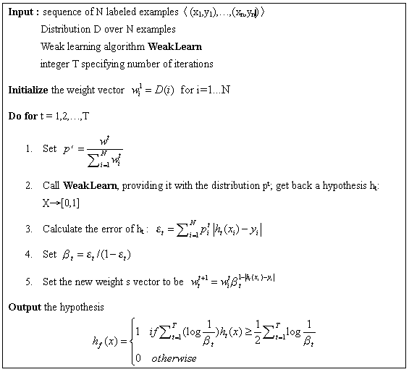
AdaBoost Algorithm

Slide 10
Homework
Draw the ROC curve of face detection database based on Viola and Jone’s approach.

