Slide 1
Boarding & Disembarking
stOOrz

Slide 2
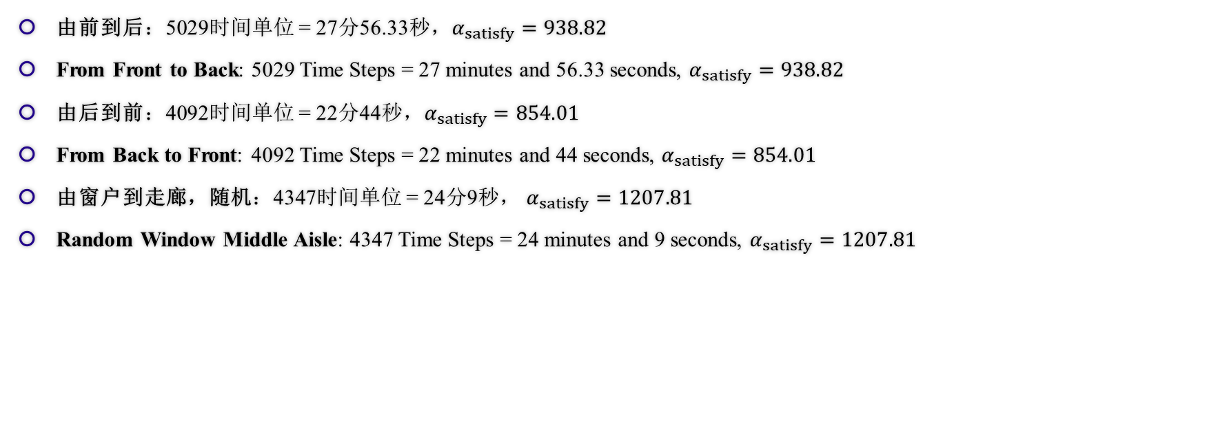
模拟结果 Results of Simulation
由前到后：5029时间单位 = 27分56.33秒，$α_{satisfy}=938.82$
From Front to Back: 5029 Time Steps = 27 minutes and 56.33 seconds, $α_{satisfy}=938.82$
由后到前：4092时间单位 = 22分44秒，$α_{satisfy}=854.01$
From Back to Front: 4092 Time Steps = 22 minutes and 44 seconds, $α_{satisfy}=854.01$
由窗户到走廊，随机：4347时间单位 = 24分9秒， $α_{satisfy}=1207.81$
Random Window Middle Aisle: 4347 Time Steps = 24 minutes and 9 seconds, $α_{satisfy}=1207.81$

Slide 3
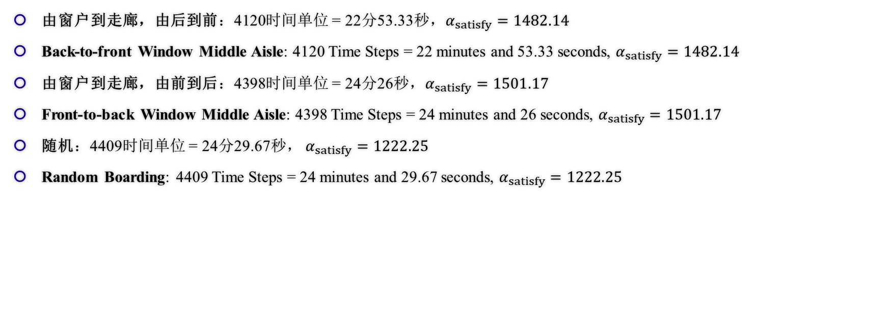
模拟结果 Results of Simulation
由窗户到走廊，由后到前：4120时间单位 = 22分53.33秒，$α_{satisfy}=1482.14$
Back-to-front Window Middle Aisle: 4120 Time Steps = 22 minutes and 53.33 seconds, $α_{satisfy}=1482.14$
由窗户到走廊，由前到后：4398时间单位 = 24分26秒，$α_{satisfy}=1501.17$
Front-to-back Window Middle Aisle: 4398 Time Steps = 24 minutes and 26 seconds, $α_{satisfy}=1501.17$
随机：4409时间单位 = 24分29.67秒， $α_{satisfy}=1222.25$
Random Boarding: 4409 Time Steps = 24 minutes and 29.67 seconds, $α_{satisfy}=1222.25$

Slide 4
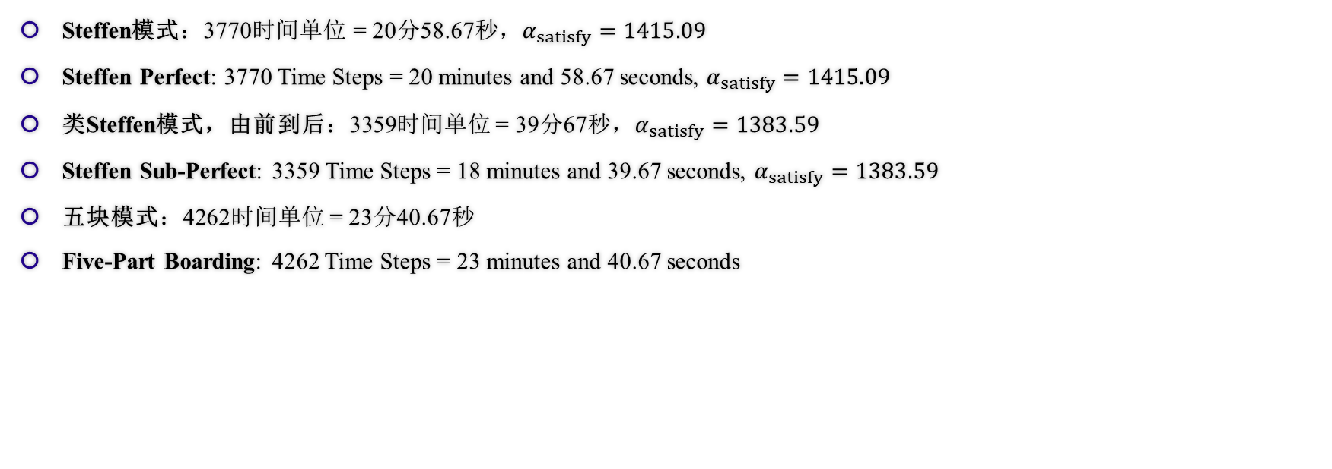
模拟结果 Results of Simulation
Steffen模式：3770时间单位 = 20分58.67秒，$α_{satisfy}=1415.09$
Steffen Perfect: 3770 Time Steps = 20 minutes and 58.67 seconds, $α_{satisfy}=1415.09$
类Steffen模式，由前到后：3359时间单位 = 39分67秒，$α_{satisfy}=1383.59$
Steffen Sub-Perfect: 3359 Time Steps = 18 minutes and 39.67 seconds, $α_{satisfy}=1383.59$
五块模式：4262时间单位 = 23分40.67秒
Five-Part Boarding: 4262 Time Steps = 23 minutes and 40.67 seconds

Slide 5
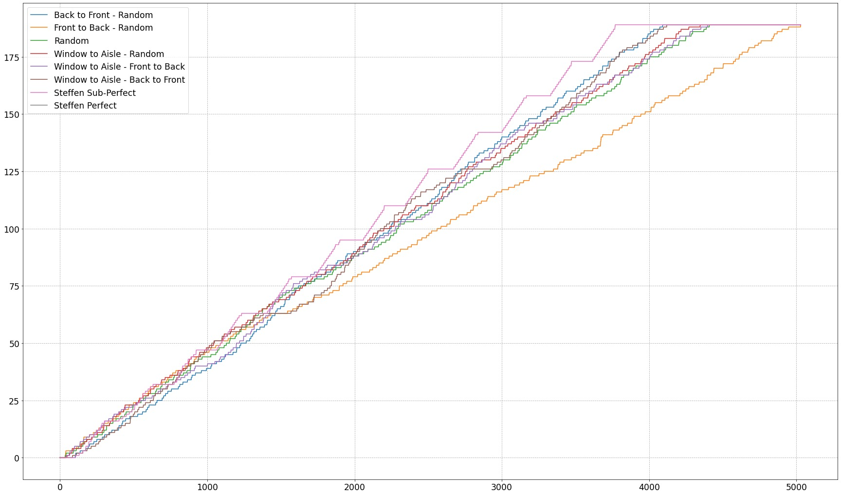
模拟结果 Results of Simulation

Slide 6
敏感度分析 Sensitivity Analysis
如何对我们的模型进行敏感度分析？
How to conduct a Sensitivity Analysis on Our Model?
使用拟合程度进行定量衡量
Use Compliancy Index to measure in Figure
对改变的可预测性
Predictable of Changes
事实证明的变化关系
Relationship proved by Facts

Slide 7
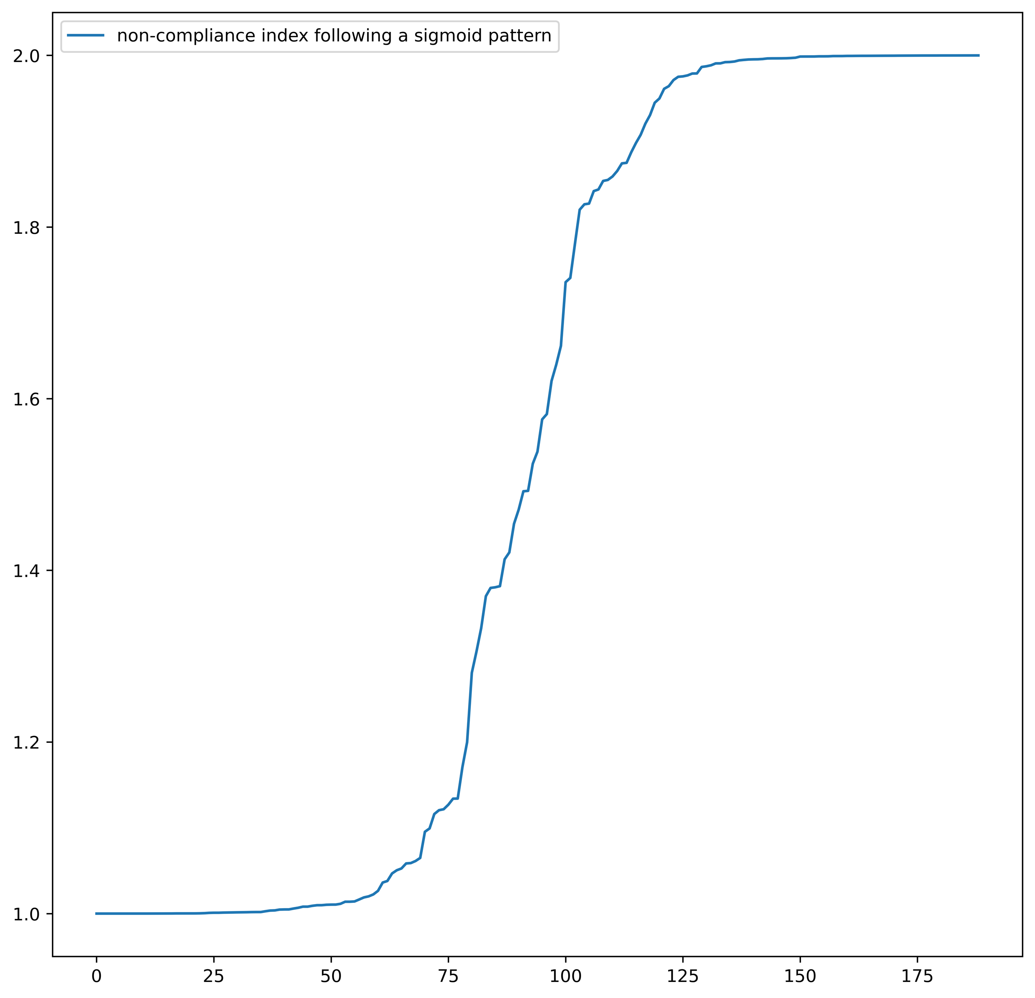
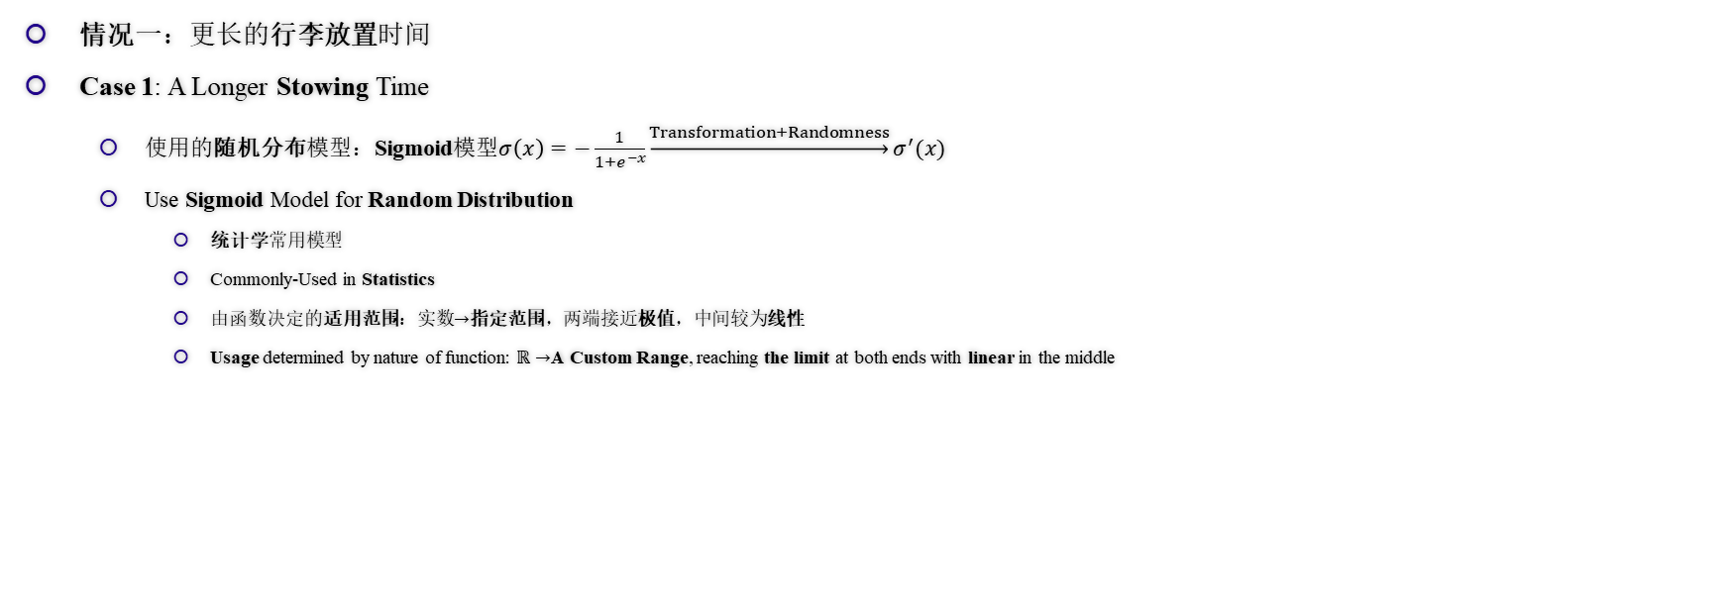
敏感度分析 Sensitivity Analysis
情况一：更长的行李放置时间
Case 1: A Longer Stowing Time
使用的随机分布模型：Sigmoid模型$σ\left(x\right)=−\frac{1}{1+e^{−x}}\underset{→}{Transformation+Randomness}σ^{′}(x)$
Use Sigmoid Model for Random Distribution
统计学常用模型
Commonly-Used in Statistics
由函数决定的适用范围：实数$→$指定范围，两端接近极值，中间较为线性
Usage determined by nature of function: $ℝ→$A Custom Range, reaching the limit at both ends with linear in the middle
图：Sigmoid模型范例
Fig. Sigmoid Model Demonstration

Slide 8
敏感度分析 Sensitivity Analysis
情况一：更长的行李放置时间
Case 1: A Longer Stowing Time
如何区分稳定和不稳定？（总体尺度上）
How to distinguish between Stable and Unstable? (Overall Timestep)
稳定：线性图像
Stable: Linear Graph
不稳定：无明显规律
Unstable: No Obvious Relationship
方差（差异化程度）的图像
The Graph of Variance
稳定：先为上凸函数（变化率逐渐递减），后为线性
Stable: Rate of Changing Decrease followed by Linear
不稳定：无线性阶段
Unstable: No Linear State

Slide 9
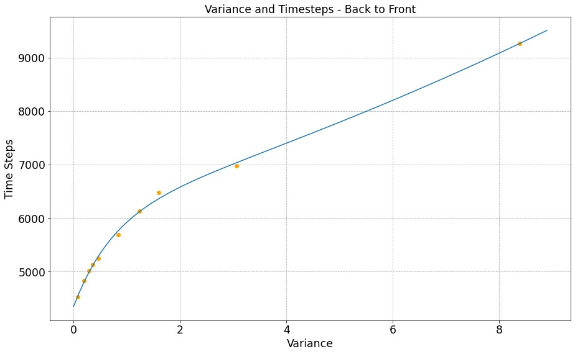
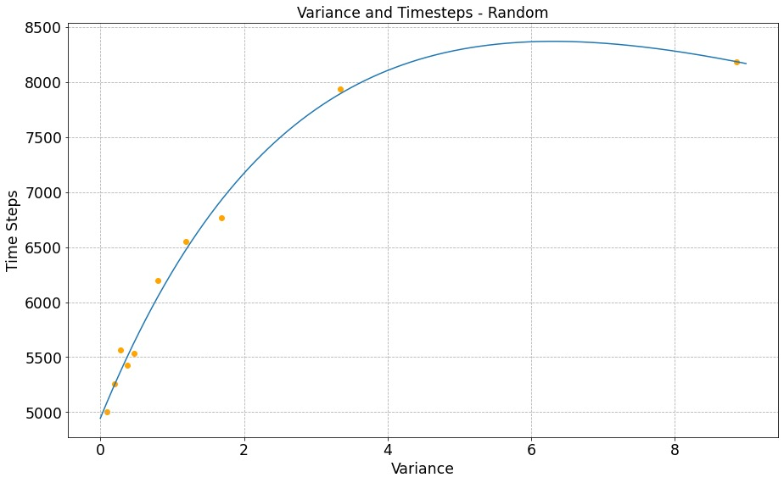
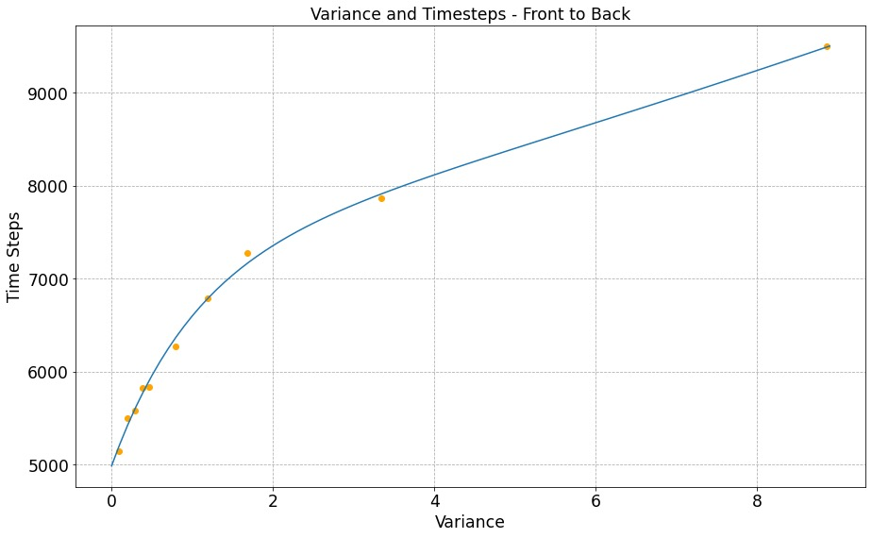
敏感度分析 Sensitivity Analysis
情况一：更长的行李放置时间
Case 1: A Longer Stowing Time
图：放置行李时间影响比较（方差）
Fig. Comparison on Longer Stowing Time, Variance

Slide 10
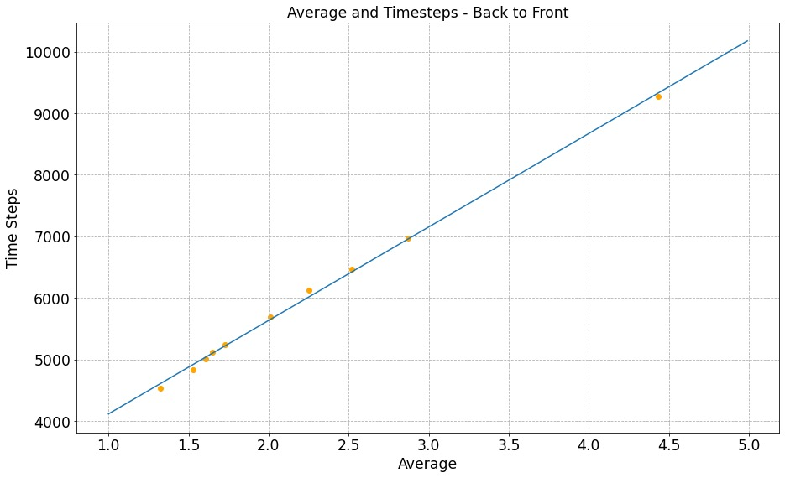
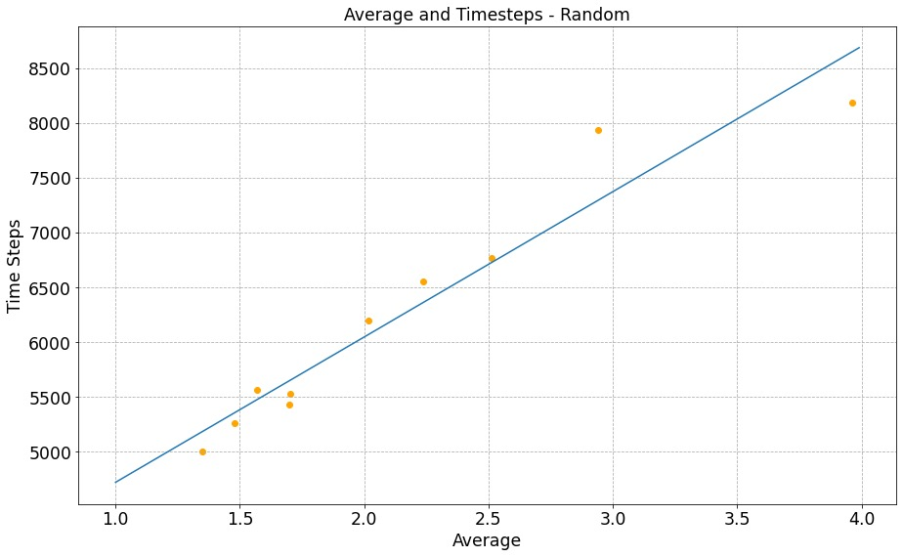
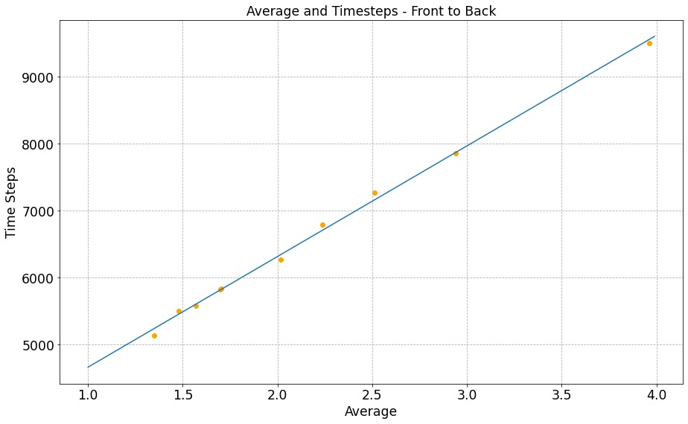
敏感度分析 Sensitivity Analysis
情况一：更长的行李放置时间
Case 1: A Longer Stowing Time
随机登机敏感度较高，由前到后登机敏感度较低
Random boarding is the most sensitive while Front-to-Back method seems totally not sensitive
图：放置行李时间影响比较（总时间）
Fig. Comparison on Longer Stowing Time, Overall Time

Slide 11
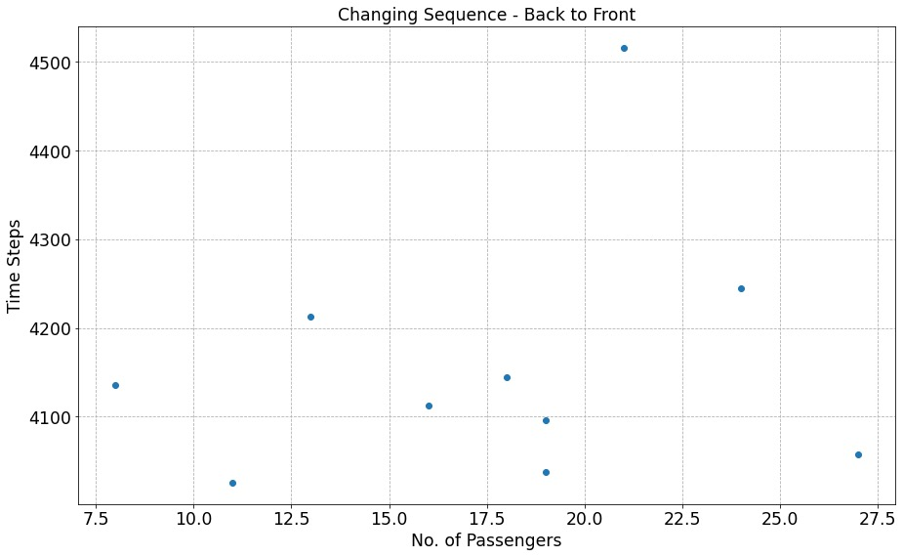
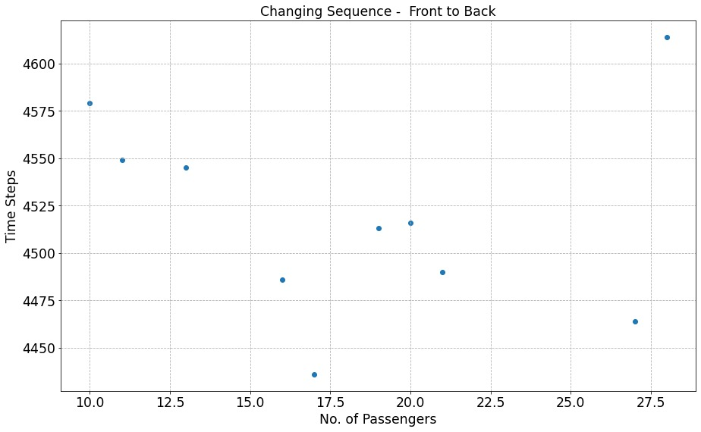
敏感度分析 Sensitivity Analysis
情况二：插队
Case 2: Queue Jumping
两个方案均为敏感方案，会对结果造成巨大的影响
Both Methods are Sensitive which makes Big Impact on Total Results
图：插队影响比较
Fig. Comparison on Queue Jumping

Slide 12
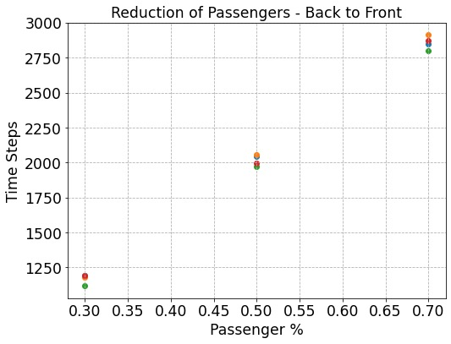
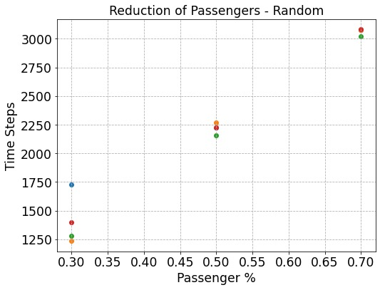
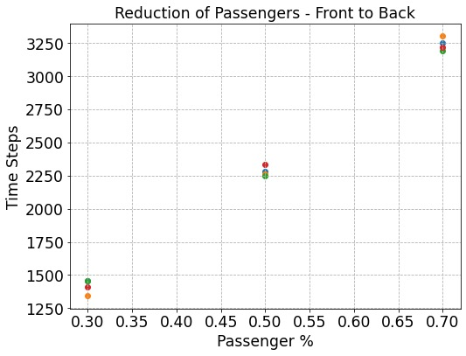
敏感度分析 Sensitivity Analysis
情况三：乘客数量的减少
Case 3: Reduction of Passengers
随机登机最为敏感（点的分布最远），由后到前登机依然十分稳定
Random Boarding is the most Sensitive (Furthest Distribution of Points), Back-to-Front Method still not so sensitive
图：乘客人数减少影响比较
Fig. Comparison on Reducing Passengers

Slide 13
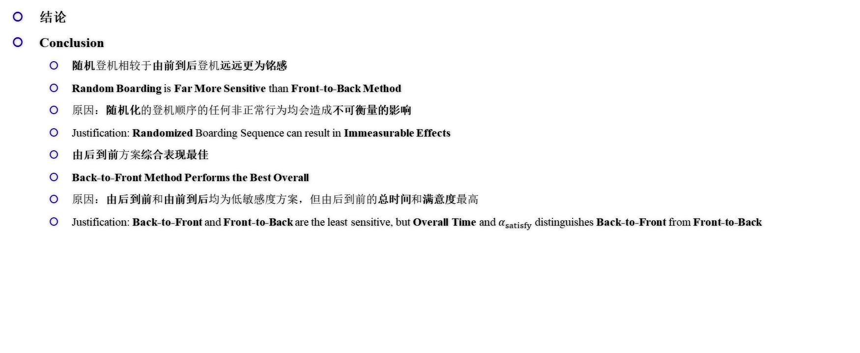
敏感度分析 Sensitivity Analysis
结论
Conclusion
随机登机相较于由前到后登机远远更为铭感
Random Boarding is Far More Sensitive than Front-to-Back Method
原因：随机化的登机顺序的任何非正常行为均会造成不可衡量的影响
Justification: Randomized Boarding Sequence can result in Immeasurable Effects
由后到前方案综合表现最佳
Back-to-Front Method Performs the Best Overall
原因：由后到前和由前到后均为低敏感度方案，但由后到前的总时间和满意度最高
Justification: Back-to-Front and Front-to-Back are the least sensitive, but Overall Time and $α_{satisfy}$ distinguishes Back-to-Front from Front-to-Back

