Slide 1
Boarding & Disembarking
stOOrz

Slide 2
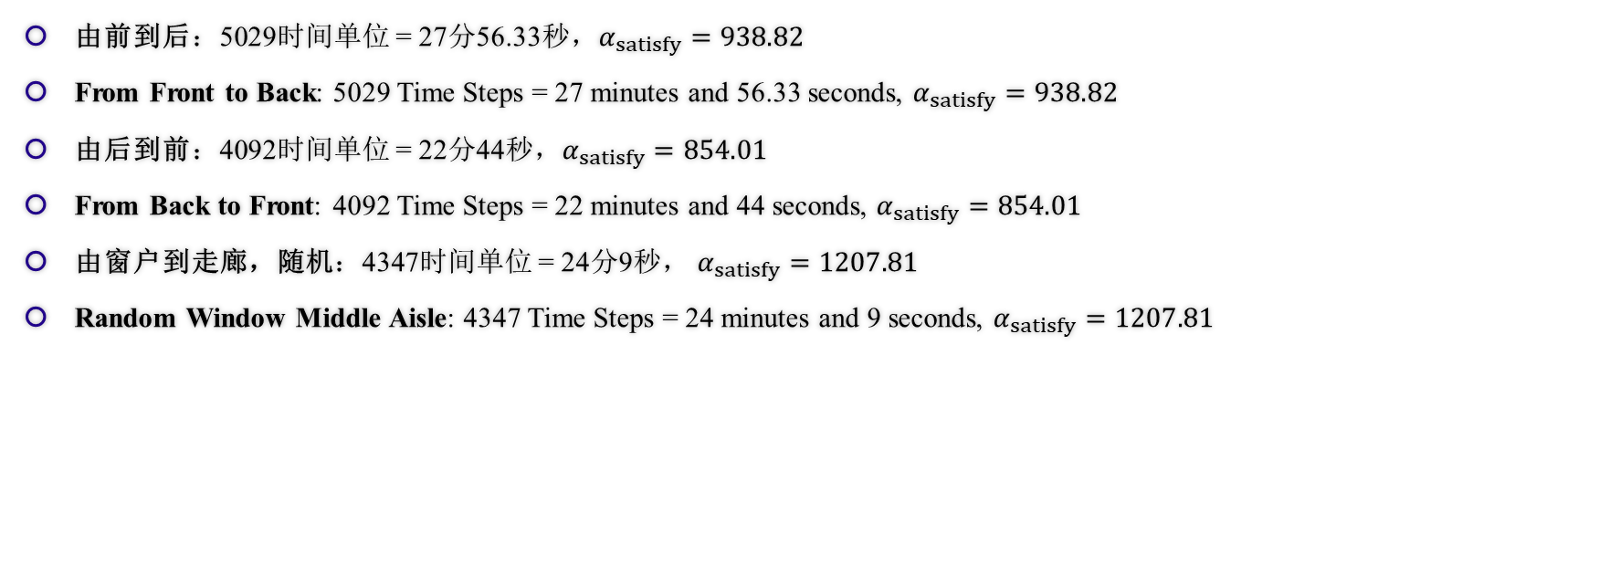
模拟结果 Results of Simulation
由前到后：5029时间单位 = 27分56.33秒，$α_{satisfy}=938.82$
From Front to Back: 5029 Time Steps = 27 minutes and 56.33 seconds, $α_{satisfy}=938.82$
由后到前：4092时间单位 = 22分44秒，$α_{satisfy}=854.01$
From Back to Front: 4092 Time Steps = 22 minutes and 44 seconds, $α_{satisfy}=854.01$
由窗户到走廊，随机：4347时间单位 = 24分9秒， $α_{satisfy}=1207.81$
Random Window Middle Aisle: 4347 Time Steps = 24 minutes and 9 seconds, $α_{satisfy}=1207.81$
Notes:
These are the results we got through the simulation of our code (read and compare, simply)

Slide 3
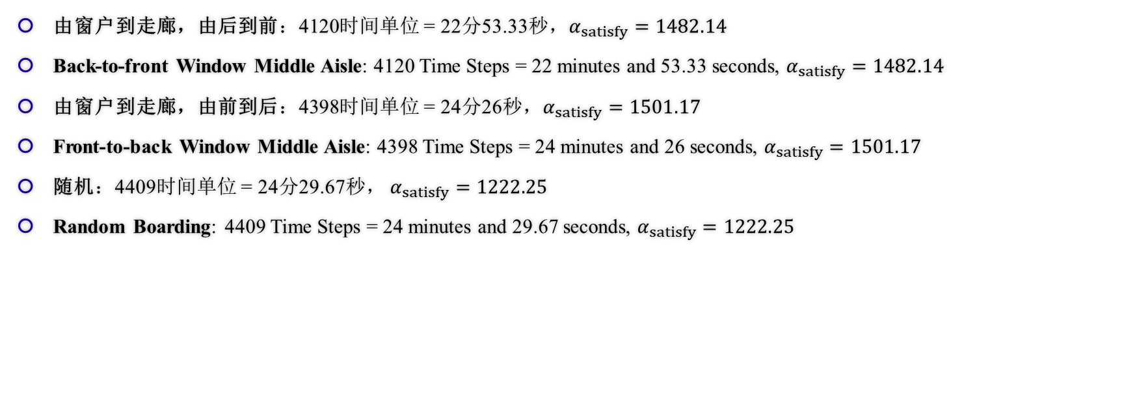
模拟结果 Results of Simulation
由窗户到走廊，由后到前：4120时间单位 = 22分53.33秒，$α_{satisfy}=1482.14$
Back-to-front Window Middle Aisle: 4120 Time Steps = 22 minutes and 53.33 seconds, $α_{satisfy}=1482.14$
由窗户到走廊，由前到后：4398时间单位 = 24分26秒，$α_{satisfy}=1501.17$
Front-to-back Window Middle Aisle: 4398 Time Steps = 24 minutes and 26 seconds, $α_{satisfy}=1501.17$
随机：4409时间单位 = 24分29.67秒， $α_{satisfy}=1222.25$
Random Boarding: 4409 Time Steps = 24 minutes and 29.67 seconds, $α_{satisfy}=1222.25$
Notes:
These are the results we got through the simulation of our code (read and compare, simply)

Slide 4
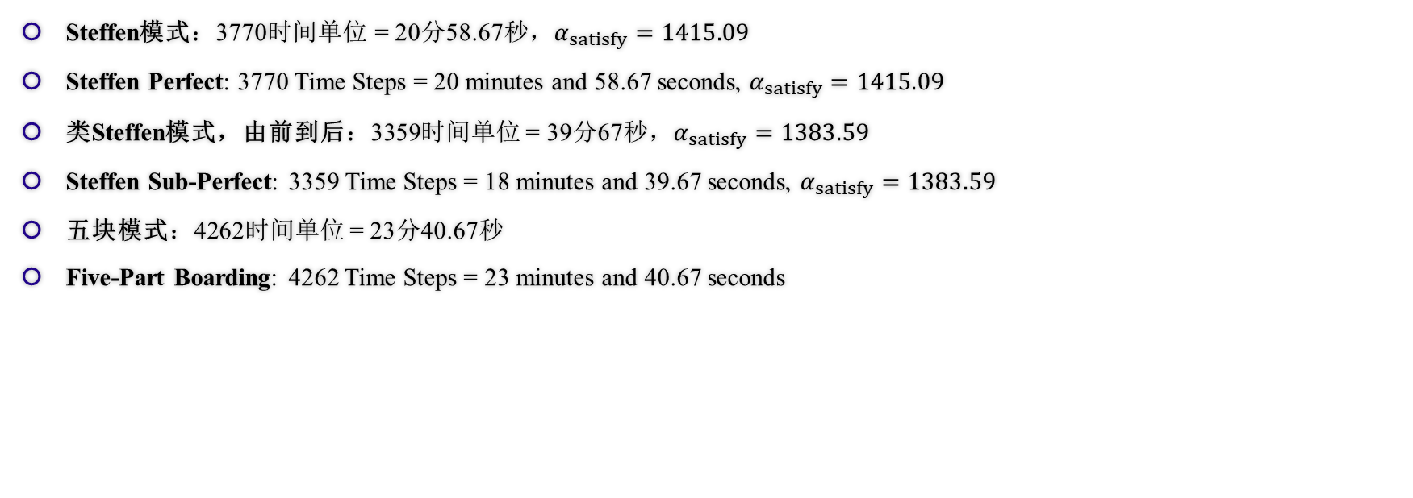
模拟结果 Results of Simulation
Steffen模式：3770时间单位 = 20分58.67秒，$α_{satisfy}=1415.09$
Steffen Perfect: 3770 Time Steps = 20 minutes and 58.67 seconds, $α_{satisfy}=1415.09$
类Steffen模式，由前到后：3359时间单位 = 39分67秒，$α_{satisfy}=1383.59$
Steffen Sub-Perfect: 3359 Time Steps = 18 minutes and 39.67 seconds, $α_{satisfy}=1383.59$
五块模式：4262时间单位 = 23分40.67秒
Five-Part Boarding: 4262 Time Steps = 23 minutes and 40.67 seconds
Notes:
These are the results we got through the simulation of our code (read and compare, simply)

Slide 5
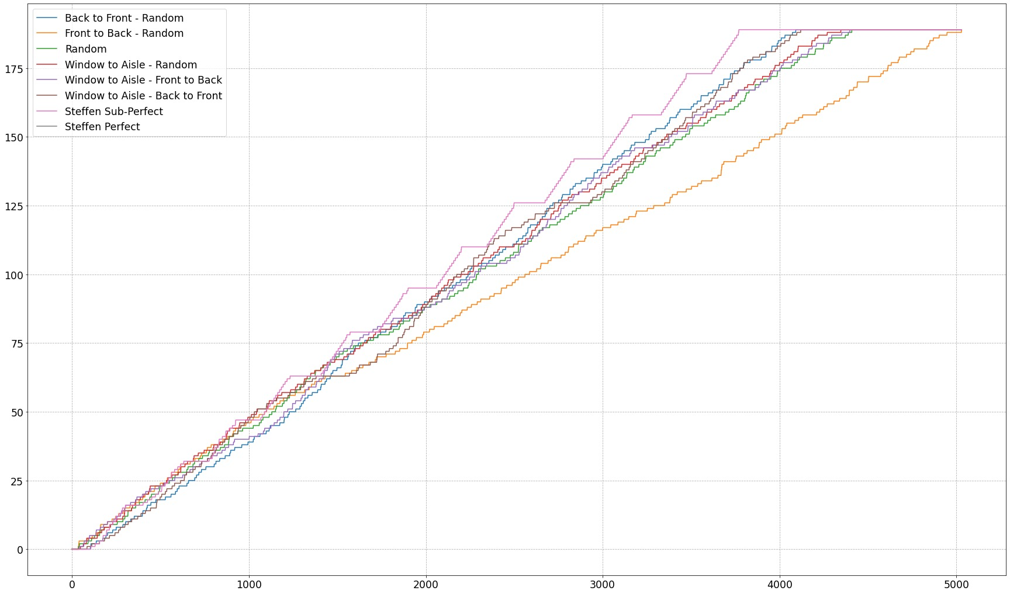
模拟结果 Results of Simulation
Notes:
This is a graph to compare between several ways. We can see that Steffen Sub-Perfect performs the best overall with Steffen Perfect following, and back-to-front, windle-to-aisle following, It is obvious that the random method even outweigh front-to-back method.

Slide 6
敏感度分析 Sensitivity Analysis
如何对我们的模型进行敏感度分析？
How to conduct a Sensitivity Analysis on Our Model?
使用拟合程度进行定量衡量
Use Compliancy Index to measure in Figure
对改变的可预测性
Predictable of Changes
事实证明的变化关系
Relationship proved by Facts
Notes:
We need to conduct a sensitivity analysis on our model, but how? We use compliancy index to measure in figure. It shows the predictability of changes of the model, and the function to compare with is a relationship proved by facts.

Slide 7
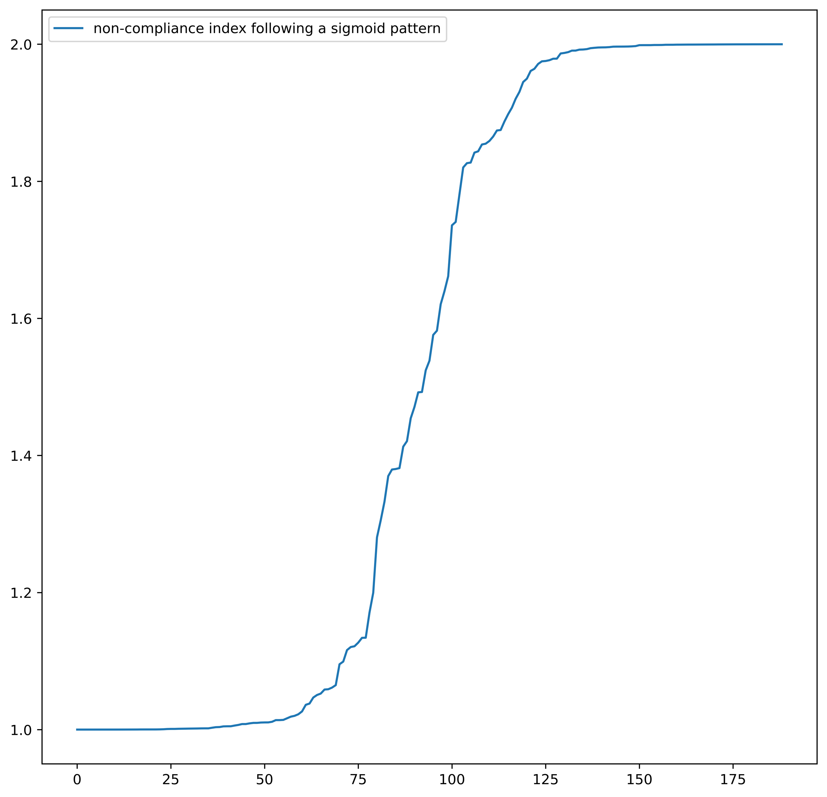
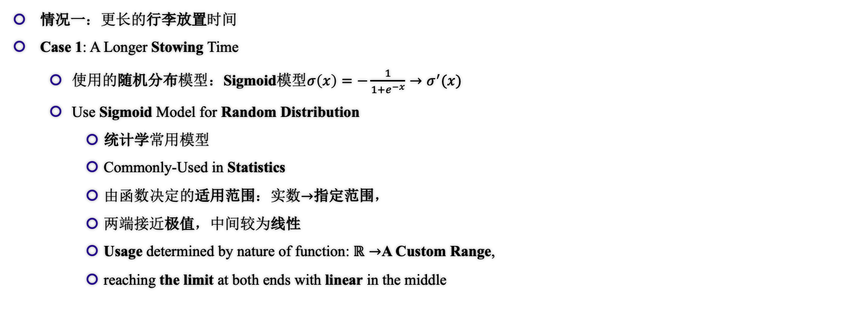
敏感度分析 Sensitivity Analysis
情况一：更长的行李放置时间
Case 1: A Longer Stowing Time
使用的随机分布模型：Sigmoid模型$σ\left(x\right)=−\frac{1}{1+e^{−x}}→σ^{′}(x)$
Use Sigmoid Model for Random Distribution
统计学常用模型
Commonly-Used in Statistics
由函数决定的适用范围：实数$→$指定范围，
两端接近极值，中间较为线性
Usage determined by nature of function: $ℝ→$A Custom Range,
reaching the limit at both ends with linear in the middle
图：Sigmoid模型范例
Fig. Sigmoid Model Demonstration
Notes:
Case one of our Sensitivity Analysis is a longer stowing time. We use a random model – sigmoid model – as shown in the slides, to distribute the dicompliance of passengers in a relatively realistic method. The reason why we choose the sigmoid model is due to its speciality in it’s functions and value, as shown in the figure to the right.

Slide 8
敏感度分析 Sensitivity Analysis
情况一：更长的行李放置时间
Case 1: A Longer Stowing Time
如何区分稳定和不稳定？（总体尺度上）
How to distinguish between Stable and Unstable? (Overall Timestep)
稳定：线性图像
Stable: Linear Graph
不稳定：无明显规律
Unstable: No Obvious Relationship
方差（差异化程度）的图像
The Graph of Variance
稳定：先为上凸函数（变化率逐渐递减），后为线性
Stable: Rate of Changing Decrease followed by Linear
不稳定：无线性阶段
Unstable: No Linear State
Notes:
How to distinguish stable and unstable on overall timestep? It is obvious that, if a method is stable, its graph (timestep – discompliancy) should be a linear one, while if it is unstablem, that should have no obvious relationship. Determining the stability can also be based on variance: if stable, then it should be expomential (rate of changing decrease) and followed by a linear function; if not, there shouldn’t be any obvious linear state.

Slide 9
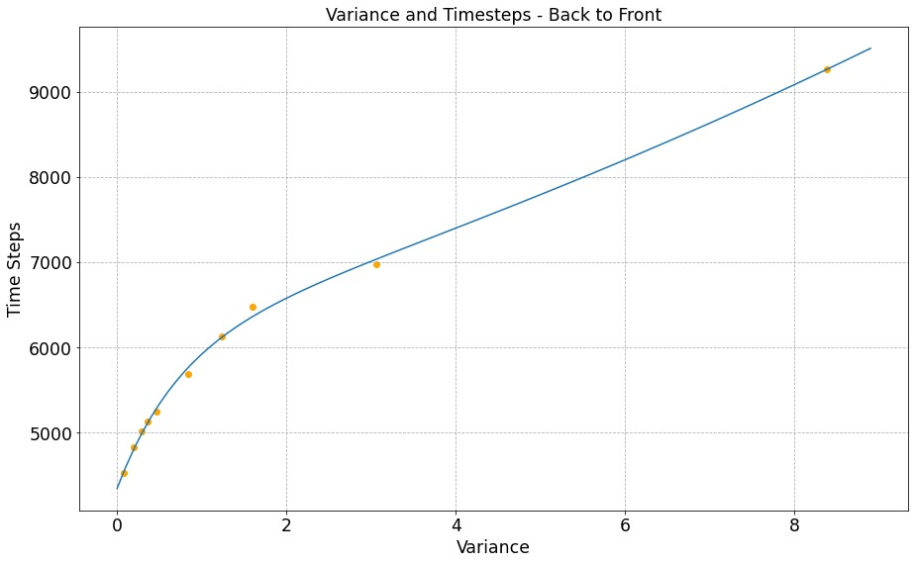
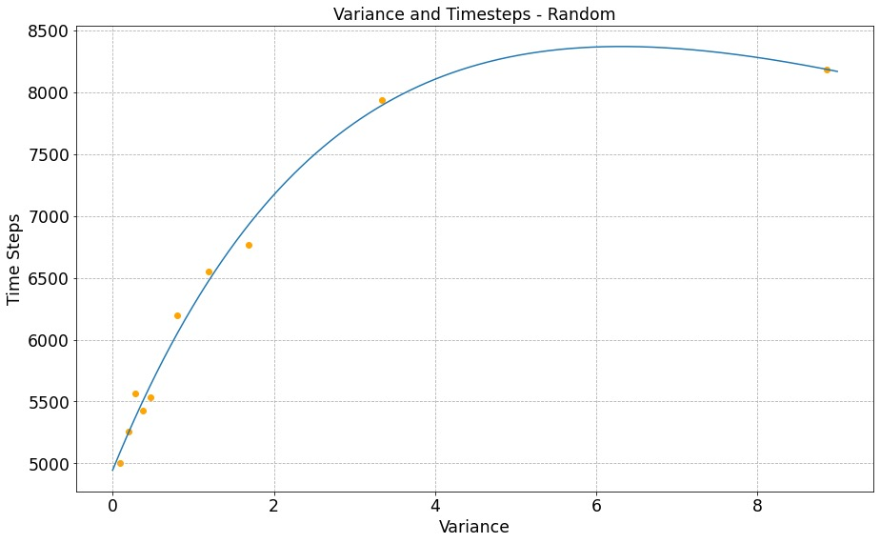
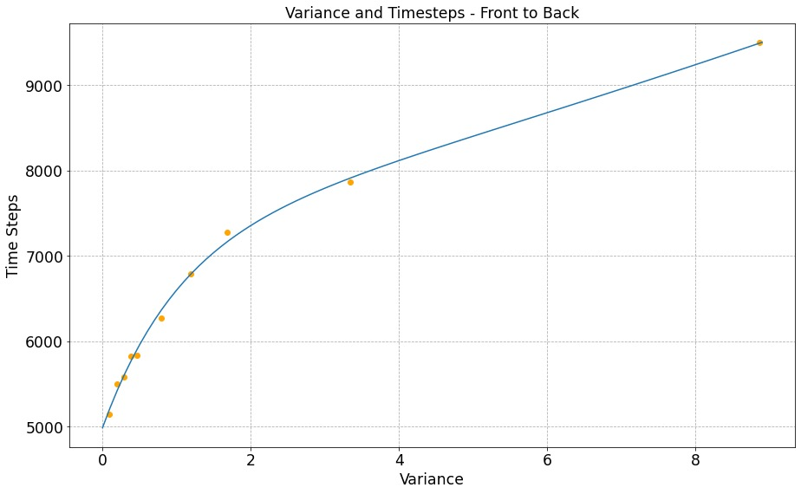
敏感度分析 Sensitivity Analysis
情况一：更长的行李放置时间
Case 1: A Longer Stowing Time
图：放置行李时间影响比较（方差）
Fig. Comparison on Longer Stowing Time, Variance
Notes:
These are three graphs of variance-timesteps back to front.

Slide 10
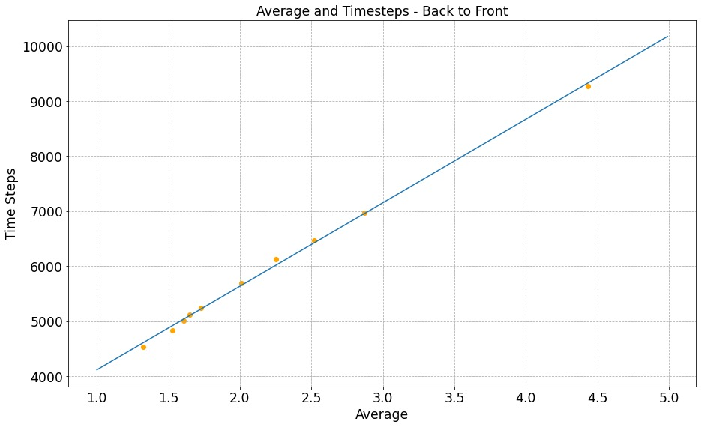
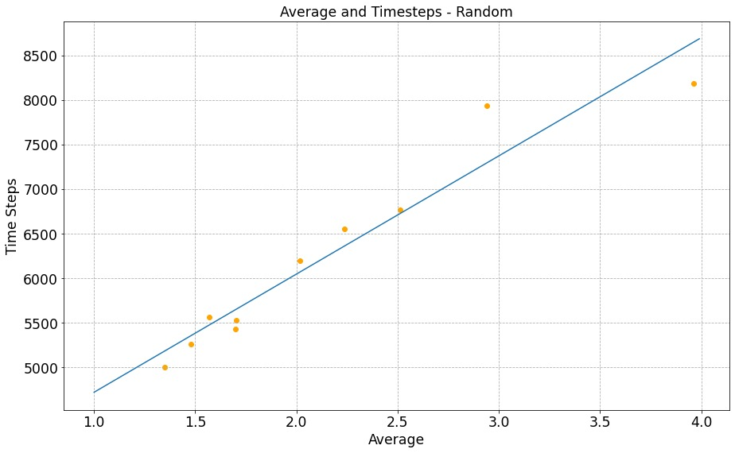
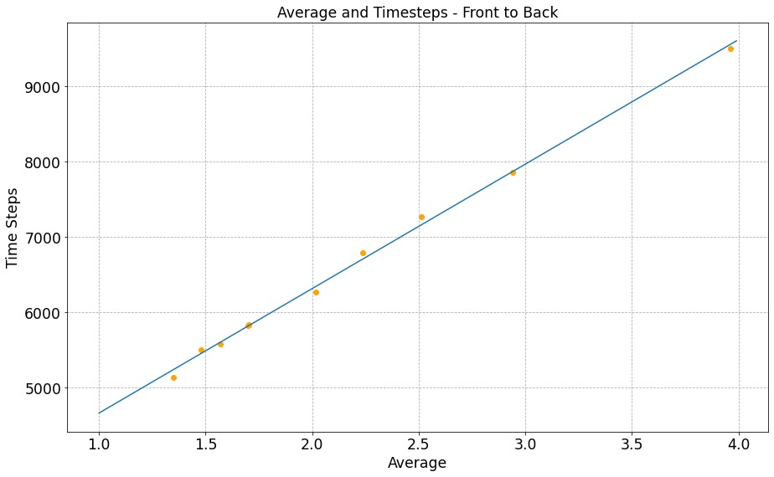
敏感度分析 Sensitivity Analysis
情况一：更长的行李放置时间
Case 1: A Longer Stowing Time
随机登机敏感度较高，由前到后登机敏感度较低
Random boarding is the most sensitive while Front-to-Back method seems totally not sensitive
图：放置行李时间影响比较（总时间）
Fig. Comparison on Longer Stowing Time, Overall Time
Notes:
We can draw the conclusion that random boarding is the most sensitive while front-to-back seems totally not sensitive.

Slide 11
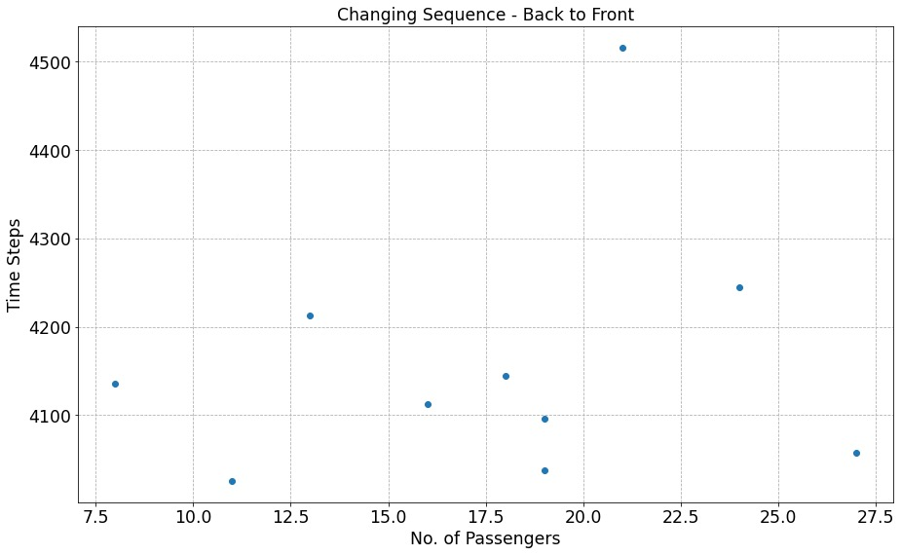
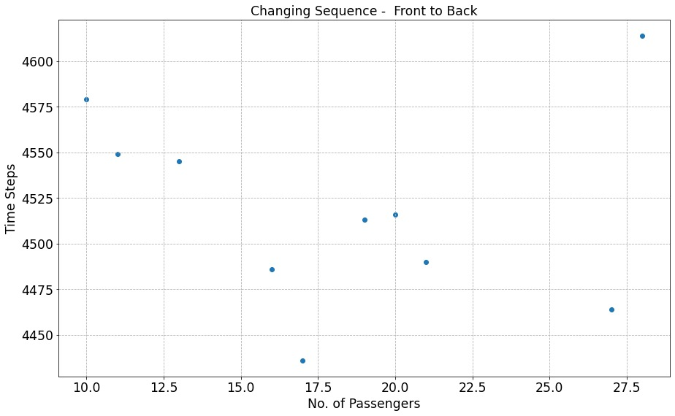
敏感度分析 Sensitivity Analysis
情况二：插队
Case 2: Queue Jumping
两个方案均为敏感方案，会对结果造成巨大的影响
Both Methods are Sensitive which makes Big Impact on Total Results
图：插队影响比较
Fig. Comparison on Queue Jumping
Notes:
Next, we analyzed queue-jumping situation and drew the conclusion that both methods are sensitive which means queue-jumping makes big impact on total results

Slide 12
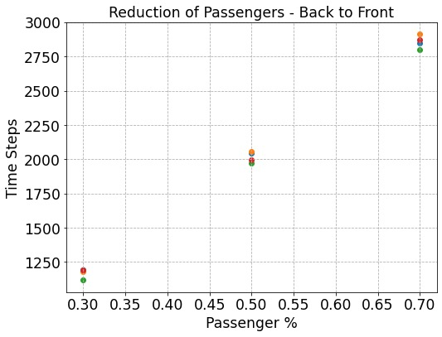
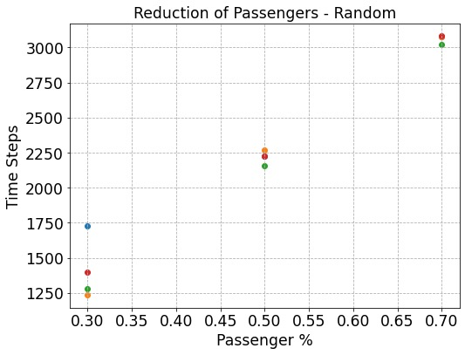
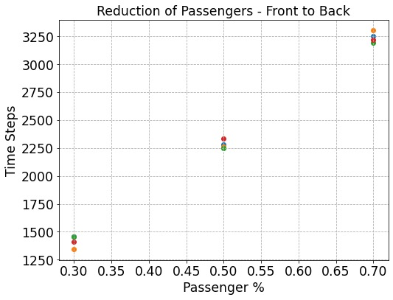
敏感度分析 Sensitivity Analysis
情况三：乘客数量的减少
Case 3: Reduction of Passengers
随机登机最为敏感（点的分布最远），由后到前登机依然十分稳定
Random Boarding is the most Sensitive (Furthest Distribution of Points), Back-to-Front Method still not so sensitive
图：乘客人数减少影响比较
Fig. Comparison on Reducing Passengers
Notes:
Last but no least, we conducted a research on the reduction of passengers, and found out that random boarding is the most sensitive (see the distribution of points) while back-to-front is not so sensitive.

Slide 13
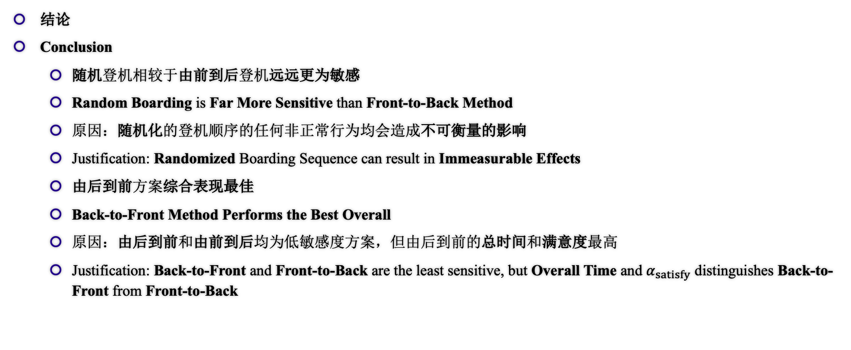
敏感度分析 Sensitivity Analysis
结论
Conclusion
随机登机相较于由前到后登机远远更为敏感
Random Boarding is Far More Sensitive than Front-to-Back Method
原因：随机化的登机顺序的任何非正常行为均会造成不可衡量的影响
Justification: Randomized Boarding Sequence can result in Immeasurable Effects
由后到前方案综合表现最佳
Back-to-Front Method Performs the Best Overall
原因：由后到前和由前到后均为低敏感度方案，但由后到前的总时间和满意度最高
Justification: Back-to-Front and Front-to-Back are the least sensitive, but Overall Time and $α_{satisfy}$ distinguishes Back-to-Front from Front-to-Back
Notes:
These are the major conclusions that can be drawn from our sensitivity analysis: Random is far more sensitive than front to back, because of randomized sequence can result in immeasurable effects. Back-to-front is the best overall, because it is the least sensitive and has a better overall time and satisfaction.

