Slide 1
总假设 General Assumptions
每名乘客都会将自己的行李放在自己座位的正上方。
For each passenger, their luggage is put on the rack above them.
航空公司一般都会保证这件事，以避免不必要的拥堵。
Airlines usually ensure this fact to minimize unnecessary congestion.
所有乘客的取行李和放行李的标准时间都相同。
For a certain passenger, the time to lay down his luggage and the time to remove it is the same.
这一过程可以被数学地看作可逆的（想象时间倒流）。
This process can be mathematically acknowledged as reversible (Consider when time relapses).
过道的宽度恰好能容纳一名乘客。
The total width of a passenger and his luggage is similar to the width between rows.
为了提供乘客最好的飞行体验，航空公司需要找到一个既能满足乘客需要又能最大化载客量的列间距。
To provide the passengers with the best flying experience, the airline company needs to find a width between rows which will both satisfy the needs of people and maximize the plane’s capacity.
这可以把连续模型变为离散的，简化计算。
This can turn the continuous model into a discrete model to simplify the calculation.
所有乘客在过道中的最大速度相等。
All passengers walk at the same speed on the aisles.
虽然会有年龄和性别造成的能量差异，乘客们在飞机上行走寻找座位的速度是差不多的。因此，我们可以忽略这一差异并假设所有乘客都以一个相同的理想速度行走。
Though there are energy difference caused by age and sex, there is slight difference of walking velocity when different passengers walk on a plane searching for their assigned seat. Therefore, we can neglect the difference and assume that all the passengers have the same ideal velocity.
Notes:
These are the general assumptions of our model. All these assumptions are reasonable according to real-life flying experiences. We need to explain that the third assumption is to make the model discrete to simplify the calculation.

Slide 2
总假设 General Assumptions
乘客只会朝着自己座位的方向移动，而不会往回走。
Passengers never go backward.
大多数乘客专注于找座位，因此他们很少迷路并走回头路。
Most passengers are concentrated on finding their seat most. Therefore, they seldom miss their way
and try to move backward.
头等舱和商务舱乘客会优先登机。
First and business class passengers are prioritized with respect to those of the economic class.
虽然（根据论文中的最终结果）这并不是对所有机型和乘客的最佳策略，让贵宾先登机会让他们更满足，从而增大航空公司收入。因此我们考虑这一因素以让模型更真实。
Although (according to the ultimate results displayed in our essay), this is not the best boarding
strategy for any types of plane and passengers, letting distinguished guests board first will give these
passengers a sense of satisfaction and enlarge the airline company’s income. Therefore, we took this
fact into consideration to make our model more realistic.
乘客给其他乘客让座时的横移速度等于其在过道中的最大速度。
The horizontal velocity of passengers offering seats is equal to the maximum speed in the aisle.
在让座时，乘客不会被其他乘客堵住。并且由于手中行李和身边座位的影响差不多，我们可以假设乘客在飞机上的最大横移速度等于他们的最大走动速度。
Passengers wouldn’t be blocked when offering seats. And it’s reasonable to assume that the
horizontal and vertical velocity is approximately the same, for the impact of the luggage in hand and
the seats beside a passenger are approximately the same.
Notes:
Another three general assumptions.

Slide 3
模型A-假设 Assumptions-Model A
行李架足够大，能容纳任意大小的行李。
The luggage racks are designed to be adequate for any reasonable amount of luggage.
每名乘客能携带的行李量有限
There’s a limit on the amount of luggage each passenger can bring
把行李放在行李架上和把行李挤到座位里在时间上相等
It’s the (for time) the same as putting luggage into the rack if a passenger puts the luggage into the seat
乘客总是保持他们的最大速度。
There is enough space in the aisle so that every passenger can walk at their maximum speed.
这显然不可能。
This is obviously IMPOSSIBLE.
乘客一般会尽快就座，因此合理的假设是乘客总以可能的最大速度行进。
Passengers usually want to get seated as quickly as possible, so it’s reasonable to assume that passengers always walk as quickly as possible.
所有乘客在登机前都是排好队的，且不存在迟到情况。 // 补充
All the passengers have lined up before boarding, and none of them would be late.
所有乘客都不愿意错过飞机。对于排队来说，因为过道宽度只能一个人同时通过，乘客在登机过程中的顺序是不变的。
This is reasonable because passengers all don’t want to miss the plane. And as for the queuing, according that the aisle is
only wide enough for one passenger, it’s reasonable that they keep in the same sequence all the time.
Notes:
Here are the assumptions of Model A. In Model A, we would consider only the simplest situation, so we consider that there’s enough space to store luggage and there’s no one being late for boarding. We also consider the velocity in a specific cell to be constant (which would be ignored in later models, but it’s only used to calculate the distances and wouldn’t cause serious problems). And considering that all passengers want to get seated as quickly as possible, we consider that they always walk as fast as possible.

Slide 4
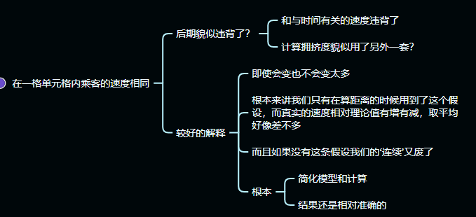
模型A-假设 Assumptions-Model A
在一个特定单元格中，乘客速度是一个常量。
In a certain cell, v is a fixed value.
这条假设在后面的模型中被违背了，并且在计算拥挤度的时候没用到
Ignored in later models and wasn’t used when calculating queuing index
但它只在计算距离时有用
But only used to calculate distance
在同一个单元格中，速度变化不大，并且平均速度与我们所用的平均值大约相等。
The velocity wouldn’t change much in a certain cell, and the actual average speed is approximately equal to the average we’ve made
Notes:
Here are the assumptions of Model A. In Model A, we would consider only the simplest situation, so we consider that there’s enough space to store luggage and there’s no one being late for boarding. We also consider the velocity in a specific cell to be constant (which would be ignored in later models, but it’s only used to calculate the distances and wouldn’t cause serious problems). And considering that all passengers want to get seated as quickly as possible, we consider that they always walk as fast as possible.

Slide 5
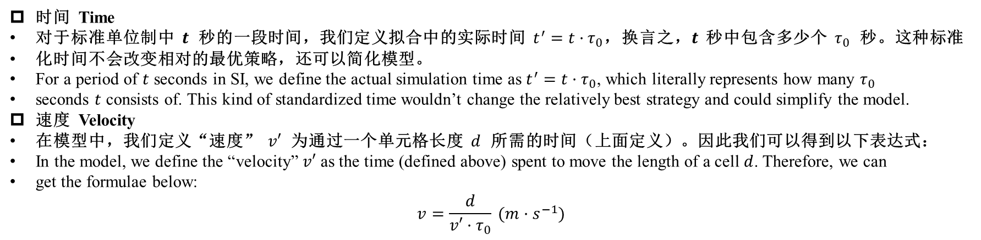
定义 Definitions
时间 Time
对于标准单位制中 $t$ 秒的一段时间，我们定义拟合中的实际时间 $t^{′}=t·τ_{0}$，换言之，$t$ 秒中包含多少个 $τ_{0}$ 秒。这种标准
化时间不会改变相对的最优策略，还可以简化模型。
For a period of $t$ seconds in SI, we define the actual simulation time as $t^{′}=t·τ_{0}$, which literally represents how many $τ_{0}$
seconds $t$ consists of. This kind of standardized time wouldn’t change the relatively best strategy and could simplify the model.
速度 Velocity
在模型中，我们定义“速度” $v′$ 为通过一个单元格长度 $d$ 所需的时间（上面定义）。因此我们可以得到以下表达式：
In the model, we define the “velocity” $v′$ as the time (defined above) spent to move the length of a cell $d$. Therefore, we can
get the formulae below:
$$v=\frac{d}{v′·τ_{0}} (m·s^{−1})$$
Notes:
In the model, the definition of time and velocity is different from SI, and this is the relationship between SI time and velocity and ours. We make these changes to make the calculations simpler.

Slide 6
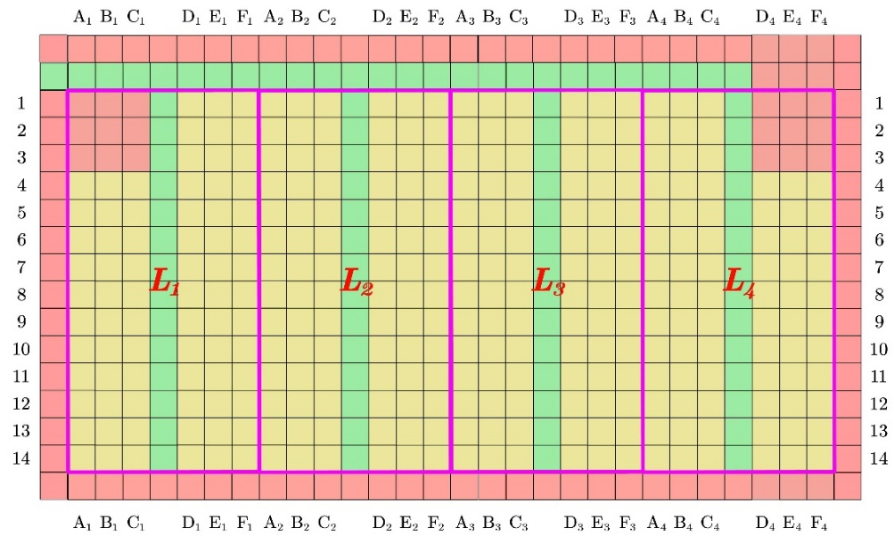
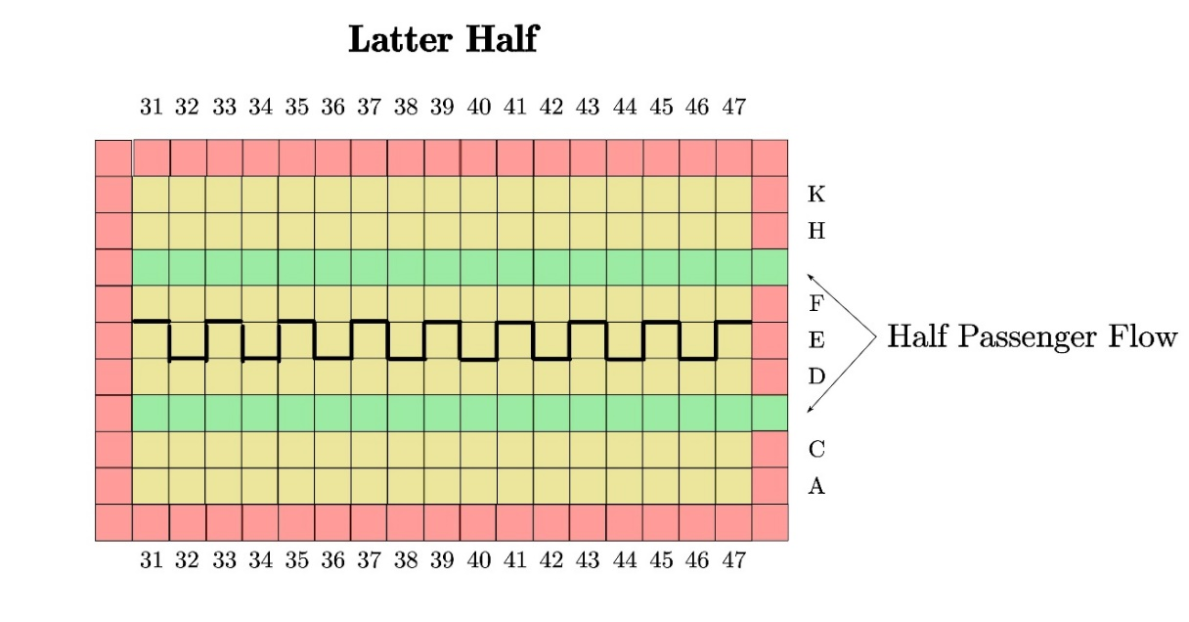
将模型应用于不同机型 Apply the model to different aircrafts
主要思想
对于TETA和Flying Wing两种多过道的飞机，我们发现，它们可以按照分过道的不同分为几个较小的部分，这几个部分中的乘
客在分过道上互不影响。因此，我们可以考虑将这些部分分治处理，每个部分中分别采用最优的登机策略。然后，因为前面
已经证明了过道占得越满效率越高的结论，我们只需让主过道占得最满即可。
For TETA and Flying Wing, two kinds of multi-aisle aircrafts, we found that they can be divided into smaller parts according to aisles,
and passengers in different parts won’t influence each other on part aisles. So we could consider respectively deal with these parts. We
can use the best boarding sequence in each part. Then, for we’ve proved the conclusion that the best strategy is to make full use of the
aisles, we only need to make sure the main aisle is full.
Notes:
Here’s the main ideas when we apply the model to different aircrafts. TETA and Flying Wing are two kinds of multi-aisle aircrafts, and we found that they can be divided into smaller individual parts similar to ordinary one-aisle aircrafts.

Slide 7
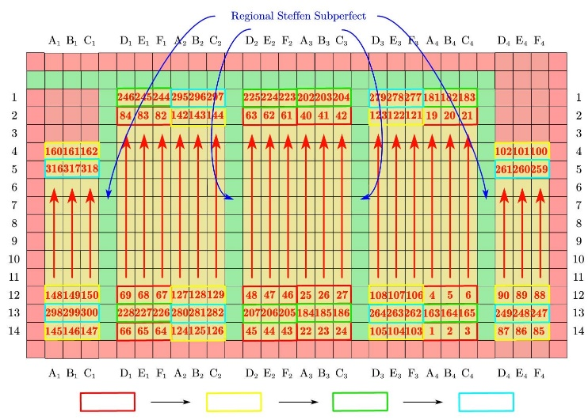
将模型应用于不同机型 Apply the model to different aircrafts
结论
因此，对于这一类的飞机，我们只需要预先将所有乘客按他们所在的小部分进行分组，将每组中的乘客按照组内的登机顺序
进行排序，最后再确定组间乘客的登机先后顺序即可。
Thus for this kind of aircrafts, we only need to divide the passengers into groups according to the parts they’re in and sort the
passengers in each group according to the sequence of boarding within the group, and finally decide the sequence between groups.
显然，由于外侧组的乘客可能会堵住主过道影响内侧组的乘客登机，为了确保过道的使用效率，我们应当让内侧组的乘客先
登机。同时，为了防止内侧组有人就座之后带来的空单元格，我们决定在外侧组的一些乘客登机之后再安排几个内侧组的乘
客，用来补齐这些空单元格。
Obviously, passengers in the outer groups may block the main aisle and influence inner group passengers’ boarding, so we should board
inner group passengers first to ensure the used efficiency of aisles. Meanwhile, to prevent empty cells caused by seated inner group
passengers, we decided to arrange a few inner group passengers after some outer group passengers have boarded, to fill up the empty
cells.
Notes:
To optimize the whole plan, it’s obvious that we need to optimize the boarding sequence inside groups, and then we need to optimize the between-group sequences.

