Slide 1
Background
Time and efficiency play a vital role in air transportation. For normal passenger flights, sections which require a great amount of time include boarding and disembarking of passengers. Therefore, it's necessary to build a model which provides the best strategy for different plane types and on various occasions.
时间和效率在飞机运行过程中起到重要作用。在一般的飞行中，登机和离机的时间消耗占据了机前准备的很大一部分。因此，为登机和离机的过程与特殊机型和突发状况制定最佳方案十分重要。
Notes:
如ppt所言

Slide 2
Notation
Constant A:won’t change in the whole scope.
Constant B: may change in the whole scope, but won’t change for a fixed set of passengers and a set plane.
Variable: varies for different initial sequences of passengers.
常量A：在整个过程中不会变化。
常量B：在整个过程中会变化，但对于一个乘客群体不会变化。
变量：随着时间变化而改变。
Notes:
如ppt所言

Slide 3
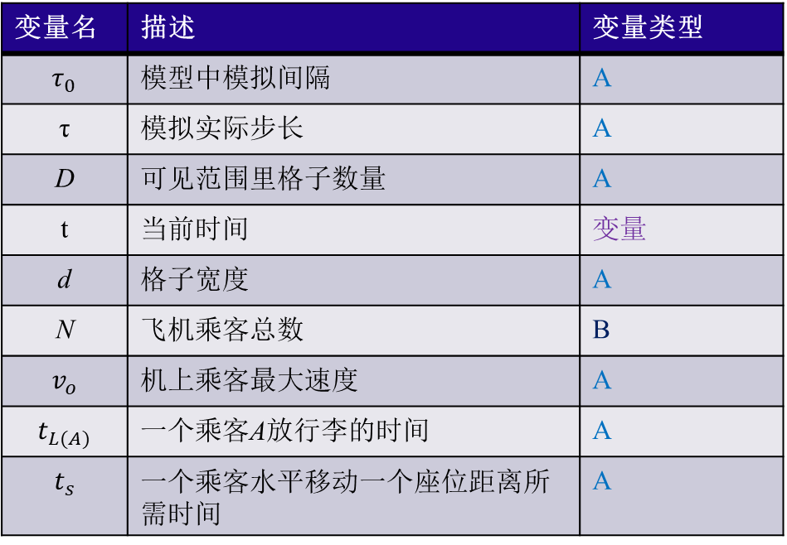
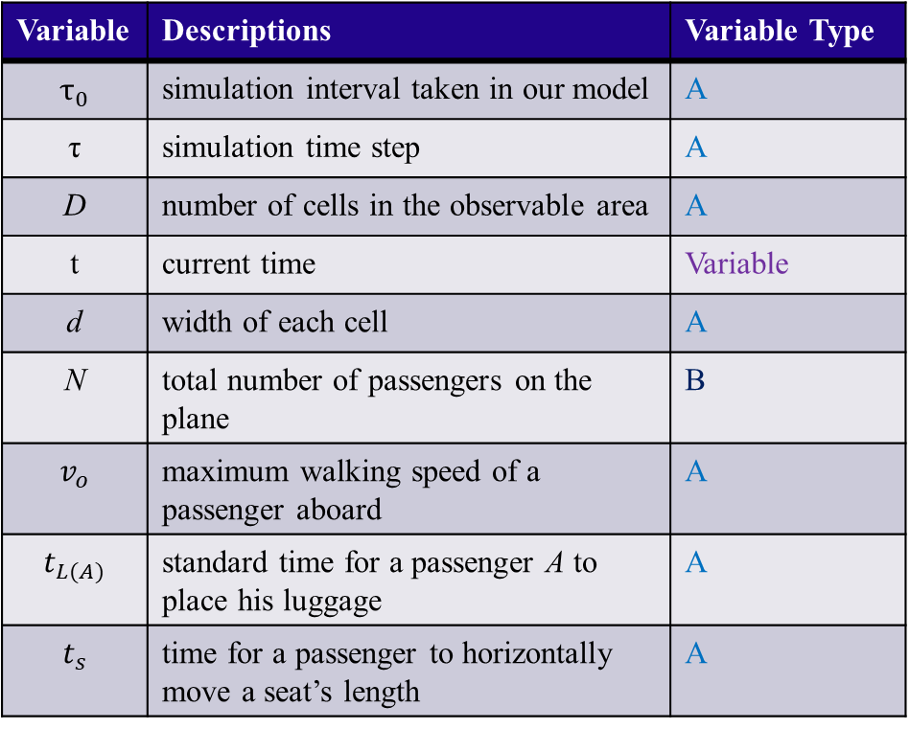
Notation
Variable | Descriptions | Variable Type
$$τ_{0}$$ | simulation interval taken in our model | A
τ | simulation time step | A
D | number of cells in the observable area | A
t | current time | Variable
d | width of each cell | A
N | total number of passengers on the plane | B
$$v_{o}$$ | maximum walking speed of a passenger aboard | A
$$t_{L(A)}$$ | standard time for a passenger A to place his luggage | A
$$t_{s}$$ | time for a passenger to horizontally move a seat’s length | A
变量名 | 描述 | 变量类型
$$τ_{0}$$ | 模型中模拟间隔 | A
τ | 模拟实际步长 | A
D | 可见范围里格子数量 | A
t | 当前时间 | 变量
d | 格子宽度 | A
$$\text{N}$$ | 飞机乘客总数 | B
$$v_{o}$$ | 机上乘客最大速度 | A
$$t_{L(A)}$$ | 一个乘客A放行李的时间 | A
$$t_{s}$$ | 一个乘客水平移动一个座位距离所需时间 | A

Slide 4
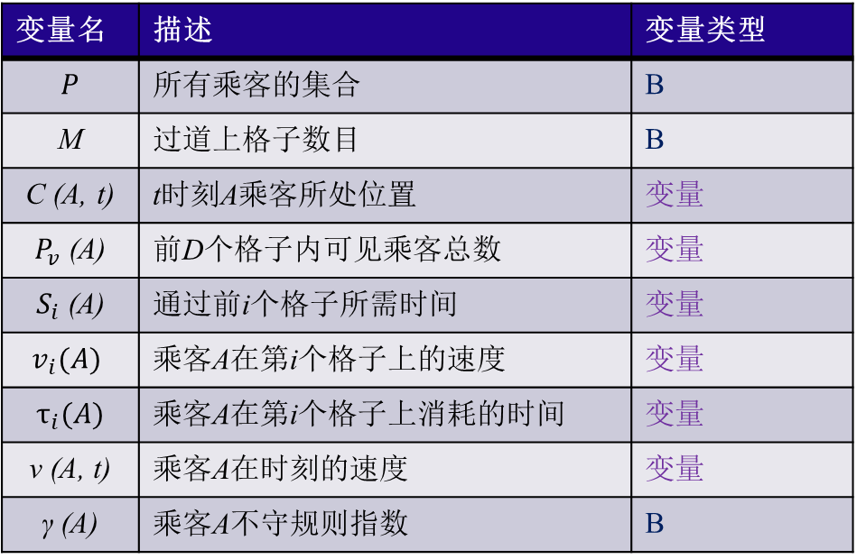
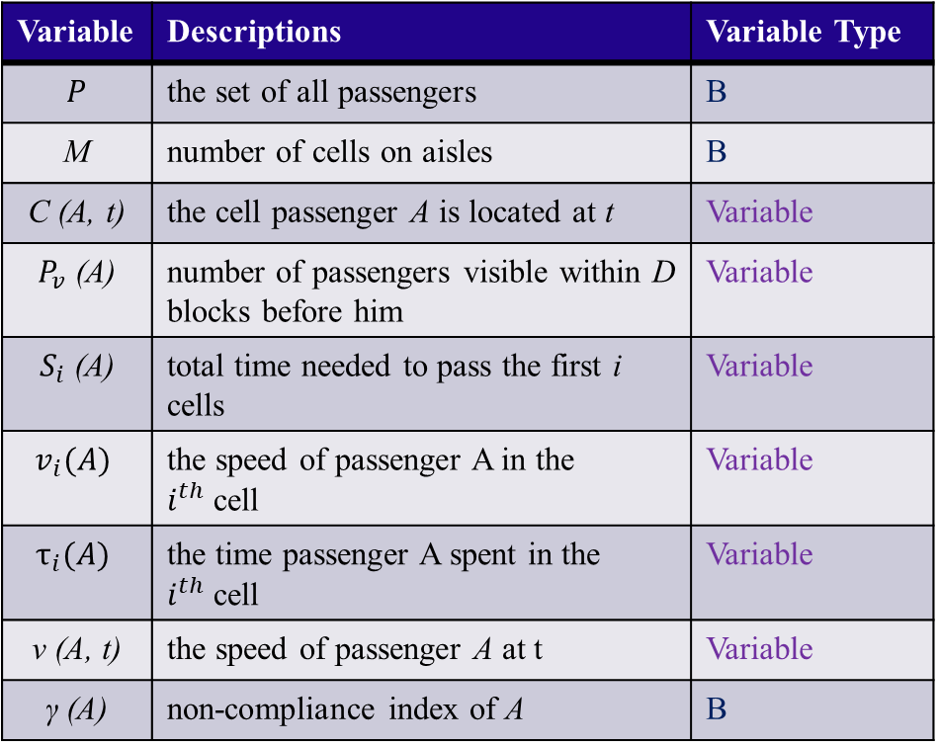
Notation
Variable | Descriptions | Variable Type
$$P$$ | the set of all passengers | B
M | number of cells on aisles | B
C (A, t) | the cell passenger A is located at t | Variable
$P_{v}$ (A) | number of passengers visible within D blocks before him | Variable
$S_{i}$ (A) | total time needed to pass the first i cells | Variable
$$v_{i}(A)$$ | the speed of passenger A in the $i^{th}$cell | Variable
$$τ_{i}(A)$$ | the time passenger A spent in the $i^{th}$cell | Variable
$$\text{v}\text{ (}\text{A}\text{, }\text{t}\text{)}$$ | the speed of passenger A at t | Variable
$$\text{γ}\text{ (}\text{A}\text{)}$$ | non-compliance index of A | B
变量名 | 描述 | 变量类型
$$P$$ | 所有乘客的集合 | B
M | 过道上格子数目 | B
C (A, t) | t时刻A乘客所处位置 | 变量
$P_{v}$ (A) | 前D个格子内可见乘客总数 | 变量
$S_{i}$ (A) | 通过前i个格子所需时间 | 变量
$$v_{i}(A)$$ | 乘客A在第i个格子上的速度 | 变量
$$τ_{i}(A)$$ | 乘客A在第i个格子上消耗的时间 | 变量
$$\text{v}\text{ (}\text{A}\text{, }\text{t}\text{)}$$ | 乘客A在时刻的速度 | 变量
$$\text{γ}\text{ (}\text{A}\text{)}$$ | 乘客A不守规则指数 | B

Slide 5
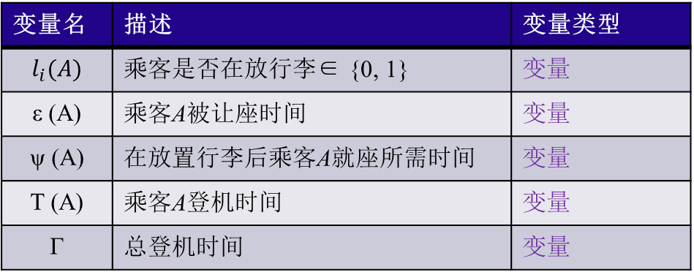
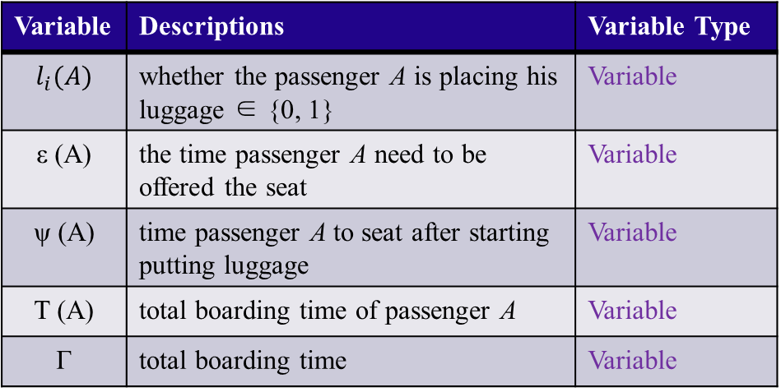
Notation
Variable | Descriptions | Variable Type
$$l_{i}(A)$$ | whether the passenger A is placing his luggage ∈ {0, 1} | Variable
ε (A) | the time passenger A need to be offered the seat | Variable
ψ (A) | time passenger A to seat after starting putting luggage | Variable
T (A) | total boarding time of passenger A | Variable
Γ | total boarding time | Variable
变量名 | 描述 | 变量类型
$$l_{i}(A)$$ | 乘客是否在放行李∈ {0, 1} | 变量
ε (A) | 乘客A被让座时间 | 变量
ψ (A) | 在放置行李后乘客A就座所需时间 | 变量
T (A) | 乘客A登机时间 | 变量
Γ | 总登机时间 | 变量

Slide 6
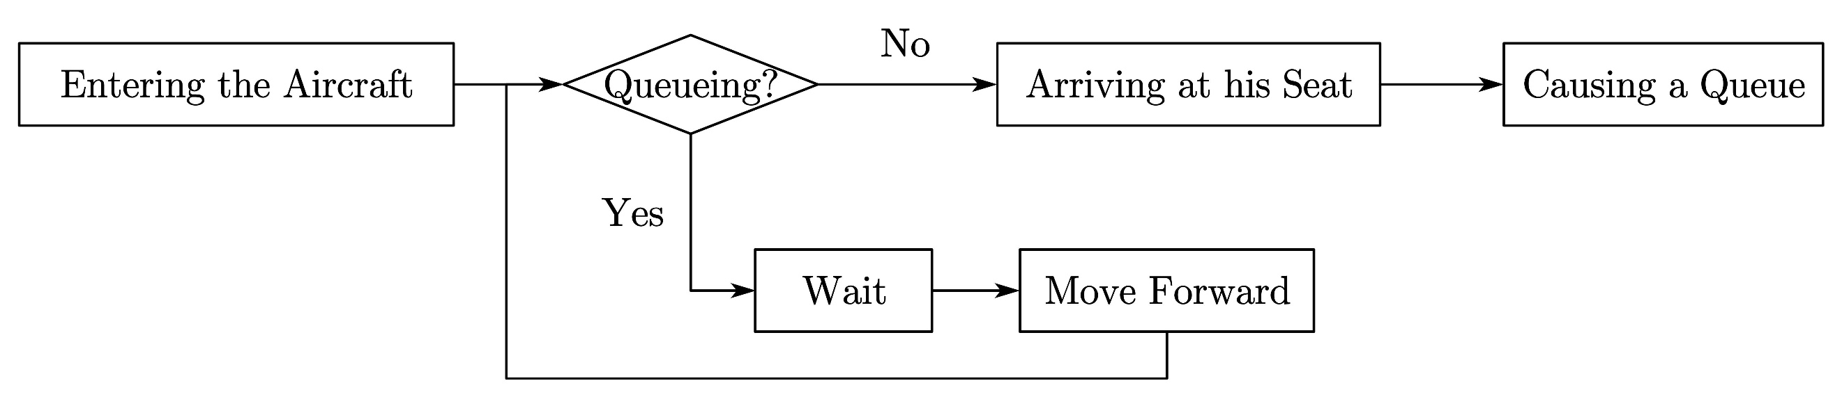
Background
Flowing chart showing the whole process of boarding.
Notes:
To begin with, we will first introduce a simple process of a person’s boarding a plane, which is shown in this chart on the slide. While boarding a plane, passengers will first go to their assigned seat, put their luggage on the rack and then get seated. While a passenger stowing their bags, other travellers who are stuck behind in the queue and haven't reached their target seats should wait until the passenger finishes the process, resulting in a queue.

Slide 7
Our Work
Design a model which can calculate the time required to board and disembark when applied to all kinds of planes.
Improve the model considering different situations, satisfaction degree of passengers and emergency events and design a brief strategy based on the results of our model.
Apply our model to real-life planes and find out the best strategy which minimizes the boarding and disembarking time.
设计出一个可以计算出登机离机时间且可以引用于所有机型的模型。
在考虑不同情况，乘客满意度和突发状况的情况下优化模型，并根据模型结果初步制定出完整方案。
将我们的模型应用与真实飞机上，找到使登离机时间最小化的方案。
Notes:
Based on the background information and our investigations on the boarding process, we determined our work.

Slide 8
Strengths
Accuracy
Universality
Efficiency
准确性
多样性
有效性
Notes:
We have concluded some of the strengths of our model.
First, accuracy. In our model, we take several special situations into consideration. Also, we use several programs to facilitate our calculation. This makes our result reasonable and precise.
The second strength is universality. In our model, we succeeded in achieving visualization of the plane and successfully simulated the whole process of different boarding methods which has been shown just now. This means that our model can be applied to a variety of problems.
Finally, our model bears efficiency. As shown in the second model, we use a program to facilitate our calculations in finding the best strategy. Therefore, a lot of time is saved and it proved that our model has efficiency.

Slide 9
Weaknesses
Complexity
Difficult to operate
复杂性
难于操作
Notes:
Also, we have found some weaknesses that needed to be improved.
The first problem is complexity. We introduce a great many variables and a variety of explanations in our model. Some of them are a little bit abstract and some of our calculations conducted by programs aren't shown in this essay. This will make our model more complex and less easy to understand.
The second weakness is that our model is difficult to operate when it comes to reality. As can be seen in the descriptions above, our model provides a plan with some details that must be strictly obeyed. This will increase the difficulty for the crews to let every passenger be aware of the rules. However, we have thought of a method that can ease this kind of difficulty. When there’s a passenger ahead waiting, we can first let him get to his seat. According to our sensitivity analysis, this will not have a big impact on our boarding time. Therefore, this kind of strategy is somehow reasonable and flexible.

Slide 10
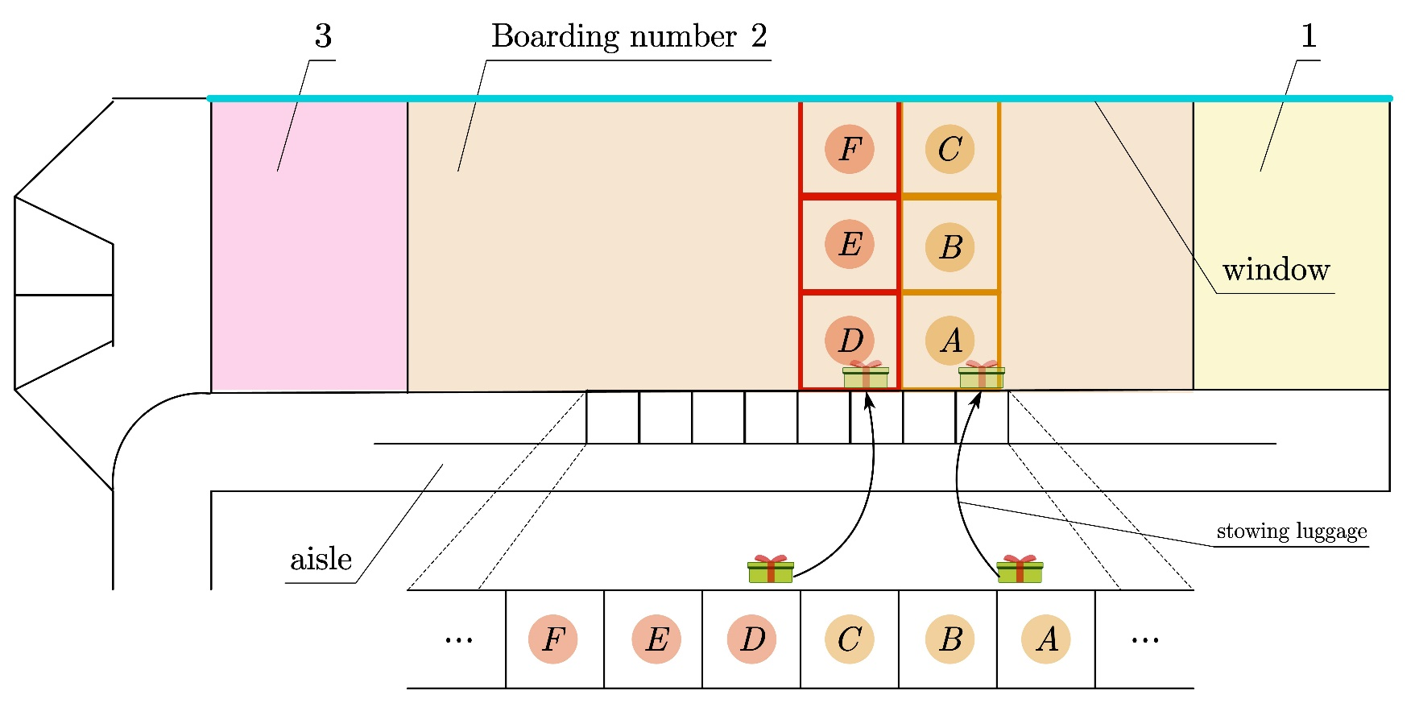
A Letter to the Executives
Two factors（两个主要因素）:
Hommization （人性化）
Efficiency（有效）
Three suggestions（三条有效建议）:
Avoid blocks in general aisles.（防止主过道拥堵）
Provide enough space for luggage.（为行李提供足够空间）
Prevent queue-jumping.（防止不必要的插队）
Notes:
Based on our model, we write a letter to provide the airline executives with some suggestions. First, we point out two important factors in the whole boarding and disembarking process----that is hommization and efficiency. Later, we draw a simple chart to illustrate our plan. You can look ate the picture in the power point. In addition, we also offer some simple tips that could be applied to all kinds of planes. Airline executives need to prevent passengers from being stuck in general aisles, provide passengers with enough space to place their luggage and prevent queue-jumping.

