Slide 1
FLASH SALES
1
Team #20048439
Zhehan Xu, Tong Xin, Jingwen Gu, Chengyang Yue
Faculty Advisor: Junjun Chen
Shanghai Experimental School

Slide 2
OUR WORK
2
Simulation
Optimization
Product Utility
Experimental Simulation
Initialize
Simplify
Allocation Optimization
Shopping List
Classification
Alter
Produce
Mapping
Allocation & Layout
Specification
Determine
Layout Optimization
Customer Behavior
Region
Flow Direction
Shelf
Cause
Flux
Damage
Damage
Justify

Slide 3
GENERAL ASSUMPTIONS
3
Microeconomic Context
Customer Initialization
Customer Capabilities
Customer Behavior
Pre-sale familiarization: Shopping List & Layout

Slide 4
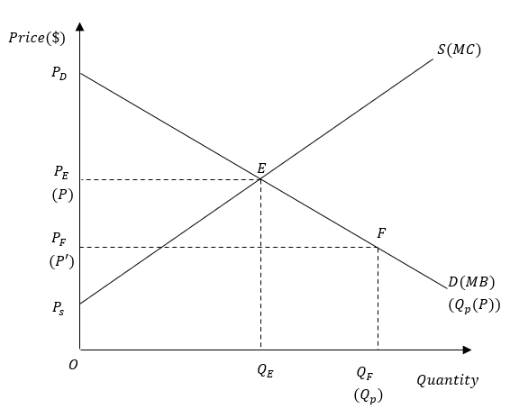



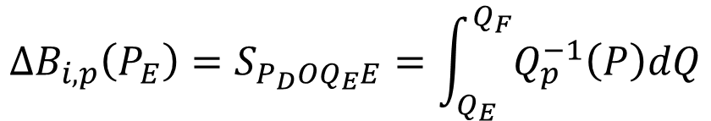
PRODUCT UTILITY
4
$${U_{p}=E(u}_{i,p})$$
$$u_{i,p}=ΔB_{i,p}×R_{i,p}×r_{p}$$
Additional benefit due to sale $ΔB_{i,p}$ computed from dataset
Consumer preference: random variable $R_{i,p}\sim N(0,1)$
Product quality (rating) $r_{p}$ given in the dataset
$${ΔB}_{i,p}\left(P_{E}\right)=S_{P_{D}OQ_{E}E}=\int_{Q_{E}}^{Q_{F}}{Q_{p}^{−1}\left(P\right)dQ}$$
$=\frac{1}{2}(P_{p}^{2}−{P_{p}^{′}}^{2})(−\frac{dQ}{dP})$

Slide 5
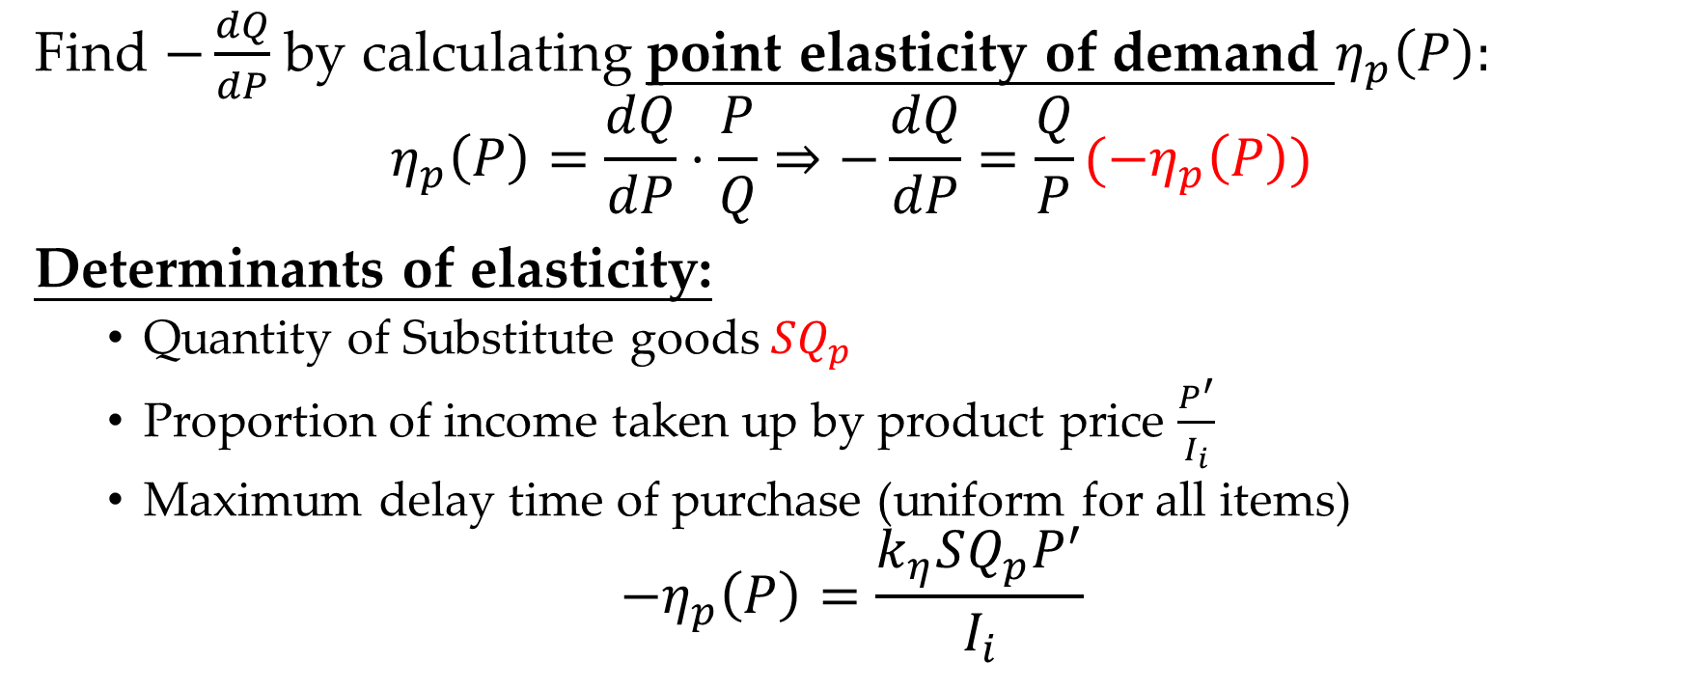
PRODUCT UTILITY
5
Find $−\frac{dQ}{dP}$ by calculating point elasticity of demand $η_{p}\left(P\right):$
$$η_{p}\left(P\right)=\frac{dQ}{dP}⋅\frac{P}{Q}⇒−\frac{dQ}{dP}=\frac{Q}{P}(−η_{p}\left(P\right))$$
Determinants of elasticity:
Quantity of Substitute goods $SQ_{p}$
Proportion of income taken up by product price $\frac{P^{′}}{I_{i}}$
Maximum delay time of purchase (uniform for all items)
$$−η_{p}\left(P\right)=\frac{k_{η}SQ_{p}P^{′}}{I_{i}}$$

Slide 6
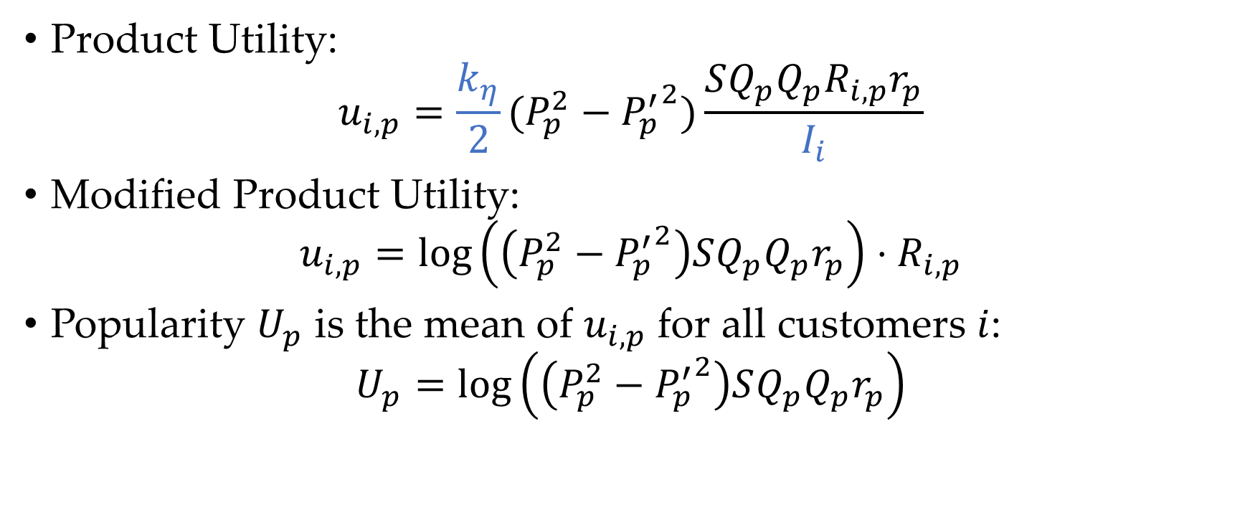
PRODUCT UTILITY
6
Product Utility:
$$u_{i,p}=\frac{k_{η}}{2}(P_{p}^{2}−{P_{p}^{′}}^{2})\frac{SQ_{p}Q_{p}R_{i,p}r_{p}}{I_{i}}$$
Modified Product Utility:
$$u_{i,p}=\log\left(\left(P_{p}^{2}−{P_{p}^{′}}^{2}\right)SQ_{p}Q_{p}r_{p}\right)⋅R_{i,p}$$
Popularity $U_{p}$ is the mean of $u_{i,p}$ for all customers $i$:
$$U_{p}=\log\left(\left(P_{p}^{2}−{P_{p}^{′}}^{2}\right)SQ_{p}Q_{p}r_{p}\right)$$

Slide 7
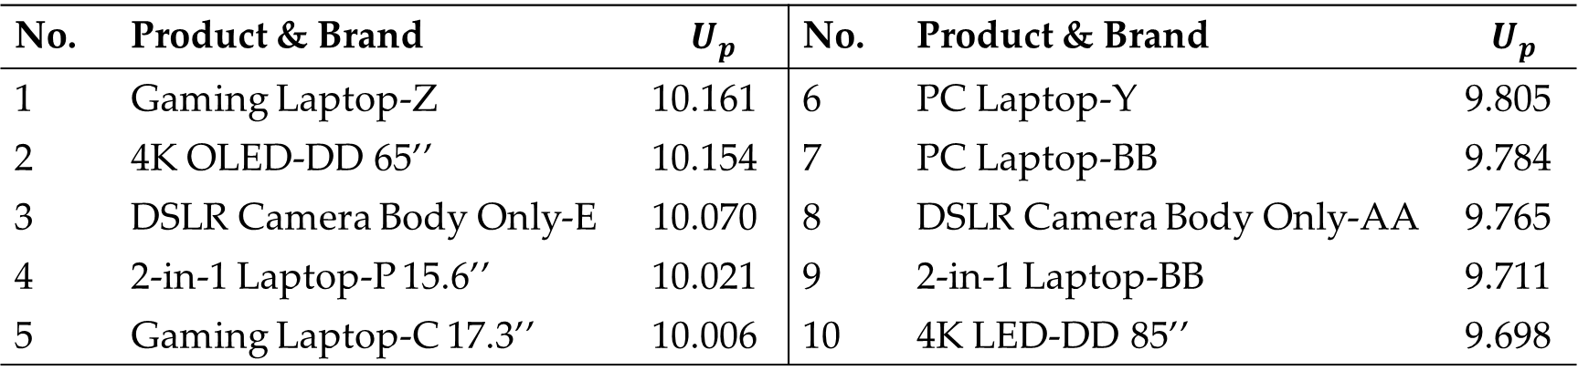
PRODUCT UTILITY
7
No. | Product & Brand | $$U_{p}$$ | No. | Product & Brand | $$U_{p}$$
1 | Gaming Laptop-Z | 10.161 | 6 | PC Laptop-Y | 9.805
2 | 4K OLED-DD 65’’ | 10.154 | 7 | PC Laptop-BB | 9.784
3 | DSLR Camera Body Only-E | 10.070 | 8 | DSLR Camera Body Only-AA | 9.765
4 | 2-in-1 Laptop-P 15.6’’ | 10.021 | 9 | 2-in-1 Laptop-BB | 9.711
5 | Gaming Laptop-C 17.3’’ | 10.006 | 10 | 4K LED-DD 85’’ | 9.698

Slide 8
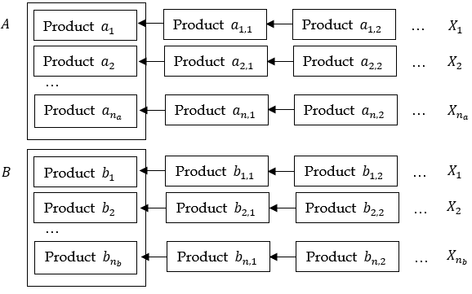

SHOPPING LIST
8
Primary List: Highest utility
Substitution Lists: Medium utility, substitutes to Primary & Secondary Lists
Secondary List: High utility
Same category
$$\frac{\left|P_{p1}^{′}−P_{p2}^{′}\right|}{P_{p1}^{′}}<λ_{p}$$
$$u_{i,p1}−u_{i,p2}<λ_{u}$$

Slide 9

CUSTOMER BEHAVIOR
9
Initialize Shopping List
Enter Store
Any items on list?
N
Y
Move to item with highest utility on list
FLOYD Algorithm,
Carrying Capacity $K$
Event A: Product Sold out
/ Damaged on Shelf
Evoke Events
Event B: Product Damaged
En Route
Pay & Exit

Slide 10
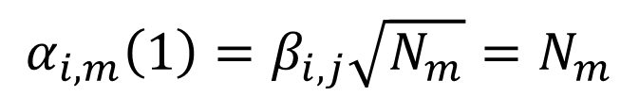
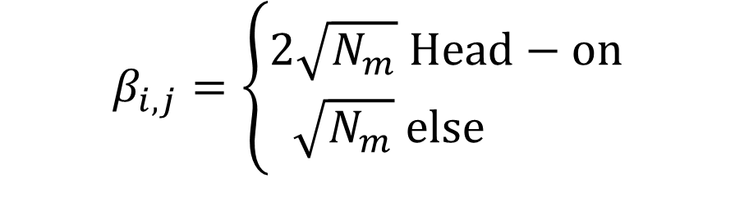
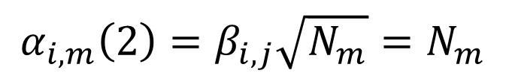
PRODUCT DAMAGE
10
Component 1: Overcrowding near Shelf
Type 1: On Shelf
$$α_{i,m}\left(1\right)=β_{i,j}\sqrt{N_{m}}=N_{m}$$
Component 2: Scrambling for products
Type 2: En Route
$$α_{i,m}\left(2\right)=β_{i,j}\sqrt{N_{m}}=N_{m}$$
$$β_{i,j}=\left\{\begin{aligned}2\sqrt{N_{m}} Head−on \\ \sqrt{N_{m}} else \end{aligned}\right.$$

Slide 11
EXPERIMENTAL SIMULATION
11
Constant utility
Randomly generate shopping lists
Require conversion from experimental scenario to reality

Slide 12




CONVERSION TO REALITY
12
Causation Side (Shelf $t$)
Incidence Side (Shelf $s$)
Inclination of item selection
$$φ_{t}=\frac{P_{t}}{P_{t}^{′}}$$
The number of items on shelf
$$ψ_{s}=\frac{q_{s}}{q^{′}n_{s}}$$
Overcrowding
On Shelf
Another product
Scrambling
This product
En Route
Another product

Slide 13



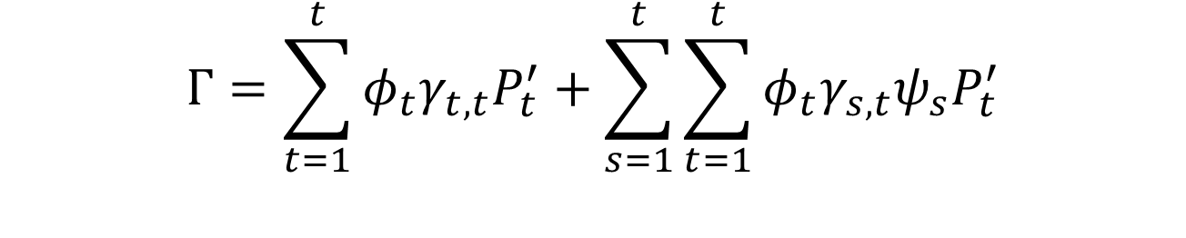
CONVERSION TO REALITY
13
Caused by This Product
Caused by Another Product
$$U=(φ_{1},φ_{2},⋯,φ_{7})$$
$$S={\left(γ_{1,1}P′,γ_{2,2}P′,⋯γ_{7,7}P′\right)}^{T}$$
$$T=\left(\begin{matrix}γ_{1,1} & ⋯ & γ_{1,7} \\ ⋮ & ⋱ & ⋮ \\ γ_{7,1} & ⋯ & γ_{7,7}\end{matrix}\right)$$
$$V={\left(ψ_{1}P^{′},ψ_{2}P^{′},⋯ψ_{7}P^{′}\right)}^{T}$$
$$Γ=US+UTV$$
Actual Damage
$$φ_{t}γ_{t,t}$$
Actual Loss
$$\sum_{t=1}^{t}{φ_{t}γ_{t,t}P_{t}^{′}}$$
Actual Damage
$${φ_{t}γ_{s,t}ψ}_{s}$$
Actual Loss
$$\sum_{s=1}^{t}{\sum_{t=1}^{t}{{φ_{t}γ_{s,t}ψ}_{s}P_{t}^{′}}}$$
$$Γ=\sum_{t=1}^{t}{φ_{t}γ_{t,t}P_{t}^{′}}+\sum_{s=1}^{t}{\sum_{t=1}^{t}{{φ_{t}γ_{s,t}ψ}_{s}P_{t}^{′}}}$$

Slide 14
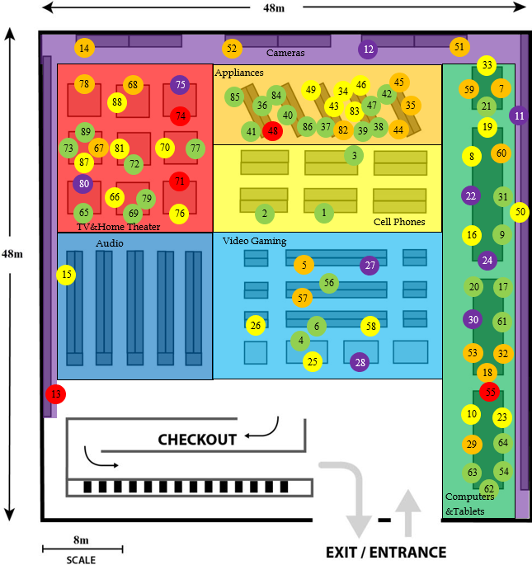
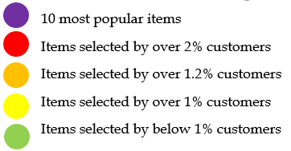
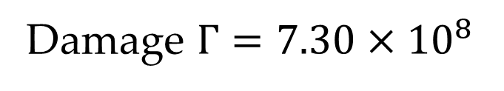
RESULTS
14
Damage $Γ=7.30×{10}^{8}$

Slide 15
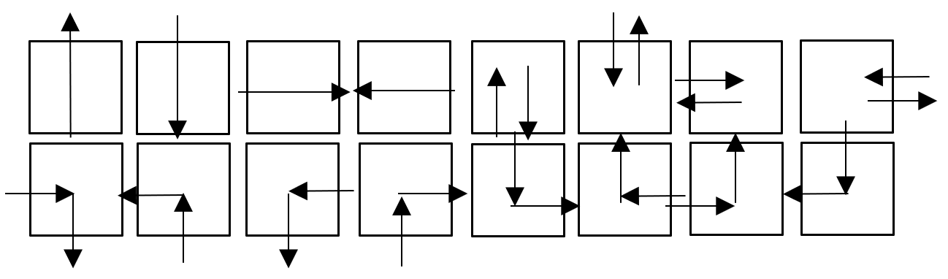

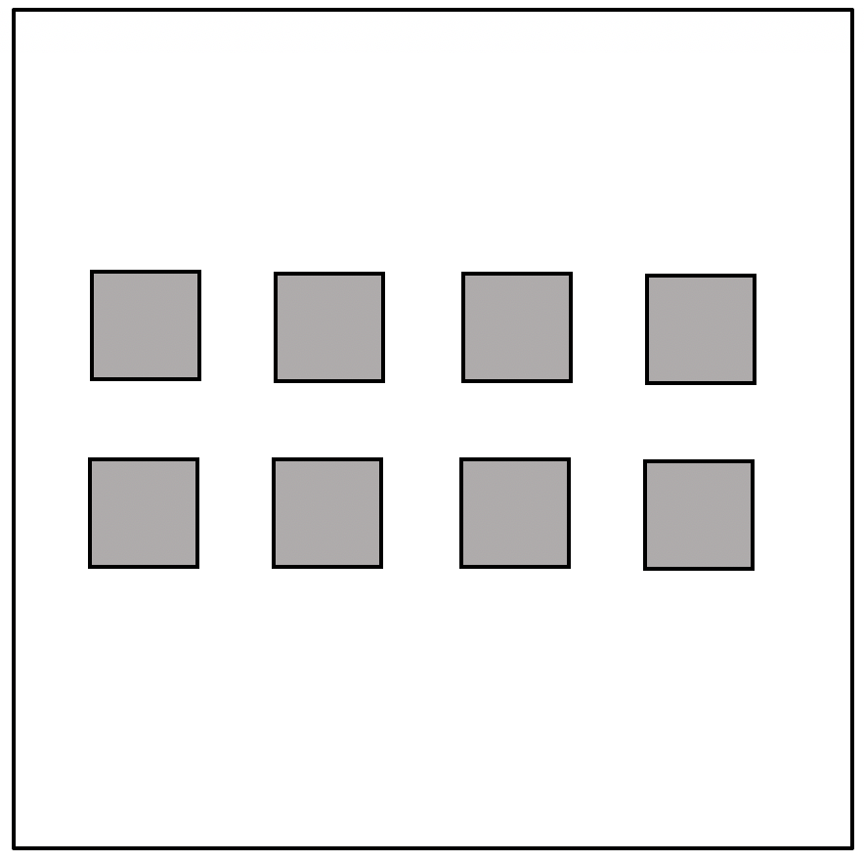
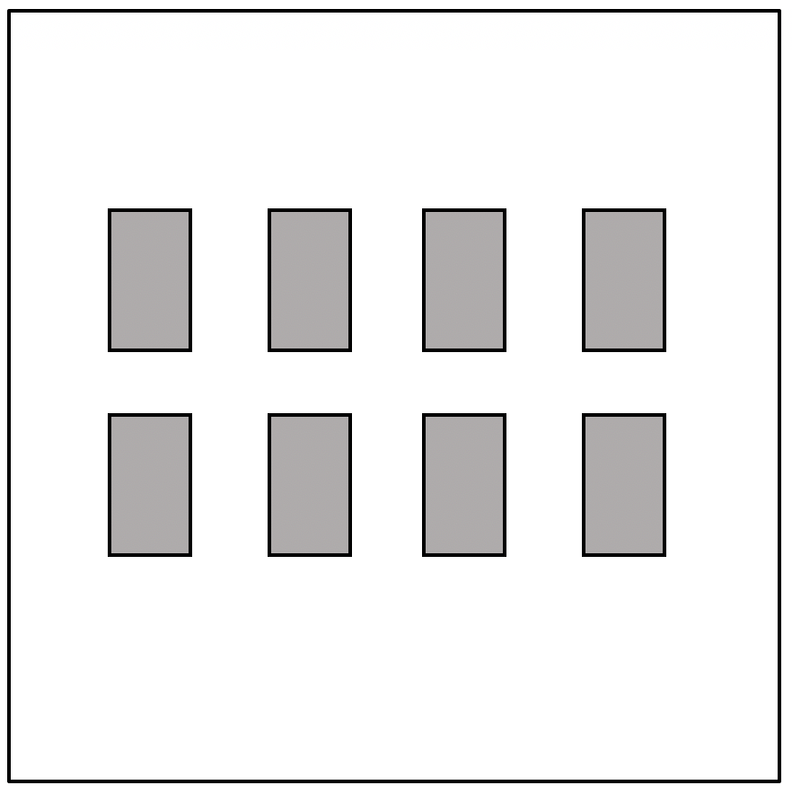
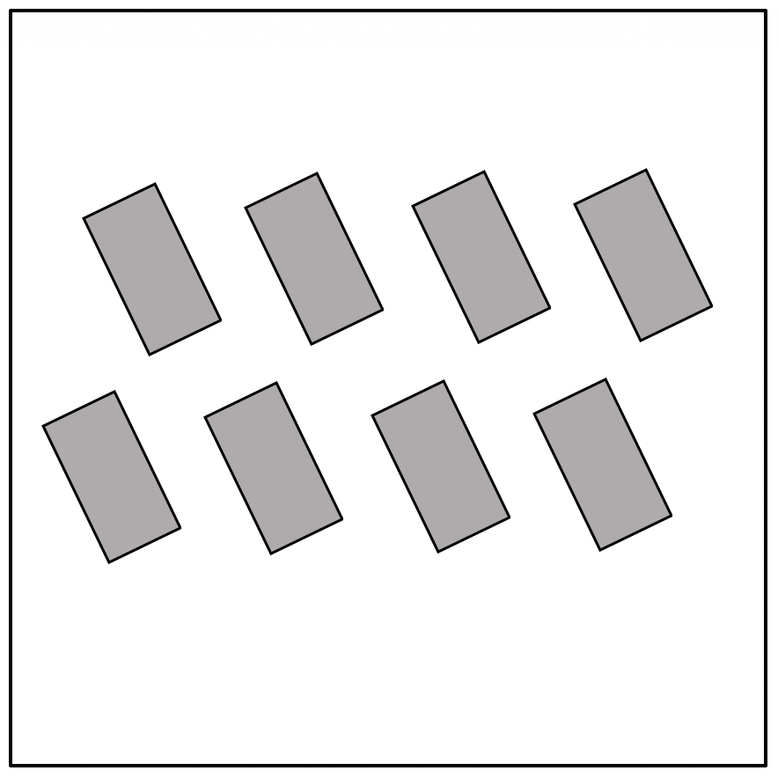
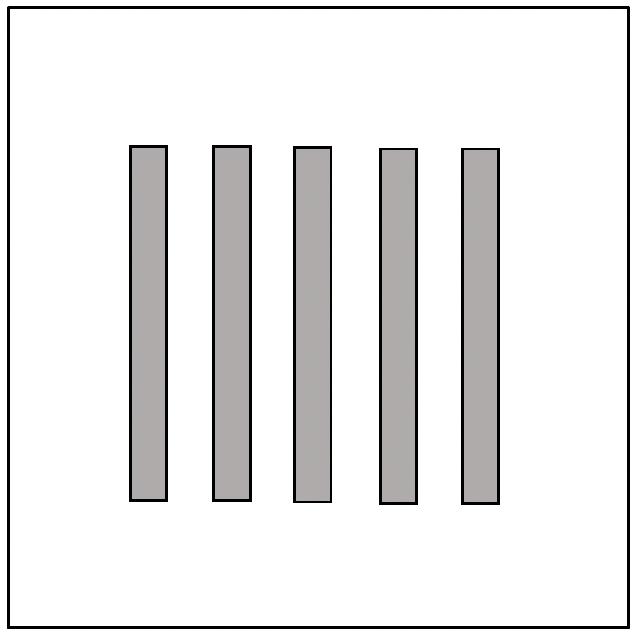
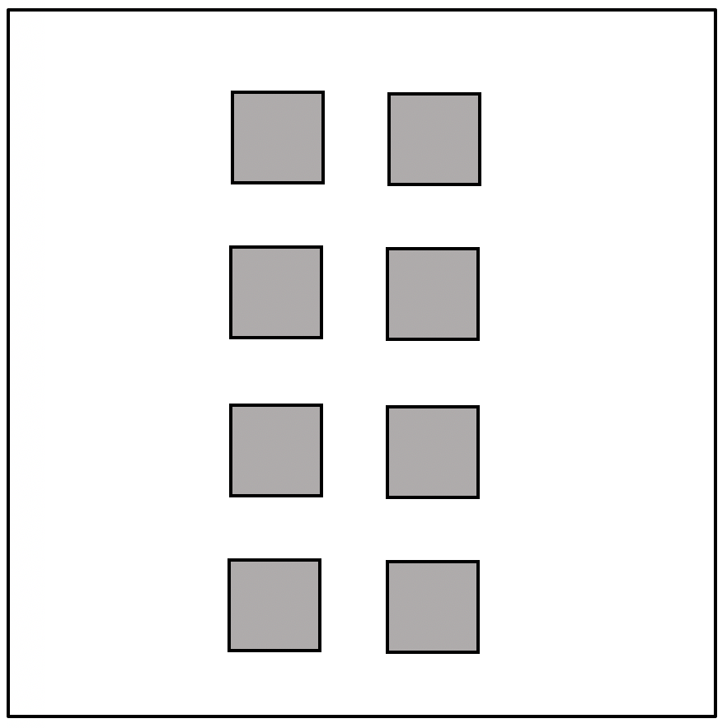
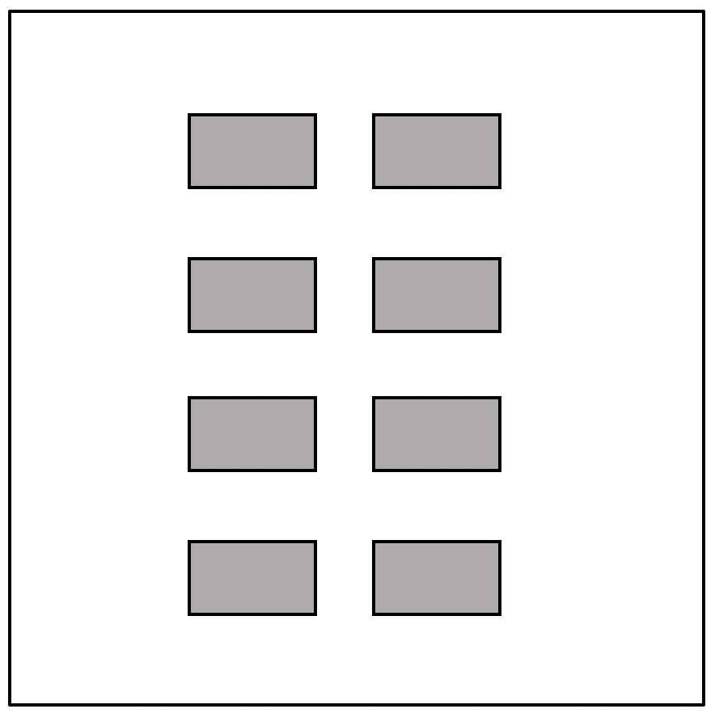
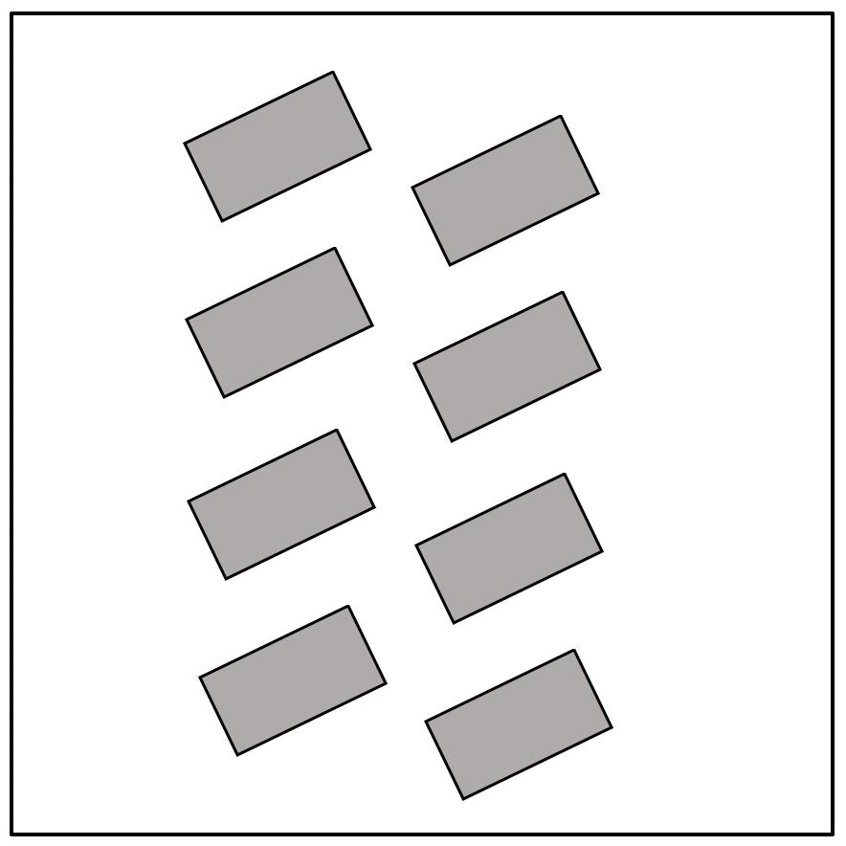
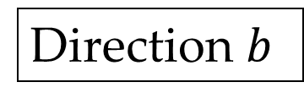

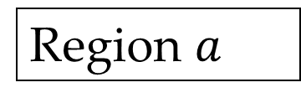
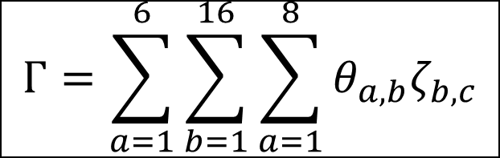
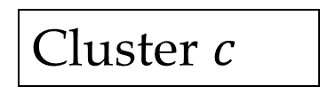
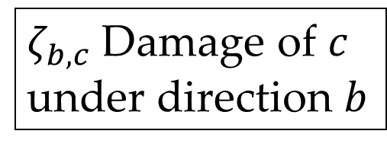
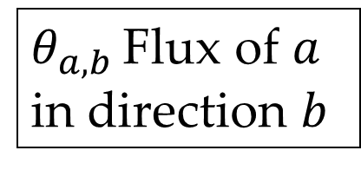
LAYOUT OPTIMIZATION
15
$$Y=\left(\begin{matrix}θ_{1,1} & ⋯ & θ_{1,16} \\ ⋮ & ⋱ & ⋮ \\ θ_{6,1} & ⋯ & θ_{6,16}\end{matrix}\right)$$
$$Z=\left(\begin{matrix}ζ_{1,1} & ⋯ & ζ_{1,8} \\ ⋮ & ⋱ & ⋮ \\ ζ_{6,1} & ⋯ & ζ_{6,8}\end{matrix}\right)$$
$$W=YZ$$
Region $a$
Experimental Simulation
Direction $b$
$θ_{a,b }$Flux of $a$ in direction $b$
$$Γ=\sum_{a=1}^{6}{\sum_{b=1}^{16}{\sum_{a=1}^{8}{θ_{a,b}ζ_{b,c}}}}$$
$ζ_{b,c}$Damage of $c$ under direction $b$
Layout
Cluster $c$
Experimental Simulation

Slide 16
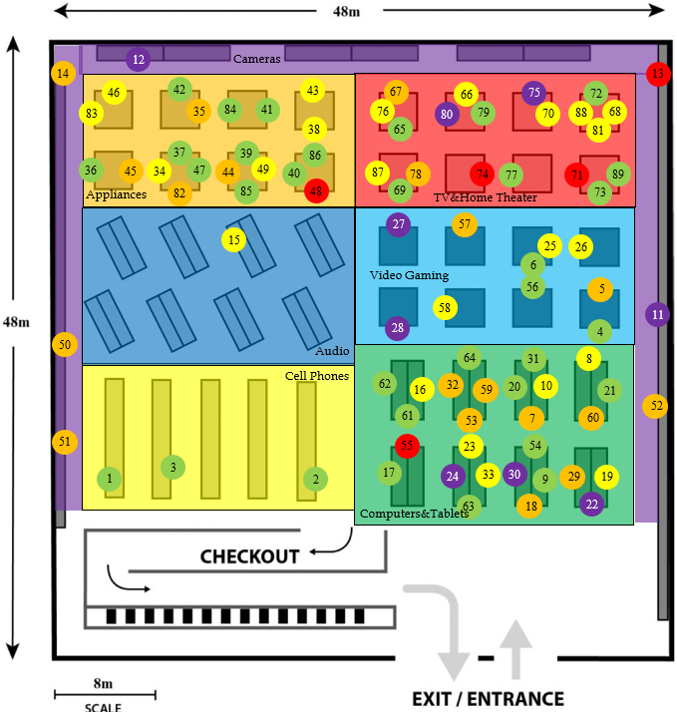
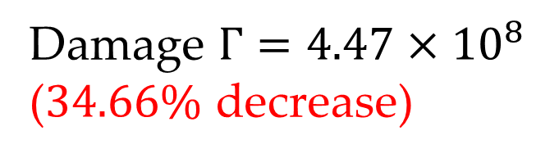
RESULTS
16
Damage $Γ=4.47×{10}^{8}$
($34.66\%$ decrease)

Slide 17
RESULT ANALYSIS
17
Products concentrated on the right
Place popular items in the rear
Shelves match direction of pedestrian flow
Vertical in the front
Slanted on the left
Squares in the rear
Most potentially lucrative: Cameras
Helpful to open up more cashier stations

Slide 18

SENSITIVITY ANALYSIS
18
Cashier Queueing Rate $v$ : Sensitive, but reasonable
Cell Carrying Capacity $K$: Insensitive
Gauging Time $t$: Insensitive

Slide 19

19
STRENGTHS
WEAKNESSES
Independent of external data
Generic
Realistic
Generally insensitive
Inaccuracy for slanted shelves
Multitudinous assumptions
Limitation of patterns in 2(d)
Sensitive to $v$

Slide 20
THANK YOU!
Any Questions?

Slide 21
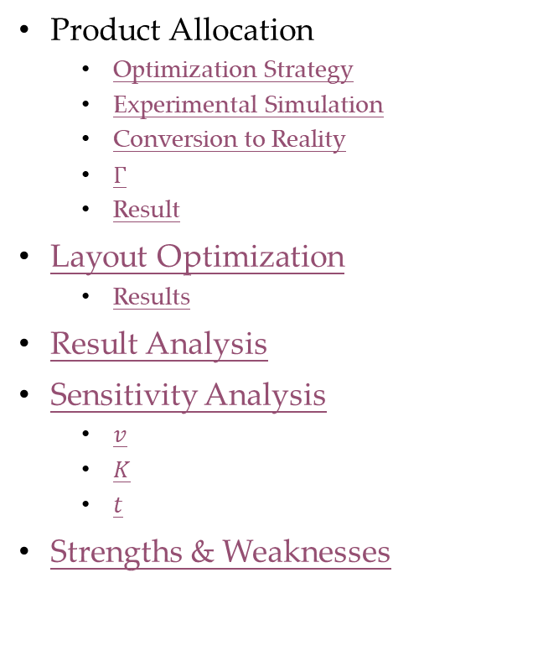
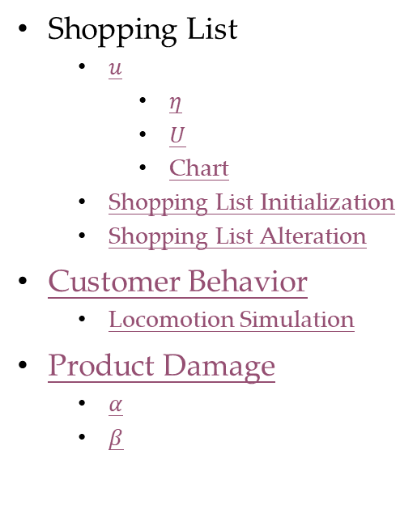
Q&A
Title
Our Work
General Assumptions
Microeconomic Context
Customer Initialization
Customer Capabilities
Customer Behavior
Shopping List
$u$
$η$
$U$
Chart
Shopping List Initialization
Shopping List Alteration
Customer Behavior
Locomotion Simulation
Product Damage
$α$
$β$
Product Allocation
Optimization Strategy
Experimental Simulation
Conversion to Reality
$Γ$
Result
Layout Optimization
Results
Result Analysis
Sensitivity Analysis
$v$
$K$
$t$
Strengths & Weaknesses

Slide 22
MICROECONOMIC CONTEXT
22
Market Structure:
Previous Market State:
Demand Function:
End-state of All Products:
Restitution for damage:
Perfect Competition
Equilibrium
Linear
Sold / Damaged
Unobtainable

Slide 23
CUSTOMER INITIALIZATION
23
Primary Goal:
Preparation:
Purchase at Low Prices
Shopping List
Familiarization

Slide 24
CUSTOMER CAPABILITIES
24
Know if a product is sold out only when at the shelf
Estimate severity of crowding only through moving rates
No product damage at cashiers
Instantaneously identify damaged products

Slide 25
CUSTOMER BEHAVIOR
25
No non-sale purchases unless item is placed in his way
Keep focused on obtaining one product until achieved/failed
En route damage of negligible importance compared with products being sold out
Sequence of obtaining products based on product utilities
If product unobtainable, more inclined to purchase substitute than unrelated products

Slide 26

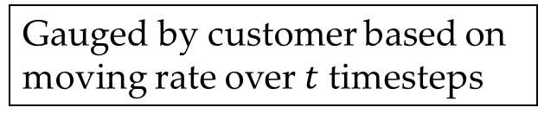









LOCOMOTION SIMULATION
26
Choices: 4 adjacent cells $m_{1},m_{2},m_{3},m_{4}$
Sole factor: expected time to reach destination $n$
minimize
$${\hat{t}}_{m→n}=\frac{s_{m,n}}{v_{m}}$$
FLOYD Algorithm
$$m_{2}$$
$$S_{m_{1},n}$$
Gauged by customer based on moving rate over $t$ timesteps
$$m_{3}$$
$$i$$
$$m_{1}$$
$$v_{m_{1}}$$
$$m_{4}$$
$$n$$
Cell Carrying Capacity $K$

Slide 27
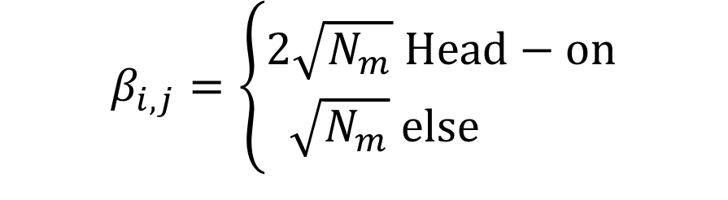
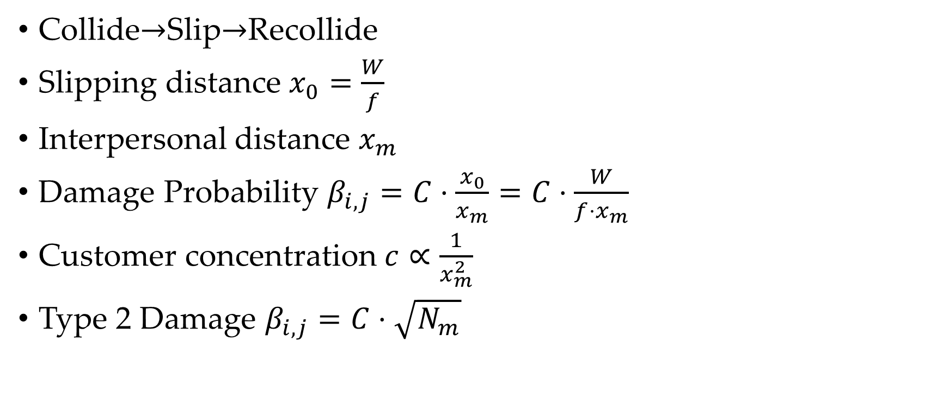
PRODUCT DAMAGE QUANTIFICATION-En Route
27
Collide$→$Slip$→$Recollide
Slipping distance $x_{0}=\frac{W}{f}$
Interpersonal distance $x_{m}$
Damage Probability $β_{i,j}=C⋅\frac{x_{0}}{x_{m}}=C⋅\frac{W}{f⋅x_{m}}$
Customer concentration $c∝\frac{1}{x_{m}^{2}}$
Type 2 Damage $β_{i,j}=C⋅\sqrt{N_{m}}$
$$β_{i,j}=\left\{\begin{aligned}2\sqrt{N_{m}} Head−on \\ \sqrt{N_{m}} else \end{aligned}\right.$$

Slide 28
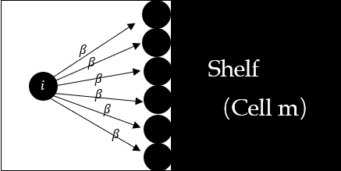
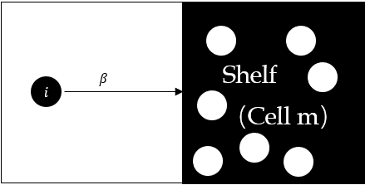


PRODUCT DAMAGE QUANTIFICATION-On Shelf
28
Pushing By
Product Scrambling
$$α_{i,m}\left(1\right)=β_{i,j}\sqrt{N_{m}}=N_{m}$$
$$α_{i,m}\left(2\right)=β_{i,j}\sqrt{N_{m}}=N_{m}$$

Slide 29











SHOPPING LIST ALTERATION - Event A
29
$X_{i,a_{1}}≠∅$:
Replace with first substitute
$X_{i,a_{1}}=∅ \&\& B_{i}≠∅$:
Replace with first secondary item
$X_{i,a_{1}}=∅ \&\& B_{i}=∅$:
Do nothing
$$p_{1}$$
$$p_{8}$$
Primary
$$p_{2}$$
$$p_{6}$$
$$p_{12}$$
$$p_{3}$$
$$p_{4}$$
Secondary
$$p_{5}$$
$$p_{11}$$
$$p_{15}$$
Substitution Lists

Slide 30










SHOPPING LIST ALTERATION - Event B
30
Obtained
$$p_{1}$$
$\frac{u_{1}}{t_{1}}≤\frac{u_{2}}{t_{2}}$:
Re-include damaged item
$\frac{u_{1}}{t_{1}}>\frac{u_{2}}{t_{2}} \&\& B_{i}≠∅$:
Add first secondary item
$\frac{u_{1}}{t_{1}}>\frac{u_{2}}{t_{2}} \&\& B_{i}=∅$:
Do nothing
Primary
$$p_{2}$$
$$p_{6}$$
$$p_{12}$$
$$p_{3}$$
$$p_{4}$$
Secondary
$$p_{5}$$
$$p_{11}$$
$$p_{15}$$
Substitution Lists

Slide 31




















OPTIMIZATION STRATEGY
31
$$p_{1}$$
$$p_{6}$$
$$p_{11}$$
$$p_{16}$$
Classification
Mapping
Specification
$$p_{2}$$
$$p_{7}$$
$$p_{12}$$
$$p_{17}$$
$$p_{3}$$
$$p_{8}$$
$$p_{13}$$
$$p_{18}$$
$$p_{4}$$
$$p_{9}$$
$$p_{14}$$
$$p_{19}$$
Layout
$$p_{5}$$
$$p_{10}$$
$$p_{15}$$
$$p_{20}$$

Slide 32



CASHIER QUEUEING RATE $v$
32
$$V$$ | $$Γ(×10^{8})$$
0.5 | 14.8
1 | 11.4
2 | 10.7
3 | 7.30
4 | 5.18
Sensitive, but reasonable
More cashiers can reduce damage

Slide 33



CELL CARRYING CAPACITY $K$
33
$$K$$ | $$Γ(×10^{8})$$
5 | 7.84
6 | 7.56
7 | 7.30
8 | 6.88
Insensitive & can be easily gauged

Slide 34



GAUGING TIME $t$
34
$$t$$ | $$Γ(×10^{8})$$
1 | 7.29
2 | 7.30
3 | 7.27
4 | 7.25
Insensitive & can be easily gauged

