Slide 1
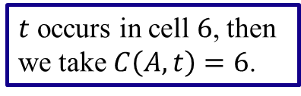

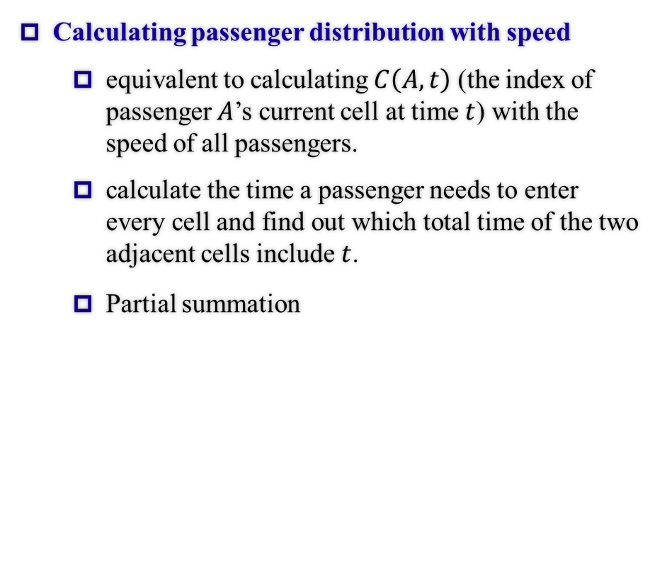
Total Boarding Time (Under Regular States)
Calculating passenger distribution with speed
equivalent to calculating $C\left(A,t\right)$ (the index of passenger $A$’s current cell at time $t$) with the speed of all passengers.
calculate the time a passenger needs to enter every cell and find out which total time of the two adjacent cells include $t$.
Partial summation
1
2
3
4
5
6
7
8
Total time
$t$ occurs in cell $6$, then we take $C\left(A,t\right)=6$.
$$t$$
1

