Slide 1
Dynamic Decisions
Evaluating the Earth’s Carrying Capacity
Notes:
Adam

Slide 2
Introduction
Notes:
Welcome, who we are
what is the problem
why is it important

Slide 3
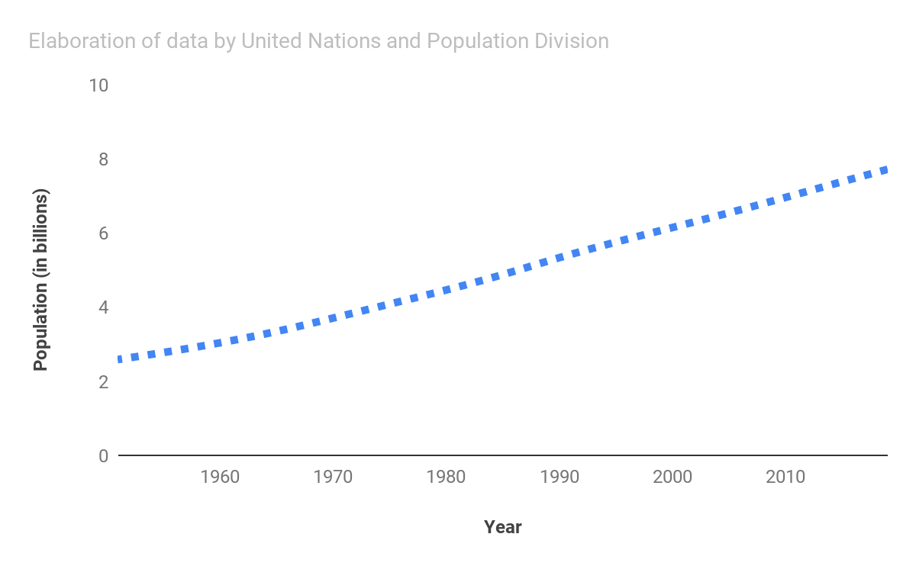
World Population
Notes:
raising population

Slide 4
World Population
Food
Life Standards
Water
Natural Resources
Notes:
what problems it causes/may cause

Slide 5
Problem Restatement
Notes:
Krzyś

Slide 6
Problem Restatement
Calculating current Earth’s carrying capacity
Finding key factors
Predicting and improving future Earth’s carrying capacity
Notes:
We have divided our problem to three smaller tasks to effectively solve it. Firstly we had to identify factors which significantly affect human population. Then using these factors we had to calculate Earth’s current carrying capacity. Our final goal was to make conclusions based on previous questions, predict how will CC change in the future and find the best way to increase it.

Slide 7
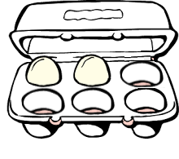
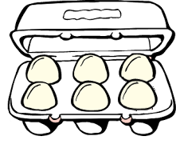
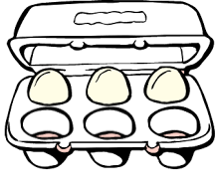
Population Equilibrium
Carrying Capacity
Notes:
To illustrate common misconception about earth’s carrying capacity, let us consider a thought experiment There are three eggs in a 6-position egg-box. If we eat one of them and then put a new one in it everyday, the size of the egg population will be maintained at three. Now what is the carrying capacity of this egg population, three or six? We assumed it is six, because we define egg’s carrying capacity as the maximal amount of eggs that can fit in the egg box!

Slide 8
General Assumptions
Trade of resources
Data time spread is negligible
Notes:
The two main assumptions of our model are that both trade of resources between countries and time spread of our data is negligible

Slide 9
Key factors

Slide 10
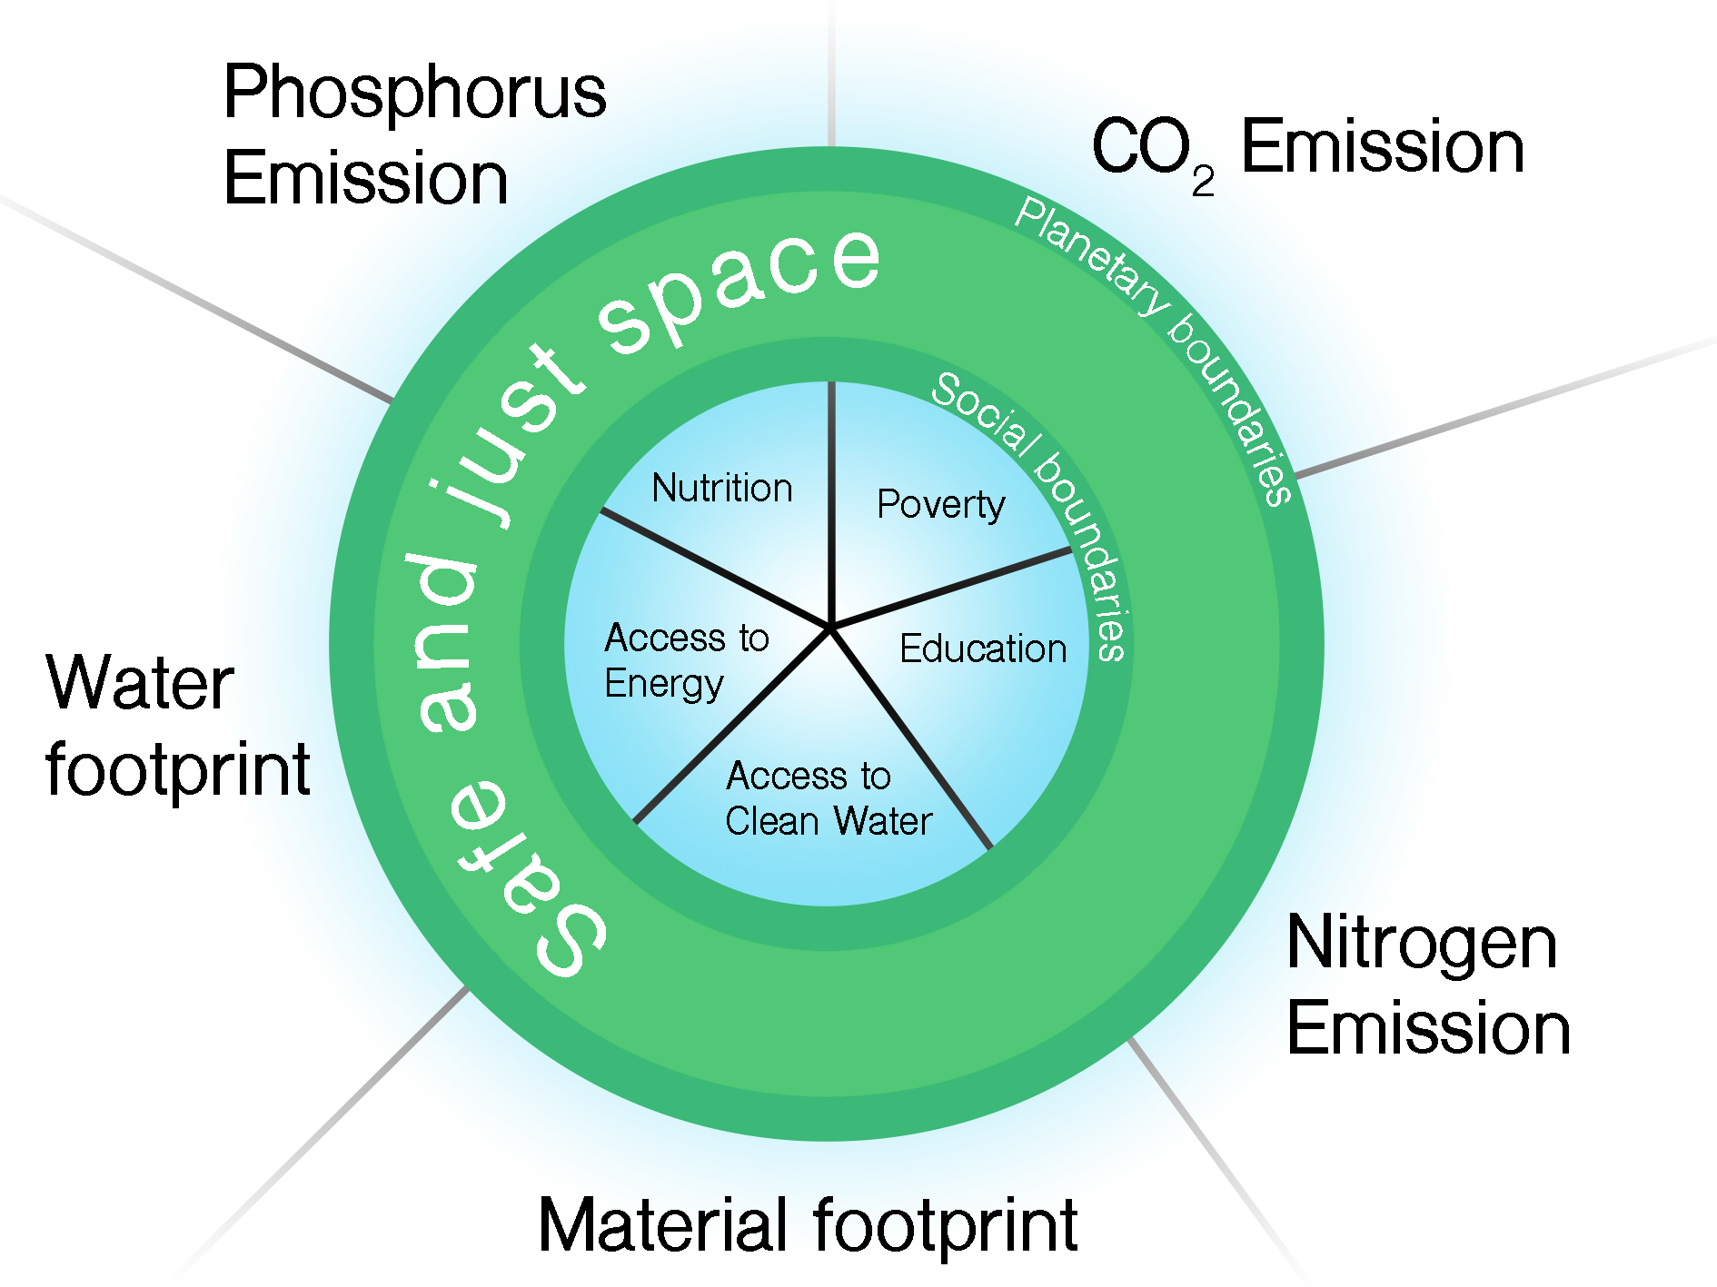
Safe and Just Space
Notes:
Our model deeply relies on the so called Safe and Just Space
Safe and just space is a framework proposed by Kate Raworth in 2012
that focuses on sustainable environmental development while maintaining decent life for people.
It forms a doughnut-shaped space bounded by planetary and social boundaries
This bounded area is a “safe operating space” for people to live happily, while not damaging the environment
For us the Earth’s carrying capacity is the maximum population that can live within the Safe and Just Space.

Slide 11
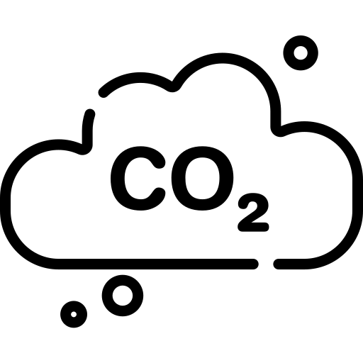
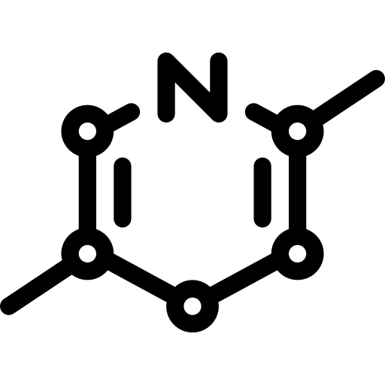
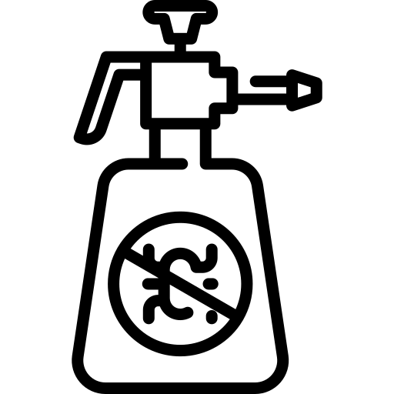


Biophysical Factors
CO2 emission
Nitrogen emission
Phosphorus emission
Material footprint
Water footprint
Notes:
Based on the Safe and Just Space we selected 10 key factors. We divided them into two groups: biophysical factors which are...

Slide 12
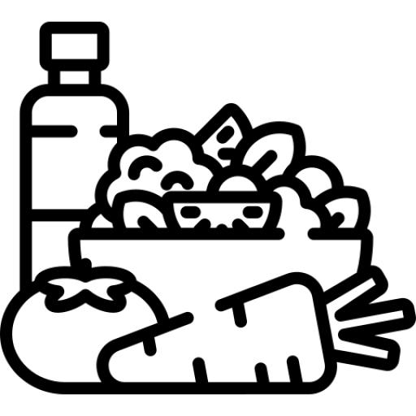



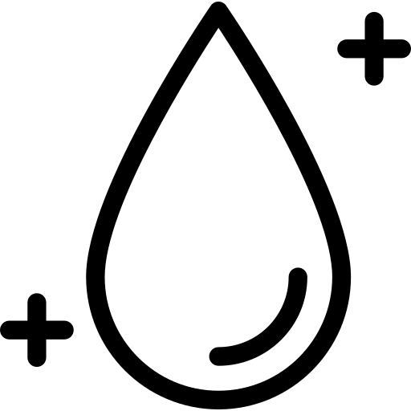
Social Factors
Nutrition
Percent of population living in poverty
Education
Access to electricity
Access to clean water
Notes:
And social factors that are:

Slide 13
Our Models
Notes:
Adam

Slide 14
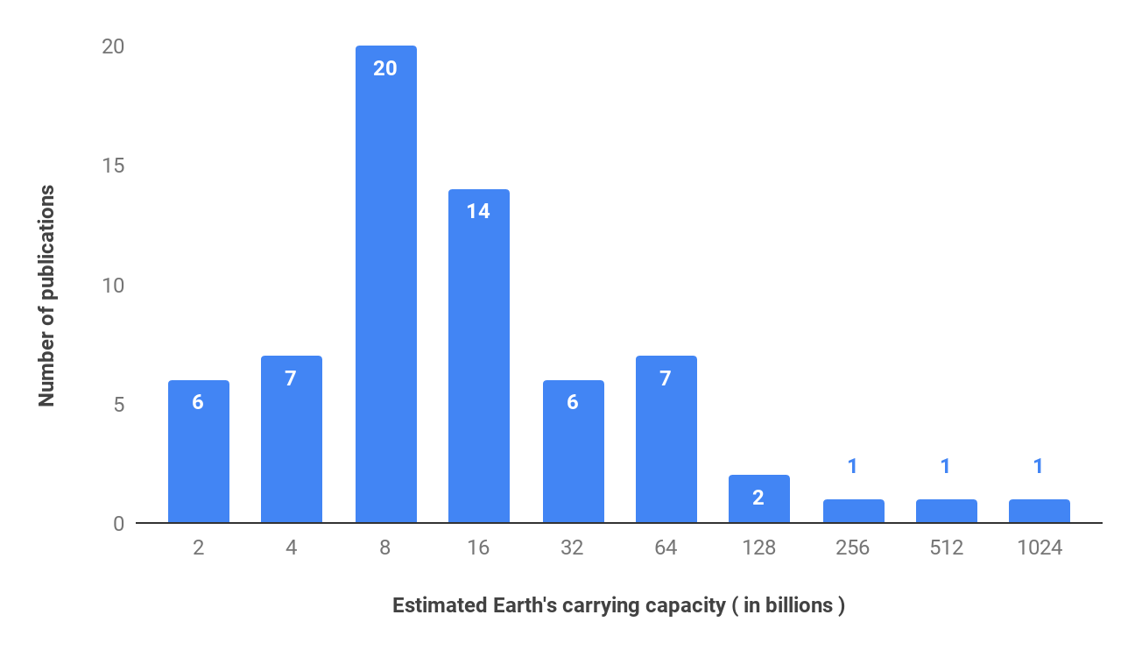
Historical results
20
14
7
7
6
6
2
1
1
1
Notes:
Different results
8 bln most popular
there is large discrepancy so the result depends on the assumptions to a great extent

Slide 15

Basic Model
Notes:
How to calculate

Slide 16



Basic Model
Water
Nutrition
Area
Notes:
Adam

Slide 17
Results
12
13
31
Area:
billions
Nutrition:
billions
Water:
billions
Notes:
Adam

Slide 18

Dynamic Model
Notes:
Our main model is based on an observation that the key factors are interdependent. That means that for example change in population induces change in co2 emission which further induces change in material footprint and so on and so forth. In Dynamic Model we combined the notion of Safe and Just Space with System Dynamics.
which is just an approach that enabled us to calculate how a given system of interdependent elements behaves..

Slide 19
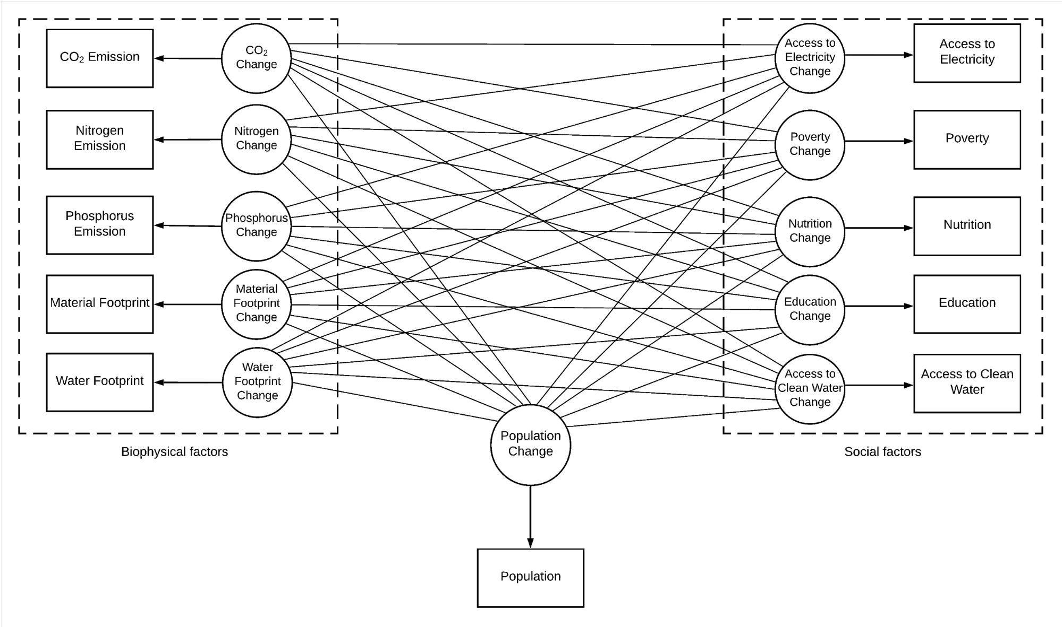
Calculations
Notes:
First, according to Safe and Just Space we set certain thresholds that our key factors must not exceed. Next using a Python System Dynamics library we were able to create a code that calculates what maximum population fits into the Safe and Just Space. The graph above is a simplification of the system used in our model

Slide 20
Results
7.6 billions
Notes:
We calculated the carrying capacity for each country separately and combined our result. The final number we got out of the Dynamic Model was 7.6 Billion.

Slide 21
Strengths
Weaknesses
System Dynamics takes interdependence of Key Factors into consideration
Economic processes are not taken into account
Social Factors are included in the model
Lack of insight control of model calculations because we work on Python library
Earth’s Carrying Capacity is calculated for every country separately
The model allows for analysis of how each factors contributes to Carrying Capacity allowing us to find ways to increase it
Notes:
We are of course aware of the strenghts and weaknesses of this model, with the strenghts being that:
it takes interdependence into account
it includes social factors
earth’s carrying capacity is calculated for every country separately
this model also allows for analysis of what role each factor plays in changing the carrying capacity
The weaknesses of this model are that
economic processes are not considered
and we lack insight of calculations made backstage by the Python library

Slide 22
Raising Earth’s Carrying Capacity
Notes:
Krzyś

Slide 23




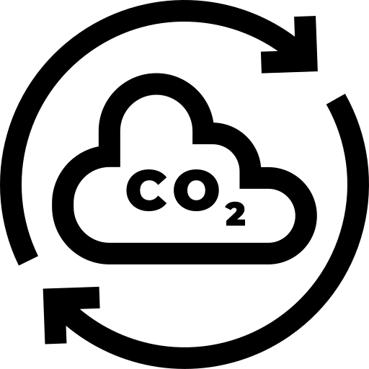




Strategies
Nuclear Power
Reforestation
Electrical Cars Policy
Diet change
Liquid coal
Capturing CO2
Space solar energy
Tidal energy
Geothermal energy
Plastic decomposing bacteria
Notes:
Our goal was to figure out a way to increase CC as efficient as we can. We found 10 innovative technologies which can change the world in the nearest future. Cold fusion, liquid coal, and more.

Slide 24
President model
Notes:
Now let us introduce the President Model! President Model is based on a combination of probability decision trees and Q-learning algorithm. In this model we simulated a World Leader - the President who can make decisions that impact the whole world. This way we can see what combination of decisions he can make to raise the earth’s carrying capacity.

Slide 25
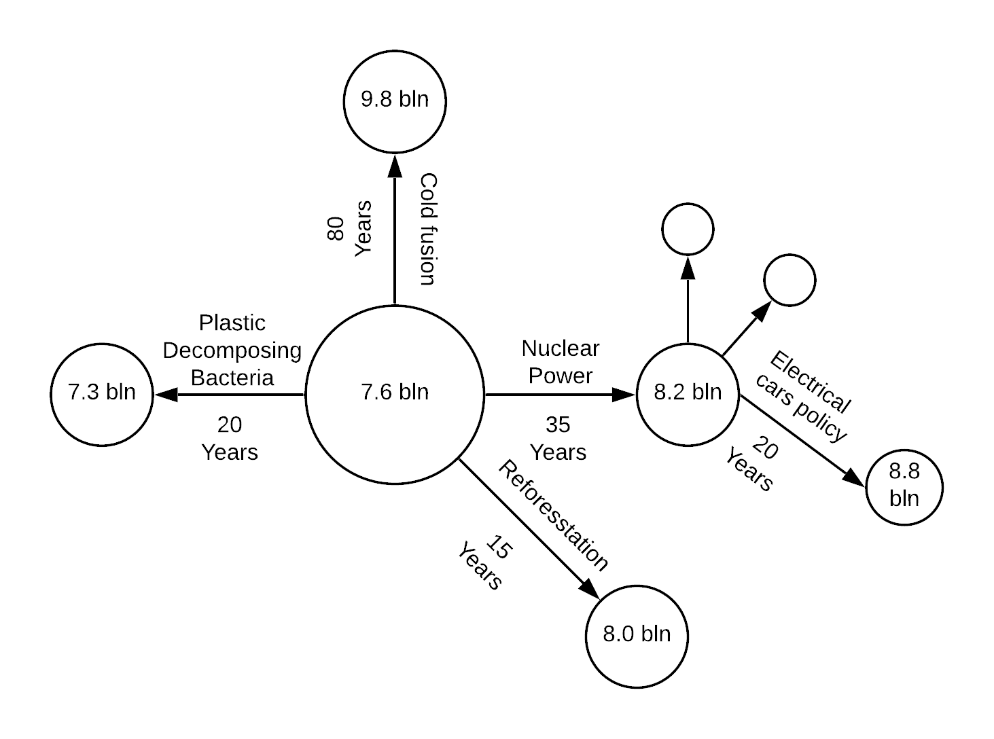
President Model
Notes:
In President Model creating an artificial environment is crucial, therefore we tried many different possible scenarios. Q-learning approach fits to this problem because of its simplicity in application, fast learning time and ability to adapt to environment with given set of rules.

Slide 26
President Model
Create environment (Q-table)
Choose the solution
Perform the action using impact table
Measure current capacity (using Dynamic Model)
Update environment (Q-table)
Notes:
In our model we used Q-learning reinforcement algorithm. The goal of Q-learning was to learn a policy, which would tell the president what action to take under what circumstances. For any set of strategies, Q-learning finds a policy that maximizes the expected value of the total reward in our case Earth's carrying capacity. For our model we created an environment which is representation of these strategies where each has an impact on Earth’s carrying capacity.

Slide 27
Results
13 billions
+70%
12.30 billions
13.14 billions
12.76 billions
13.54 billions
+63%
+73%
+68%
+78%
Notes:
President model left us with an average ​70% increase in future Earth’s carrying capacity which gives us ​13 billion​ people that our Earth can hold.

Slide 28
Questions?
Notes:
That’s all from us! We are open to any questions…

Slide 29
Thank you!
Notes:
!

