Slide 1
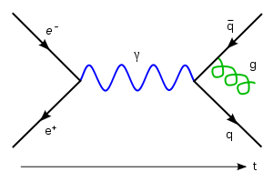
Dirac’s Positron
By
Arpan Saha,
Engineering Physics with Nanoscience,
IIT-Bombay
Arpan Saha, Sophomore, IITB, Engineering Physics with Nanoscience
Friday, November 5, 2010
Notes:
Positron- By: Arpan Saha, IITB,2010
11/05/10

Slide 2
An overview
One of the many achievements of Paul Adrian Maurice Dirac, had been to predict the existence of positrons.
Over the course of these slides, we will be examining how he successfully posited an equation for the dynamics of an electron that was both consistent with special relativity as well as quantum mechanics.
And so we shall see how in the process, he was inevitably led to the conclusion that positrons exist.
Arpan Saha, Sophomore, IITB, Engineering Physics with Nanoscience ,
Friday, November 5, 2010
Notes:
11/05/10
Positron- By: Arpan Saha, IITB,2010

Slide 3
Topics of Discussion
We shall be taking up the following topics:
The Dirac Equation
Lorentz Covariance of Dirac
Probability Conservation
Solutions of Dirac
Negative energies?
A way out?
The Positron
Concluding Remarks
Skobeltsyn's Mysterious Particle
Schrodinger’s Equation
The Hamiltonian Operator
Relativistic Limits
4-Momentum
Revisiting the Hamiltonian
The Klein-Gordon Equation
Issues with Klein-Gordon
Dirac’s Insight
Arpan Saha, Sophomore, IITB, Engineering Physics with Nanoscience ,
Friday, November 5, 2010
Notes:
11/05/10
Positron- By: Arpan Saha, IITB,2010

Slide 4
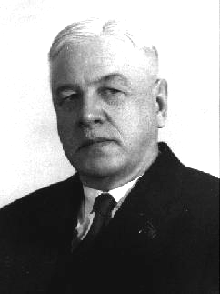
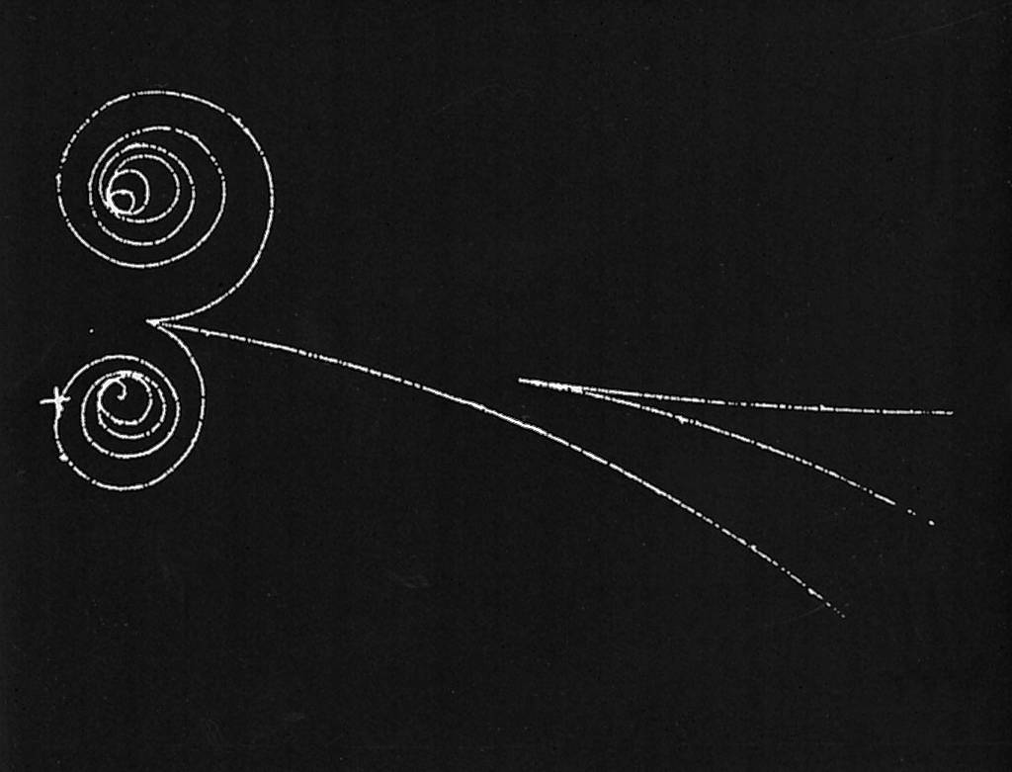
Skobeltsyn’s Mysterious Particle
In 1923, Dmitri Skobeltsyn, a Soviet physicist then working in St. Petersburg University, Leningrad, observed a particle in his bubble chamber that had all the attributes of the electron, except that it had the opposite charge.
The same observations was reported in 1929 by Chung-Yao Chao, a grad student at Caltech while he was working with gamma radiation.
Arpan Saha, Sophomore, IITB, Engineering Physics with Nanoscience ,
Friday, November 5, 2010
Notes:
Positron- By: Arpan Saha, IITB,2010
11/05/10

Slide 5
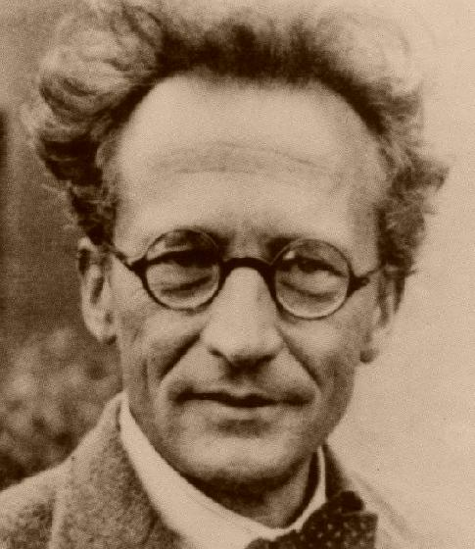
Skobeltsyn’s Mysterious Particle
Having never observed such a particle before they remain baffled as to what it was.
To answer this we’ll need to start with Schrödinger's discovery of the eponymous equation in his 1926 paper Quantization as an Eigenvalue problem.
Arpan Saha, Sophomore, IITB, Engineering Physics with Nanoscience ,
Friday, November 5, 2010
Notes:
Positron- By: Arpan Saha, IITB,2010
11/05/10

Slide 6
Schrodinger's Equation
Schrödinger, building on the matrix formulation of Heisenberg, realized the state of a particle could be described as a complex-valued wavefunction.
Any wavefunction could be expressed as linear combinations of basis eigenfunctions, whose evolution through time was given by the Schrodinger’s Equation.
i∂ψ/∂t = Hψ
Arpan Saha, Sophomore, IITB, Engineering Physics with Nanoscience ,
Friday, November 5, 2010
Notes:
Positron- By: Arpan Saha, IITB,2010
11/05/10

Slide 7
The Hamiltonian Operator
H is the Hamiltonian operator that on acting upon a wavefunction at a certain instant yielded its energy as the eigenvalue.
In the absence of potential, the Hamiltonian is given by the classical formula for kinetic energy:
H = p²/2m
Substituting the operator for momentum p we get:
H = (–1/2m)(∇)²
Arpan Saha, Sophomore, IITB, Engineering Physics with Nanoscience ,
Friday, November 5, 2010
Notes:
Positron- By: Arpan Saha, IITB,2010
11/05/10

Slide 8
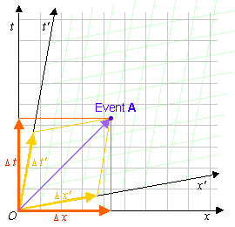
Relativistic Limits
The Schrödinger equation breaks down at relativistic limits.
This is because it is not Lorentz covariant.
Time and space do not enter the equation symmetrically.
What is the remedy?
Arpan Saha, Sophomore, IITB, Engineering Physics with Nanoscience ,
Friday, November 5, 2010
Notes:
11/05/10
Positron- By: Arpan Saha, IITB,2010

Slide 9
4-Momentum
In Minkowski’s formulation of STR, momentum becomes a 4-vector.
Energy is the time component. The space components are as they are.
The norm, in naturalized units, is the rest mass m.
So we have as the Einstein formula:
m² = E² – p²
That is E = √(p² + m²)
Arpan Saha, Sophomore, IITB, Engineering Physics with Nanoscience ,
Friday, November 5, 2010
Notes:
11/05/10
Positron- By: Arpan Saha, IITB,2010

Slide 10
Revisiting the Hamiltonian
We let H = √(p² + m²) = √(–(∇)² + m²)
So Schrödinger becomes:
i∂ψ/∂t = √(–(∇)² + m²)ψ
The square root can be interpreted as a Taylor series.
But then, time and space remain asymmetric.
Furthermore, the presence of an infinite number of terms makes the theory nonlocal.
So, what if we instead use H² = p² + m² ?
Arpan Saha, Sophomore, IITB, Engineering Physics with Nanoscience ,
Friday, November 5, 2010
Notes:
11/05/10
Positron- By: Arpan Saha, IITB,2010

Slide 11
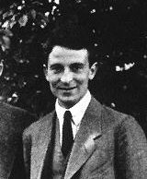
The Klein-Gordon Equation
We get what is known as the Klein-Gordon Equation, obtained in 1927 by Oskar Klein and Walter Gordon.
–∂²ψ/∂t² = (–(∇)² + m²)ψ
Using the d’Alembert Operator we have:
²ψ = m²ψ
But certain problems arise which stand in its way of being a complete description of the dynamics of a relativistic electron.
Arpan Saha, Sophomore, IITB, Engineering Physics with Nanoscience ,
Friday, November 5, 2010
Notes:
11/05/10
Positron- By: Arpan Saha, IITB,2010

Slide 12
Issues with Klein-Gordon
Though Lorentz covariant Klein-Gordon fails some of the requirements of the QM postulates.
Being second order in time, determining a particular solution required information about both ψ as well as ∂ψ/∂t. But QM says wavefunction must be a complete description.
Also, Klein-Gordon admits solutions where norm and hence, probability is not conserved.
So, Klein-Gordon is necessary but not sufficient.
Arpan Saha, Sophomore, IITB, Engineering Physics with Nanoscience ,
Friday, November 5, 2010
Notes:
11/05/10
Positron- By: Arpan Saha, IITB,2010

Slide 13
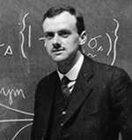
Dirac’s Insight
We needed an equation that was both first-order in time as well as space.
Paul Dirac realized that this might be possible if we interpret the square root in the Einstein formula differently.
Arpan Saha, Sophomore, IITB, Engineering Physics with Nanoscience ,
Friday, November 5, 2010
Notes:
11/05/10
Positron- By: Arpan Saha, IITB,2010

Slide 14
Dirac’s Insight
Let √(p² + m²) be of the form α^{k}p_{k} + mβ
Comparing coefficients in (α^{k}p_{k} + mβ)² = p² + m², we have:
αªα^{b} + αªα^{b} = 2δ^{ab}
α^{k}β + βα^{k} = 0
β² = 1
This has no solutions in scalars, but it does have if we allow α^{k} and β to be square matrices.
Arpan Saha, Sophomore, IITB, Engineering Physics with Nanoscience ,
Friday, November 5, 2010
Notes:
11/05/10
Positron- By: Arpan Saha, IITB,2010

Slide 15



Dirac’s Insight
It is not difficult to show that α^{k} and β have eigenvalues +–1, trace zero and hence an even order.
The simplest solutions (of order 4) are given by the following, σ^{k} being the Pauli spin matrices.
Arpan Saha, Sophomore, IITB, Engineering Physics with Nanoscience ,
Friday, November 5, 2010
Notes:
11/05/10
Positron- By: Arpan Saha, IITB,2010

Slide 16
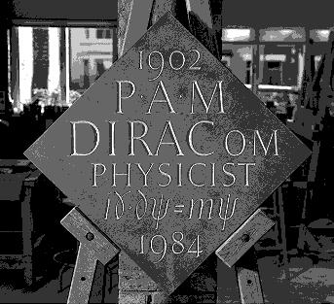
The Dirac Equation
On being plugged back into our original equation we get:
∂₀Ψ = (–iα^{k}∂_{k} + mβ)Ψ
Here Ψ represents a 4×1 matrix (called a spinor) with wavefunctions that satisfy Klein-Gordon.
Schrodinger and KG which are scalar could describe only spin 0 particles or particles in absence of magnetic fields.
Dirac incorporated spin automatically and could potentially be used to describe electrons subjected to both electric as well as magnetic potentials.
Arpan Saha, Sophomore, IITB, Engineering Physics with Nanoscience ,
Friday, November 5, 2010
Notes:
11/05/10
Positron- By: Arpan Saha, IITB,2010

Slide 17
Lorentz Covariance of Dirac
But we have to check whether it is Lorentz covariant or not.
For this we let β operate on Dirac throughout and define the Dirac matrices γ^{k} = βα^{k} while γ⁰ = β
We obtain (γ^{λ}∂_{λ} – 2m)Ψ = 0, which is manifestly covariant.
Hence, the Dirac equation conforms with STR.
Does it conform with QM as well? Let’s check.
Arpan Saha, Sophomore, IITB, Engineering Physics with Nanoscience ,
Friday, November 5, 2010
Notes:
11/05/10
Positron- By: Arpan Saha, IITB,2010

Slide 18
Probability Conservation
That the Dirac equation is first-order in time and space is straightforward.
The equation permits, when the matrices α^{k} and β are hermitian, a continuity equation.
The density is Ψ†Ψ, which consists of a positive definite entry that can be interpreted as probability density.
Probability can hence remain conserved.
Dirac is thus a happy marriage of QM and STR.
Arpan Saha, Sophomore, IITB, Engineering Physics with Nanoscience
Friday, November 5, 2010
Notes:
11/05/10
Positron- By: Arpan Saha, IITB,2010

Slide 19
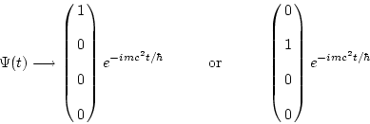

Solutions of Dirac
Consider a free electron at rest.
Four of the eigenspinors satisfying Dirac are as follows:
Arpan Saha, Sophomore, IITB, Engineering Physics with Nanoscience ,
Friday, November 5, 2010
Notes:
11/05/10
Positron- By: Arpan Saha, IITB,2010

Slide 20
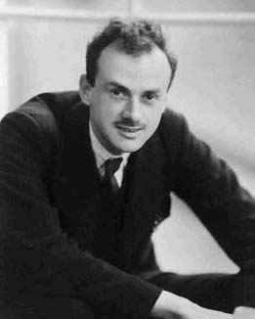
Negative energies?
It is easy to see that the first two correspond to positive energy states.
And the last two correspond to negative energy state.
Why is this a problem? Why can’t we just neglect the solution?
QM doesn’t permit us to do so, as electrons may jump into negative states and keep losing energy without ever hitting ground state.
Arpan Saha, Sophomore, IITB, Engineering Physics with Nanoscience ,
Friday, November 5, 2010
Notes:
11/05/10
Positron- By: Arpan Saha, IITB,2010

Slide 21
A way out?
Dirac suggested that the negative energy levels were already occupied by a ‘sea of electrons’.
Hence, electrons in ground state are unable to step down to lower energies.
But what if an electron from the Dirac sea got excited and left behind a ‘hole’.
This hole would have all the attributes of an electron except that it would carry the opposite charge.
Which brings us to where we started from.
Arpan Saha, Sophomore, IITB, Engineering Physics with Nanoscience ,
Friday, November 5, 2010
Notes:
11/05/10
Positron- By: Arpan Saha, IITB,2010

Slide 22
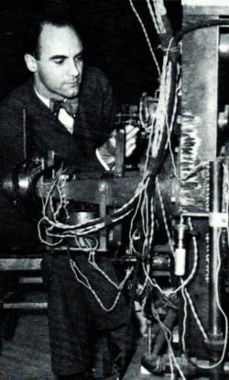
The Positron
Dirac was initially wary of his theory as there was virtually no literature pertaining to the observation of such a particle.
In 1932, Carl David Anderson, while investigating cosmic rays, chanced across particles that behaved exactly like Dirac’s holes.
Named the positron, it earned Anderson the 1936 Nobel Prize in Physics.
Arpan Saha, Sophomore, IITB, Engineering Physics with Nanoscience ,
Friday, November 5, 2010
Notes:
11/05/10
Positron- By: Arpan Saha, IITB,2010

Slide 23
Concluding Remarks
While the formulation in terms of ‘holes’ might seem to indicate some asymmetry, particles and their antiparticles are absolutely symmetrical.
An operation called charge conjugation takes one from a particle’s wavefunction to that of its antiparticle in the same potential.
In fact, as Feynman showed we might even regard antiparticles as particles traveling backwards through time.
Arpan Saha, Sophomore, IITB, Engineering Physics with Nanoscience ,
Friday, November 5, 2010
Notes:
11/05/10
Positron- By: Arpan Saha, IITB,2010

Slide 24
Bibliography
Dirac, P. A. M. (2004), Principles of Quantum Mechanics 4th edn, Oxford University Press
Feynman, R. P. (1967), The Character of Physical Law: The 1964 Messenger Lectures, MIT Press
Schwabl, F. (2004), Advanced Quantum Mechanics 2nd edn, Springer International
Srednicki, M. (2006), Quantum Field Theory, Cambridge University Press
Arpan Saha, Sophomore, IITB, Engineering Physics with Nanoscience ,
Friday, November 5, 2010
Notes:
11/05/10
Positron- By: Arpan Saha, IITB,2010

Slide 25
Thank you!
Arpan Saha, Sophomore, IITB, Engineering Physics with Nanoscience ,
Friday, November 5, 2010
Notes:
11/05/10
Positron- By: Arpan Saha, IITB,2010

