Slide 1
TECHNS
SHADOW MAKER

Slide 2
TEAM MEMBERS
Ram Charan Teja- 1st year, B.Tech, Civil Department
Pranay Kumar- 1st year, B.Tech, Mechanical Department
MSRK Teja- 1st year, B.Tech, Mechanical Department
Soovadeep Bakshi- 1st year, B.Tech, Mechanical Department

Slide 3
PROJECT ABSTRACT
Theme of Project: To capture a video on camera and project the silhouette of a moving object in the video on a screen.
Abstract: This project deals with the real-time manipulation of video captured through a camera using Processing. Initially, the camera captures the background, and then, our code takes the real-time video feed and compares it with the background image. If it finds any object(s) foreign to the background image, it projects the object’s silhouette on to the screen.
We have decided to extend the project further and actually modify our code so that we can use it for other purposes.

Slide 4
IDEA
The idea behind the project is basically entertainment.
For example, shadow dancing, where the shadow of the person who is dancing is projected on the screen.
Other possible applications have been discussed later.

Slide 5
COMPONENTS REQUIRED
Props Required: Camera, Projector, System
Software Used: Processing (Freeware developed by Casey Reas and Benjamin Fry, both formerly of the Aesthetics an Computation Group at the MIT Media Lab)
The camera and projector required are readily available. Also, as Processing is an OSS, our project requires absolutely zero spending!

Slide 6
PLAN OF ACTION
As all the four of us were completely incognizant of the field of image processing, we had decided to learn the basics of programming in Processing.
After completing the tutorial in the first two weeks, we proceeded to complete our basic project, i.e., projecting the silhouette of a moving object on screen, by the end of the third week.
As of now, we plan to develop further. We have decided on some applications of this project, which we plan to work on in the coming weeks.

Slide 7
PROGRESS
Week 1 (till 11th May):
The whole week was dedicated to completing the Processing tutorials. As mentioned in the PoA in the previous slide, all team members spent the first week getting acquainted with Processing syntax.
Week 2 (till 18th May):
In week 2, we continued with the tutorials. By the end of the week, we were almost done with the tutorials, i.e., we are, at present, quite comfortable with deciphering basic coding functionality in Processing.

Slide 8
Week 3 (till 25th May):
Throughout this week, we have worked on completing our basic objective, i.e., projecting a silhouette on the screen. We have completed this work.
Weeks 4 & 5:
As planned, we will continue to develop the project further, and we hope to implement our project for some practical uses.

Slide 9
APPLICATIONS
Shadow Dancing: Basically for entertainment. As the dancer performs, we take a continuous live video and the projector projects the silhouette of the dancer on the screen.
Motion Tracking: One of the applications of our code is motion tracking. By using a brightly coloured finger-cap whose colour does not match with the surroundings, we can track the motion of a finger in front of the camera. Here is a screenshot of the colour tracking application we have developed.

Slide 10
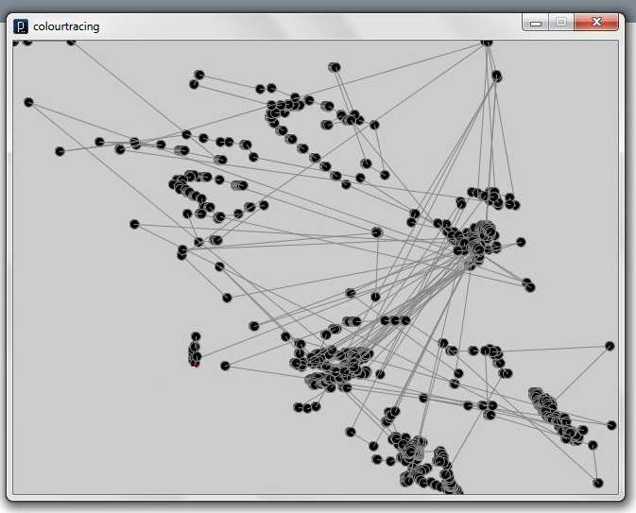

Slide 11
Gaming: We intend to use our motion tracking application in interactive gaming, with the player controlling with the motion of his finger.

Slide 12
REFERENCES
We have used the example sets included in Processing whilst writing our code. These examples contain many useful techniques and code snippets which have been really helpful.

Slide 13
THANK YOU
We would like to thank Ashay (our mentor) for his help, and the managers of the club for giving us the chance to learn something new.

