Slide 1

1RE03
Two Wheeled
Balancing Bot

Slide 2
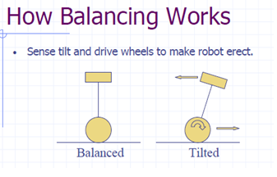
Tilt is sensed by sensors(accelerometer and gyroscope)

Slide 3

Arduino(ATmega 328)
Two axis Accelerometer(MMA6361L)
Gyroscope (LY510A)
L298D motor driver IC
LM 7805 IC
12V 150 RPM Johnson motor x 2
11.1V Li-ion battery

Slide 4

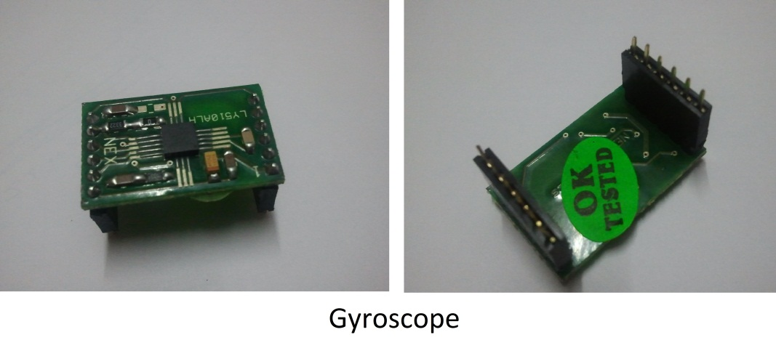
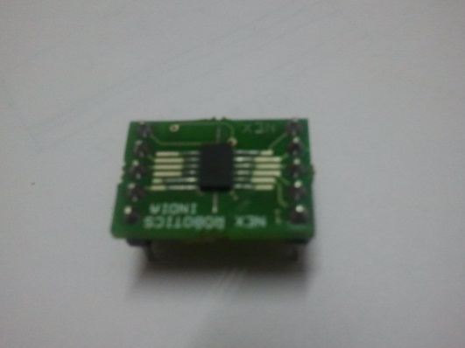
Accelerometer
Tilt angle is calculated using accelerometer and gyroscope independently.
The accelerometer cannot differentiate the horizontal acceleration of the bot from gravity, which gives error in the tilt angle.
Gyroscope gives the angular velocity, which on integrating gives the tilt angle.

Slide 5

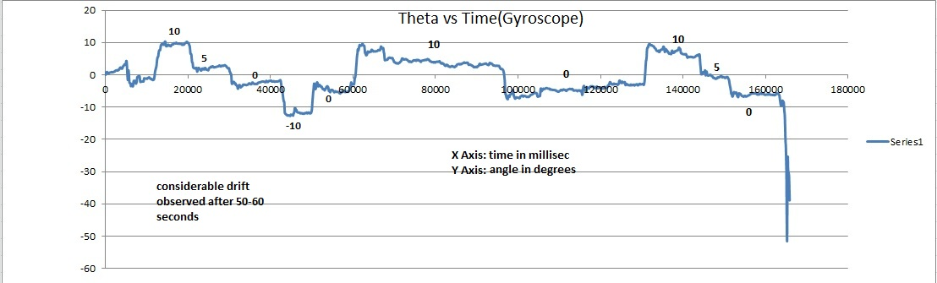
This is the first integrated output of the gyroscope giving the tilt angle.
After some time, considerable drift is observed.

Slide 6

A dynamic fluctuation is observed in the accelerometer readings.
Gyroscope readings drift with time.
A combination of both the readings is done using complementary filter.

Slide 7
Low pass filter is applied to accelerometer.
High pass filter is applied to gyroscope.
Mathematically, complementary filter looks like this:
Tilt angle = (1-a)*gyroscope + a*accelerometer;
Gyroscope = tilt angle;
where a is a small number

Slide 8
Complementary filter filters out the fluctuations of the accelerometer and also corrects the gyroscopic drift.

Slide 9

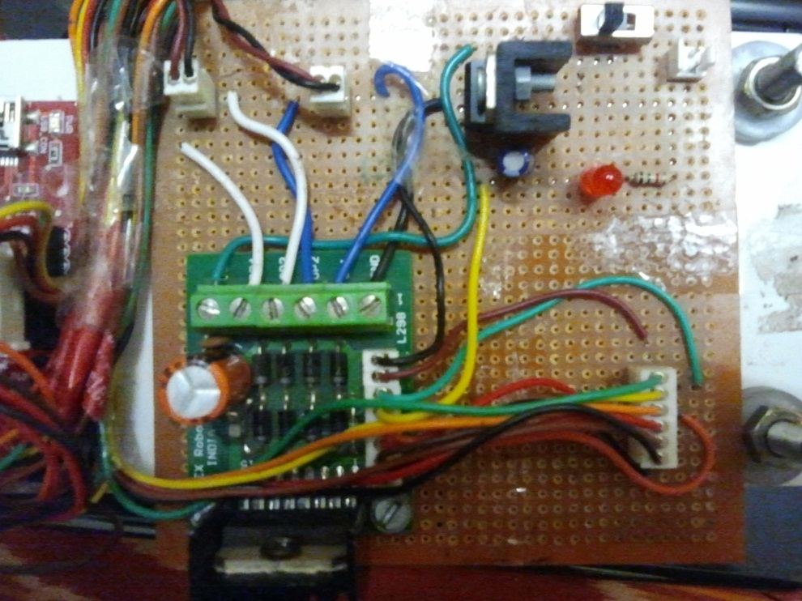
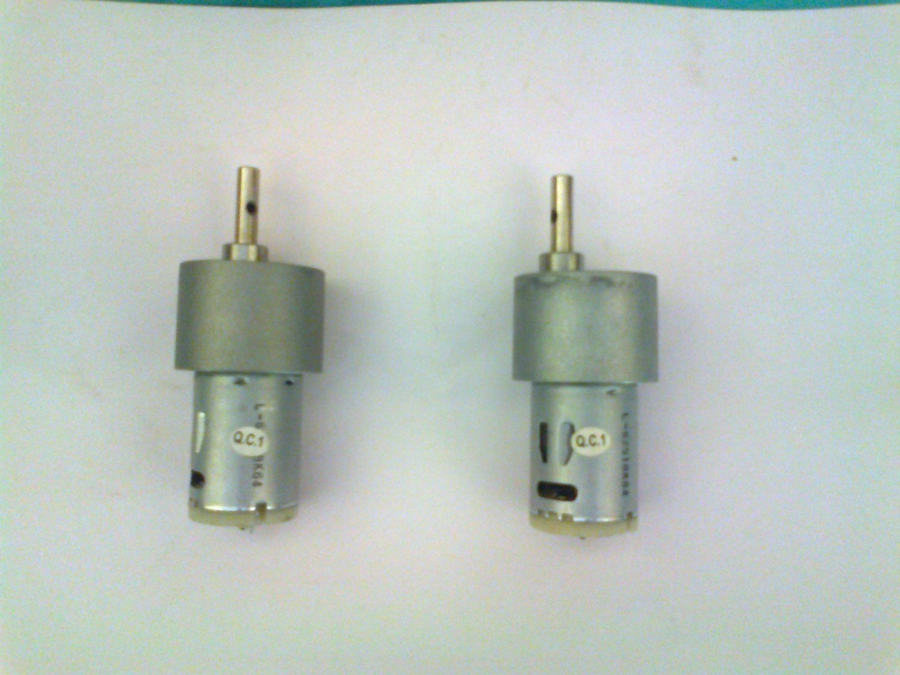
L298D motor driver ckt.
Johnson motors
L298D driver gives 2A current per channel.

Slide 10

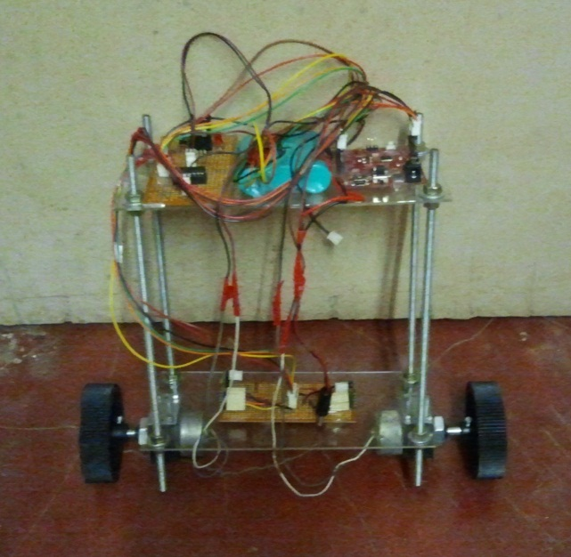
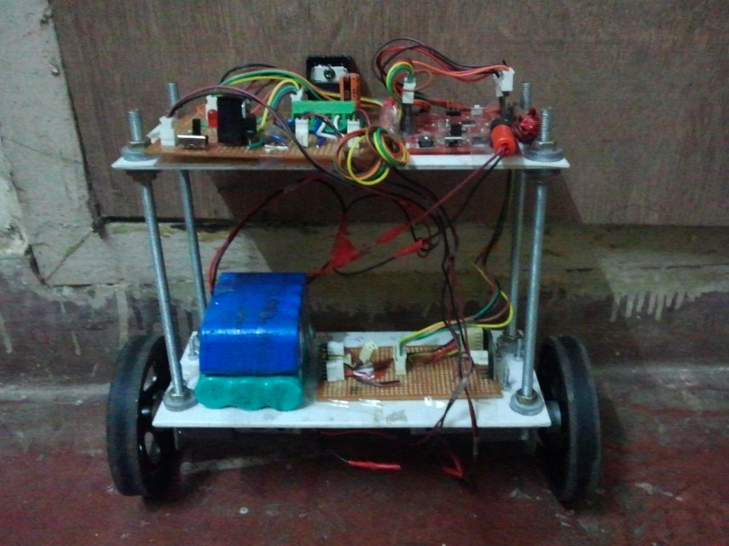
First chassis
Final chassis
Different combinations were tried by varying the position of the mass(batteries).
Height of the bot was reduced.

Slide 11

PD controller has been used for balancing the bot.
For greater precision we have used tan of tilt angle.
Mathematically, the PD controller looks like:
pwm = kp * tan(tilt angle) + kd * d/dt (tilt angle);

