Slide 1
Service Connector
Middleware for new EUREX IT platform
Jan Trnka, CEO

Slide 2
Actual situation
Current USP middleware is a key component
USP server runs on OpenVMS-Alpha only, this is end of life!
Framework with USP, ICS, TXS, TXR, ROFF, RCFM is cumbersome (too complex, not flexible, not scalable, proprietary protocol)
SWX speaks about USP replacement since 5 years. (without a visible progress, several evaluations have failed)
VCA – Wombat is not an option
=> New middleware is the starting point to renew the framework.
Notes:
After the merger of the SWX, Telekurs, SIS into the new SIX Group, things are getting worse for EUREX.
The operational costs are increasing as result of the internal overhead and incompetence
Developers are shared among other projects the cycle is longer, priorities are unclear and hard to set
New functionality required for the business takes ages to specify implement and to deploy
Eurex is 50% owned by SIX and is fully dependent on it.

Slide 3
Why not a standard product?
Standard product:
  Dos not cover requirements => customized extensions required (ownership & maintenance problem)
  Not a single product => cocktail of tools (compatibility issue, maintenance problem)
  Lot of features not used => maintenance overhead
Big impact on architecture => business impact
Big impact on interfaces => no smooth transition from old
=> There is no adequate standard product on the market

Slide 4
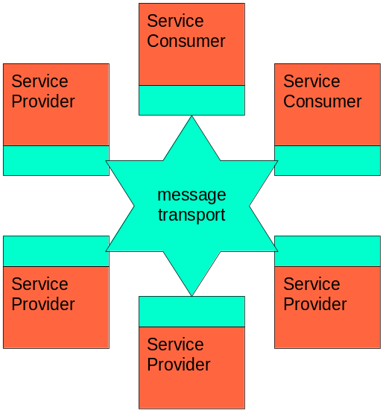
Goals
Part of EUREX business vision
First part of new EUREX IT platform
Designed for new services (SOA)
Allow transition from old
=> 1-st step to SwapVision

Slide 5
Key features
Simple and small => reduced to real business needs
Use of Standards => web standard protocol (http)
Use of Open Source components
Multiplatform => all java solution
Includes advanced Proxy => highly scalable
Optimized performance
Fits into existing infrastructure
Similar API to USP => seamless transition from old (server, client, proxy)
Designed for 24x7 operation and high availability

Slide 6
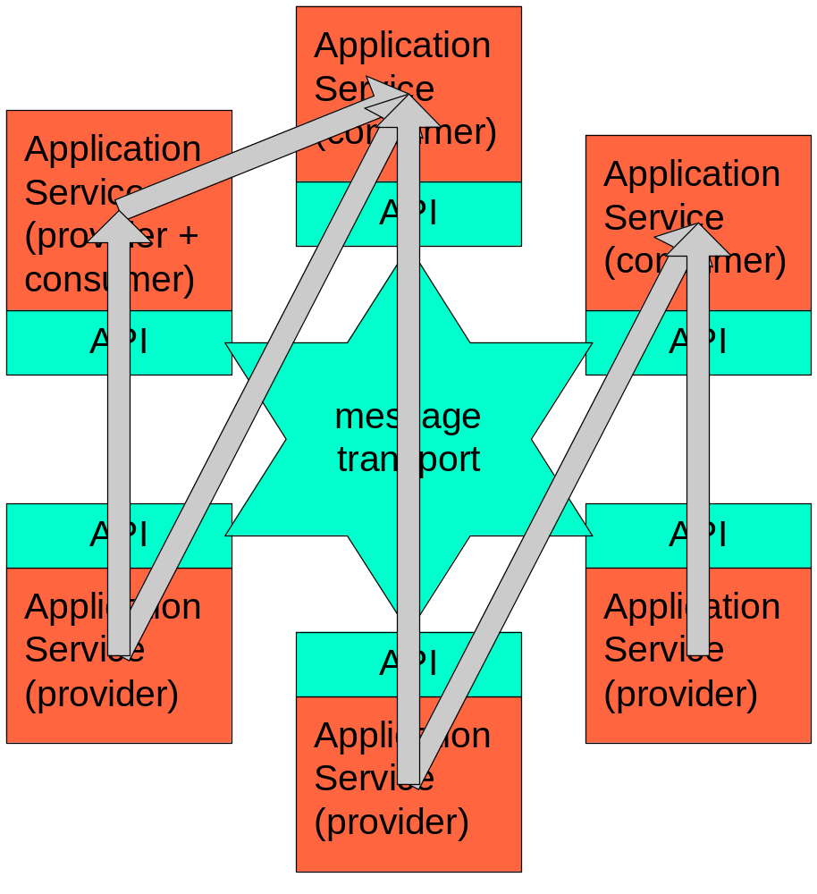
Schema
Service provider & consumer
Multi-role
Multi-peer communication
Synchronous + asynchronous
Push and Pull style
Messaging middleware (no data types, no marshaling)
Stateless, but virtual sessions for USP compatibility

Slide 7
Technical Features
Two communication styles:
  Request / Response (synchronous + asynchronous)
  Subscribe / Publish (asynchronous)
Gateway for non-java Applications (legacy code)
Proxy (optional) with
  Connection pooling (resource saving)
  Message Fan-Out (bandwidth saving)
  Message cache (reduced GUI start-up time)
  Central configuration (automatic deployment)
No persistency
No security features

Slide 8
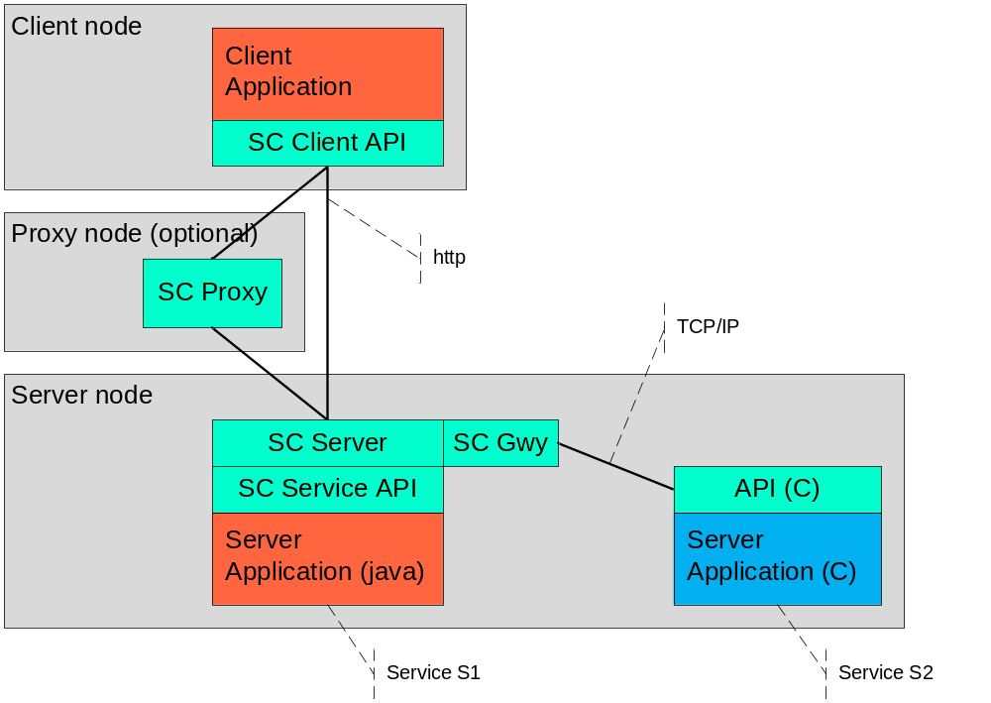
Service Connector components

Slide 9
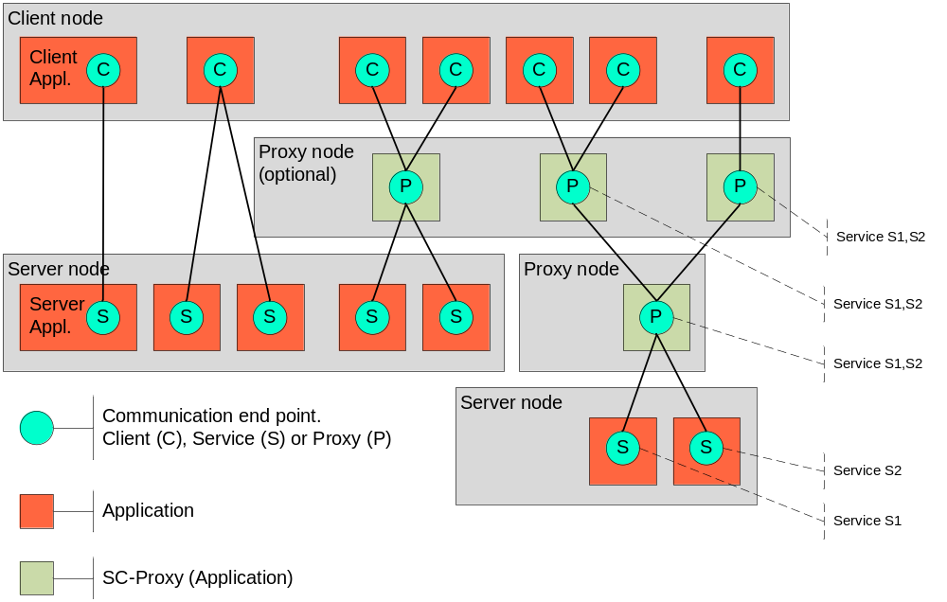
Topology

Slide 10
USP compatibility
    No infrastructure changes (to CVI or SCAP)
    Service Connector will run:
      on OpenVMS, parallel to USP
      on any other platform running Java 5
    Similar client API for Java, minimal code change
    Similar server side API, but need code change.
    Server applications connected via gateway
    Server process management not included in SC
    (replaced by scripts and tools for OPS)
    USP-Proxy replaced by SC-Proxy (+new features)

Slide 11
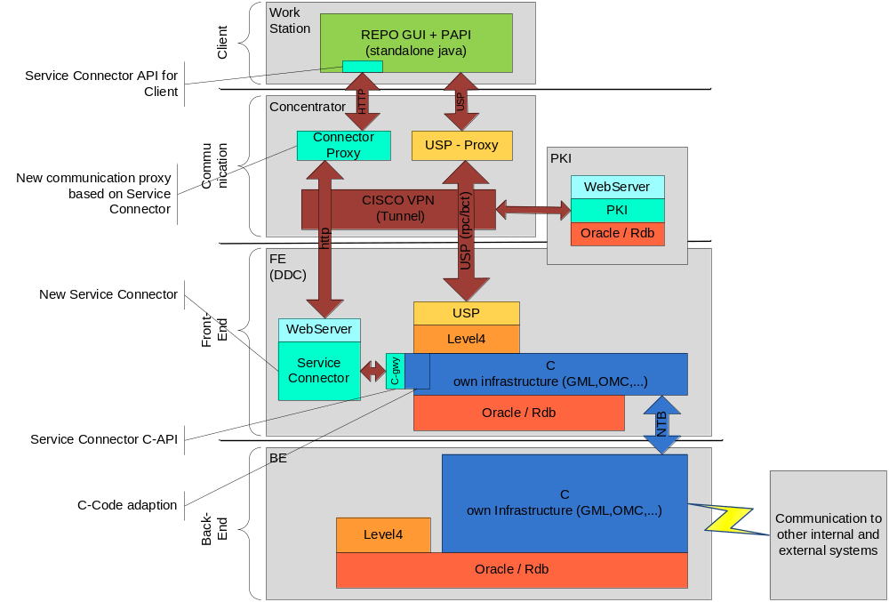
Deployment - Phase a) (starting 2Q2010)

Slide 12
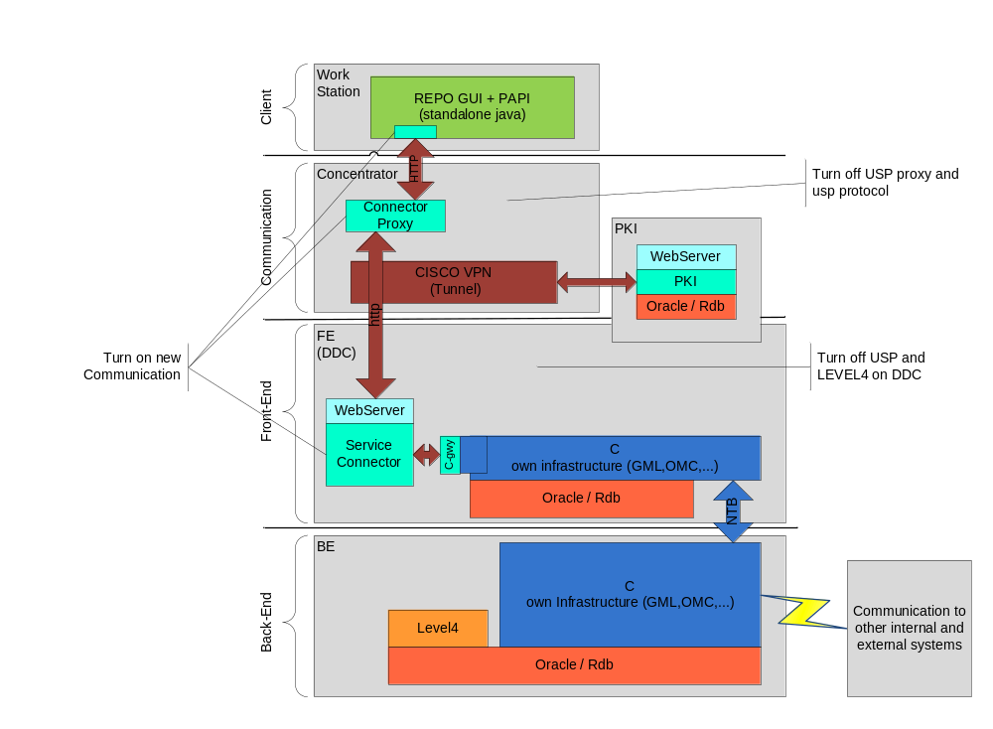
Deployment - Phase b) (starting 4Q2010)
Notes:
Turn on new communication via Service Connector
Turn off USP and Level4 on DDC.
LEVEL4 remains in Back-End for CUI

Slide 13
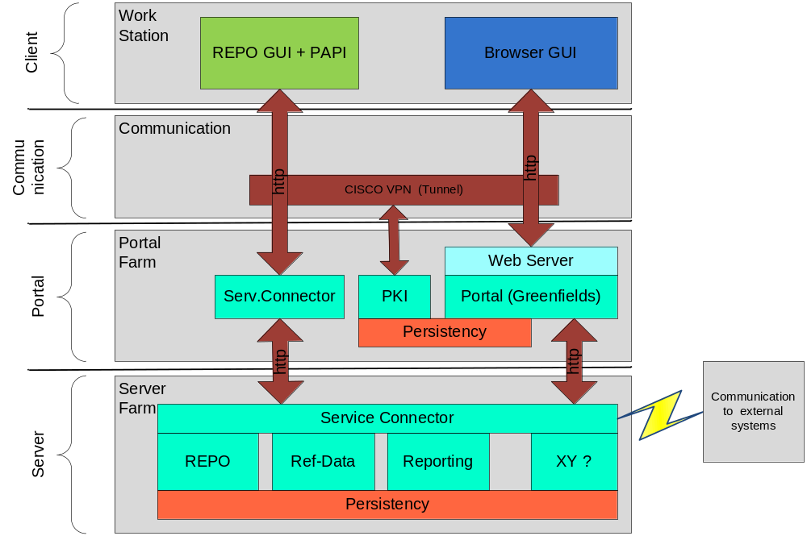
Final future picture

Slide 14
Project
    Phases:
    Development
      Finalize concepts (by Sep. 2009)
      Develop & test software (by Feb. 2010)
    Deployment
      Deploy and migrate old to new (by 2Q2010)
      Finish transition, turn off USP (by 4Q2010)
Development cost (Phase 1) ca. 350k CHF
Deployment cost (Phase 2) depends on SIX

Slide 15
Open issues:
Resource collision with RM12?

