Slide 1

Timelink Browser game
TEAM 2:
TimeShifters

Slide 2
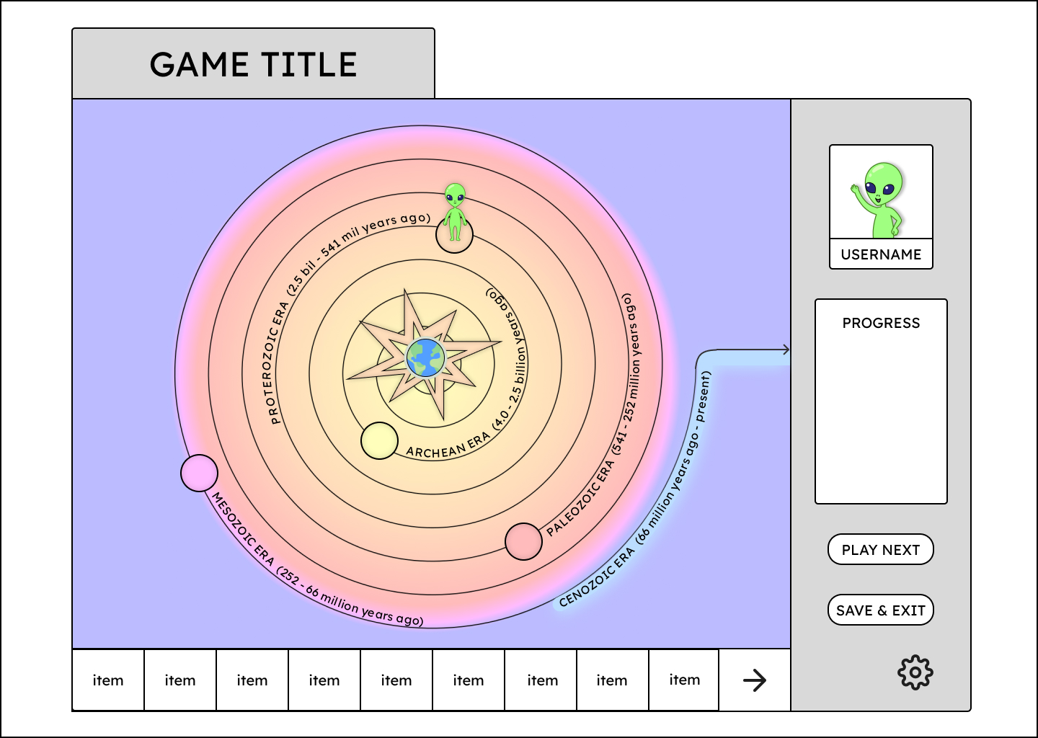
Overview of the idea
Objective: Develop a small, interactive browser game where users navigate a boardgame–like map.
The playground field consists of different ages/eras in Earth history, which user needs to pass through to win.
On every move user gets a new task to solve. Every correct answer allows to continue the movement along the Timelink.

Slide 3
Team. Expected roles
Team: Hossain, Saara, Stefanie, Vladimir
Frontend Developer: building the UI, components, and user interactions. Hossain, Saara, Stefanie, Vladimir
Backend Developer: setting up the server, database, and API endpoints. Hossain, Vladimir
Game Designer: game mechanics, content creation (story, tasks), and user experience. Easter eggs. Saara, Stefanie, Vladimir
Art Designer: finds and creates images and designs to make the game look fine. Saara
Tester(s): tests the result of every bit of code. Hossain, Stefanie
Project Manager/First Scrum Master: oversees project timelines and documentation. The only person who can merge. Stefanie

Slide 4
What is this project about? Problem to solve?
Timelink is an interactive game where players learn about history by solving puzzles/minigames related to different time periods, aiming to win by getting through Earth history to the present moment.
By blending history with interactive gameplay, Timelink aims to make learning about the past more engaging and accessible, allowing players to actively participate in uncovering historical knowledge in a way that feels like a fun, little adventure.
Real aim: our team members will learn how to work in cooperation with other developers.

Slide 5
What features are planned to be in MVP?
Interactive map: a basic 2D map where players can move tile by tile.
Riddles and tasks: simple puzzles linked to different historical periods in every tile.
User Authentication: login system to save progress across sessions.
Progress tracking: player’s advancement through historical eras stored in database.
Scoring system: rewards awarded for solving riddles and completing tasks.
Sound design: some music on the background and sound effects like steps across the map.

Slide 6
What tech will you use?
Version control: GitHub
Project management: Trello
Prototyping and creating UX/UI: Figma
Frontend: React
Backend: Node.js with Express
Database: MariaBD
Style guide: decide later
Additional Libraries (optional):
Phaser.io framework for gameplay mechanics
Axios for API calls (obviously there are APIs with riddles)
Passport.js for authentication
ReactPlayer for background music
Some CSS framework decide later
External APIs:
Background music API: https://audiomack.com/data-api/docs
“Historic facts" API: decide later

Slide 7
Risk management
Scope:
Risk: delay in MVP realisation
Solution: Stick to MVP features as outlined. Set a "point of no return" after which no new features can be added, only refined.
Technical Challenges:
Risk: the project is too difficult for us.
Solution: Break down the project into manageable components, use existing libraries, prioritize essential tasks.
Content:
Risk: implementing controversial or doubtful historical facts
Solution: start with general, well-known historical facts for the MVP. Delegate content research to team members who have expertise.
Time Management and Team Coordination:
Risk: workloads could be challenging
Solution: assign clear roles and deadlines. Regular meetings will help ensure everyone is on track, workload is divided fairly and allow quick adjustment for any roadblocks.
Game Art and Visual Consistency:
Risk: lack of artistic resources might make the game appear inconsistent or just pathetic.
Solution: Use open-source and royalty-free art resources. Simplify the design to keep it cohesive if original art resources are limited.

Slide 8
Scrum meetings timetable Communication channels
Where:
MS Teams
When:
Every Monday and Thursday at 15:05
Duration:
30 minutes

Slide 9
Collaboration rules
Clear role assignments: each team member is responsible for specific tasks. Respect role boundaries, collaborate when help is needed.
Regular check-ins: regular team meetings to discuss progress, roadblocks, and upcoming tasks. Priorities and timelines update.
Documentation: document code, design decisions, and tasks.
Code reviews: test all code locally before submitting it for review. Code should be reviewed by at least one other team member before merging.
Commit messages: clear and descriptive commit messages. Use a consistent format.
Communication etiquette: be clear and concise, respect each other’s time.
Respect deadlines: meet deadlines for assigned tasks or communicate early if more time is needed.
Decision-making: major decisions require team input and consensus. A majority vote can be used.
Supportive environment: encourage asking questions and offering help. Constructive feedback is welcome.
[type]: | [short description]
add | a new feature or enhancement
fix | a bug fix
docs | documentation changes or updates
style | changes that do not affect the logic (e.g., formatting, spacing)
refactor | code changes that neither fix a bug nor add a feature
delete | remove something
PULL FIRST!!!

