Slide 1

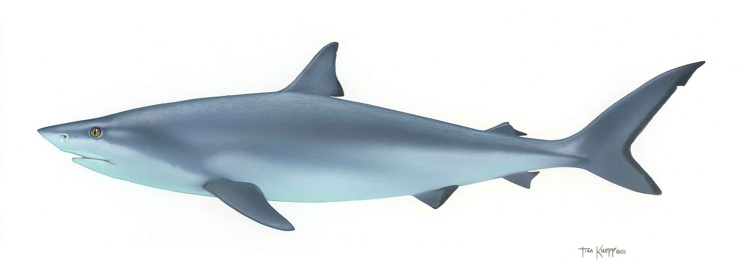
Shark Attacks
The World of Data:
This Photo by Unknown Author is licensed under CC BY-SA

Slide 2
Shark Attack Questions:
Location:
Are shark attacks seasonal?
Where are the shark attacks located?
Victim:
Are there more male or female victims?
Are certain activities more dangerous?
Does the activity play a part in fatality result?
Sharks:
Are certain sharks more prevalent to attack?
Which shares are more prevalent to have fatal attacks?

Slide 3
Location

Slide 4
Victim

Slide 5
Shark Types

Slide 6
Weather

