Slide 1

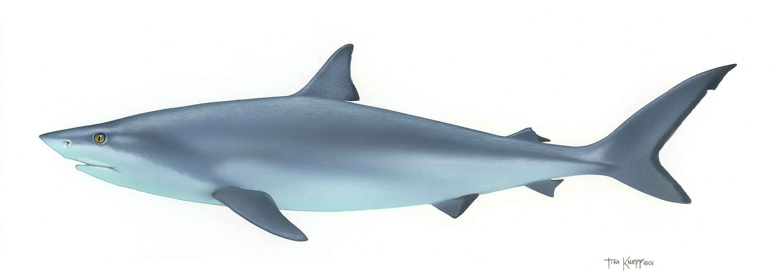
Shark Attacks
The World of Data:
This Photo by Unknown Author is licensed under CC BY-SA

Slide 2
Shark Attack Questions:
Location:
Are shark attacks seasonal?
Where are the shark attacks located?
Victim:
Are there more male or female victims?
Are certain activities more dangerous?
Does the activity play a part in fatality result?
Sharks:
Are certain sharks more prevalent to attack?
Which shares are more prevalent to have fatal attacks?

Slide 3
Cleansing the Data
Utilized Case ID to create a Date column. Any that could not be reasonably determined was dropped along with post 1975: The Year of Jaws.
Rough start of grouping similar activities together. Checked other columns for potential cleanup need.
Export to CSV to use for analysis.

Slide 4
Location

Slide 5
Location

Slide 6
Victim
Finalized cleaning of Type, Activity, Sex, Age, and Fatal columns.
Reorganized Injury column to remark type of injury: Severe, Minor to Moderate, and None
Questions to answer:
Which activity results in the most shark attacks?
Which gender is attacked the most?
Which gender provokes attacks the most?
Which age group have the most fatalities?
Are there more injuries when attacks are provoked?

Slide 7
Victim

Slide 8
Victim

Slide 9
Shark Types

Slide 10
Shark Types

Slide 11
Weather

