Slide 1

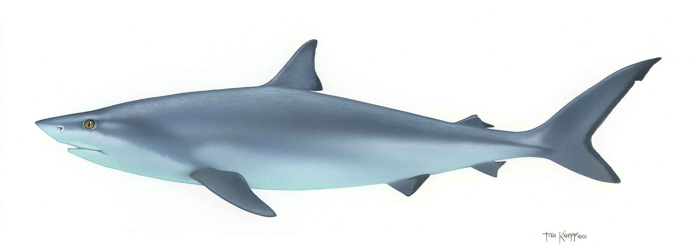
Shark Attacks
The World of Data:
This Photo by Unknown Author is licensed under CC BY-SA

Slide 2
Shark Attack Questions:
Location:
Are shark attacks seasonal?
Where are the shark attacks located?
Victim:
Are there more male or female victims?
Are certain activities more dangerous?
Does the activity play a part in fatality result?
Sharks:
Are certain sharks more prevalent to attack?
Which sharks are more prevalent to have fatal attacks?

Slide 3
Cleansing the Data
Utilized Case ID to create a Date column. Any that could not be reasonably determined was dropped along with post 1975: The Year of Jaws.
Rough start of grouping similar activities together. Checked other columns for potential cleanup need. Removed columns that were unneeded for project.
Export to CSV to use for analysis.

Slide 4
Location
Finalized cleaning of Location, Country, and Area columns. Created bins for time periods.
Questions to answer:
What location has the most shark attacks, focusing on USA?
Does the season of the year affect the likelihood of being attacked?

Slide 5
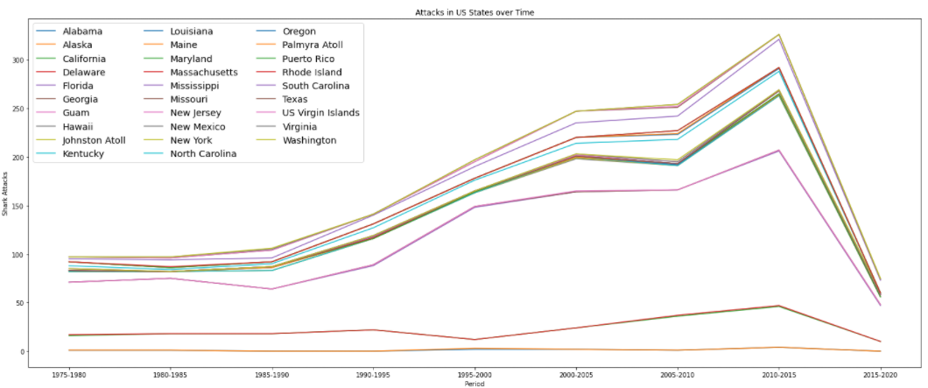
Location

Slide 6
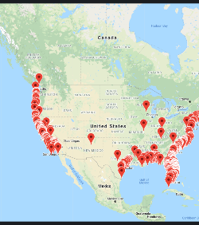
Location
As expected, most shark attacks are along the coastal regions.

Slide 7
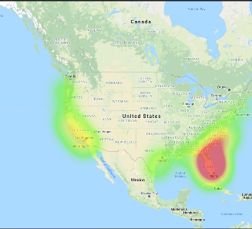
Location
Most US attacks are in the Florida alongside Georgia and South Carolina

Slide 8
Victim
Finalized cleaning of Type, Activity, Sex, Age, and Fatal columns.
Reorganized Injury column to remark type of injury: Severe, Minor to Moderate, and None
Questions to answer:
Which gender is attacked the most?
Which activity results in the most shark attacks?
Which gender provokes attacks the most?
Are there more injuries when attacks are provoked?
Are most attack injuries severe?
Which age group have the most fatalities?

Slide 9
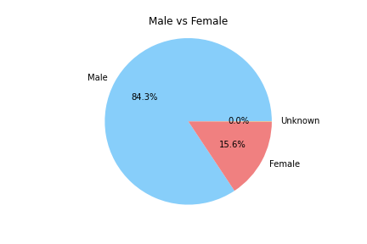
Victims by Gender
2513 attacks to male
466 attacks to females
1 attack unknown gender
This was reported as “lli” where definition could not be found

Slide 10
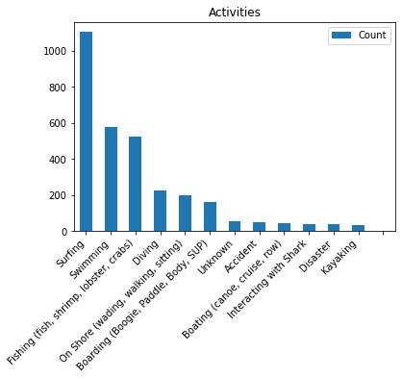
Victims by Activity
Sharks prefer attacking surfers over all other activities
Data was grouped by activity type as best as possible.
Accidents: unintentional
Disasters: weather, intentional
Unknown: included reports where context was unknown such as Batin and Cruising

Slide 11
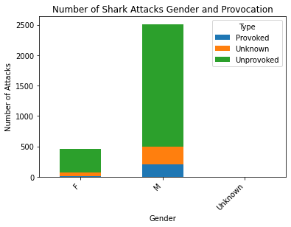
Gender Provoking
Males provoked sharks the most
Most attacks were unknown on whether the victim provoked the sharks or not

Slide 12
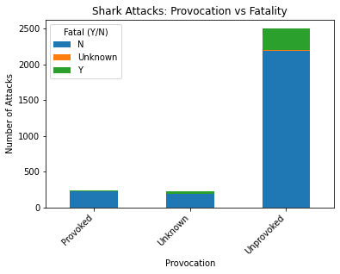
Fatality by Provoking
Overall, most attacks were not fatal
Most fatalities were unprovoked attacks

Slide 13
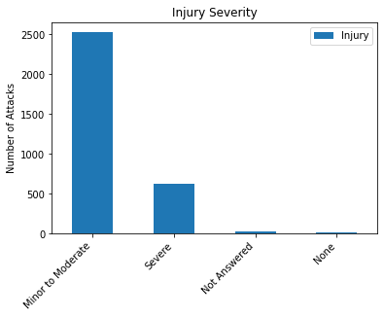
Injury Severity
Most injuries are minor to moderate
Data breakdown:
Severe = broken bones, missing limbs, loss of life
Mild to Moderate = all other injuries including scratches and bite marks
None = no injuries, speculation, media involvement without facts
Unknown = no reports

Slide 14
Shark Types
Finalized cleaning of Species column, utilized cleaned Fatal column, merged Fatal and Species.
Questions to answer:
Which shark species attack the most?
What shark types have the most fatalities?

Slide 15
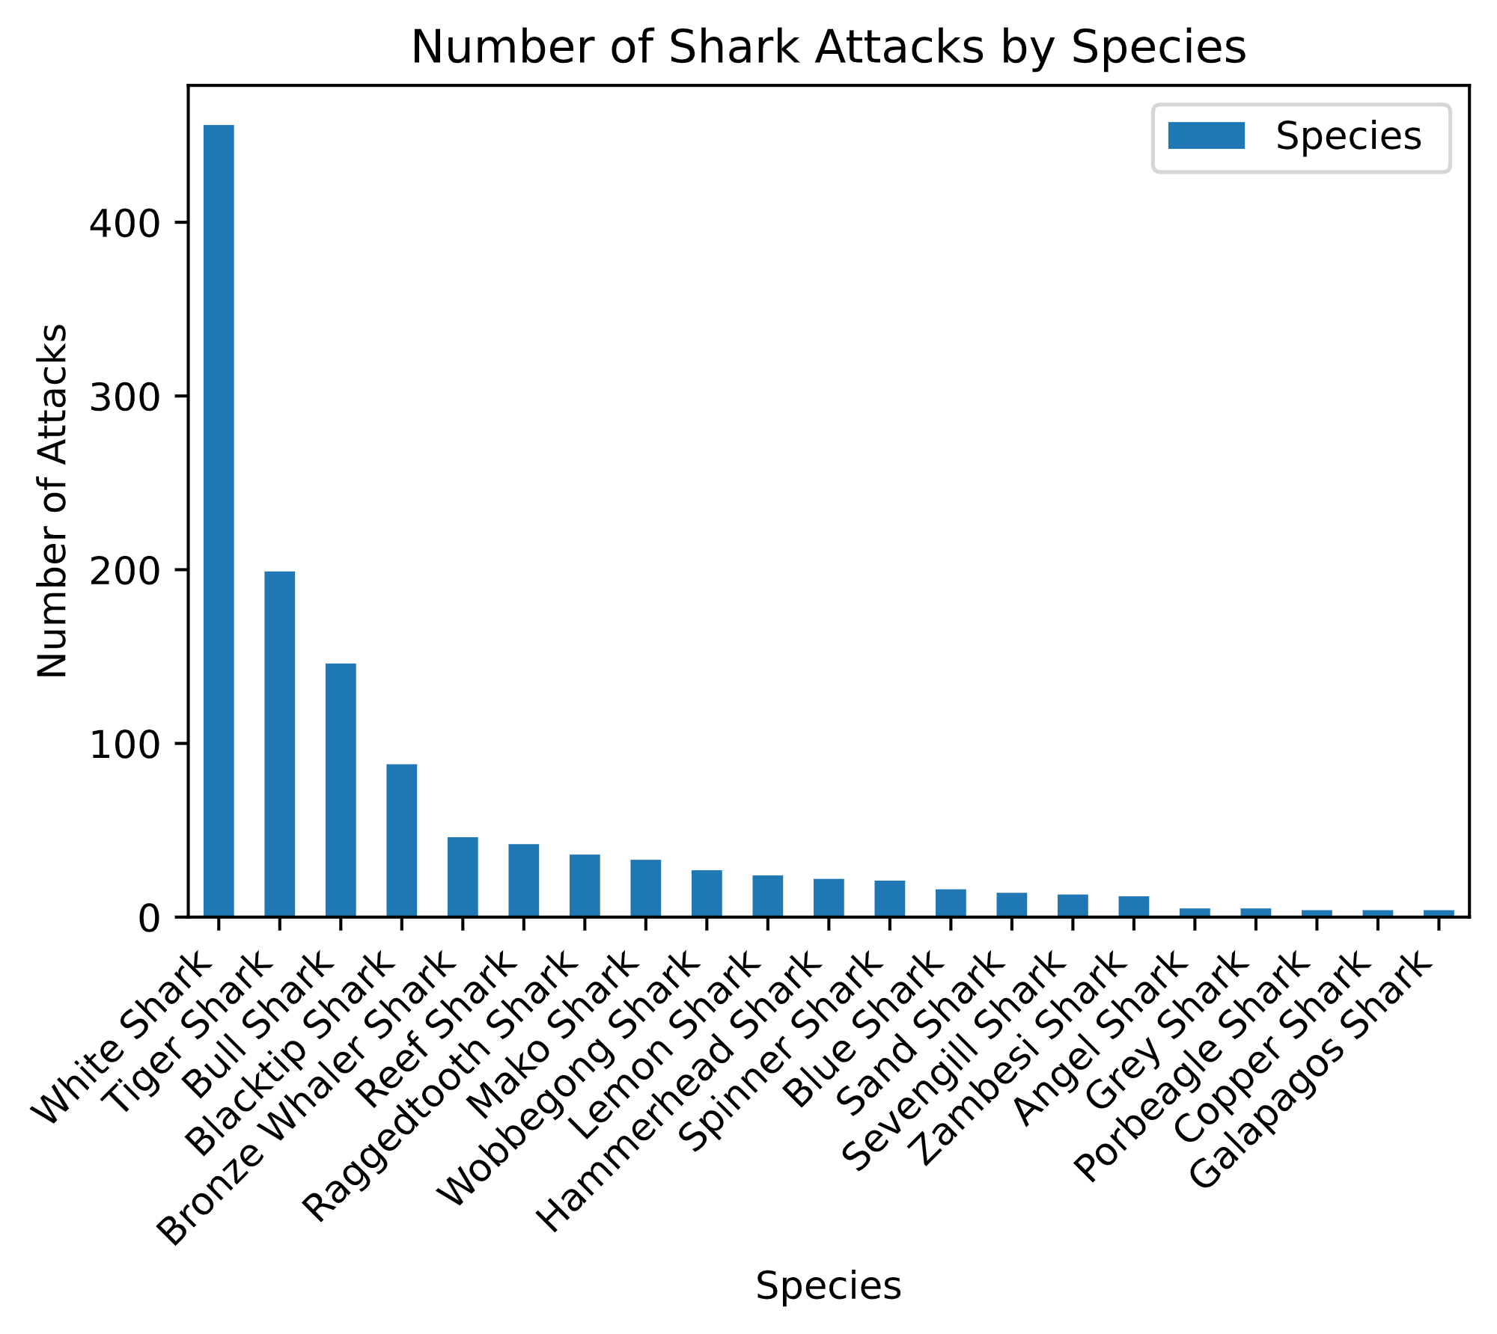
Shark by Species
White Sharks had the most attacks, followed by Tiger Sharks
Chart includes only species that had more than 3 attacks

Slide 16
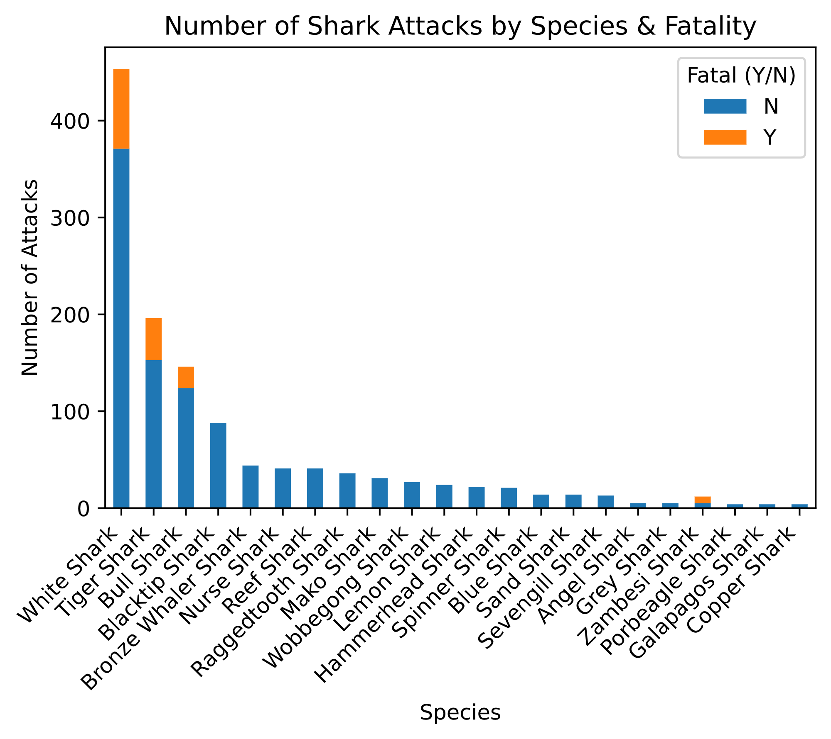
Shark Species vs Fatality
White Sharks are the most fatal followed by Tiger Sharks
Data complications: most descriptions were by shark size and not by species

Slide 17
Weather
TBD
Use of API to obtain historic weather for location by groups and compare with number of attacks
Analyze if storms increase shark attacks

