Slide 1

Stagha Sandwiches
A site to order ice cream sandwiches so they’re ready for pickup when you arrive at the store.
By Stacie & Megha

Slide 2

Triumphs
We have a working site!
CSS is always a triumph.
Resolved Team Issues.
We survived project 1.

Slide 3

Challenges
The destroy and update functions were the most difficult.
Embedding AJAX calls.
Branch merging on GitHub.
Learning to work as a pair.

Slide 4
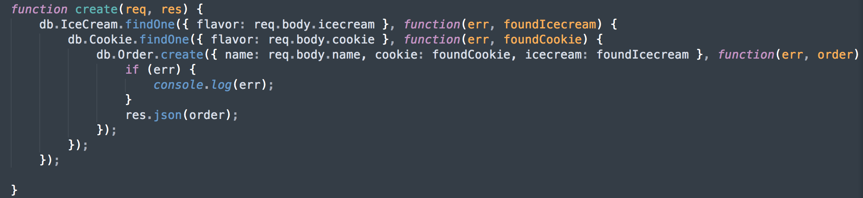
Standout Code
Embedded controllers:

Slide 5
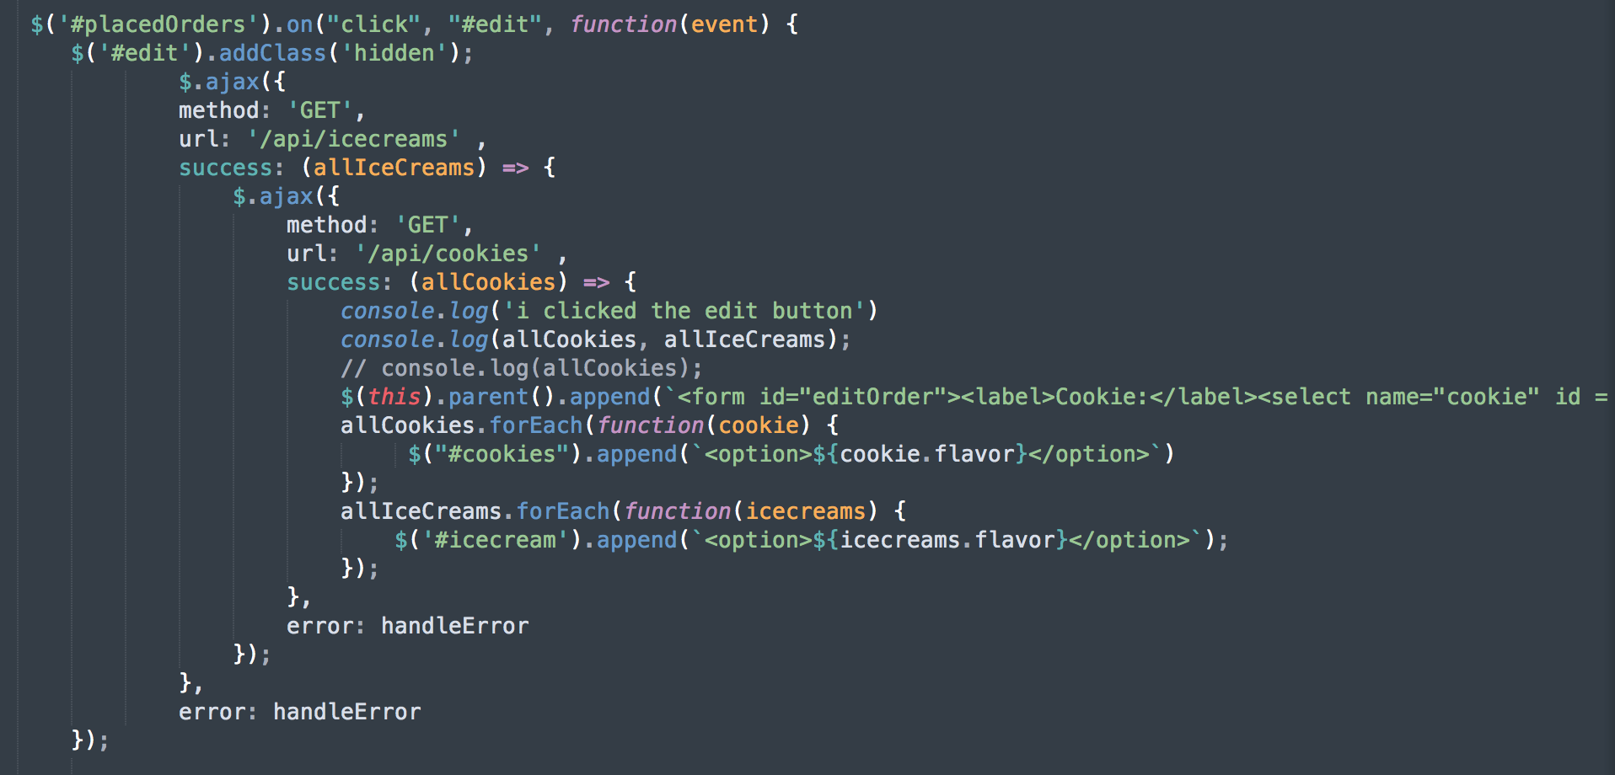
Standout Code
Nested AJAX Calls:

Slide 6
ShoutOuts
Thanks Dave & Jacob for helping us push to Heroku
Thanks Esther for all the help.
Thanks Faisal for some of the help.

