Slide 1

OOP PROJECT
MEGAMAN
MEMBERS:
Võ Ngọc Duy Nguyên ITITIU19167
Nguyễn Hữu Luân ITITIU19027
Nguyễn Thiên Bảo ITITUN19014
DEMO: 4/1/2021

Slide 2

Our GitHub Link
Link: https://github.com/stackTsi/MegamanXDemoProject

Slide 3
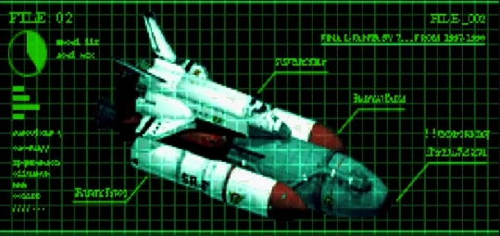
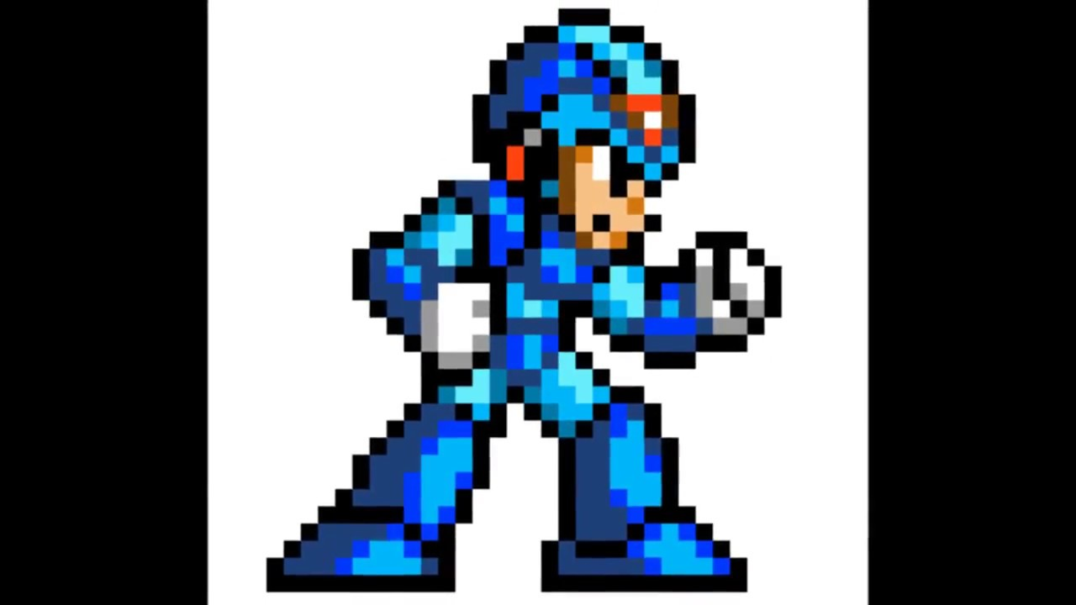
Game Introduction
Megaman X’s spaceship had crashed near an excavation site. His X-Buster is down and he needs to collect all 6 Energy Cores to reboot his weapon and repair his ship.
In this mini-game, the player controls X to collect all the Energy Core while escaping from Batton Bones to exit the cave.

Slide 4
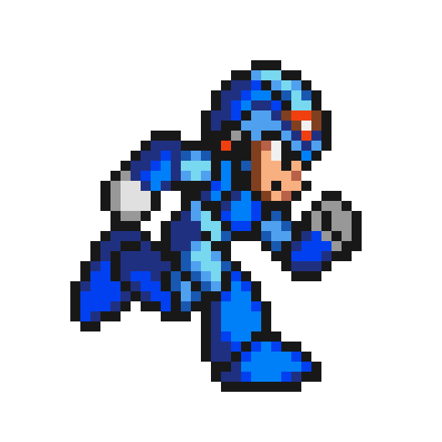
Abilities
MOVING
Press ⇦ to move left and ⇨ to move right

Slide 5
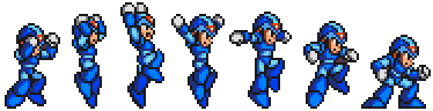
JUMPING
Press X to make character jumping, the longer you press the higher he jumps

Slide 6
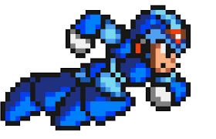
DASHING
It is the ability to moving for short distance with high speed, player press Z to use it.
It also can combine with X ( Jumping ) to make a combo for evading enemies.

Slide 7

Energy Cores
Player must collect total 6 Energy Cores to win this game. A Counter will be on the top-left of the screen.

Slide 8
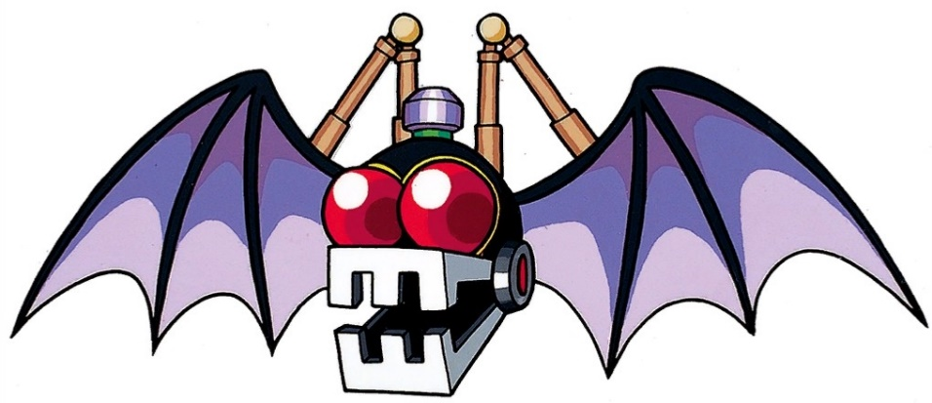
Enemies
Batton Bone
They are a battle robot ,which simulate bat, appear around cave and will fly toward player if player in their vision
They will chase player, if having a impact the player will be killed and the game is over.
Therefore, player must combine their abilities to evade them

Slide 9




Project’s Engine:
For coding:
HAXE, HTML
For design:
Ogmo Editor, HaxeFlixel

Slide 10


Thank you for watching our Demo

