Slide 1
MODELLING THE EFFECTS OF RUSSIA UKRAINE WAR ON THE COST OF DOMESTIC BORROWING
USING THE VASICEK MODEL

Slide 2
RESEARCH PROJECT PARTICIPANTS
OCHADIA BILLY LIVINGSTONE
SIMBA KAUME
ANTON ODONGO
SAMSON CERULLO

Slide 3
ABSTRACT
The purpose of this study is to analyze the effect of Russia-Ukraine war on the cost of borrowing using the commercial banks’ lending rate. A descriptive design was used where the monthly commercial bank lending rate data for the period from 1997 to 2022 was used to build the model. The monthly lending rate data for the period from 1997 to 2022 was obtained from the Central Bank of Kenya website.
Two mathematical models were used to model the dynamics of commercial banks’ lending rate to the cost of borrowing. The Vasicek model which incorporates the logic of mean-reversion and applies it to interest rate dynamics. The model was calibrated using the simple ordinary least squares regression (OLS). The fitted model had a convergence parameter α, which shows the speed at which the model reverts back to the mean and variance parameter which shows the volatility of the model. The model was then used to estimate future lending rates.
Results revealed that, in terms of impact of estimated parameters on volatility and lending rate forecast we can see that the more the stochastic factors impact the lending rate in the short run the more volatile the lending rate is affected in the long run, but also the smaller the convergence parameter α is, the larger the variance would be. If the convergence speed is very low the lending rate can deviate for quite a long time unpredictably from the equilibrium level. These results show that small disruptions on financial systems like war can have significant effects on lending rates of commercial banks.

Slide 4
CHAPTER ONE INTRODUCTION

Slide 5
BACKGROUND OF THE STUDY
Russian president Vladimir Putin has repeatedly made clear that he considers Ukraine’s place to be under Russia’s thumb. That was its position from the day of Russian Empire under Catherine the Great in the 18th Century through the nation’s share history in the Soviet Union.
After the dissolution of the Soviet Union (USSR) in 1991, Ukraine and Russia maintained close ties. In 1994, Ukraine agreed to accede to the treaty on the Non-proliferation of nuclear weapon as a non-nuclear weapon state. Former Soviet nuclear weapons in Ukraine were removed and dismantled. In return, Russia, United Kingdom and the United States agreed to uphold the territorial integrity and political independence Ukraine through the Budapest Memorandum on security assurances.
In 1999, Russia was one of the signatories of the charter for European security which “reaffirmed the inherent right of each and every participating state to be free to choose or change its security arrangements, including treaties of alliance as they evolve.
The 2004 Ukrainian presidential election was controversial. During the election campaign, opposition candidate Victor Yushchenko was poisoned by TCDD dioxin, he later implicated Russian involvement.

Slide 6
BACKGROUND OF THE STUDY
At the 2008 Bucharest summit, Ukraine and Georgia sought to join the North Atlantic treaty Organization (NATO). The response among NATO members was divided; Western European countries opposed offering Membership Action Plan (MAP) in order to avoid antagonizing Russia, while US president George w. Bush push for their admission. NATO ultimately refused to offer Ukraine and Georgia MAPs. Putin received strong opposition to Georgia’s and Ukraine’s NATO membership bids. By January 2022, the possibility of Ukraine joining NATO remained remote.
The Russo-Ukrainian war has been ongoing between Russia (alongside Russia separatists in Ukraine) and Ukraine since February 2014. Following Ukraine’s Revolution of dignity, Russia annexed Crimea from war in Donbas against Ukrainian government forces; fight for the first eight years of conflict also included naval incidents, cyber warfare and heightened political tensions.
In February 2022, the conflict was a major escalation as Russia launched full scale invasion of Ukraine.

Slide 7
STATEMENT OF THE PROBLEM
Economic shockwaves have been felt across all industries as penalties from the EU, the US, and many other countries ramp up on the Russian Federation. Energy prices are rising, stock prices are falling, supply chains are collapsing and inflation has reached record levels. These recent events have led to increased demand for haven assets, strengthening the US currency. The local currency neared a low of 114 and is expected to weaken further as the US prepares to hike interest rates. Kenya is looking at higher debt repayment and cost of living as the shilling remains vulnerable to the US Dollar, which is gaining from the Russia-Ukraine war. According to the latest statistics of the Kenyan shilling by Forecast Economics, accelerating inflation in the U.S. over the past few months and the Fed’s increasingly hawkish tone have raised expectations of a sooner-than-anticipated rate hike.
The Russia-Ukraine war, in all its dimension, is producing alarming cascading effects to a world economy already battered by Covid-19 and climate change with particular dramatic impacts on developing economies like Kenya. The Kenyan economy is a commodity market implying it generates most of its revenue through commodity export. The sanctions against Russia directly impacts Kenya with disruption in trades of Kenya primary commodities.

Slide 8
STATEMENT OF THE PROBLEM
These disruptions have led to collapsing supplying chains and high energy prices which come with price implications therefore leading to high inflation. On October 2022, Kenya recorded an all-time high 12-month inflation of 9.59. To curb this high inflation the CBK increased the CBR rate which is the rate published by the Central Bank of Kenya under the provisions of the Central Bank of Kenya Act as the lowest rate at which the Central Bank lends money to Banks in Kenya and which has been adopted as the base rate under the provisions of the Banking (Amendment) Act, 2016. A hike in the CBR rate causes the Commercial Banks to increase the lending rate which raises the cost of borrowing money to curb the demand for goods and services.
Consequently, this study seeks to investigate if there is any significant effect of Russian-Ukraine war on the cost of domestic borrowing using the commercial banks’ lending rate. To investigate the effect of Russian-Ukraine war on the cost of domestic borrowing using commercial banks’ lending rate, we need a term-structure model with mean reverting behavior and constant volatility and can fit historical data adequately, produce realistic dynamics and can be calibrated easily to current market lending rate data for which the appropriate model was the Vasicek model (1977).

Slide 9
OBJECTIVE OF THE STUDY
Based on term-structure model (Vasicek model), the objective of this study is to establish the relationship between Russia-Ukraine war on the cost of domestic borrowing using commercial banks’ lending rate.

Slide 10
SIGNIFICANCE OF THE STUDY
The Central Bank’s monetary policy decisions are made to maintain a low and stable inflation rate over time which is an indication of price stability. According to the Central Bank of Kenya the CBR is reviewed and announced by the MPC at least every two months. Movements in the CBR, both in direction and magnitude, signal the monetary policy stance. Whenever the Central Bank is injecting liquidity through Reverse Repo, the CBR rate is the lowest acceptable rate by law. Likewise, whenever the Bank wishes to withdraw liquidity through a Vertical Repo, the CBR rate is the highest rate that the CBK will pay on any bid received.
However, to ensure flexibility and effectiveness of monetary policy operations in periods of volatility in the market, the CBK can raise the maximum acceptable interest rates on Term Auction Deposit to above the CBR. Movements in the CBR rate are transmitted to changes in short-term interest rates. Lower interest rates encourage economic activity and thus growth. When interest rates decline, the quantity of credit should increase.
This study is important in the following ways:
The Central Bank will be able to find out the level of impact of its monetary policy especially interest rates on the cost of borrowing.
Potential investors will be able to anticipate the impact of changes in interest rates on the cost of capital & capital returns.
Financial sectors like banks, insurance companies and brokerage firms will be able to curate new products based on short- & long-term interest rates.
The finding of the study will give the national government, domestic and foreign investors, financial market players an insight on the magnitude of impact of Russia-Ukraine war and its consequences to access to capital.

Slide 11
CHAPTER TWO LITERATURE REVIEW

Slide 12
Introduction
Several scholars have tried to analyze the impact of conflicts on financial systems across the world. Towards this end this chapter tries to look at some of the theories about interest, criticisms, plus the major findings and conclusions obtained. This chapter is organized into two sections; theoretical literature and empirical literature.

Slide 13
REVIEW OF THEORIES NEO-CLASSICAL THEORY OF INTEREST, LOANABLE FUNDS THEORY
Loanable funds theory is a reformulation of the classical saving and investment theory of interest. It incorporates monetary factors with the non-investments. This loanable fund theory is associated with other Swedish economists and the British economist’s improvement over old classical theory of interest.
According to this theory, the rate of interest is determined by the demand for and supply of loanable funds. Classical theory of interest considered only saving out of current income in the supply of saving while neo-classical economists considered not only saving but also bank credit, dishoarding and disinvestment.
Since loanable funds theory of interest considered both savings of classical theory of interest and bank loans, dishoarding, and disinvestment; it is often referred as real as well as monetary theory of interest. Thus, it is both real and monetary theory of interest. When rate of interest is zero, saving is not zero because in this theory saving is independent of rate of interest and it depends on income. Thus, saving is a steep curve as compared to dishoarding curve.
As interest rate increases, demand for investment decreases and vice-versa. Intersection of supply of loanable funds and demand for investment determines the rate of interest.
Loanable funds theory is a flow theory because it involves the linking of the interest rate with investment and hoarding of funds on the demand side with savings, dishoarding, and bank money on the supply side. These are all flow variables. As such, the theory hypothesizes that it is the ‘flow equilibrium’ (or the equilibrium between the two flows) of loanable funds, which determines the rate of interest.

Slide 14
CRITCISMS
The demand and supply schedules for loanable funds determine the equilibrium rate of interest which does not equate each component on the supply side with the corresponding component on the demand side. Thus, the equilibrium rate reflects unstable equilibrium. For stable equilibrium, it is essential that ex ante (planned) investment must equal ex-ante savings at the equilibrium rate.
Prof. Hansen asserts that the loanable funds theory like the classical and the Keynesian theories of interest is indeterminate. The supply curve of loanable funds is composed of savings, dis-hoardings and bank money. But since savings vary with past income and the new money and activated balances with the current income, it follows that the total supply curve of loanable funds also varies with income. Thus, the loanable funds theory is indeterminate unless the income level is already known.
The loanable funds theory states that the supply of loanable funds can be increased by releasing cash balances of savings and decreased by absorbing cash balances into savings. This implies that the cash balances are fairly elastic. But this does not seem to be a correct view because the total cash balances available with the community are fixed and equal the total supply of money at any time. Whenever there are variations in the cash balances, they are in fact in the velocity of circulation of money rather than in the amount of cash balances with the community.
The theory over-emphasizes the influence of the rate of interest on savings. It regards savings as interest elastic. Generally speaking, people save not to earn rate of interest but to satisfy precautionary motive. So, savings are interest inelastic.

Slide 15
Interest rate (lending rate)
An interest rate is the rate at which interest is paid by a borrower for the use of money that they borrow from a lender. Interest rates are normally expressed as a percentage of the principal for a period of one year. Interest rates targets are also a vital tool of monetary policy and are taken into account when dealing with variables like investment, inflation, and unemployment
Howells (2008) the rate of interest is a payment from borrowers to lenders which compensates the latter for parting with funds for a period of time and at some risk. The effect of interest rates is to influence behavior which stretches over a period of time- Lending for a period, forgoing the ability to consume for a period, investing in capital goods which yield a return over a period. The relevant concept of interest rates is, thus, strictly speaking, the expected rate. Nominal interest 12 rates are the rates of interest that are actually paid, in money form.
Nominal interest rates consist of four elements:
і= r – Π + Ɩ + σ
Where r, is the real short-term rate of interest, Π is the inflation premium, Ɩ is the liquidity premium and σ is the premium for risk Real rate of interest is the returns that lenders require even if there is no risk and prices are constant. The determination of interest rates through demand and supply stresses the role of private decision makers or what might be called “market forces”. The ability of all central banks to exercise any influence over interest rates lies in their role as lenders of last result.

Slide 16
SUMMARY OF THE REVIEWED LITERATURE
Evidence from reviewed literature shows that although the consequences of crisis have had a total impact on Russia’s economy, the world economy has begun to feel the impact of the crisis. Inflation which is already ravaging most global economy is steady rising due to the sharp increase in oil, natural gas and food prices just a few days into the crisis.
Experts expect negative impact on household consumption, increase uncertainties, unpredicted stock swings, supply chain disruption, bulging utility bills, decrease investments due to political risks and economic growth impediments. It is therefore vital for policymakers worldwide to seek alternative means of survival if the war persists for long.

Slide 17
CHAPTER THREE RESEARCH METHODOLOGY

Slide 18
Introduction.
This chapter covers the methodology of study and includes the research design, model selection, model calibration, data sources, model components, data analysis procedure, tools used and conclusion.
The purpose of this chapter is to design the methodology of the research approach through mixed types of research techniques. The research approach also supports the researcher on how to come across the research results findings.
In this chapter, the general design of the research and the methods used for data collection are explained in detail. It includes three main parts. The first part gives a highlight about the dissertation design. The second part discusses about quantitative data collection, model selection, model calibration and analysis methods. The last part illustrates the general research frameworks. The purpose of this section is to indicate how the research was conducted throughout the study period, how the model was selected and fitted.

Slide 19

MODEL SELCTION (VASICEK MODEL)
Predicting how interest rates evolve can be difficult. Investors and analysts have many tools available to help them figure out how they will change over time in order to make well -informed decisions about how their investments and the economy
We used the Vasicek model in the case of modelling the movement and evolution of interest rates. It estimates where interest rates will move in a given period of time and can be used to help analysts and investors to figure out how the economy and investments will fare in the future.
It outlines the movements of interest rates as a factor composed of market risk, time and equilibrium value. The rate tends to revert towards the mean of these factors over time. The model shows where interest rates will end up at the end of a given period of time by considering current market volatility, the long-run mean interest value and a given market risk factors. It is instantaneous interest using the following equation.
$drt= α\left(u −rt\right)dt+ σdWt$
Where;
W =Random market risk (Represented by a wiener process)
t= Time period
$α(μ−$rt) =Expected change in the interest rate at time t (the drift factor)
$α$ =speed of the reversion to the mean
$μ$ =long-term level of the mean
$σ$=volatility at time t

Slide 20

COMPONENTS OF THE VASICEK MODEL
The Vasicek interest rate model is a single -factor short-rate model that predicts where interest rates will end up at the end of a given period of time. It outlines an interest rates evaluation as a factor composed of market risk, time and equilibrium value.
$drt= α\left(u −rt\right)dt+ σdWt$ (eqn*)
In the case of eqn*, the model specifies that the instantaneous interest rate follows the stochastic differential equation, where d refers to the derivative of the variable following it. In the absence of market stock (i.e., when $dWt$=0) the interest rate remains constant (rt= $u$). When rt<u the drift factor becomes positive, which indicates that the interest rate will increase towards equilibrium.
From eqn* µ represents the ‘mean’ level of the short rate. If the short rate grows the drift becomes negative, pulling the rate back to µ. The speed of the ‘reversion’ is determined by α (α is the convergence speed of the interest rate back to the equilibrium level µ). If α is high, the reversion will be very quick.

Slide 21

MODEL CALIBRATION: ORDINARY LEAST SQUARES
Ordinary least squares regression (OLS) is a common technique for estimating coefficients of linear regression equations which describe the relationship between one or more independent variable. OLS is also a type of linear least squares method for choosing the unknown parameters in a linear regression model (with fixed level-one effects of a linear function of a set of explanatory variables) by the principle of least squares: minimizing the sum of the squares of the differences between the observed in the input dataset and the output of the (linear) function of the independent variable.
In the case of a model with explanatory variables, the OLS regression model writes
Y=β o + ∑_{j =1…. p}β_{j}x_{j +}ε
To be able to calibrate the model efficiently to explain the dynamics of lending rate and minimize the standard error we had to express the continuous stochastic differential equation of the Vasicek model (eqn*) into the discrete form according to the following (eqn**).
Discrete Form:$∆rt= α(b−r$_{t-1}) $∆t+ ε$t(0, σ²)
Where;
$∆rt$-converts the derivative of interest to its first difference
$∆t$-represents the discrete changes of time (i.e., months)

Slide 22

MODEL CALIBRATION: ORDINARY LEAST SQUARES
ε_{t} is the error term and σ² is the variance
OLS Form: r_{t} – r_{t-1} = $αb− αr$_{t-1} + ε_{t} (0, σ²)
To estimate the model using simple OLS (eqn***), we regressed the first difference of the lending rate onto the constant ($α$b) and the lagged lending rate($αr$_{t-1} ) and we will also have an error term absolute ε_{t} which in the Vasicek model is assumed to be identically and independently distributed(iid) with parameter σ² that corresponds to the variance of the lending rate which is essential in estimating the volatility of lending rate in the short run and in the long run due to the mean reverting nature of the Vasicek model.
Before estimating the model, we used the OLS model to calculate the regression coefficients β and the standard error for the model. The Excel LINEST function was used to perform this task by regressing the delta values of lending rate to the lagged values to calculate the model parameter estimates and the statistical significance for the model. The model was then used to make projections of interest rate across various periods.

Slide 23
CHAPTER FOUR DATA ANALYSIS, RESULTS AND DISCUSSIONS

Slide 24
Introduction.
This chapter represents the results and findings of the study based on the research objectives. The results are presented in form of summary tables and graphs. Regression and correlation analysis are used to analyze the data to answer research objectives. For the purposes of the study, test of hypothesis was carried to test the hypothesis that the Russia-Ukraine war had significant effects on the Commercial Banks lending rate. Hypothesis testing is a form of statistical inference that uses data from a sample to draw conclusions about a population parameter or probability distribution. First, a tentative assumption is made about a parameter or distribution. This assumption is called the Null Hypothesis (H₀).
Chi-Squared Test of hypothesis was used with a significance level threshold of 0.05. Chi-Squared test is for testing the relationship between two categorical variables. The underlying principle is that if two categorical variables are independent, then one categorical variable should have similar composition when the other categorical variable change.

Slide 25
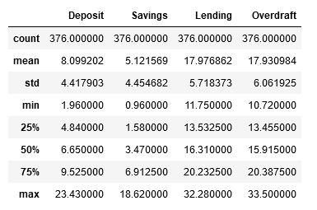
Descriptive Analysis
Secondary data was sourced and used for the purpose of addressing the main research objectives of this project. The monthly Commercial Bank Lending Rate was sourced from the CBK for the years 1991 to 2022. The study had only one variable (lending rate) and descriptive measures were computed and are summarized in the table 4.21 below.
Table 4.21 Summary of descriptive statistics for study variables.

Slide 26
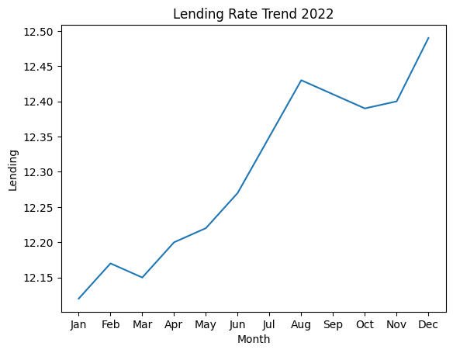
Descriptive Analysis
The arithmetic mean is equal to the sum of the values divided by the number of values, the lending rate has a mean of 17.976862. Standard deviation shows how much variation or "dispersion" exists from the average (mean, or expected value). A low standard deviation indicates that the data points tend to be very close to the mean; whereas high standard deviation indicates that the data points are spread out over a large range of values. The lending rate has a standard deviation of 5.718373.

Slide 27
Descriptive Analysis
From the graph it can clearly be seen that the lending rate in 2022 has been increasing since the beginning of the war in late February. This is due to high inflationary pressures that came as a result of economic sanctions imposed on Russia and disruptions of supply chain of oil and food products from Russia & Ukraine which come with price implications. To curb high inflationary pressures the Central Bank of Kenya increased the CBR rate. The CBR rate, Central Bank Rate or “CBR” means the rate published by the Central Bank of Kenya under the provisions of the Central Bank of Kenya Act as the lowest rate at which the Central Bank lends money to Banks in Kenya and which has been adopted as the base rate under the provisions of the Banking (Amendment) Act, 2016. A hike in the CBR rate causes the Commercial Banks to increase the lending rate which raises the cost of borrowing money to curb the demand for goods and services. The figures 4.2 below show the trend of inflation and the CBR rate for the year 2022 respectively.

Slide 28
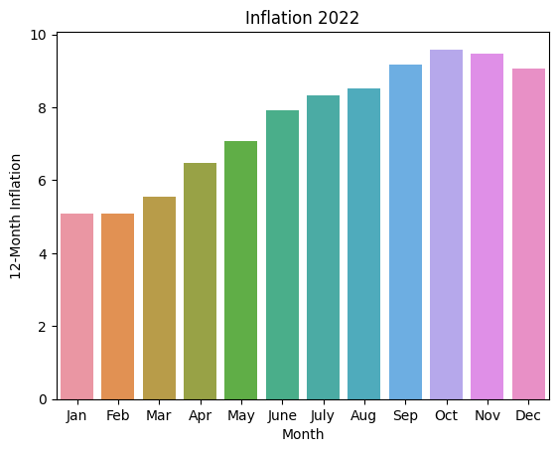
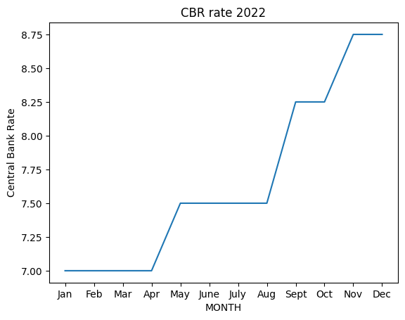
Descriptive Analysis

Slide 29
Table 4.32: Lending rate values for 2021/22
Month | Jan | Feb | Mar | Apr | May | June | July | Aug | Sep | Oct | Nov | Dec | Row total
2021 | 12 | 12.02 | 12.05 | 12.08 | 12.06 | 12.02 | 12.09 | 12.12 | 12.1 | 12.12 | 12.15 | 12.16 | 144.97
2022 | 12.12 | 12.17 | 12.15 | 12.2 | 12.22 | 12.27 | 12.35 | 12.43 | 12.41 | 12.39 | 12.37 | 12.36 | 147.44
Col Total | 24.12 | 24.19 | 24.2 | 24.28 | 24.28 | 24.29 | 24.44 | 24.55 | 24.51 | 24.51 | 24.52 | 24.52 | 292.41

Slide 30
Table 4.33: Expected frequencies calculated from table 4.32
Month | Jan | Feb | Mar | Apr | May | June | July | Aug | Sep | Oct | Nov | Dec | Row total
2021 | 11.95 | 11.99 | 12.0 | 12.04 | 12.04 | 12.04 | 12.12 | 12.17 | 12.15 | 12.15 | 12.16 | 12.16 | 144.97
2022 | 12.16 | 12.20 | 12.20 | 12.24 | 12.24 | 12.25 | 12.32 | 12.38 | 12.36 | 12.36 | 12.36 | 12.36 | 147.44
Col Total | 24.12 | 24.19 | 24.2 | 24.28 | 24.28 | 24.29 | 24.44 | 24.55 | 24.51 | 24.51 | 24.52 | 24.52 | 292.41

Slide 31
Table 4.34: Test statistics
Month | Jan | Feb | Mar | Apr | May | June | July | Aug | Sep | Oct | Nov | Dec
2021 | 0.000147 | 6.15E-05 | 0.000227 | 0.000150385 | 4.22325E-05 | 4.17057E-05 | 5.91754E-05 | 0.000216 | 0.000218 | 8.16E-05 | 3.41E-06 | 1.04E-06
2022 | 0.000144 | 6.05E-05 | 0.000223 | 0.000147866 | 4.1525E-05 | 4.10071E-05 | 5.8184E-05 | 0.000213 | 0.000214 | 8.02E-05 | 3.35E-06 | 1.03E-06

Slide 32

Data Analysis and Results
The data analysis and results are based on the following key variable that is; the lending rate from 1991 to 2022.
Recall $drt= α\left(μ −rt\right)dt+σdWt$ for constants $α$ > 0, $μ$ and $σ$ (eqn3)
Here µ represents the ‘mean’ level of the short rate. If the short rate grows the drift becomes negative, pulling the rate back to µ. The speed of the ‘reversion’ is determined by α. If α is high, the reversion will be very quick. Since it will be a bit difficult to calibrate the continuous form i.e. (eqn 3) above of the Vasicek model, we therefore represent the above model in discrete form using simple ordinary least squares regression (OLS).
Discrete form: $∆rt= α$($μ$ - $r$_{t-1})$∆t+εt(0,$ σ²) (eqn4)
OLS Form: r_{t} – r_{t-1} = $αb− αr$_{t-1} + ε_{t} (0, σ²) (eqn5)

Slide 33

Forecasting after time t:
E(rt) = r0$e^{−αt}+μ ∗(1 − e^{−αt}$) (eqn6)
V(rt) = σ²/2$α$ * $(1 − e^{−αt}$) (eqn7)
Long run forecast i.e. t = $∞$
E(rt) = $μ$
V(rt) = σ²/2$α$

Slide 34
Table 4.35: Regression parameter estimates
 | -a | a*b
Coefficients | 0.004978789 | -0.078057178
Standard error | 0.005756442 | 0.1086611
 | 0.002001521 | 0.636630381 | sigma(σ)
 | 0.74806473 | 373 | degrees of freedom
 | 0.30318932 | 151.1762443

Slide 35
Table 4.36: Test statistics
 | -a | a*b
t-stat | 0.864907353 | -0.718354394
p-value | 38.76% | 47.30%

Slide 36
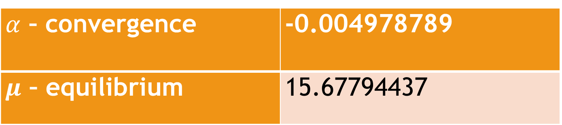
Table 4.37: Model parameters
$α$ – convergence | -0.004978789
$μ$ – equilibrium | 15.67794437

Slide 37

Fitted model
$∆rt=−0.004978789(15.67794437−r\text{t}\text{-1)}∆t+ εt(0,\text{0.636630381}\text{2}$)

Slide 38
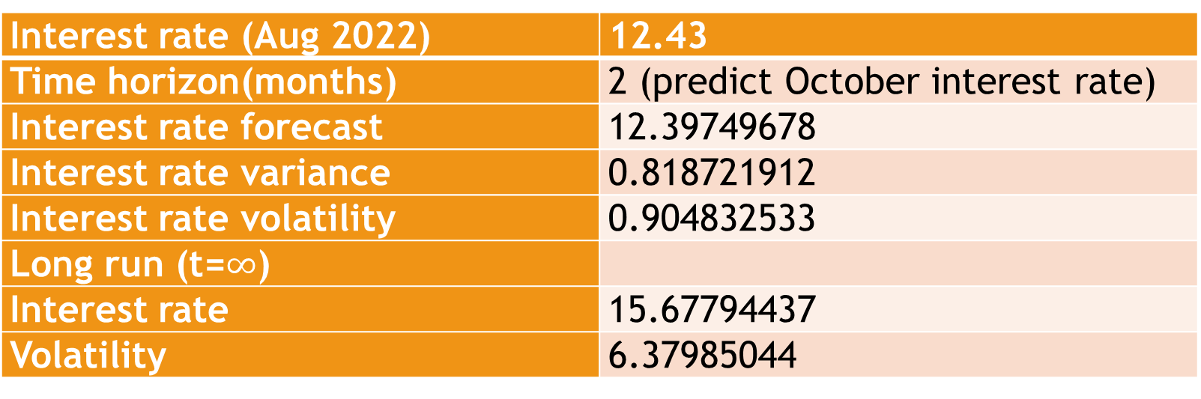
Table 4.38: Forecast of estimation variables
Interest rate (Aug 2022) | 12.43
Time horizon(months) | 2 (predict October interest rate)
Interest rate forecast | 12.39749678
Interest rate variance | 0.818721912
Interest rate volatility | 0.904832533
Long run (t=$∞$)
Interest rate | 15.67794437
Volatility | 6.37985044

Slide 39
Explanation of the Parameter Estimate Analysis
The fitted discrete form of the Vasicek model fitted for the data in results on table 4.35 is based on Ordinary Least Squares Regression (OLS). OLS is a type of linear least squares method for choosing the unknown parameters in a linear regression model (with fixed level-one effects of a linear function of a set of explanatory variables) by the principle of least squares: minimizing the sum of the squares of the differences between the observed in the input dataset and the output of the (linear) function of the independent variable. In table 4.35 the constant coefficient (with a value of 0.004978789) is very significant to the model.
The lagged value of the lending rate has important contribution as it allows us to estimate the model, using EXCEL LINEST function which calculates the statistics for a line by using the “least squares” method to calculate a straight line that best fits the data and return an array that describes the line.
The model had a convergence speed of 0.004978789 according to table 4.33 which means that every single month the interest rate reverts back to the equilibrium by roughly 0.5% point of the deviation. The long run equilibrium value of lending rate for Commercial Banks is 15.67794437.
From table 4.36, A 2 tailed distribution test was done with a significance level of 0.05, and the p-value obtained (i.e., 0.473) is greater than 0.05, showing that the Vasicek model does indeed significantly explain the dynamics of the monthly lending rate of Commercial Banks over the years from 1991 to 2022.

Slide 40
Explanation of the Parameter Estimate Analysis
A forecast using eqn 6 was done to test the accuracy of the model. According to the results from table 4.34, interest rate for the month of August was used as the base rate to predict the interest for the month of October, time (t=2) was in months. The original lending rate for the month of October was 12.39 and the predicted value is 12.39749678. From the forecast in table 4.34 we can see that the further in the future we are the more dominating the long run equilibrium is and the less relevant the current lending rate for our forecast. Which means when t = ∞ our lending rate forecast becomes the long run equilibrium b.
We calculate the lending rate variance using eqn 7 and find the square root of the variance to get volatility at 0.904832533. Which means that over the course of 2 months the average lending rate will be 12.39749678 but on average it will deviate from the forecast by around 0.904832533 basis points. The long run volatility is calculated using eqn 9 giving 6.37985044.
In terms of impact of estimated parameters on volatility and lending rate forecast we can see that the more the stochastic factors impact the lending rate in the short run the more volatile the lending rate is in the long run, but also the smaller the convergence parameter α is, the larger the variance would be. If the convergence speed is very low the lending rate can deviate for quite a long time unpredictably from the equilibrium level of 15.67794437.

Slide 41
Hypothesis Testing
Based on the objective of the study we formulate a hypothesis as below: We want to find out if the Russia-Ukraine war did affect the lending rate of Commercial Banks
H₀: Russia-Ukraine war had a significant impact on Commercial Banks lending rate
H_{1:} Russia-Ukraine war did not have a significant impact on Commercial Banks lending rate
From table 4.34;
chi-square statistic (calculated) = 0.002478,
Degrees of freedom (12-1) * (2-1) = 11
Significance level = 0.05
χ²_{0.05,11} = 19.68
Therefore, chi-square statistic tabulated = 19.68
Since 0.002478 < 19.68, we do not have sufficient evidence to reject the null hypothesis and so we should conclude that there is insufficient evidence that the Russia-Ukraine war had a significant impact on Commercial Banks lending rate.

Slide 42
CHAPTER FIVE SUMMARY, CONCLUSION AND RECOMMENDATIONS

Slide 43

CONCLUSION
In this study we explored the effect of Russia-Ukraine war on the cost of borrowing using the discrete form of the Vasicek model (1977) and commercial banks’ lending rate as the variable. Statistical significance of the model was calculated based on the results on table 4.35. the p-value of interaction of -a (convergence speed) with a value of 0.39 and the product of convergence speed and equilibrium (a*b) with a value of 0.47 are greater than 0.05 significance level hence prove of negative relationship. The Vasicek model would be unbiased but could be quite imprecise if the standard error was symmetric but heavy-tailed or if the standard error variance is large(>1).
The continuous form of the Vasicek model (eqn3) which is basically a stochastic differential equation was difficult to calibrate using dated data, as a result we represented the Vasicek model in discrete form (eqn4) and calibrated using the ordinary least squares regression. The model had lower standard error based on results on table 4.35, where α represented the speed of convergence/reversion of lending rate back to the equilibrium level (b), $∆t$ represented change in time in months and σ² represented the variance of the model which is used to calculate the volatility of lending rate.

Slide 44
CONCLUSION
Moreover, it is clearly evident that the more the stochastic factors impact the lending rate in the short run the more volatile the lending rate is in the long run, but also the smaller the convergence parameter α is, the larger the variance would be. If the convergence speed is very low the lending rate can deviate for quite a long time unpredictably from the equilibrium level of 15.67794437. This can be observed from table 4.38. The hypothesis test (4.4) was done to determine the effect of Russia-Ukraine war on lending rate, where we accept:
H₀: Russia-Ukraine war had a significant impact on Commercial Banks lending rate and reject:
H_{1:} Russia-Ukraine war did not have a significant impact on Commercial Banks lending rate.
From results on table 4.34 we fail to reject the null hypothesis (H₀).

Slide 45
RECOMMENDATIONS
The results of this paper have an important policy implication for borrowers and the government. It is well known that lending rate is the rate banks and other financial institutions use to lend funds in the form of loans to their customers. Increase in lending rates have a negative effect on economic growth. From results on table 4.38 the long run lending rate is 15.67794437, this clearly shows that lending rates are expected to increase over time into the future. Since this increase will have a negative impact on economic growth the government should salvage the situation with the following recommendations:
Favorable stock market conditions which attract international investors who lend to domestic companies or invest in domestic markets therefore contributing to domestic money supply and lending dynamics. The government should reduce the fiscal deficit by coming up with cost-effective revenue collection methods and reduce domestic borrowing, an increase in domestic borrowing overshadows the borrowing population and in turn pushes up lending rates. The government should also increase the amount of money made available to borrowers by lowering the CBR rate therefore making it profitable for commercial banks and lending institutions to lend money, this will in turn lower the rates.

Slide 46
LIMITATION OF THE STUDY
The study focused on the effect of Russia-Ukraine war on the cost of borrowing with the lending rate as a proxy instead of borrowers. The study also looked at lending rate alone while various other factors can be included in the model.

Slide 47
REFERENCES
Angela Stent, ‘America and Russia: Same Old, Same Old’, The National Interest, September-October 2017. http://nationalinterest.org/feature/america-russia-same-old-same-old-21941
Saunders M, Lewis P, Thornhill A. Research Methods for Business Student. 5th ed. Edinburgh Gate: Pearson Education Limited; 2009
Vasicek, O. (1977). "An equilibrium characterization of the term structure". Journal of Financial Economics. 5 (2): 177–188. CiteSeerX 10.1.1.164.447. doi:10.1016/0304-405X(77)90016-2.
Jessica James, Nick Webber (2000). Interest Rate Modelling. Wiley. ISBN 978-0-471-97523-6
Damiano Brigo, Fabio Mercurio (2001). Interest Rate Models – Theory and Practice with Smile, Inflation and Credit (2nd ed. 2006 ed.). Springer Verlag. ISBN 978-3-540-22149-4.
Heij, Christiaan; Boer, Paul; Franses, Philip H.; Kloek, Teun; van Dijk, Herman K. (2004). Econometric Methods with Applications in Business and Economics (1st ed.). Oxford: Oxford University Press. pp. 76–115. ISBN 978-0-19-926801-6.
Davidson, Russell; MacKinnon, James G. (1993). Estimation and Inference in Econometrics. New York: Oxford University Press. p. 33. ISBN 0-19-506011-3.

Slide 48
THE END

