Slide 1
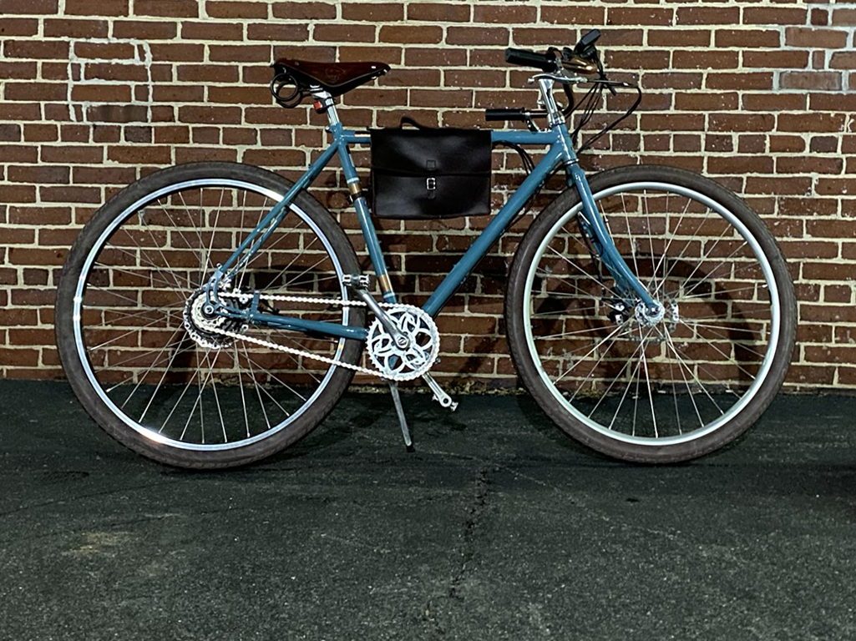
throttle.
battery
controller.
motor.

