Slide 1
<a rel="license" href="http://creativecommons.org/licenses/by/4.0/"><img alt="Creative Commons License" style="border-width:0" src="https://i.creativecommons.org/l/by/4.0/88x31.png" /></a><br />This work is licensed under a <a rel="license" href="http://creativecommons.org/licenses/by/4.0/">Creative Commons Attribution 4.0 International License</

Slide 2
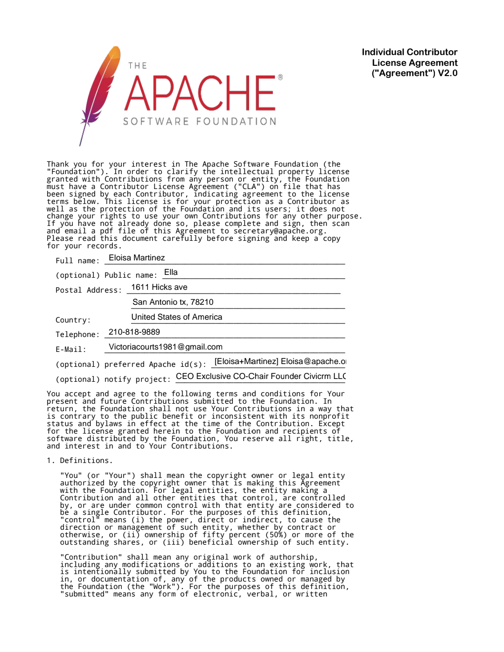
Ella Intelligent Global Network Inc

Slide 3
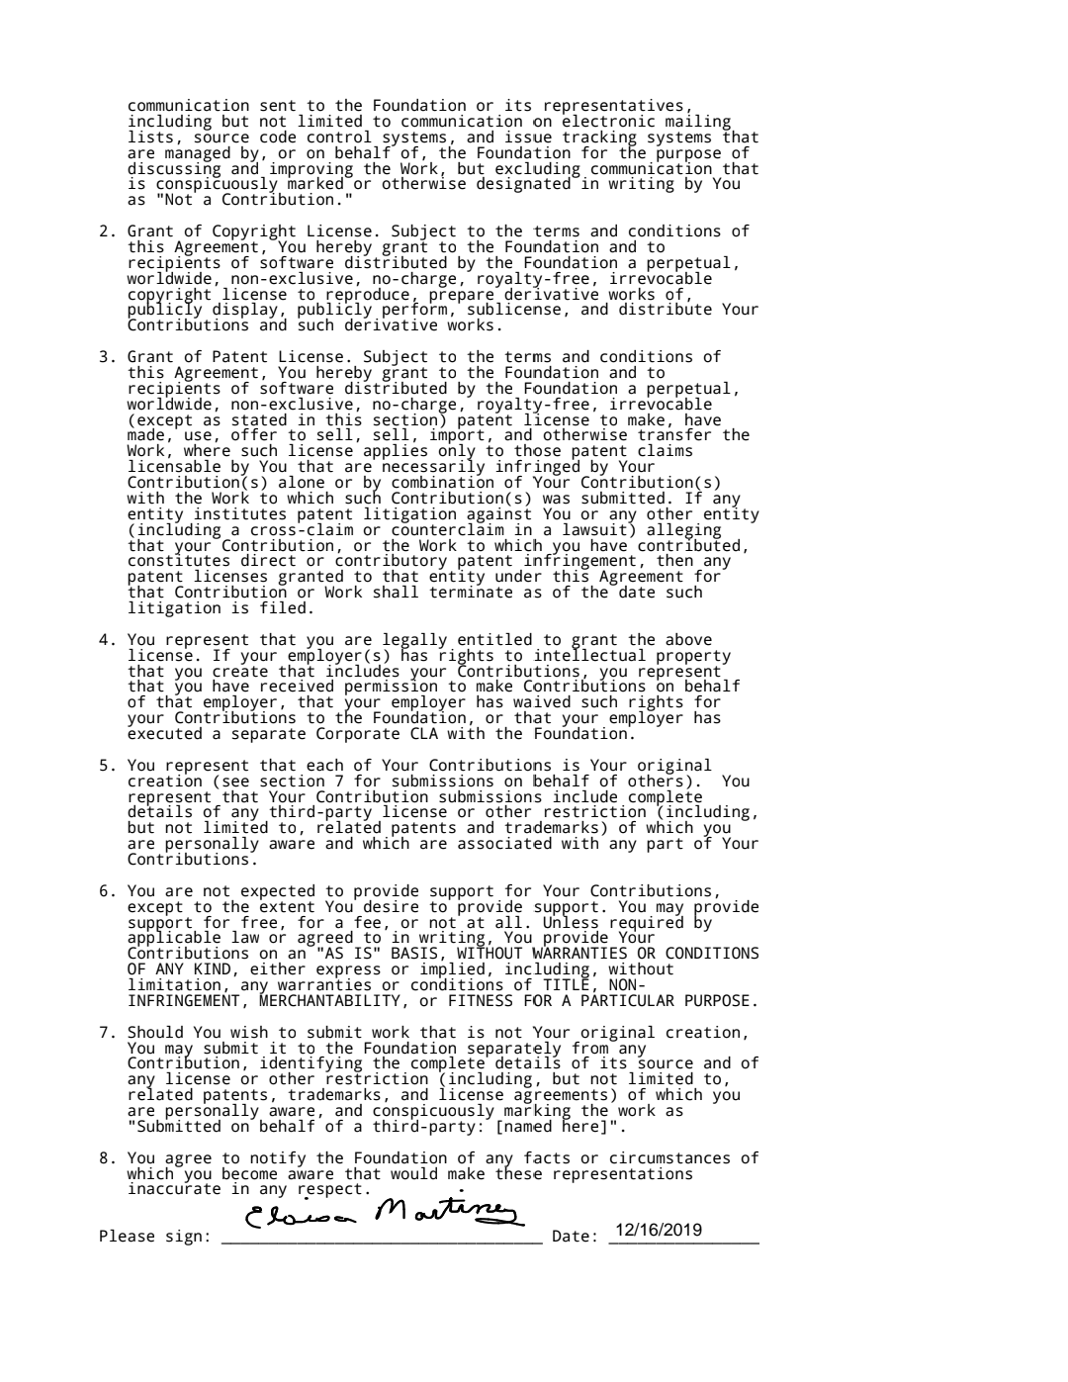

Slide 4
https://ellaintelligentglobalnetwork.co.in

Slide 5
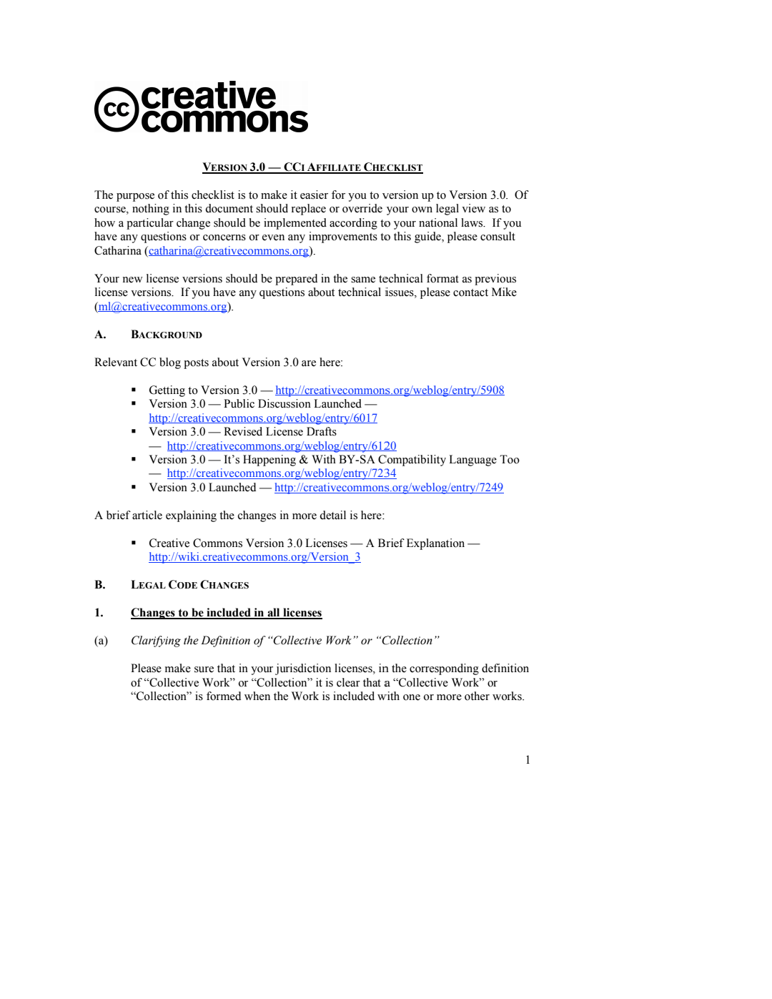

Slide 6
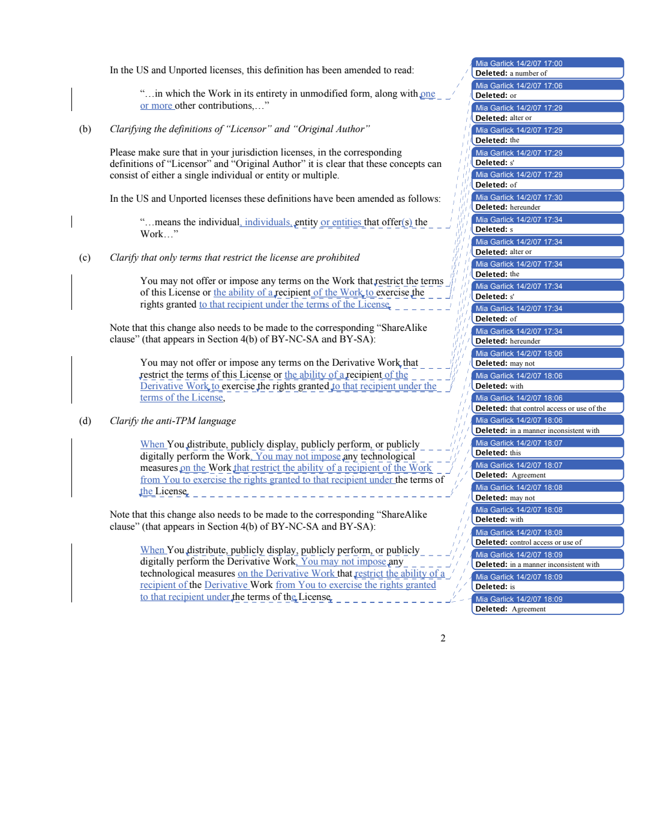

Slide 7
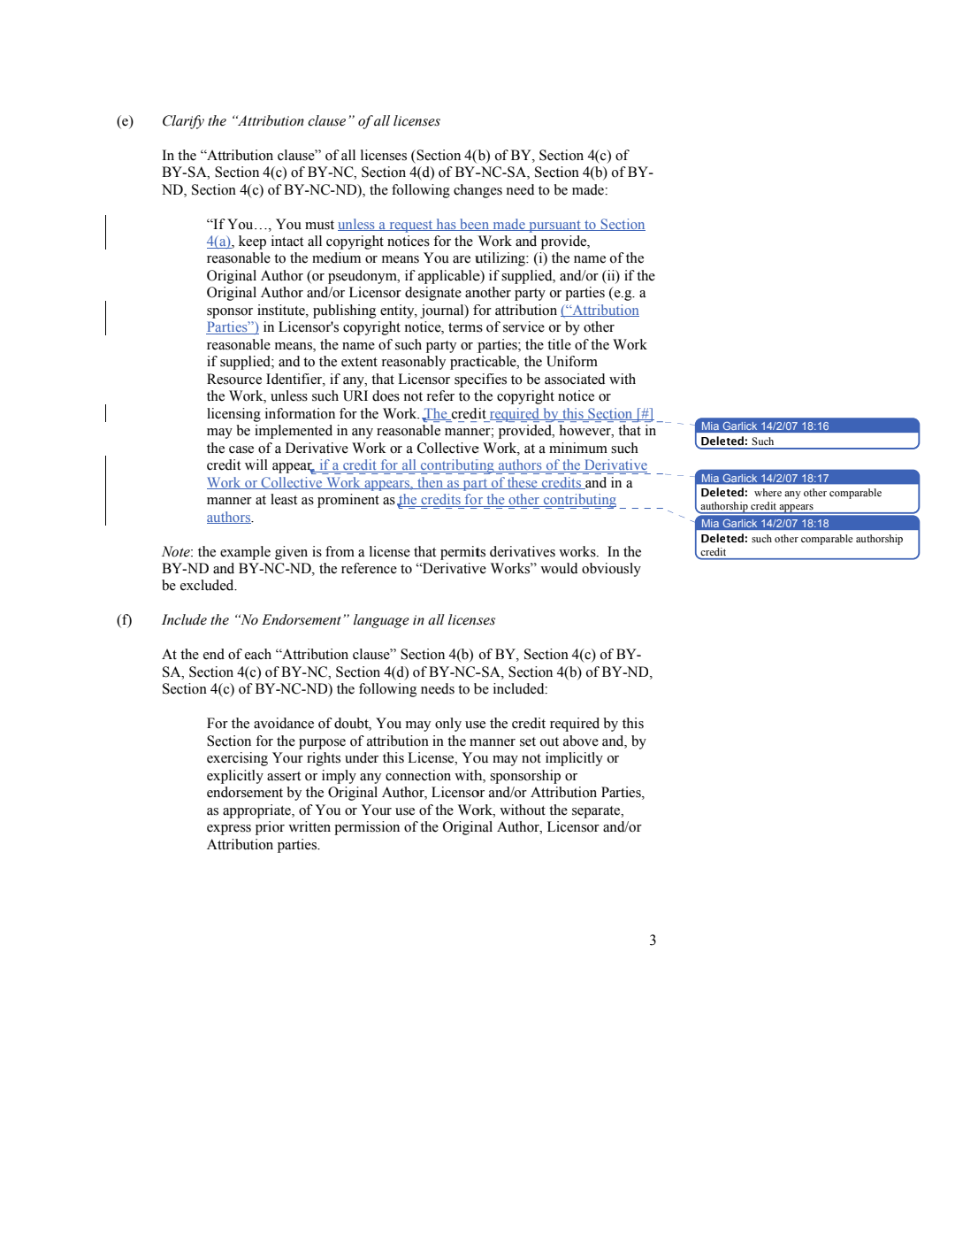

Slide 8
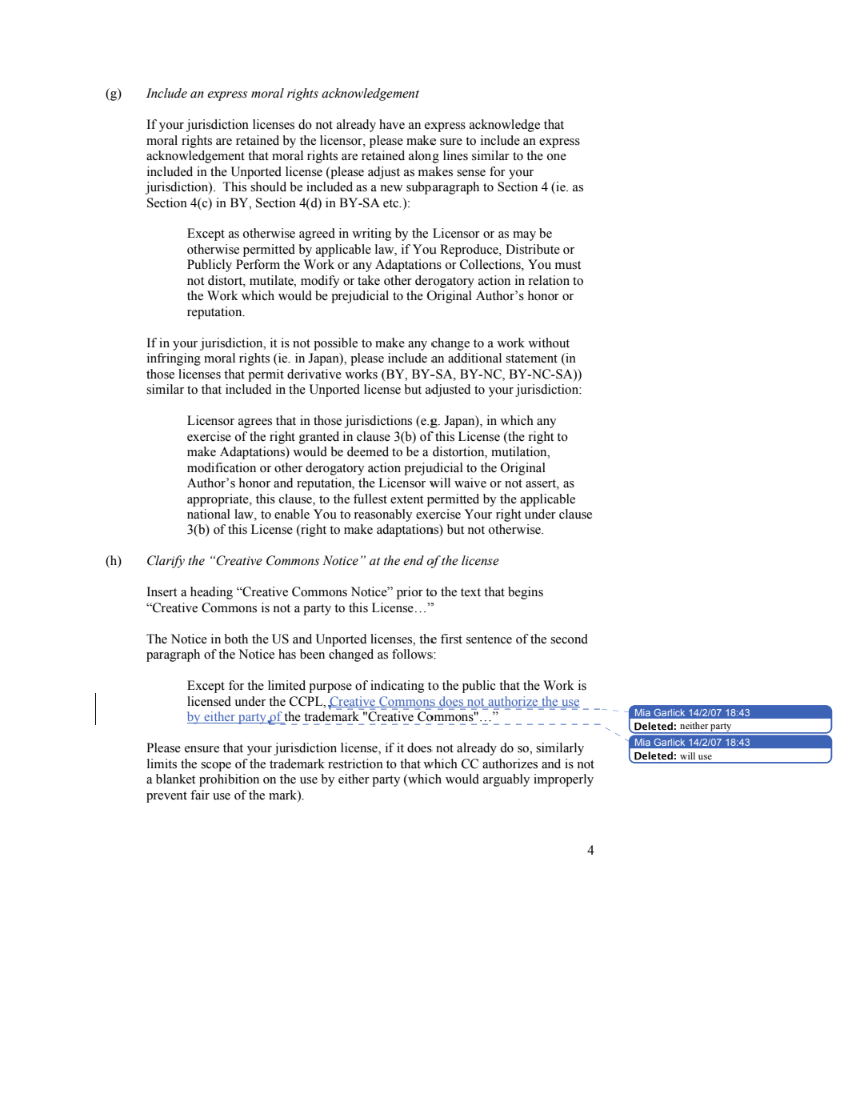

Slide 9
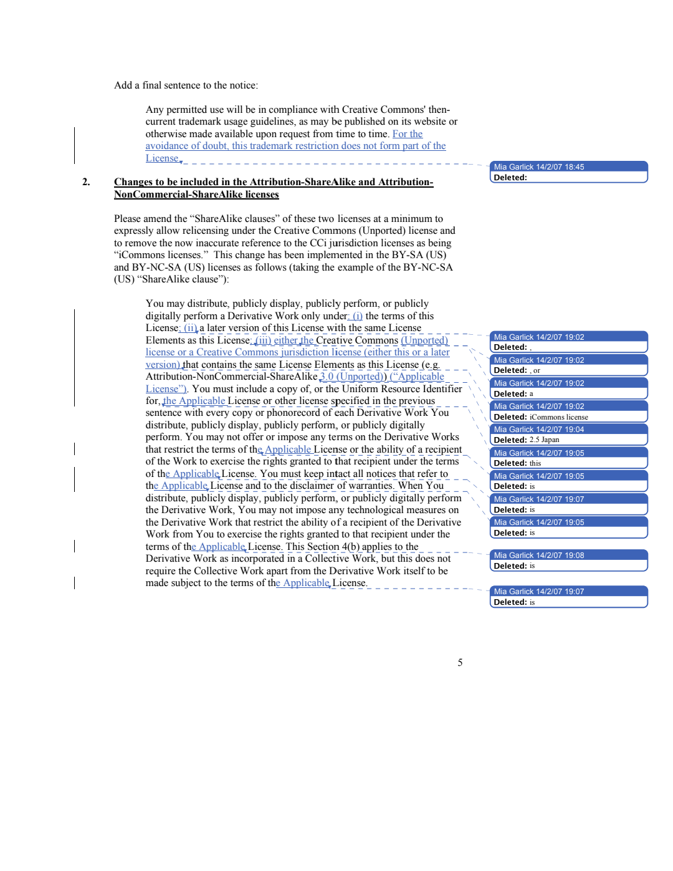

Slide 10
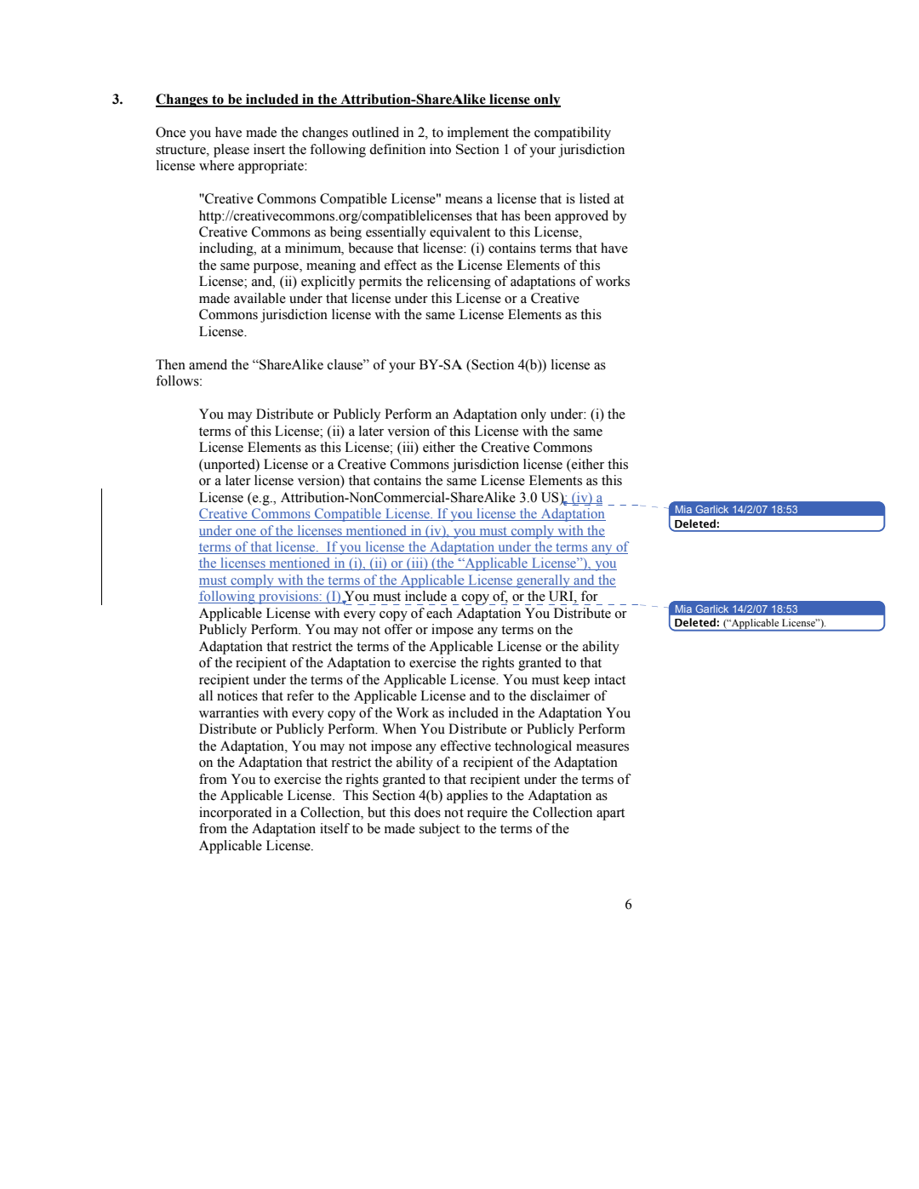

Slide 11
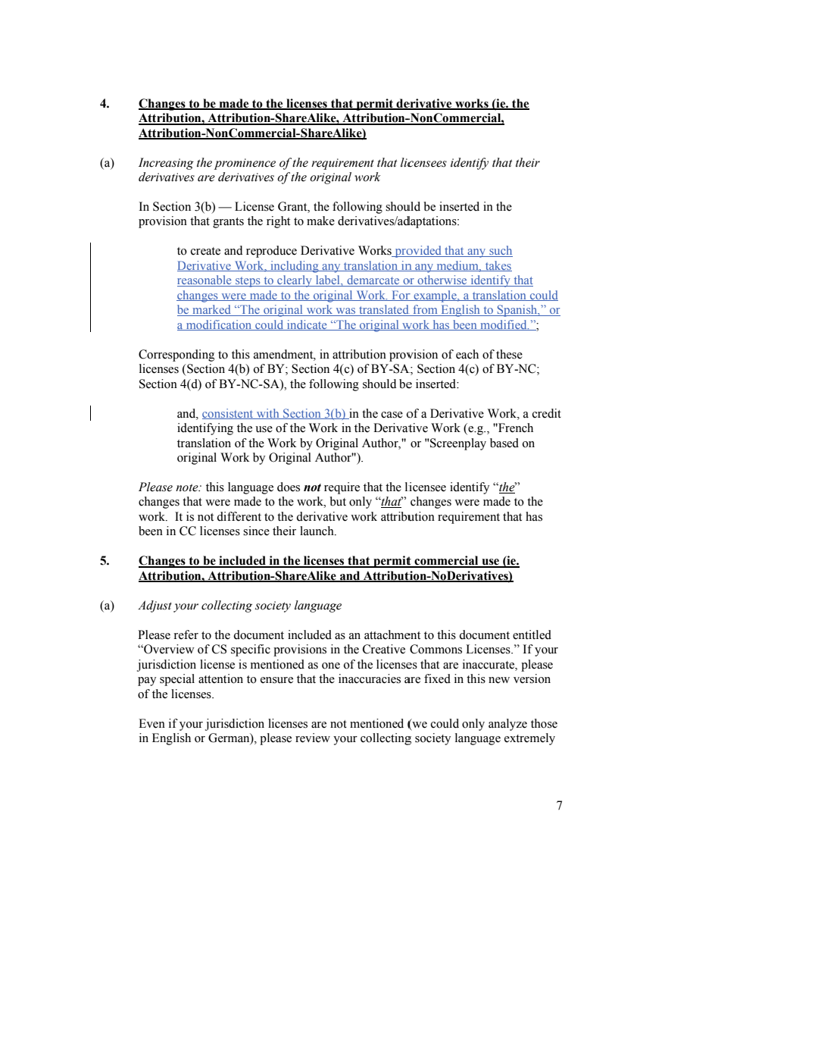

Slide 12
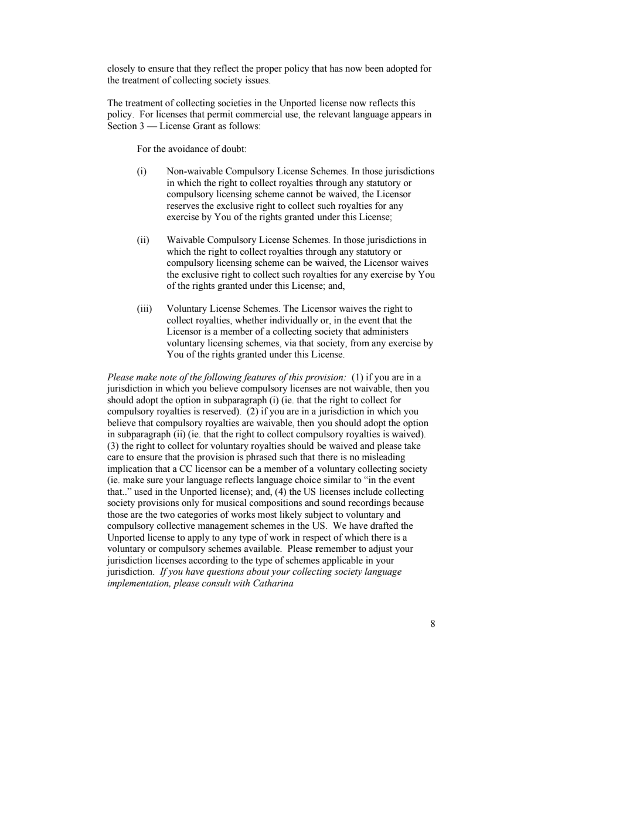

Slide 13
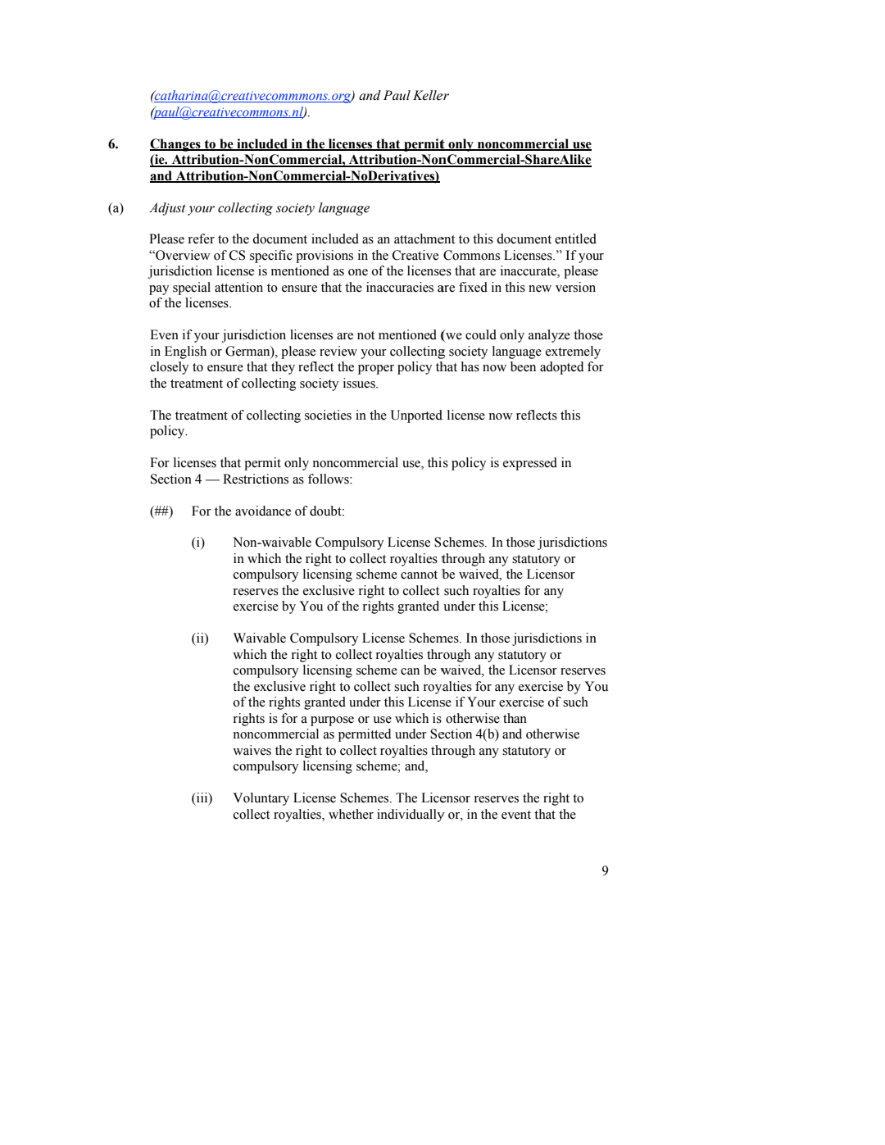

Slide 14
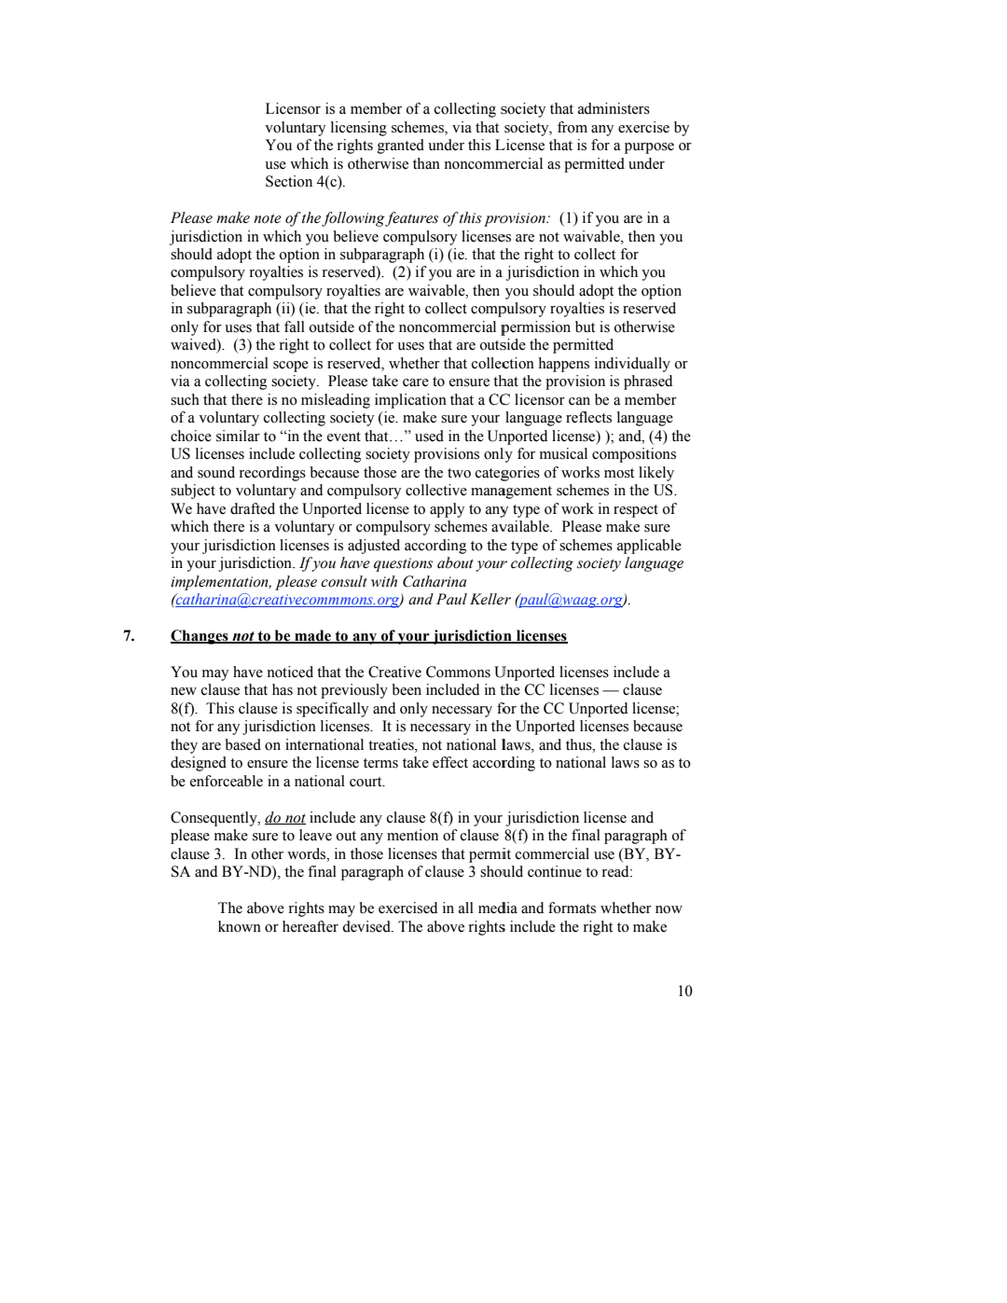

Slide 15
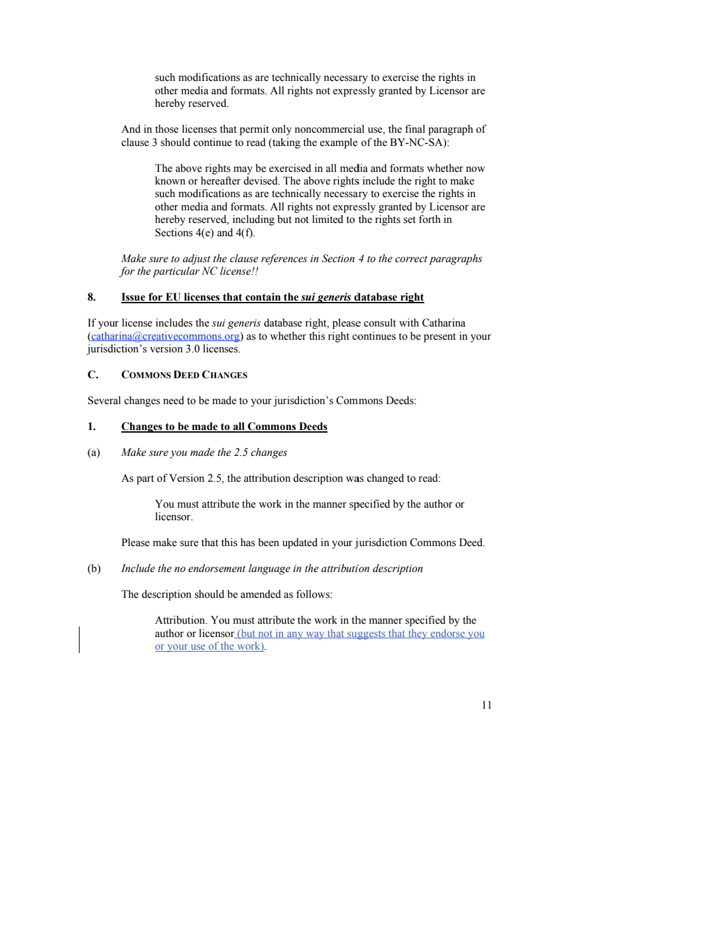

Slide 16
