Slide 1
JSON Schema.net
By Jack Wootton

Slide 2
JSON
{
“Company” : “Tigerspike”,
“Location” : “London”
}

Slide 3
JSON
{
“Company” : “Tigerspike” ,
“Location” : “London”
}
Attribute
Delimiter
Key
Value
Object

Slide 4
JSON
{
“Company” : “Tigerspike”,
“Location” : “London”,
“Employee” : {
“Name” : “Jack Wootton”,
“DressesWell” : false
}
}

Slide 5
Tigerspike and JSON
Phoenix serves JSON to iPad / iPhone
Sport Magazine for TalkSport
Russia Beyond The Headlines
Telegraph Media Group
JSON defines structure not just content e.g. sections -> articles -> adverts.
Any others?
App = (UI + logic + JSON)

Slide 6
Real JSON
{"d":{"__type":"SyndicateAPIWrapper.SyndicateAPI.SectionResponse","UpdatedDate":"\/Date(1335146688497)\/","Section":null,"Sections":[{"ID":1330,"Title":"Home","Description":"Home","Image":null,"IsActive":true,"Link":null,"NextUpdate":"\/Date(1335146986917)\/","ParentID":-1,"Rank":15,"Reference":"home","Level":1,"MajorVersion":null,"MinorVersion":null,"PointVersion":null,"TimeStamp":"AAAAAEnSgdM=","TrackingCode":"","AdCode":"","LandscapeImage":null,"Colour":"#ff0000","ClientTTL":5,"ClientID":375,"FeedUrl":"http://ipad.rbth.ru/top.xml","ImageFeedUrl":null,"VideoFeedUrl":null,"TTL":5,"IsInPageFlow":false,"Type":"home","Assets":[],"Articles":[{"TimeStamp":"AAAAAEnSgb0=","ID":599138663,"Title":"Top Stories","Author":null,"ContentData":"","Description":"","Enclosure":"media-carousel","IsActive":true,"Link":null,"PublishDate":null,"Reference":"home,0","SectionID":1330,"Rank":0,"Standfirst":null,"SummaryTitle":null,"SummaryContent":null,"Tag":null,"ShareUrl":null,"Assets":[{"ID":643785401,"Name":"Private military companies: to be or not to be","Rank":0,"Url":"http://ipad.rbth.ru/assets/images/720_398/Politics/RIA_Novosti_maroon_beret_720.jpg","ArticleID":599138663,"AssetType":"Image","Caption":"What form the PMCs will take in the specific conditions pertaining to Russia?","SectionID":null,"ThumbnailUrl":null,"PosterImageUrl":"politics,http://ipad.rbth.ru/article/17071.xml","PublishDate":null,"Duration":null,"FileSize":null,"Copyright":null,"Author":"standard","ShareUrl":null,"Bitrate":0,"Reference":null},{"ID":643785402,"Name":"Rosatom ponders UK deal","Rank":1,"Url":"http://ipad.rbth.ru/assets/images/720_398/International/720.jpg","ArticleID":599138663,"AssetType":"Image","Caption":"The British government may find itself faced with an offer that is hard to refuse","SectionID":null,"ThumbnailUrl":null,"PosterImageUrl":"international,http://ipad.rbth.ru/article/17066.xml","PublishDate":null,"Duration":null,"FileSize":null,"Copyright":null,"Author":"standard","ShareUrl":null,"Bitrate":0,"Reference":null},{"ID":643785403,"Name":"Public TV in Russia may end up satisfying no one","Rank":2,"Url":"http://ipad.rbth.ru/assets/images/720_398/Society/RIAN_01096820.HR.720.jpg","ArticleID":599138663,"AssetType":"Image","Caption":"The television station is increasingly being seen as a half-measure meant to mollify the public","SectionID":null,"ThumbnailUrl":null,"PosterImageUrl":"society,http://ipad.rbth.ru/article/17046.xml","PublishDate":null,"Duration":null,"FileSize":null,"Copyright":null,"Author":"standard","ShareUrl":null,"Bitrate":0,"Reference":null},{"ID":643785404,"Name":"Rosneft and Exxon converge around the shelf","Rank":3,"Url":"http://ipad.rbth.ru/assets/images/720_398/Business/RIA_Novosti_rosneft_720.jpg","ArticleID":599138663,"AssetType":"Image","Caption":"Agreements move forward on joint development of new Russian energy resources","SectionID":null,"ThumbnailUrl":null,"PosterImageUrl":"business,http://ipad.rbth.ru/article/17034.xml","PublishDate":null,"Duration":null,"FileSize":null,"Copyright":null,"Author":"standard","ShareUrl":null,"Bitrate":0,"Reference":null},{"ID":643785405,"Name":"The cold market for haute cuisine","Rank":4,"Url":"http://ipad.rbth.ru/assets/images/720_398/Arts and Living/_MG_01_720.jpg","ArticleID":599138663,"AssetType":"Image","Caption":"Even as Muscovites flock to cooking schools few entrepreneurs are taking advantage of the demand","SectionID":null,"ThumbnailUrl":null,"PosterImageUrl":"business,http://ipad.rbth.ru/article/17021.xml","PublishDate":null,"Duration":null,"FileSize":null,"Copyright":null,"Author":"standard","ShareUrl":null,"Bitrate":0,"Reference":null}]},{"TimeStamp":"AAAAAEnSgb4=","ID":599138664,"Title":"Editor\u0027s Picks","Author":null,"ContentData":"","Description":"","Enclosure":"image-carousel","IsActive":true,"Link":null,"PublishDate":null,"Reference":"home,1","SectionID":1330,"Rank":1,"Standfirst":null,"SummaryTitle":null,"SummaryContent":null,"Tag":null,"ShareUrl":null,"Assets":[{"ID":643785406,"Name":"","Rank":0,"Url":"http://ipad.rbth.ru/assets/images/216_155/Arts and Living/Amatriain-Kaniskin-8-155.jpg","ArticleID":599138664,"AssetType":"PreviewImage","Caption":"NY Ballet competition launches young careers","SectionID":null,"ThumbnailUrl":"http://ipad.rbth.ru/assets/images/216_155/Arts and Living/Amatriain-Kaniskin-8-155.jpg","PosterImageUrl":"arts-and-living,http://ipad.rbth.ru/article/17040.xml","PublishDate":null,"Duration":null,"FileSize":null,"Copyright":null,"Author":null,"ShareUrl":null,"Bitrate":0,"Reference":null},{"ID":643785407,"Name":"","Rank":1,"Url":"http://ipad.rbth.ru/assets/images/216_155/Business/Getty_Images_Fotobank_bank_216.jpg","ArticleID":599138664,"AssetType":"PreviewImage","Caption":"Will Russian companies issue debt in rubles?","SectionID":null,"ThumbnailUrl":"http://ipad.rbth.ru/assets/images/216_155/Business/Getty_Images_Fotobank_bank_216.jpg","PosterImageUrl":"business,http://ipad.rbth.ru/article/17017.xml","PublishDate":null,"Duration":null,"FileSize":null,"Copyright":null,"Author":null,"ShareUrl":null,"Bitrate":0,"Reference":null},{"ID":643785408,"Name":"","Rank":2,"Url":"http://ipad.rbth.ru/assets/images/216_155/Society/AP_Assange_216.jpg","ArticleID":599138664,"AssetType":"PreviewImage","Caption":"Wikileaks makes its debut on Russian news channel","SectionID":null,"ThumbnailUrl":"http://ipad.rbth.ru/assets/images/216_155/Society/AP_Assange_216.jpg","PosterImageUrl":"society,http://ipad.rbth.ru/article/17008.xml","PublishDate":null,"Duration":null,"FileSize":null,"Copyright":null,"Author":null,"ShareUrl":null,"Bitrate":0,"Reference":null},{"ID":643785409,"Name":"","Rank":3,"Url":"http://ipad.rbth.ru/assets/images/216_155/Business/ITAR-TASS_ozon_216.jpg","ArticleID":599138664,"AssetType":"PreviewImage","Caption":"Russia anticipates an e-commerce boom","SectionID":null,"ThumbnailUrl":"http://ipad.rbth.ru/assets/images/216_155/Business/ITAR-TASS_ozon_216.jpg","PosterImageUrl":"business,http://ipad.rbth.ru/article/16977.xml","PublishDate":null,"Duration":null,"FileSize":null,"Copyright":null,"Author":null,"ShareUrl":null,"Bitrate":0,"Reference":null},{"ID":643785410,"Name":"","Rank":4,"Url":"http://ipad.rbth.ru/assets/images/216_155/PhotoXPress_sceince_216.jpg","ArticleID":599138664,"AssetType":"PreviewImage","Caption":"New grants revitalize Russian science","SectionID":null,"ThumbnailUrl":"http://ipad.rbth.ru/assets/images/216_155/PhotoXPress_sceince_216.jpg","PosterImageUrl":"society,http://ipad.rbth.ru/article/16568.xml","PublishDate":null,"Duration":null,"FileSize":null,"Copyright":null,"Author":null,"ShareUrl":null,"Bitrate":0,"Reference":null}]

Slide 7
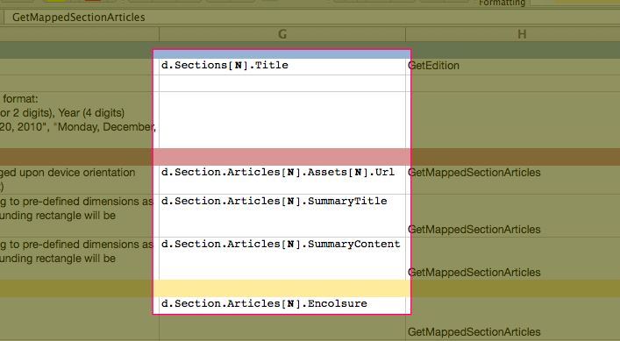
Documenting JSON

Slide 8
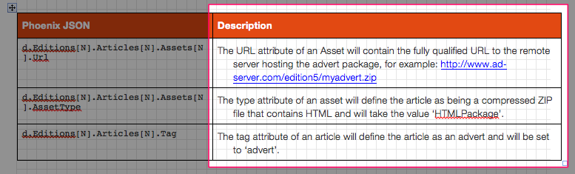
Documenting JOSN

Slide 9
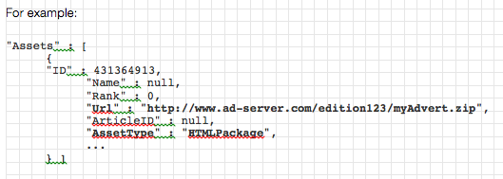
Documenting JSON
“…but Name is always required”
“…ummm, and Rank has a max value”
“…also, ‘ID’ cannot be null”
“…I think Url must always follow this pattern”

Slide 10
Software and JSON
Not just SA’s that have this problem
Software has this problem too!
How can an iOS application know if the JSON received is what it expects?
Could just try and parse the JOSN and then fail.
…but only know about ‘wrong’ JSON after passing has started, and maybe nearly finished

Slide 11
Solution
Schemas
Schemas formally describe and define JSON
Syntax, just like a programming language
…in fact, JSON schemas follow the same syntax JSON
…they are JSON
Schemas define JSON in applications
Schemas describe JSON in documentation

Slide 12
Solution
{
"type": "object",
"properties": {
"Company": {
"type": "string",
"required": false
},
"Employee": {
"type": "object",
"properties": {
"DressesWell": {
"type": "boolean",
"required": false
},
"Name": {
"type": "string",
}
}
},
"Location": {
"type": "string",
}
}
}
{
“Company” : “Tigerspike”,
“Location” : “London”,
“Employee” : {
“Name” : “Jack Wootton”,
“DressesWell” : false
}
}

Slide 13
Why aren’t they used more?
Yes. Schemas are fantastic.
Why aren’t they used more?
Writing schemas is laborious, time-consuming.
Error prone (after-all schemas have strict syntax rules, just like programming)
Secondary importance to JSON / app logic

Slide 14
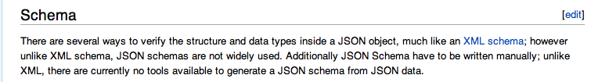
Generating Schemas
Lots of tools to generate schemas from XML
Decided to use JOSN schema…
Time to break out an editor
…not quite

Slide 15
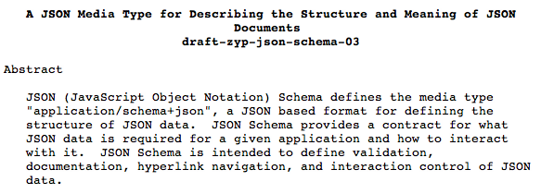
IEEE
IEEE define JSON schema
Need to know the ‘rules’ schemas must follow
Anyone can contribute to IEEE documents
27 pages
Schemas can describe a lot, not just content in JSON

Slide 16
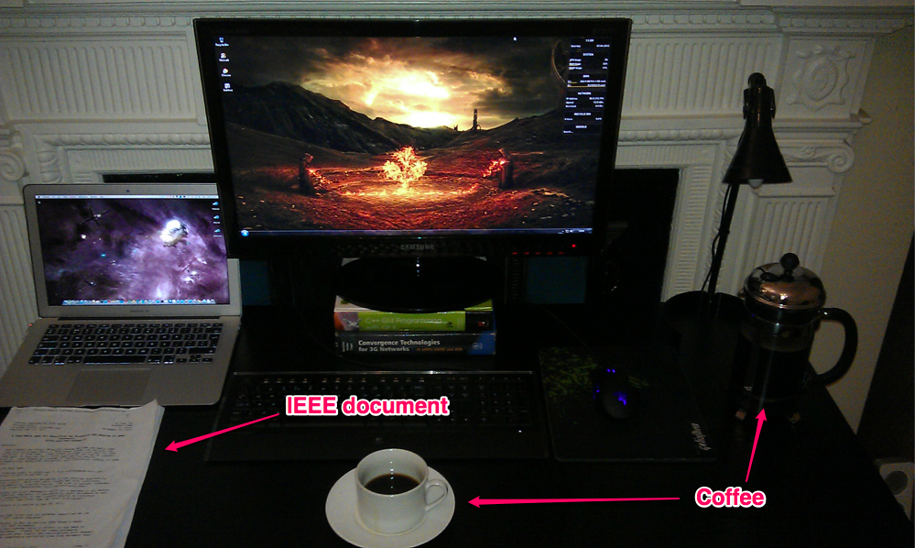
What do you need?

Slide 17

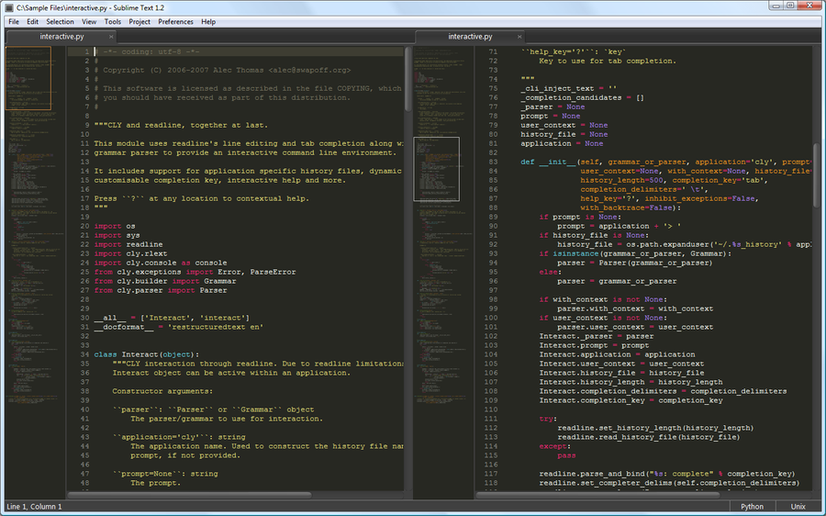
What do you need?

Slide 18
Demo
Phase #1: Algorithm to parse JSON and data structure to store result.
N number of nested objects (arbitrary depth)
simpleJson.json
…real example (tmgExample.json)
Note that content is not part of schema

Slide 19
Basic output
Error prone, laborious, time consuming, leg-work of creating schema automated
Usable and provides a good starting place to refine schema
depthTest.json

Slide 20
Schema Output
Phase #2: Think about the user after they use the tool
Probably want to paste schema into document and paste it as a value into code
Provide two new views: Review and String
Demo

Slide 21
Edit View
Phase #3: Allow schema to be modified
Add values that cannot be encoded in JSON
Demo

Slide 22
Demo
Easy to modify schemas (types and other ‘simple’ attributes).
But maybe input JSON was not exactly what the user intended
JSON has nested objects
Schemas have nested schemas describing those objects
…allow user to make structural changes to schema (i.e. add new schemas etc).

Slide 23
Working with schemas
Phase #4: Think about the user before they use the tool
Can’t expect user to do everything in one go
Tool useless if there is no input JSON
Allow input to be JSON schema
schemaInput.json

Slide 24
Recap
Generate schema -> Edit/add attributes -> Modify structure -> Schemas as input
Thought about user before they get to the tool, and when they’ve finished.
Phase#4: Advanced schema features:
Defaults
References
Extensions

Slide 25
Input Defaults
Default values
Default required attributes
Default ID
Default $schema
Demo

Slide 26
References
{
"properties": {
"B": {
"description": "B's description",
"$ref": "http://jsonschema.net/examples/C.json"
}
}
}
{
"properties": {
"C": {
"description": "C's description.",
"type": "any"
}
}
}
Demo (refB2C.josn)

Slide 27
Reference chaining
{
"properties": {
"A": {
"description": "A's description.",
"$ref": "http://jsonschema.net/examples/B.json"
}
}
}
{
"properties": {
"B": {
"description": "B's description",
"$ref": "http://jsonschema.net/examples/C.json"
}
}
}
{
"properties": {
"C": {
"description": "C's description.",
"type": "any"
}
}
}
Demo (refA2B2C.josn)

Slide 28
Extensions
{
"type": "object",
"$schema": "http://json-schema.org/draft-03/schema",
"properties": {
"age": {
"type": "number"
},
"firstName": {
"type": "string"
},
"lastName": {
"type": "string"
}
},
"extends": {
"type":"string"
}
}
Demo (simpleExtends.josn)

Slide 29
Extending references
{
"type": "object",
"$schema": "http://json-schema.org/draft-03/schema",
"properties": {
"age": {
"type": "number"
},
"firstName": {
"type": "string"
}
},
"extends": {
"$ref": "http://jsonschema.net/examples/B.json"
}
}
Demo (extendsRef.josn)

Slide 30
Feedback
From JSON schema community (yes, it exists)
“Awesome tool, thank you Jack, I will definitely follow this project”
“I like your app and think it goes into the right direction”
“Ambitious project, great start”
“nice work :-)”
“Great job! Nice looking tool”
“I took note but have only just had time to take a look. Excellent tool!”
“Thanks for a useful tool.”
“First off, good job. Seems to work well and I like the UI. Keeping it simple is a hard trick to pull off but a worthy goal.”

Slide 31
Lessons
Think about user before and after they use software
Expose tool to community early
A ‘feature’ is rarely just one thing (i.e. default values and the ‘required’ problem)
UI problems === algorithm problems (i.e. modifying large DOM structure)
Try to stick to hardware backed CSS selectors even when using a library
Libraries make it easier to do bad things

Slide 32
Challenges
IEEE documents / schema definitions still require interpretation
Keeping syntax valid during editing
DOM performance!
Keeping code organised

Slide 33
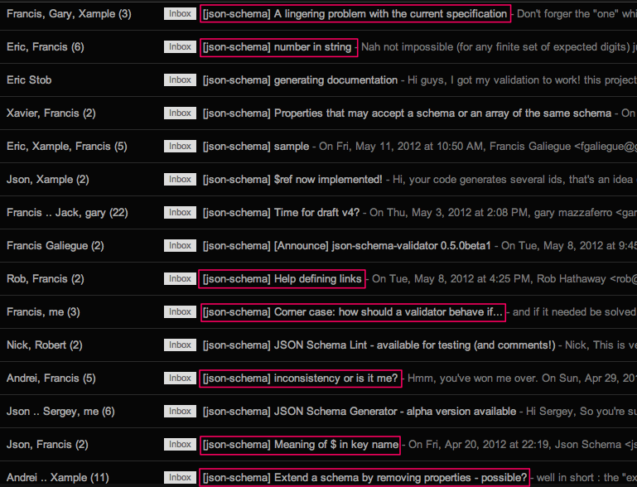

Slide 34
Finally
If you have the problem, someone else probably does too.
Can’t reply on client projects for creativity and innovation
Free time drives creativity and innovation

Slide 35
Questions?
Did you pronounce ‘tuple’ correctly?

Slide 36
…yes
The word tuple is derived from Latin and in mathematics means ‘an ordered set of elements’.
We are familiar with the pronunciation for ‘quintuple’: kwin-too-puhl
Same for tuple (not ‘tupple’)

