Slide 1
IAB Workshop on
Stack Evolution in a Middlebox Internet (SEMI)
26-27 January 2015, Zurich
IETF 92 Technical Plenary Report, 23 March 2015, Dallas
Brian Trammell <ietf@trammell.ch>

Slide 2
Background
IAB IP Stack Evolution Program currently focuses on two broad areas:
evolution of interfaces to transport and network-layer services beyond SOCK_STREAM and SOCK_DGRAM
Improving path transparency in the presence of firewalls and middleboxes.
Follows the IAB’s interest in general issues of protocol evolution (RFC 5218, ITAT workshop)
Within the program, the IAB convened a workshop in January to discuss ossification of the transport layer…
…and how to fix it for emerging applications (e.g. rtcweb)

Slide 3

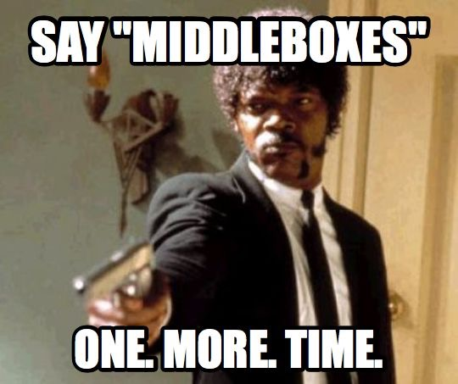
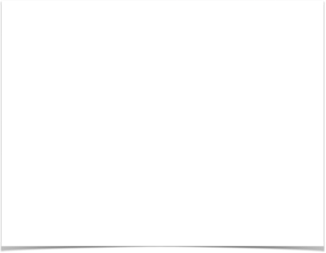
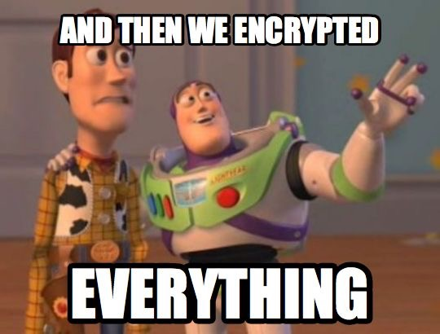
Why now?
new energy in the IETF:
work which requires flexibility we don't appear to have (RTCWEB, TCPINC)
work to provide that flexibility at the interface (TAPS)
pressure created by increasing deployment of encryption:
"Everything over TLS" will brick lots of deployed middleboxes
Opportunity to strike a balance between endpoint and midpoint requirements.

Slide 4
Workshop Positions
20 position papers accepted, 38 invitations sent.
Stated goals of participants included:
deeper understanding of architecture and incentives,
broadening of transport interfaces
further research and community education on the issue
definition of middlebox cooperation approaches.
On transport evolution, there were two camps:
“TCP is broken, burn it to the ground and start over”
“Long live TCP!”

Slide 5
Identified Goals
Future work (WG/RG) on middlebox cooperation (protocol/functionality/etc.), including:
mechanisms for detection of path characteristics
measurement for path impairment detection and troubleshooting
Better understanding of how transport should/must evolve, including applicability of present transports to specific use cases.
Interface improvement: expose more to applications about transport (in the right way)
Identify trust issues and deployment incentives in cooperation and evolution approaches (this is hard)

Slide 6
Outcome: Measurement
We need to make data-driven engineering decisions about transport protocol extension
If a protocol works in 99.5% of the Internet, why not use when you can?
If a feature breaks in 0.5% of the Internet, how much complexity to work around that is too much?
Service providers and platform developers have access to a great deal of data which, in aggregate, could better inform these decisions.
HOPS BarBoF, 21:30 Sunday

Slide 7
Cooperation: A new view of the two-stemmed Internet martini glass
Expose what you must to the path
Everything else is end-to-end
Crypto keeps everyone honest
Encapsulation for path exposure in user-space transports: SPUD BoF: 9:00 Wednesday, International room

Slide 8
Cooperation Vocabulary
Once you have this mechanism, what do you say with it?
There need to be incentives to expose information.
There need to be incentives not to lie.
A2P (app to path): problem appears tractable, there is a minimal set of useful information (e.g. session lifetime) which can be exposed, and is anyway useful to the far endpoint.
P2A (path to app): the way forward is less clear
If treated as advisory: problem might be tractable; similar to ICMP, but inband.
If treated as authoritative: previously unsolved problem, many trust issues.

Slide 9
TODO
Initial workshop report: Real Soon Now (mid-April)
Until then: transcripts, slides, position papers at https://www.iab.org/activities/workshops/semi/
Cooperation with ETSI NFV Forum on middlebox issues (in progress)
Discussions on transport extensibility in area meetings
UDP encapsulation guidelines
Statement on architectural assumptions in transport evolution (referred to program)

Slide 10
Further Discussion
Middlebox measurement issues (“How Ossified is the Protocol Stack”): hops@ietf.org
Substrate Protocol for User Datagrams spud@ietf.org
Transport Services WG taps@ietf.org
Other future work stackevo@iab.org

