Slide 1
Introduction to Integration Solutions
‹#›

Slide 2
Providing Solutions to Integration Problem
Linking different applications is nothing but Integrations.
We know how mule flows can be written to contain orchestration logic which orchestrates different applications.
Challenges arise when integration efforts span organizational boundaries
Various stakeholders have multiple, and sometimes conflicting, goals
These stakeholders have different assumptions, understandings, and language to describe these goal
‹#›

Slide 3
project stakeholders
Users
The business users (consumers) of the solution
Analysts and Managers
Responsible for managing the scope, business value, cost, resource usage, etc. of the project
Database Administrators
Network administrators
Manages network bandwidth, implements security and monitoring
‹#›

Slide 4
Developers
Responsible for implementing the solutions
Auditors
Verify compliance, policies, and integrity of the company
System Integrators
Responsible for external systems that interact with the integration systems
Architects
Responsible for designing solutions and implementing them
‹#›

Slide 5
An integration architecture must communicate with the various stakeholders
The most important objective of Integration solution architecture is :
To address in-scope requirements of stakeholders related to Integration scenarios
We have to document different views to address the goals and concerns of various stakeholders
We have to carefully document and balance the requirements from various stakeholders and their viewpoints
‹#›

Slide 6
Considerations for Integration Solutions...
While giving an integration solution as an architect, we have to consider following:
Reliability
Reliability aspires to have zero message/data loss after a Mule application stops or crashes
Durability
Durability is the ability of a product to remain functional, when faced with the challenges of normal operation over its design lifetime.
Performance
Security
Implementing best testing strategies
Logging and monitoring capabilities
Transaction Management ,etc
‹#›

Slide 7
Considerations for Integration Solutions...
While designing Integration solutions, we have to consider both functional and nonfunctional requirements
Functional requirements are often discovered from user stories
Non-functional requirements may exist beyond or outside a user story
Examples:
"The system must survive Mule runtime restarts"
"All data at rest must be encrypted per corporate standards”
‹#›

Slide 8
The “4 +1” VIEW MODEL
‹#›

Slide 9
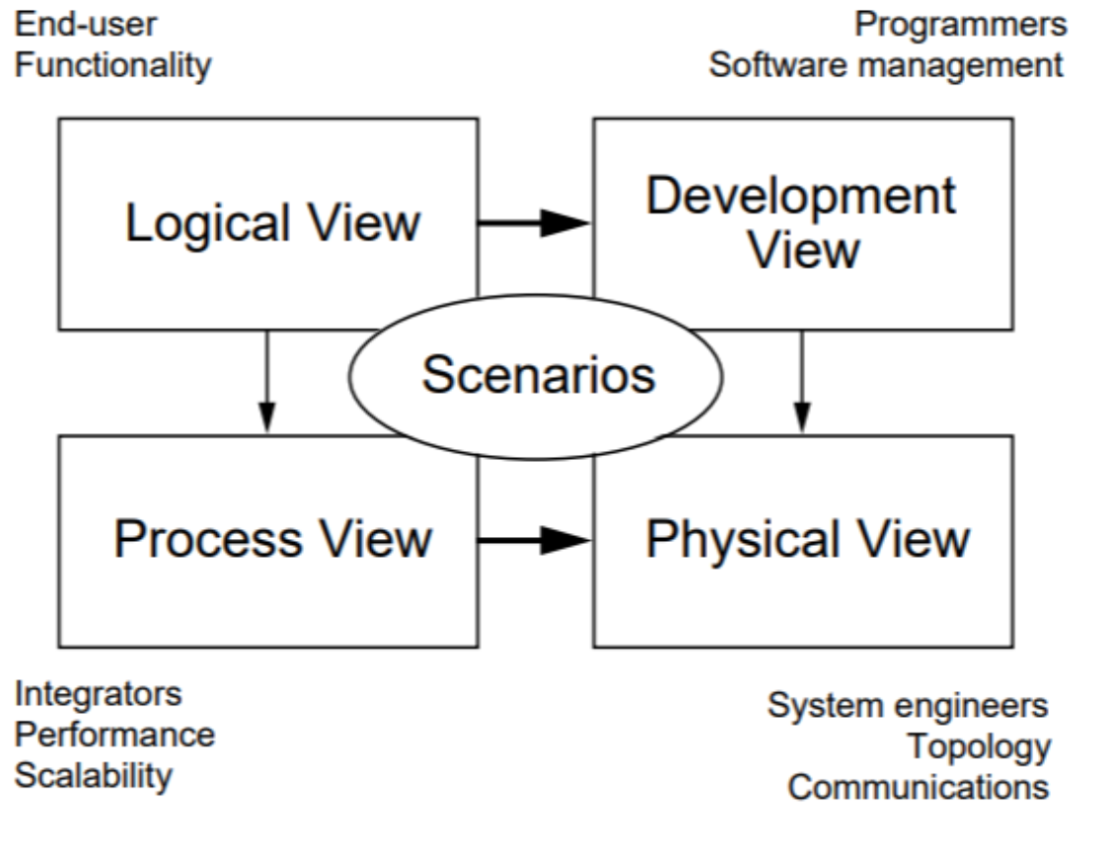
4+1 Views
‹#›

Slide 10
Logical View
The logical view is concerned with the functionality that the system provides to end-users.
UML diagrams are used to represent the logical view, and include class diagrams, and state diagrams.
‹#›

Slide 11
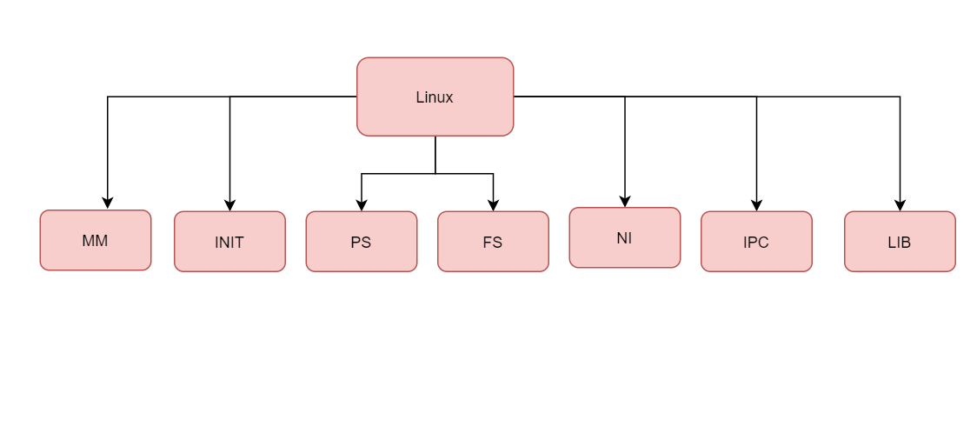
Linux Os Logical View
‹#›

Slide 12
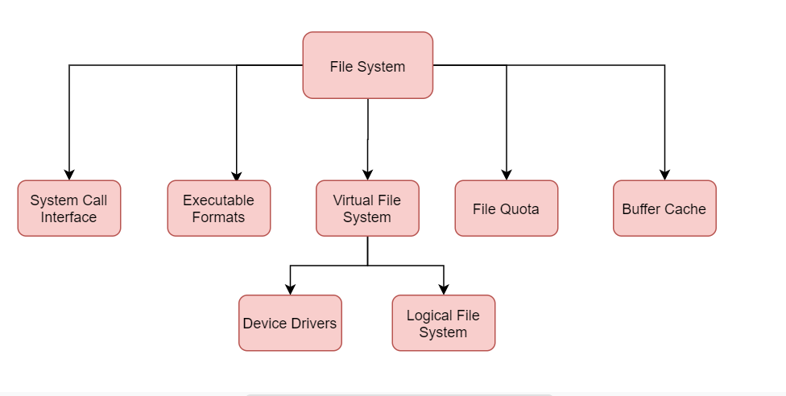
Logical View of File System
‹#›

Slide 13
Process View: Communication between processes and/or services
It deals with the dynamic aspects of the system, explains the system processes and how they communicate, and focuses on the run time behavior of the system.
It addresses concurrency, distribution, integrator, performance, and scalability, etc. UML diagrams to represent process view include the sequence diagram, communication diagram, activity diagram.
‹#›

Slide 14
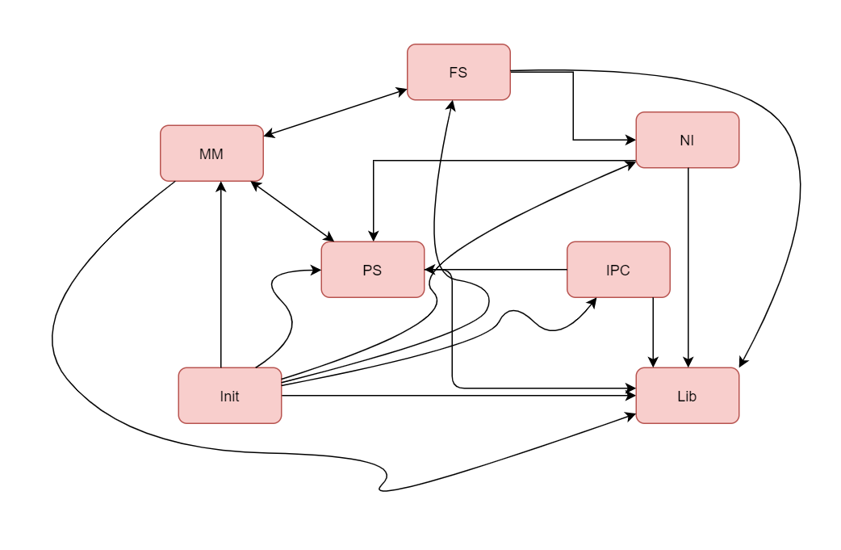
Process View
‹#›

Slide 15
Physical View: Deployment of your services
The physical view depicts the system from a system engineer's point of view.
It is concerned with the topology of software components on the physical layer as well as the physical connections between these components.
This view is also known as the deployment view.
‹#›

Slide 16
Development View
The development view illustrates a system from a programmer's perspective and is concerned with software management.
This view is also known as the implementation view.
‹#›

Slide 17
Scenarios
The description of an architecture is illustrated using a small set of use cases, or scenarios, which become a fifth view.
The scenarios describe sequences of interactions between objects and between processes.
They are used to identify architectural elements and to illustrate and validate the architecture design.
They also serve as a starting point for tests of an architecture prototype.
This view is also known as the use case view.
‹#›

Slide 18
The analysis phase focuses more on the business requirements
Usually on the scenarios and logical views
The design phase refine the logical views into more actionable
views
Oriented to more technical stakeholders
Design the interfaces and interactions to realize the user stories
Process views, development views, and physical views
‹#›

