Slide 1


Harness the Power of
Transaction Grid Computing ™
Corporate Briefing
January 2005
Version 6.3 Exec Summary

Slide 2

Who is ?
Peter Yared
Founder & CEO
  CTO, Liberty Alliance, Sun
  CTO, Application Server Division, Sun
  CTO, NetDynamics (acquired by Sun)
  Founder & CEO, JRad (acquired by NetDynamics)
Jeff Veis
VP of Marketing & Business Development
  Founder, Liberty Alliance, Sun
  Director, Hewlett-Packard
  Consultant, Booz-Allen & Hamilton
  MBA, Kellogg, Northwestern University
Seasoned engineering staff from
NetDynamics, WebLogic, Kiva, and Forte

Slide 3


Who is Backing ?
ActiveGrid Closed $3M Series A
  July 2004
Mitchell Kertzman, Hummer Winblad
  CEO, Sybase
  Founder & CEO, Powersoft
  Director, CNET Networks
Jean Louis Gassée, Allegis Capital
  Founder & CEO, Be
  VP Products, Apple
  Chairman of the Board, PalmSource

Slide 4
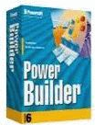

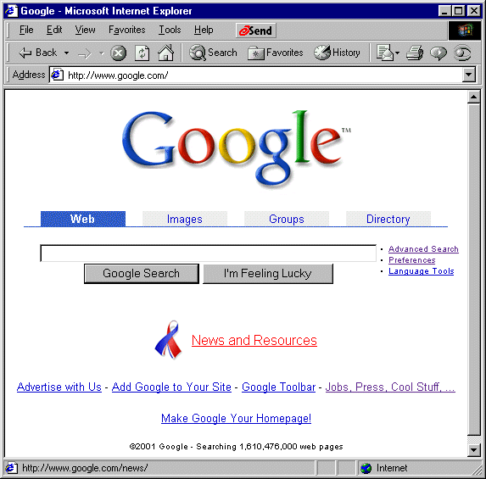

ActiveGrid Vision
Develop
like PowerBuilder™
Deploy
like
Google™
Serve
like
Starbucks®
Open Source LAMP Foundation

Slide 5


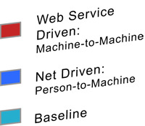







Evolution of Enterprise Computing Models
Grid
Internet
Relative Data Transaction Volume
Client/Server
Minicomputer
Mainframe
Computer Architectures Have Evolved with Data Transaction Growth

Slide 6




Three Tier Architectural Limitations
Scale Bounded
  Frequent bottlenecks at Application and Database tiers
  Proprietary middle tier caching add-ons are based on static technical rules
Costly
  J2EE requires experts to design and deploy applications
  Designed for expensive and proprietary SMP systems
Complex and Inflexible
  Siloed application SMP-based deployment
  Deployment architecture must be determined before writing a line of code
  Difficult to customize execution based on user class
Clients
Web Server
Tier
App Server
Tier
Database
Tier
Traditional 3-tier architectures
are designed to scale linearly

Slide 7










Trends Driving Enterprise Computing
Grids
  Next generation applications scale on
  LAMP Transaction Grids today
  All are hand-crafted
Open Source
  Open source innovation & reliability
  Economical LAMP software stack
  x86-based commodity computing
XML
  Web service integration of data sources
  Declarative programming with XML schemas
  Easy-to-use scripting languages
HTTP
Perl
XML Schema
BPEL
XForms
Java
PHP 5
XML
XPath
Python

Slide 8

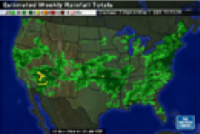
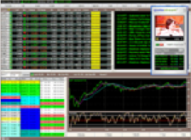

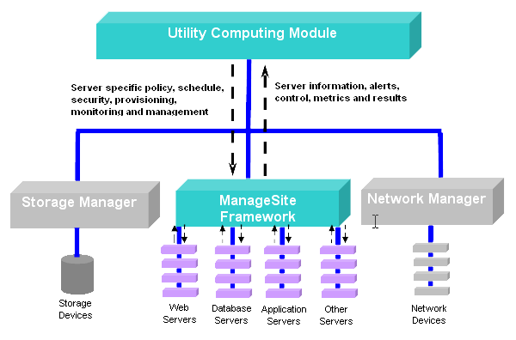

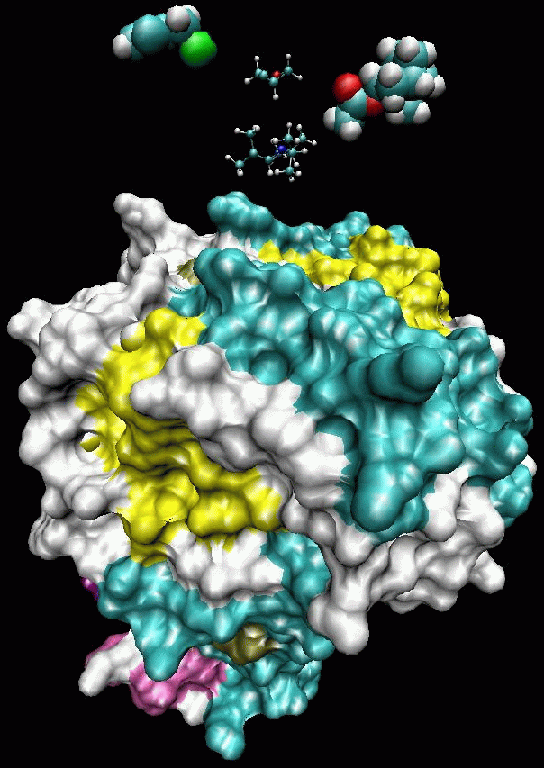

Enabling Transaction Grid Computing
Compute Grid
Parsing computational intensive applications into multiple batch
sessions
Utility Grid
Virtualizing the data center to address low
resource utilization
Transaction Grid
Deploy mainstream business applications across a grid of commodity computers running the open source LAMP stack
Scientific Applications, Animation Rendering, Weather Simulations
Financial Month-end Reporting
Order Entry, HR,
Online Commerce,
Trading Systems
Typical Applications What Is It?

Slide 9




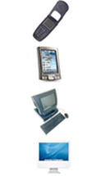



ActiveGrid Application Platform
Develop like
PowerBuilder™
Deploy like
Google™
Serve like
Starbucks®
Business
Partners
Complement
and extend your existing backend applications

Slide 10
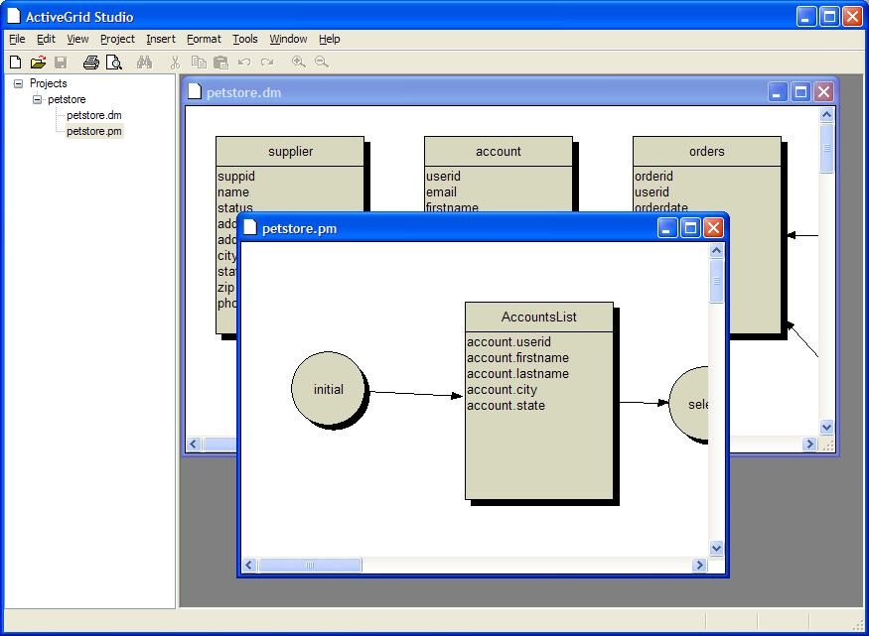
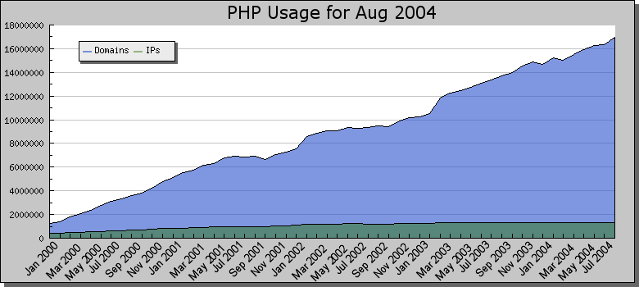
ActiveGrid Application Builder
“Develop Like PowerBuilder”
“4GL-like” Ease-of-Use
  Integrated web server and database
  Wizards for common tasks
Models
  Business Object Designer (XML Schema)
  Business Process Designer (BPEL)
Forms
  Form Designer (XForms)
Services
  PHP, Python, Perl and Java
  Logic added as “local web services”

Slide 11
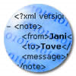
ActiveGrid Grid Application Server
“Deploy like Google”
ActiveGrid applications are written in XML and web service standards
  BPEL, XForms, XPath, XML Schema
  Scripts invoked as “local” web services
Applications are dynamically interpreted at runtime
  Spread across a grid of commodity servers
  Dynamically bind services and adapt transactions at runtime
  Tailor QoS for different user classes

Slide 12
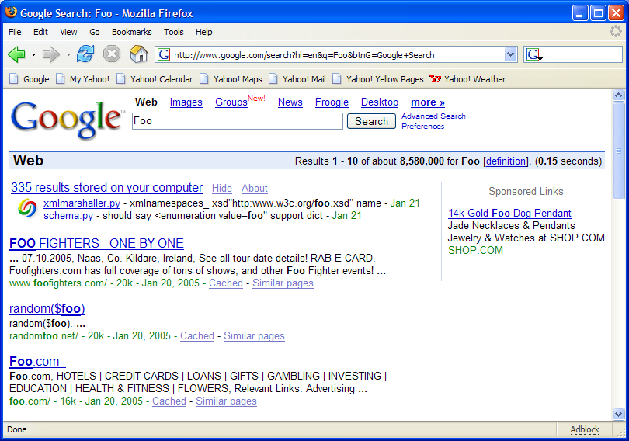


ActiveGrid Grid Application Server
“Deploy like Google”
Back-End Data
Grid Cached Data
Cached Interface

Slide 13



Adaptive Transactions
“Serve like Starbucks”
Companies strive to offer customized products for different customer segments and situations
Current IT systems generally offer only a single type of service
Pipelined architecture with multiple decisions executed at runtime
  Bean type, Milk type, steamed, flavoring,….
Controlled, policy-based decision making based on declarative inputs
  Data longevity, QOS level, Role, Transaction Type, Client Type….
Grid Application Server

Slide 14
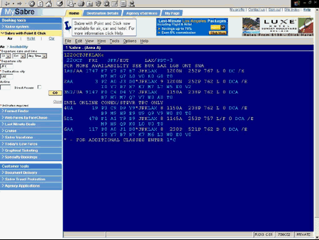
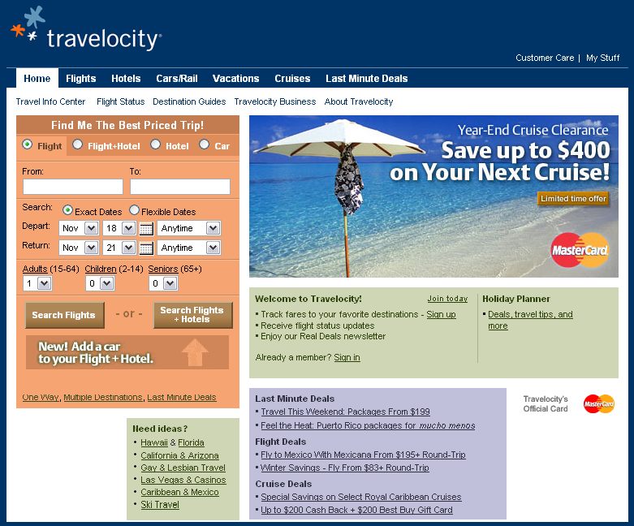
Adaptive Transactions Example
Reservation Systems
Travelocity
User: Travel Agents
Scale: Thousands
Interface: Text
Information Delivery: Real time data feeds to a traditional text oriented travel agent screen
User: Consumers
Scale: Millions
Interface: Graphical
Information Delivery: Cached data that is pulled from the backend on an hourly basis

Slide 15
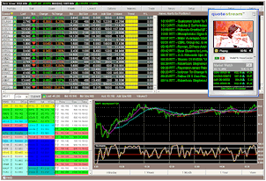
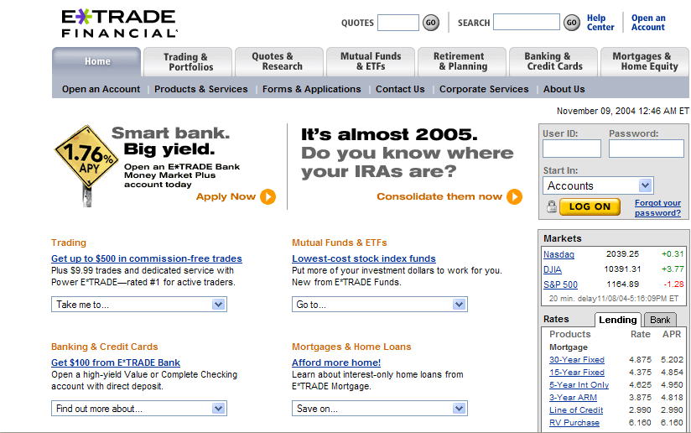
Adaptive Transactions Example
Trading Systems
Premium User
Standard User
User: Premium Users
Interface: DHTML
Information Delivery: Real time stock quotes; prioritized response times; rich browser experience; replicated session failover
User: Standard Users
Interface: HTML
Information Delivery: 15 minute cached stock quotes; no session replication

Slide 16





Adaptive Transactions
“Serve like Starbucks”
Data
Longevity
Role
Employee, Manager,
Executive,
Premium Customer,
Budget Shopper…
1 hour, 24 hour,
Real Time…
Adaptive
Transactions
Minimum Response
Time, Server Side
Session Replication…
Add to Shopping
Cart, Purchase…
QoS
Policies
Transaction
Type
Client
DHTML, Client side validation, WML, Cascading Style Sheets, tabbed browsing…

Slide 17
ActiveGrid Application Platform
Complements and Extends
Minimizes
Backend
Connections
Adapts
Dynamically to Context and Situations and
Binds Services across the Transaction Grid
Utilizes
Client
Capabilities
Business
Partners

Slide 18
ActiveGrid Grid Application Server
Architecture
DATA CACHING
Huge aggregate cache across
n machines
Reference data model to learn lifespan of data queries
Infer lifespan of query results based on joins across disparate data sources
Manage cache based on lifespan of data and priority of data
Read-only cache - writes are performed straight through to original sources
ActiveGrid
Grid Application Server
INTERFACE CACHING
Cache variety of interfaces based on client & security contexts
Tailor interfaces based on policy driven security context
Render XML Web Services with latest SOAP specifications for security, routing, etc.
Dynamically render HTML via XForms
Data Caching Service
Transaction Service
Session Service
Interface Caching Service
TRANSACTION
Determines validity of data based on policy-driven persistence levels
Client & security concurrent context options
Local stateful cache with optimistic concurrency
Write-through with pessimistic concurrency
WS-Transaction implementation for heterogeneous multi-phase commits
SESSION
Client & security concurrent context options
Session ID embedded using cookie, browser form, or URL rewriting
Multiple RAM affinity, RAM replication, database persistence, and browser form embedding options
Affinity implemented by redirects within cluster
Dynamic Binding Service
DYNAMIC BINDING
Composite applications can be portioned across N grid nodes
Self managed by grid application server based on QOS policies
Enabled by apps that are declarative with well defined scripts
<footer>ActiveGrid Proprietary and Confidential

Slide 19
ActiveGrid Application Platform
Features and Benefits
Capability | Feature | Benefit
Develop like PowerBuilder™ | 4GL graphical user Interface Native XML standards-based development Language neutral (Python, PHP, Perl & Java support)) Composite application integration Declarative programming | Faster 10X faster than J2EE 70% application integration cost savings SaaS (Software as a Service) Single-click hosted deployment
Deploy like Google™ | Commodity computing-based grids Open Source LAMP stack Intelligent Data & Interface caching Transaction and Session Mgmt | Cheaper 10X less expensive than traditional 3-tier systems 30% administration cost savings
Serve like Starbucks® | Dynamically adapted transactions Business policy-driven Client-specific rendering | Better Personalized User Experience Increase revenue Competitive differentiation Diverse client support

Slide 20
ActiveGrid Products
ActiveGrid™
Application
Builder
ActiveGrid™
Application
Builder
ActiveGrid™
Grid Application
Server
ActiveGrid™
Grid Application
Server
ActiveGrid™
Grid Application
Transaction Server
ActiveGrid™
Grid Application
Transaction Server
Open Source (ASL)
Fully integrated declarative
XML development , scripting
language and Java support
Windows, Linux & Mac OS
client support
Open Source (ASL)
Enterprise-class server
with interface rendering &
basic persistence
capabilities.
Commercial License
Data center-class server
with context aware
transaction processing and
session replication.
ActiveGrid™
Application
Builder
Free,
Commercial Support
ActiveGrid™
Grid Application
Server
Free,
Commercial Support
Hosting Partners
ActiveGrid™
Grid Application
Transaction Server
Commercial License,
Commercial Support
Hosting Partners
Develop
Deploy
<footer>ActiveGrid Proprietary and Confidential

Slide 21

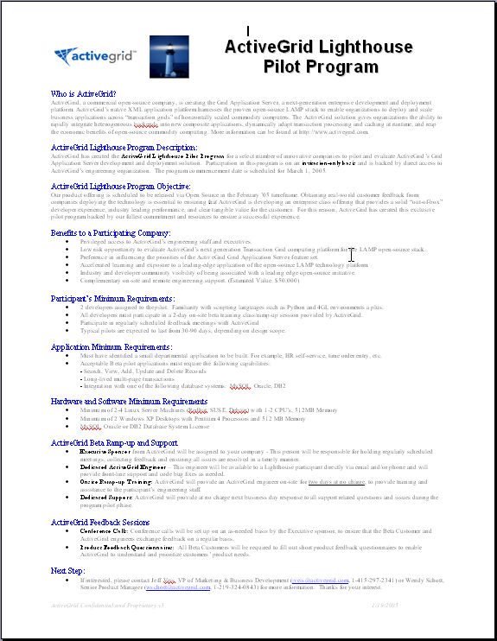
ActiveGrid Lighthouse Program
Proof-of-Concept Pilot
Benefits to a Participating Company
  Direct access to ActiveGrid engineering
  Preference in influencing ActiveGrid’s priorities
  Executive Sponsor and Onsite 2 Day Training
  Dedicated next business day technical support
Participant’s Minimum Requirements
  Assign 2 developers to the pilot
  All developers must participate in a 2-day training class
  Participate in regularly scheduled feedback meetings
Application Minimum Requirements
  Identify a small departmental application to be deployed
  Beta pilot candidate application functional requirements:
    Search, View, Add, Update and Delete Records
    Execute long-lived multi-page transactions
    Integrate with MySQL, Oracle or DB2
    Contact Jeff Veis at jveis@activegrid.com if interested
Invitation only program starts March 1, 2004

Slide 22
ActiveGrid Application Platform
Delivering Real Business Benefits
Gain Competitive Advantage
Eliminate Vendor Lock-in
Increase
Flexibility
Maximize
Utilization
Reduce
Cost
Scale Performance
Accelerate
Deployment
Open Source Transaction Grid Computing

Slide 23
Develop
like PowerBuilder™
Deploy
like
Google™
Serve
like
Starbucks®
Open Source LAMP Foundation

