Slide 1
BOF #1 – Fundamentals of the Web
Bootup Open Forums
CTO-level technical introduction to key technology
Interactive throughout – succinct Q&A will drive content
Laptops welcome although not required (not yet)
Semi-weekly – recommend topics yourself
Community involved - lead a BOF yourself

Slide 2
Fundamentals of the Web Introduction to the technology of the world wide web
BOF #1
April 5th, 2010
Hans Zaunere, Managing Member

Slide 3
Overview
The Cast and Key Concepts
The Browser Side
The Server Side
HTTP
The Database
Case Study
AJAX, AJaX, or Ajax
Web Services

Slide 4
The Cast
Browsers, servers, protocols, and code
Key concept: client – server model
The web is a classic example (as is much of the Internet)
The client requests content from a server
The server responds with the content
Pre-defined language - protocol - used to communicate
This exchange is the request-response cycle
Client: Browsers
Server: Web server
Protocol: HyperText-Transfer-Protocol (HTTP)
Content: HTML, CSS, Javascript, and media
Database: Behind the scenes source of content

Slide 5




The Browser Side
Internet Explorer, Firefox, Safari, Chrome
The browser displays content
The human-friendly user interface to the web
Makes requests to web servers to get content
The “client” in the client-server model
Content is uniquely identified by a Uniform Resource Locator (URL) - web address
Referred to as the client-side or front-end
Renders or displays the code as graphics and text
Includes HTML, CSS and JavaScript
This code is executed exclusively by the browser
Plug-ins and toolbars to extend functionality
Includes Flash, Silverlight, Yahoo!/Google toolbars

Slide 6





The Server Side
Apache, IIS, lighttpd
The web server delivers content
Serves content as the response
The server in the client-server model
Referred to as the server-side or back-end
Executes code to validate and process the request, and build the response
Includes PHP, ASP.NET, Java, Python, Ruby
This code is executed exclusively by the server
Key concept: web stacks
Sets of server technologies that deliver web content
Includes LAMP, WISP, JOLT, LAMR

Slide 7
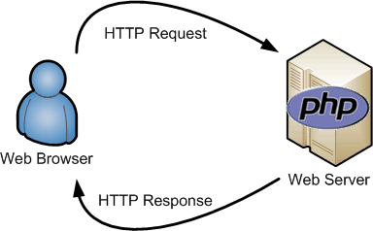
HTTP
HyperText-Transfer-Protocol
The standard used to exchange information on the web
Connects the client and server sides - communication channel
Key concept: stateless
After request-response cycle is over, neither knows of each other
Cookies are utilized to maintain a session
Server keeps knowledge that a client existed, identified by a cookie left on the browser
For such things as knowing whether a user is logged in or not
Different types of requests – POST and GET
HyperText Transfer Protocol Secure – HTTPS
Encrypts the communication channel
Provides a mechanism – an SSL certificate - to ensure the client is communicating with the server it intends to

Slide 8





The Database
MySQL, Oracle, MSSQL, PostgreSQL, “noSQL”
Databases provide web servers with content to deliver
Key concept: static vs. dynamic content
Originally, web page content was stored only as static files
Changing content involved manually editing and saving each file
Databases store content in maintainable repositories
Web apps written to dynamically create/assemble/change content
Databases can be used to store many different types of content
User information, financial information, media
Removes the limitation of storing all content in separate files

Slide 9


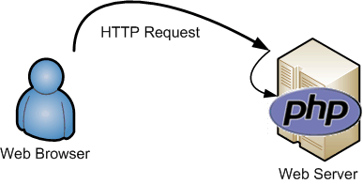
Case Study: View a Web Page
Part One – The Request
Address is typed into browser
URL - www.nyphp.org
Browser looks up the server to request
Domain registrars – godaddy.com
DNS – root servers, ne3.nyphp.com
IPs – 72.26.195.121
Browser sends request to server
HTTP (and TCP/IP)

Slide 10
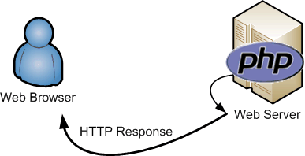
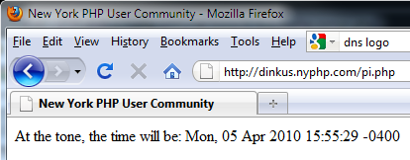
Case Study – View a Web Page
Part Two – The Response
Server processes request and builds response
LAMP stack - Linux, Apache, MySQL and PHP
Server sends response to browser
HTTP (and TCP/IP)
Browser receives content…
…and renders the web page
HTTP, HTML, CSS and JavaScript
<!DOCTYPE HTML PUBLIC "-//W3C//DTD HTML 4.01 Transitional//EN"....>
<html>
<head> <title>New York PHP User Community</title> </head>
<body>
<p><?php echo 'At the tone, the time will be: '.date('r'); ?>
</body>
</html>
All that for one request/response!

Slide 11
Ajax and the 2.0 Web
Asynchronous JavaScript And XML
Web 1.0 – Viewing a web page meant one request-response
Web 2.0 – One main request-response
… and many sub request-responses
Browser executes JavaScript received from the main request-response
Includes, JSON, HTML, XML
Access content fragments without reloading the entire page
Allows for some processing in the browser
Ajax is strictly client-side, occurring only in the browser
Although it does have ramifications for the server-side
… and somewhat blurs the division
jQuery, Prototype, Dojo, YUI, Google
Key concept: generally changing content within the browser
Includes manipulating the Document Object Model (DOM)
Dynamically update content without the main request-response

Slide 12



Web Services
When the Clients are Servers
Web sites that are computer-friendly
The browser is replaced by another web server
There is still a client-server relationship
One client is actually another server
Another content source, akin to databases
Allows highly distributed and abstracted data
The communication channel remains HTTP, however the content has changed
Includes RSS, XML and JSON
URLs become commands
Requests are commands for the remote server
They form an Application Programming Interface (API)

Slide 13
Thank You
hans.zaunere@nyphp.com
New York PHP Mailing Lists are free and available to anyone:
http://www.nyphp.org/mailinglists.php

