Slide 1
BOF #2 – Introduction to PHP and MySQL
Bootup Open Forums
CTO-level technical introduction to key technology
Interactive throughout – relevant Q&A will drive content
Laptops welcome although not required (not yet)
Semi-weekly – recommend topics yourself
Community involved - lead a BOF yourself

Slide 2
Introduction to PHP and MySQL The Dynamic Duo for a Dynamic Web
BOF #2
April 12th, 2010
Hans Zaunere, Managing Member

Slide 3
Overview
The Cast and Key Concepts
HTTP
The Request
The Process
The Database
Putting it All Together

Slide 4
The Cast
HTTP, Apache, MySQL and PHP
Key concept: client – server model
This exchange is the request-response cycle
HTTP – Protocol used to communicate
Apache – The web server
MySQL – Provides content/data to display
PHP – PHP Hypertext Preprocessor within Apache
AMP: Acronym for three key software components
Basis of modern, dynamic, web/internet applications
 | Apache | Provides the transit
 | MySQL | Provides the data
 | PHP | Provides the processing – the “glue”

Slide 5
HTTP
HyperText-Transfer-Protocol
Key concept: stateless
After request-response cycle is over, neither knows of each other
One of the issues of security or “hi-jacking”
Cookies are utilized to maintain a session
Server keeps knowledge that a client existed, identified by a cookie left on the browser
For such things as knowing whether a user is logged in or not
Different types of requests
GET – includes optional query string – read-only
POST – can also include query string – write or read
HyperText Transfer Protocol Secure – HTTPS
Encrypts the communication channel through a SSL certificate

Slide 6


The Request
Telling PHP What To Do
PHP is designed to handle HTTP communication
Apache module (other options are available)
Embedded into HTML using <?php and ?> tags
Provides “super-globals” for accessing information about the request
$_GET – GET query string variables
$_POST – POST variables
$_COOKIE – Other cookie variables
$_SESSION – Internal session information using a session ID

Slide 7
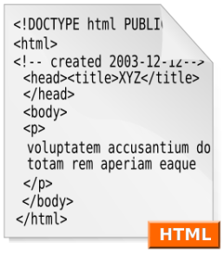
The Process
HTML – The “Goods”
PHP is designed to process hypertext
HTML is the HyperText Markup Language, used for giving structure to the information exchanged on the WWW
REQUEST: HTTP/1.1 GET /my-script.php?FirstName=David
RESPONSE:
<!DOCTYPE HTML PUBLIC "-//W3C//DTD HTML 4.01 Transitional//EN"....>
<html>
<head> <title>Hello World</title> </head>
<body>
<b>
<?php echo "Hello There ".$_GET['FirstName']; ?>
</b>
<?php echo 'At the tone, the time will be: '.date('r'); ?>
</body>
</html>
Browser then receives and renders the HTML
Doesn’t know that it’s been generated dynamically

Slide 8

The Database
SQL – The “Supplier”
Data is stored in tables and columns
PHP is designed to communicate with databases
SQL is the Structured Query Language, used for manipulating and retrieving data
SQL is also used for complex or “relational” data
SELECT FirstName,LastName,
DATE_FORMAT(DoB,'%M, %D, %Y') AS DateOfBirth
FROM Users
WHERE STRTOUPPER(LEFT(FirstName,1)) = 'H'
SELECT FirstName,LastName,Address1,Address2
FROM Users,Address
WHERE R_UserID=UserID
AND STRTOUPPER(LEFT(FirstName,1)) = 'H'

Slide 9
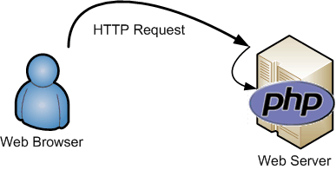
Putting It All Together
Your Cast and Crew – Apache / MySQL / PHP
Web browser uses HTTP to make web server request
Web server passes control to PHP
PHP uses SQL to query the database and fetch data
REQUEST: HTTP/1.1 GET /my-script.php?FirstNameFirstLetter=H
<?php
$FirstNameFirstLetter = mysql_escape_string($_GET['FirstNameFirstLetter']);
$Result = mysql_query("SELECT FirstName,LastName,
DATE_FORMAT(DoB,'%M, %D, %Y') AS DateOfBirth
FROM Users
WHERE STRTOUPPER(LEFT(FirstName,1))
= '{$FirstNameFirstLetter}'",$MYDBR);
$ResultCount = mysql_num_rows($Result);
$ResultArray = array();
for( $i = 0; $i < $ResultCount; ++$i )
{
$ResultArray[$i] = mysql_fetch_assoc($Result);
}
?>

Slide 10
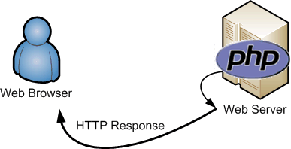
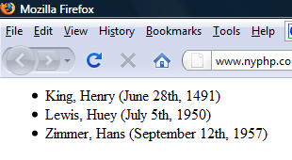
Putting It All Together
The Finale
PHP manipulates returned data and processes HTML
PHP and the web server use HTTP to respond
Web browser receives HTML and displays the results
<!DOCTYPE...>
<ul>
<?php foreach( $ResultArray as $Key => $Row ): ?>
<li><?=$Row['LastName']?>, <?=$Row['FirstName']?> (<?=$Row['DateOfBirth']?>)</li>
<?php endforeach; ?>
</ul>

Slide 11
Thank You
hans.zaunere@nyphp.com
New York PHP Mailing Lists are free and available to anyone:
http://www.nyphp.org/mailinglists.php

