Slide 1
Fundamentals of Hosting:
What You Need to Know about Managed Services, Colocation, Dedicated Servers, and Other Mission-Critical Data Services
May 10, 2010
Presented by
Phillip Koblence
VP, Operations, NYI

Slide 2
What Is Hosting?
“Providing websites a home to live.”
“Space for your site on the Internet.”
“A business that allows customers to operate their own website without having to run their own computer 24/7.”
All of the above.
None of the above.
Source: Webhostingtalk.com

Slide 3
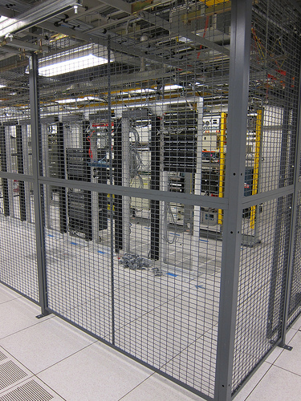
Types of Hosting
Colocation
Managed Services
Dedicated Servers
Virtual Private Servers
Web & Email Hosting
Custom Services

Slide 4
Colocation
DEFINITION – The placement of a company’s servers on the premises of a third-party provider such as a data center, where multiple customers locate network, server and storage gear and interconnect to a variety of telecommunications and other network service provider(s) with a minimum of cost and complexity.

Slide 5
Managed Services
DEFINITION – Similar to colocation, only the provider owns the server, while performing defined business tasks in the operation and maintenance of the equipment. Managed services include including offsite data backups, firewall & VPN management, virus scanning, intrusion prevention, integrity monitoring.

Slide 6
Dedicated Servers
DEFINITION – Again, provider owns the server, but customer does not share disc space with anyone. Availability, price and employee familiarity often determines which operating systems are offered on dedicated servers. Variations of Linux are usually offered at no charge to the customer.

Slide 7
Virtual Private Servers
DEFINITION – Multiple domains hosted from the same server running its own operating system that can be independently booted. Less expensive than managed and dedicated hosting. Popular lately due to advances in virtualization technology and architecture. Also for economic reasons.

Slide 8
Web & Email Hosting
DEFINITION – Specialty hosting to support these particular business functions. Most common configuration is in shared server environment, but more customized deployments are available depending on business need.

Slide 9
Custom Services
DEFINITION – Personalized deployments that fit an individual customer’s needs. The bespoke suit of mission-critical data services. See: NYI Difference

Slide 10
Benefits of Using an External Provider
Cost (material, bandwidth, staffing, etc.)
Expertise
Security (redundant power, HVAC, etc.)
Disaster Recovery/Business Continuity Planning

Slide 11
What Start-Ups Should Watch Out For
In a word: inflexibility. Some providers will force companies to purchase more services than they actually need, which is a waste of precious capital. Other dishonest providers have a low up-front price then get you with overages.

Slide 12
OnStartups.com’s Myth of Almost-Free Web Hosting #5
“The Disaster Lottery Ticket: Most web startup companies that are saving money on hosting costs are basically living on borrowed time. If you want to make startup founders lose sleep, ask them one simple question:
If all of a sudden, your server died taking all data that was on it with it, how long before you could start serving customers again? (hint: Many bootstrap startups are not worried all that much about reliable backups). For added fear, add the fact that your hosting provider does not respond to your email or phone calls within the first 24 hours.”

Slide 13
OnStartups.com Offers a Personal Example
“…Web hosting is not free. Much of your costs also depends on your proclivity for ulcers and how much money your customers are paying you (and what they can expect for that). If you’ve got 100,000 “free” users, maybe you can get away with $100-$200/month. But, even then, not for long. So, the big message here is this: Are you being realistic when planning out your business model? Can you really afford to grow to a million ‘free’ users in the hopes of making money some day? Maybe you can. But then again, maybe you can’t.”

Slide 14
WHAT TO DO?????

Slide 15
Answer: Expect more…

Slide 16
NYI Difference
Technical capabilities of a global provider combined with the personalized approach of a boutique
Customers get a customized, facilities-based solution
Award-winning approach gives customers the best of both worlds
14 years of expertise serving customers from a broad range of industries, from financial services and media, law and fashion, to technology, architecture, life sciences, and real estate
Industry partners include high-connectivity solutions providers AboveNet, Verizon Business, Optimum Lightpath, AT&T
Personalized 24x7x365 support

Slide 17
NYI Difference for Start-Ups
Flexibility means you can scale up or scale down service footprint based on current need
Personalized customer support means NYI will support your company through growing pains
Flexibility also means affordable DR/BCP solutions for small/mid-sized businesses whose need for such services is business-critical
Successful track record of supporting start-ups include Meetup.com, DayLife, etc.
“NYI is an outstanding network partner…Having worked with a great number of technology startups, they have keen insight into our unique needs.”
-- Merrill Ferguson, Director of Technical Operations, Meetup

Slide 18
Our Customers Love Us
“NYI is an extremely customer-focused company whose flexible service approach enables us to customize our technology choices to best suit our needs.”
-- Peter DiRenzo, Digital Operations Director, Wenner Media
“NYI knows that small to mid-sized businesses want accessibility to the same DR/BCP resources enjoyed by the Fortune 500.”
-- Bill LaPerch, CEO and President, AboveNet
“In terms of numbers alone, we would be spending 10X our current rate to replicate internally the superior service NYI has given us the past five years.”
-- Nick Serafini, Head of Information Services, Portware

Slide 19
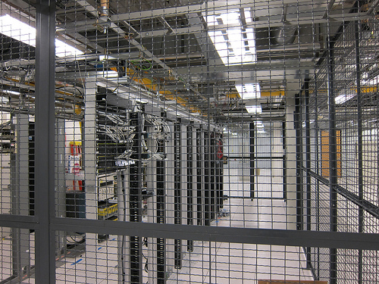
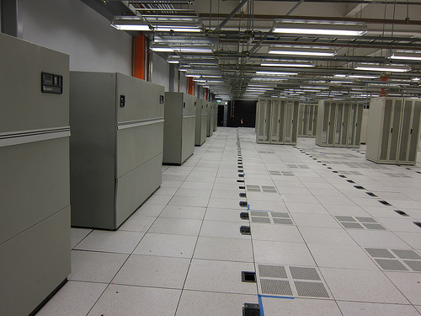

Our Latest Milestone: 999 Frontier

Slide 20
Technical Specifications: 999 Frontier
Standalone building w/over 40,000 Square Feet
5 MW of Power Available, 20 MW available for future upgrade
2N + 1 UPS Configuration (Over 2 MW Capacity)
2N Generator Configuration
24" Raised Floor
Power Density Over 150 Watts/Foot
Fully Meshed, Fault Tolerant NYI Network Available for Customer Use
Multiple Fiber Entry Points (Current Fiber Providers: Lightpath,
  AboveNet, Verizon Business, AT&T)
24x7x365 Biometric Access to Facility
Client Lounge Available for Onsite Technicians
Custom hotseat configuration for companies requiring DR/BCP office space

Slide 21
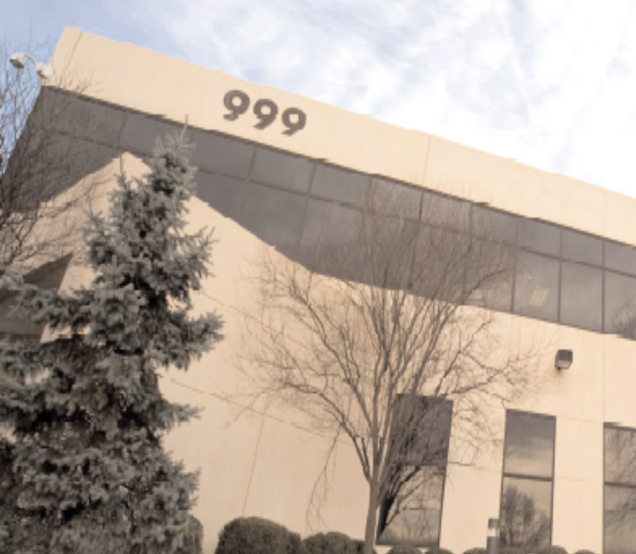
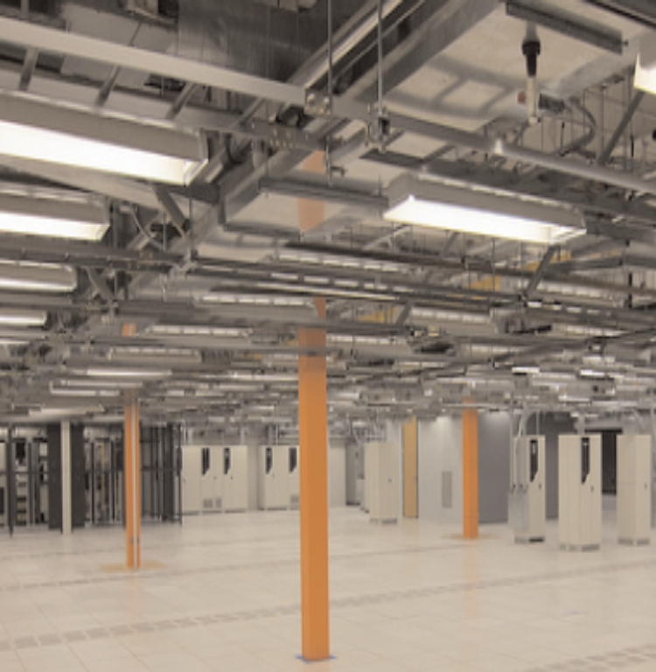
NYI & You: What Can We Do to Help?

Slide 22

Let’s Talk!
Phillip Koblence
phillip.koblence@nyi.net
212.269.1999 x2401

