Slide 1
How to Code HTML Email Newsletters
Bootup Open Forum
June 14, 2010
Tim Slavin
tim@owlhillmedia.com
http://www.reachcustomersonline.com
http://linkedin.com/in/timslavin
(516) 234-0607

Slide 2
The Big Picture
Overview
Step 1: Code with HTML Tables
Step 2: Use Inline CSS
Step 3: Testing
Step 4: Delivery
Best Practices
Resources

Slide 3
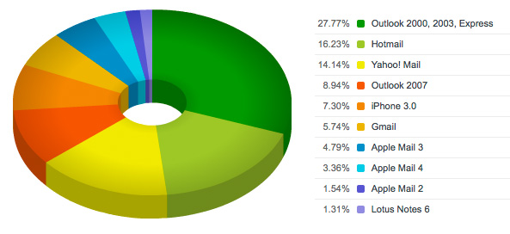
Email Software Clients
12 months and 500,000,000 email opens
http://www.campaignmonitor.com/stats/email-clients/
Notes:
These statistics are from 2009. Note that Outlook and Apple Mail numbers include mail sent to Gmail, HotMail, Yahoo!, and other webmail domains that are retrieved through POP3 in Outlook or Apple Mail.

Slide 4
HTML Email Design Constraints
Limited to email client preview window
Images often blocked initially
Can’t cram a web page into narrow email width
Less design works best: clear call to action, fewer headings, tight branding, less copy and images
The From, Subject line, and other micro-copy are what readers use to determine whether or not to open an email, NOT THE EMAIL DESIGN (sorry)
Notes:
These are the high level design constraints you face when you design an HTML email.

Slide 5
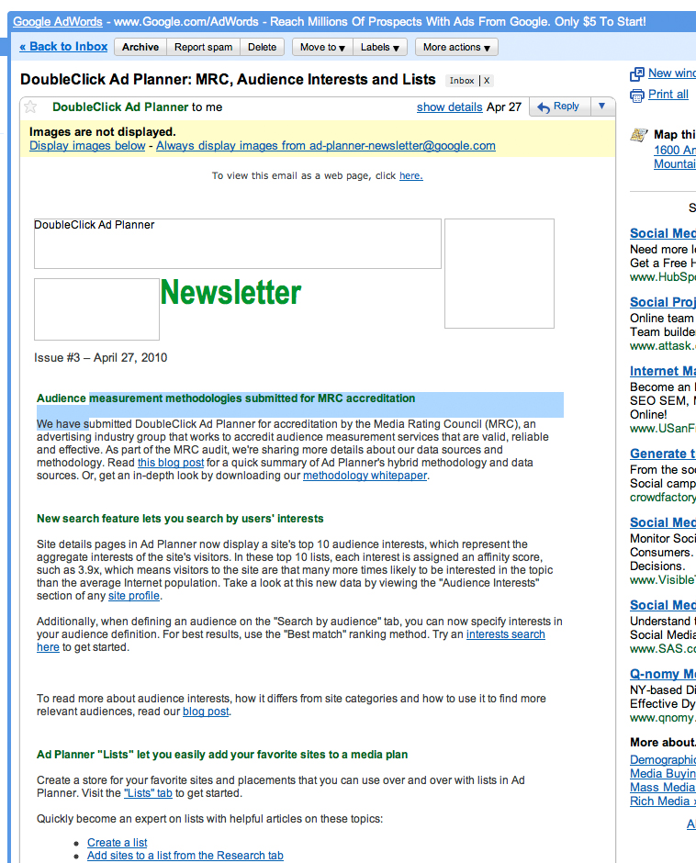
What You’re Up Against
Notes:
Here is an email in Gmail. Note the missing images outlined with square or rectangular borders. I’ve highlighted a heading and some text in this email.

Slide 6
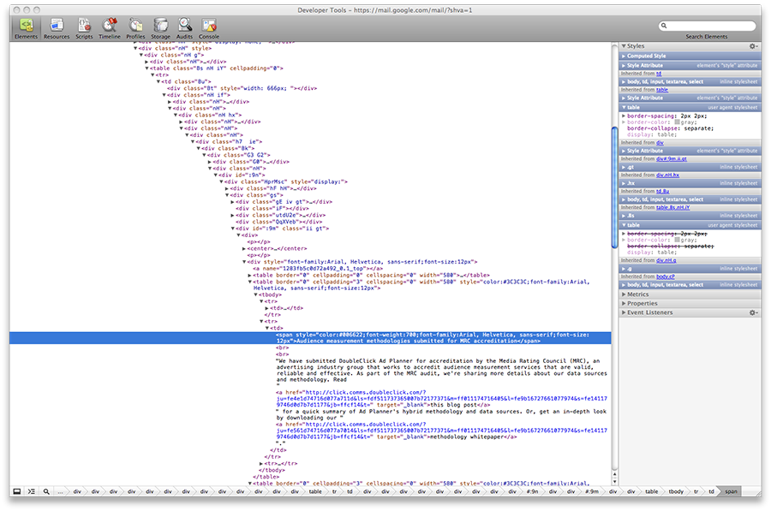
What You’re Up Against
Notes:
Now let’s look at the heading and text I’ve highlighted in my Gmail email, but as code. Note the massive amount of nested code Gmail has wrapped around the email content. This is the primary challenge faced by coding HTML email: your code will be wrapped around by other code that may or may not adversely impact your code. This presentation shows how to ensure your HTML email code displays well across most if not all email software.

Slide 7
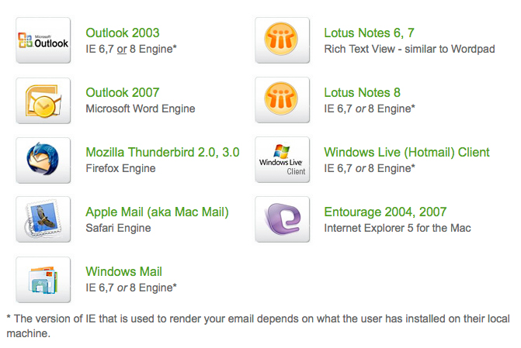
Email Software Clients
Email software and engine they use to render/interpret HTML:
http://www.emailonacid.com/blog/details/C6/strategies-for-email-testing
Notes:
Note that the problem email software clients are ones with inferior HTML rendering engines: Outlook 2007 (and Outlook 2010 that also uses the MS Word rendering engine), Lotus Notes 6 and 7, and Entourage 2004 and 2007. All other email software clients use rendering engines based on web browsers, most of which are modern browsers with decent support for basic HTML and inline CSS style definitions.

Slide 8
The Big Picture
Overview
Step 1: Code with HTML Tables
Step 2: Use Inline CSS
Step 3: Testing
Step 4: Delivery
Best Practices
Resources

Slide 9
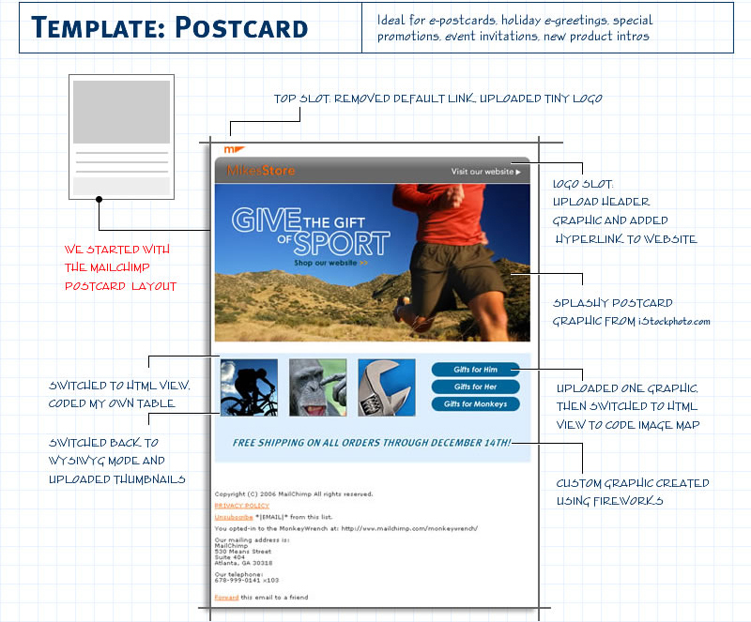
Layout Strategies
http://webimages.mailchimp.com/img/resources/template-howtos/blueprint_1.jpg
Notes:
When you design and code an HTML email, you need to think in terms of grids and nested elements. Imagine the Russian dolls that have smaller and smaller dolls nested inside them.

Slide 10
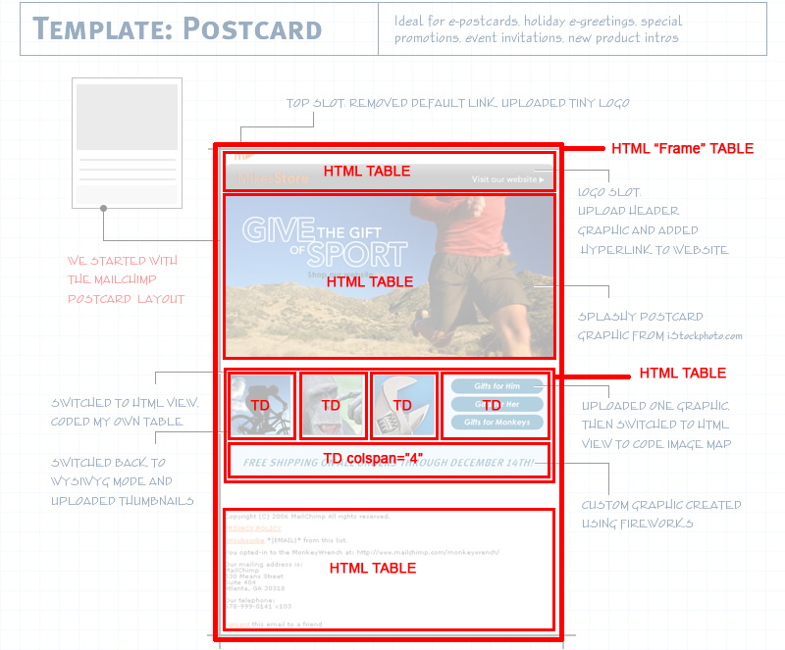
Layout Strategies
Notes:
Here is the HTML design that shows one possible way to create the code with nested HTML tables, starting with a frame table. All the HTML tables use a single table data (TD) cell except for the center area which uses two table rows (TR), one with four table data (TD) cells and one row that spans the four table data (TD) cells above it in that HTML table. This is the most basic way to think about how to layout your HTML email as code so that it can survive email software clients and display well.

Slide 11
Step 1: Use Nested HTML Tables
<table border=“0” cellpadding=“0” cellspacing=“0” width=“98%”>
<tr>
<td>
<table border=“0” cellpadding=“0” cellspacing=“0” width=“500”>
<tr>
<td>
…content here …
</td>
</tr>
</table>
</td>
</tr>
</table>
Notes:
This is how nested HTML tables look as code. Note the border=0 value and the width=98% value. The border setting lets you see and debug your HTML table as you build and nest them. The width=98% is for Yahoo! and other webmail clients that require a thin gutter space to the left and right of email they display. Note, however, that all the HTML tables nested inside the frame table use fixed widths, in this case, width=500. This prevents parts of your HTML email from slipping down or displaying incorrectly.

Slide 12
Step 1: Use Nested HTML Tables
One HTML frame table to rule them all as a pseudo-body
DIVs that float don’t always work
SPANs almost always work
Fixed width works better than fluid for non-frame tables
500 pixels wide is optimal
Use border=“1” to debug HTML table layout problems
Spacing problems? Start with TDs
Mystery gap under image? Pull </td> up flush with the image in one line of code (an ancient HTML bug):
<td><img …></td>
Notes:
These are basic guidelines to follow as you create your HTML email with nested HTML tables.

Slide 13
The Big Picture
Overview
Step 1: Code with HTML Tables
Step 2: Use Inline CSS
Step 3: Testing
Step 4: Delivery
Best Practices
Resources

Slide 14
Step 2: Use Inline CSS
<table border=“0” cellpadding=“0” cellspacing=“0” width=“98%”>
<tr>
<td>
<table border=“0” cellpadding=“0” cellspacing=“0” width=“500”>
<tr>
<td style=“margin:0 0 0 0;padding: 0 0 0 0;”>
<p style=“color: #000000;font-family:Arial; font-size: 12pt; line-height: 18pt;”> …content here … </p>
</td>
</tr>
</table>
</td>
</tr>
</table>
Notes:
This example shows what inline CSS looks like within nested HTML tables. Note that CSS shorthand for font and color is not used. You define separately the font-family, font-size, and line-height instead of font: 12pt/18pt Arial. When you send email through an email service provider, their delivery software also will tweak your inline CSS based on their experience.

Slide 15
Use Inline CSS
Gmail strips out internal stylesheets
Some webmail clients strip out any CSS not inline
External stylesheet(s) work some times but not universally
Use IMG alt, title, height, width tags to handle email clients that do not display images
Background images do not always work
Bottomline, always inline your CSS
Notes:
Some basic guideliness for using CSS styles in your HTML email.

Slide 16
The Big Picture
Overview
Step 1: Code with HTML Tables
Step 2: Use Inline CSS
Step 3: Testing
Step 4: Delivery
Best Practices
Resources

Slide 17
Testing Your HTML Email
Test first in browsers: IE 6/7/8, Firefox, Safari, Chrome, Opera
Analyze your list for most common domain names (e.g. @gmail.com)
Ignore your list analysis, it’s probably inaccurate (e.g. POP3 lets people read Gmail in Outlook, Notes/Outlook is invisible or tough to identify)
Use test accounts and email delivery services to see how your email displays across email clients
Email service providers sometimes include spam tests for your email code and copy
Bottomline: basic code always works
Notes:
As you code your HTML email, start testing first with older and modern web browsers. Once your HTML email displays well in these web browsers, then use an email delivery service to send test emails to your test accounts and use a service that shows how your email displays in a range of email software clients. Then test a specific HTML email for its potential spam rating and make any code revisions for that concern. Note that having your HTML email display well in Safari and Opera can help ensure your HTML email will display fine in a mobile phone handset that uses either web browser to render HTML email.

Slide 18
The Big Picture
Overview
Step 1: Code with HTML Tables
Step 2: Use Inline CSS
Step 3: Testing
Step 4: Delivery
Best Practices
Resources

Slide 19
ESP vs DIY
Send email with Email Service Providers (ESPs) or DIY?
Always send through ESPs: it’s their job to get their emails white-listed and avoid black lists. Cost is marginal.
Internet access providers have a threshold that will cut off your internet access because you’re a “spammer” sending 313 emails with Outlook when threshold is 312 emails
[ Insist on sending bulk email from Outlook? Create a signature template with your html email code then add the signature to your email. ]
Notes:
The question of whether to send yourself or through a legitimate email service provider should be moot. It costs very little to get a lot of benefit compared to the risks of sending email yourself to a number of people. The ability to manage subscribes and unsubscribes alone is worth the cost of an email service provider.

Slide 20
Email Service Providers (ESPs)
Break into three cost tiers: low, medium, and high cost. Cost is by email sent or monthly fee.
Evaluate ESPs on white list and blacklist process, spammer policies (do they kick people off?), client testimonials, additional services (free templates, spam tests, testing email clients), list restrictions, then cost
Test their email signup code on your site: ConstantContact, as of summer 2009, made visitors fill signup form twice
Create your HTML email then paste into the ESP new email form and test send to your test accounts
Notes:
These are basic guidelines to evaluate email service providers.

Slide 21
Email Service Providers (ESP)
Low and medium cost ESPs to consider:
Bronto.com
CampaignMonitor.com
ConstantContact.com
CoolerEmail.com
iContact.com
MailChimp.com
MyEmma.com
… and many, many, many others …
Notes:
These are a handful of low cost email service providers.

Slide 22
The Big Picture
Overview
Step 1: Code with HTML Tables
Step 2: Use Inline CSS
Step 3: Testing
Step 4: Delivery
Best Practices
Resources

Slide 23
Code That Triggers Spam Filters
1 pixel transparent graphics used to place images precisely (circa 1990s HTML trick)
Email is one image with no copy in email
Javascript anywhere in email
Forms (some times)
Notes:
These are the most common code problems that trigger spam filters. The one pixel trick is especially a problem: better to style the table data (TD) cell that contains the image or copy you need to add space to than a 1 pixel GIF file. The reason? Some email software clients interpret the 1 pixel GIF differently but display the spacing styles fine.

Slide 24
Code for HotMail, Gmail, Yahoo!
target=“_blank” for all anchor tags/links
Frame table width=“98%”
No unnecessary white spaces in TDs
Set IMG to style=“display: block” (HotMail)
Style headings at H1, H2, H3 levels
Check float, margin, padding definitions
All CSS inline (Gmail)
No PNG images (LotusNotes)
Put &nbsp; between empty TD open/close tags: <td>&nbsp;</td>
Outlook 2007 does not recognize IMG alt= element: use
title= element in all cases
Notes:
Basic guidelines for coding to display your HTML email well in web based email software clients.

Slide 25
Common HTML Email Techniques
Can you do these things?
Intra-page links (Some times)
Background images (Some times): use HTML background= in TDs first, same for bgcolor= in TDs for background colors
Video (Some times): Apple Mail works, need placeholder image/link for everyone else
Forms (Depends): can trigger spam filters
Image Maps (Yes, but why?)
Colored links: use inline style definition for A tags AND span nested between A tags
Underline links on hover…Sorry, no a:hover support
Notes:
These are common techniques for web pages that people sometimes like to achieve in an HTML email.

Slide 26
Email Micro-Copy
Micro-copy is the biggest factor in trust, open rates, and people not reporting email as spam
From and Subject should be consistent to make sorting easy
Subject should have a constant prefix (e.g. News Roundup)
From should have a human name with company name in parens, for example, “Fred Flintstone (Bedrock Gravel)” or company name, never a bare email address
Always include at top of emails an unsubscribe message/link and possibly a link to the web version of the email
Unsubscribe message/link also should say how you got their
email address: this dramatically reduces spam complaints
Notes:
These are the minimum guidelines to follow for the micro copy used for each of your HTML and text emails.

Slide 27
Don’t Forget Plain Text Email
Can help reduce spamminess when bundled with HTML email (Europe requires HTML email include text version)
Use repeated characters (e.g. ==, ++, or __) to divide sections of content
Use white space to make it easy to scroll/read
Short headlines and copy with link to learn more directly underneath
Hard returns after 70 characters per line
Notes:
These are basic guidelines for creating text emails to bundle with your HTML emails so the text emails display well and read easily.

Slide 28
Mobile Phones and HTML Email
Significant numbers of people now read HTML email on the Blackberry, Android, iPhone, and other handsets
The only way to test your HTML is with a handset emulator for specific phones
The web browser in a handset often is used by the email software on that phone to render HTML (but not always)
The more modern the handset, the more likely it will display HTML emails that use HTML tables and inline CSS.
Notes:
Some basic guidelines for how to handle viewing your HTML email in a mobile phone handset.

Slide 29
Other HTML Email Issues
Accessibility/Search Engine Optimization
Make your email headings (e.g. H1, H2, H3) and copy accessible and use key words and phrases when your HTML email archive is stored as web pages
Pay attention to words and phrases your readers might use to search their email inbox and other folders: make it easy to find your content
Automation
Use a Content Management System (CMS) to generate emails from a template (e.g. WordPress) that contains your HTML email code, then use browser View > Source to get the code for each email
MIME types: if you code software to output an email, be careful
of HTML vs text markers in your code
Notes:
And more basic guidelines for HTML email related issues. Pay particular attention to accessibility and search engine optimization opportunities if you keep an archive of your HTML emails in the form of web pages. A web page archive is an easy way to boost the value of your website to search engines.

Slide 30
The Big Picture
Overview
Step 1: Code with HTML Tables
Step 2: Use Inline CSS
Step 3: Testing
Step 4: Delivery
Best Practices
Resources

Slide 31
Free HTML Email Templates
Campaign Monitor and MailChimp offer a wide range of free templates, as do other services
However, some services automatically inline CSS styles defined in the head of their free email templates: don’t leave these definitions in place. Inline them yourself or use a service like Premailer that will do it for you.
Notes:
Free HTML email templates are a great way to get started coding HTML emails, by using them and by studying how they use nested HTML tables and inline CSS.

Slide 32
(Mostly Free) Resources
http://www.campaignmonitor.com [templates/research/delivery/testing]
http://www.mailchimp.com [templates/research/delivery/testing]
http://www.themeforest.net/category/email-templates [templates]
http://www.emailmarketingvoodoo.com/ [industry news]
http://premailer.dialect.ca/ [service to inline your css]
http://www.browsercam.com [testing]
http://www.litmusapp.com [testing]
http://browserlab.adobe.com [testing]
http://www.email-standards.org [research]
http://www.email-standards.org/clients/ [research]
http://www.campaignmonitor.com/css/ [research]
http://www.campaignmonitor.com/blog/post/2905/html5-and-video-in-email/ [video]
http://www.sitepoint.com/books/htmlemail1/ [book]
http://www.mailchimp.com/resources/email_marketing_guide.phtml [guide]
http://www.reachcustomersonline.com/2010/01/23/09.27.00/ [my article]
Notes:
These are some key online resources. There are more at the last URL, at my article on the ReachCustomersOnline.com website, the How to Code HTML Email article.

Slide 33
Questions?
Tim Slavin
tim@owlhillmedia.com
http://www.reachcustomersonline.com
http://linkedin.com/in/timslavin
(516)234-0607

