Slide 1
AMP in the Enterprise
Open Source Confidence
March 2005

Slide 2
SourceLabs Mission
Dependable Open Source Systems
Trusted source of free server infrastructure software stacks
  No vendor lock in
  Technology agnostic
  Tested, certified software
    Per SourceLabs CERT7 methodology
    Open disclosure of tests and test results
Backed by paid mission critical support and maintenance subscriptions
  Service contract, not consulting, with supporting SLA agreements
  Rapid escalation path to systems programmers with intimate knowledge of source code
  One throat to choke
Driving the next wave of open source beyond Linux

Slide 3


SourceLabs Mission
Dependable Open Source Systems
How this helps you
Easier to get projects approved – platform better understood.
Migration to latest versions less problematic
Head start on capacity planning
Greater overall recognition of AMP as a credible platform

Slide 4
What is Certification?
User/Engineering Certification
  Example: CISSP
Vendor Certification = We’ll support it
  WHQL
For SourceLabs it means CERT7
  Open disclosure of tests and test results
  For a particular distribution (i.e.stack)

Slide 5
SourceLabs Capabilities: CERT7 Software Testing
CERT7 Test Areas | Enterprise Software | Open Source Software | SourceLabs CERT7 Testing
Unit Functional Testing |  |  | 
System Functional Testing |  |  | 
System Stress Testing |  |  | 
System Scalability Profile |  |  | 
System Failover Testing |  |  | 
System Security Hardening |  |  | 
System Regression Testing |  |  | 

Slide 6
CERT7 Lab Configuration
State of the Art shiny new machines
Load Balanced through Hardware
Over 10 multi-proc servers
Highly Configurable

Slide 7
CERT7 Lab Configuration
Scalability Systems
Class
1 CPU
2 CPU
Processor
Xeon 2.8 Ghz
Xeon 2.8 Ghz
FSB Speed
800
800
Cache
1 MB
1 MB
RAM Type
DDR2 PC3200 ECC REG 400
DDR2 PC3200 ECC REG 400
RAM Amount
4 x 512 (2 GB)
2 x 512 (1 GB) 4 x 512 (2 GB) 4 x
512 + 2 x 1 GB (4 GB)
Hard Drives
2 X 40GB SATA No RAID
HD Capacity
80 GB
2 X 40GB SATA No RAID
NIC
e1000
80 GB
Net Speed
100 Mbps
e1000
Distro
RHEL 3.2
100 Mbps
Kernel
2.4.21-27
RHEL 3.2
Architecture
x86_64
2.4.21-27
x86_64

Slide 8
CERT7 AMP Roadmap
System
Regression
System
Regression
System
Regression
System
Functional
System
Functional
System
Functional
Failover
Failover
Failover
Stress
Stress
Stress
Scalability
Scalability
Scalability
Hardening
Hardening
Hardening
Unit
Functional
Unit
Functional
Unit
Functional
….
AMP Stack
W-AMP
V2

Slide 9
Tests: AMP Unit Testing
Acceptance tests
All included unit tests
Stress/Burn-in Testing

Slide 10
Tests: AMP Security Hardening
Open Source Vulnerability Test Tools
  Nessus (http://www.nessus.org)
  Nikto (http://www.cirt.net/code/nikto.shtml)
Over 7000 up to date vulnerability tests
Configuration research and testing

Slide 11
Tests: AMP Scalability
Static HTML
PHP
Database/MySQL

Slide 12
Tests: AMP Scalability
Static HTML
  Multiple threads downloading static HTML file of known size
  Quickly becomes network constrained

Slide 13
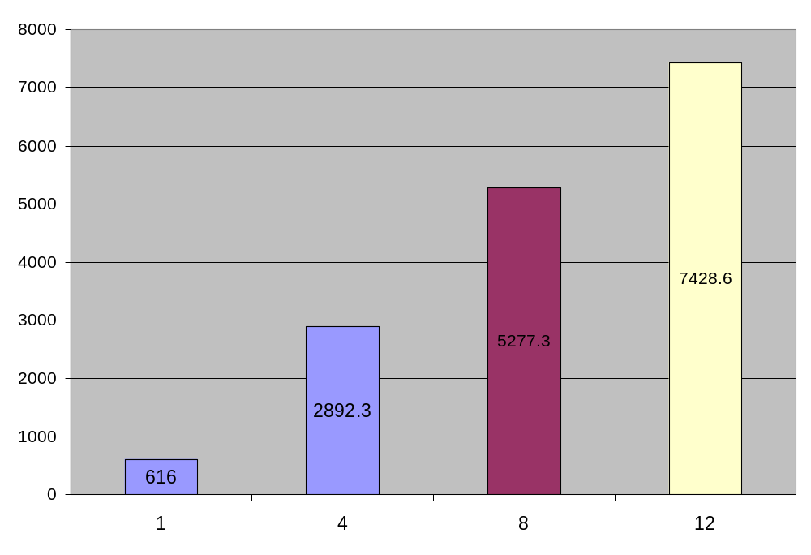
Tests: AMP Scalability
Static HTML
  Throughput grows linearly
  CPU utilization very low
  Scalability of static HTML is based on network bandwidth

Slide 14
Tests: AMP Scalability
PHP
  CPU intensive PHP code
  Started from phpbench (http://mirrors.sunsite.dk/pure-ftpd/misc/phpbench/)
  added PHP5 specific functionality
  Scale with CPU

Slide 15
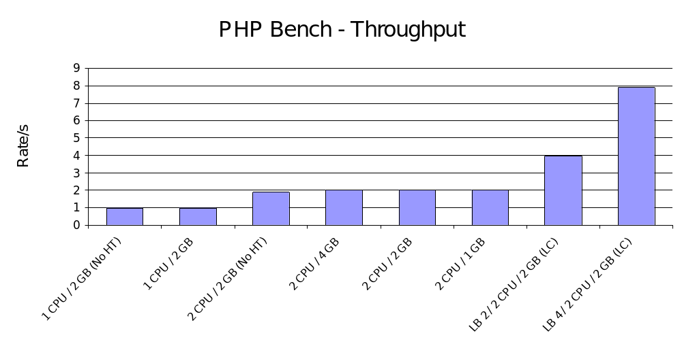
Tests: AMP Scalability
PHP
  CPU intensive code bound by CPU
  Scale is linear with CPU resources

Slide 16
Tests: AMP Scalability
Database/MySQL
  Based on ANSI SQL Standard Scalable and Portable Benchmark (AS3AP)
  Set of 4 tests per platform
  4GB MySQL database.
  All tables use the MyISAM table engine

Slide 17
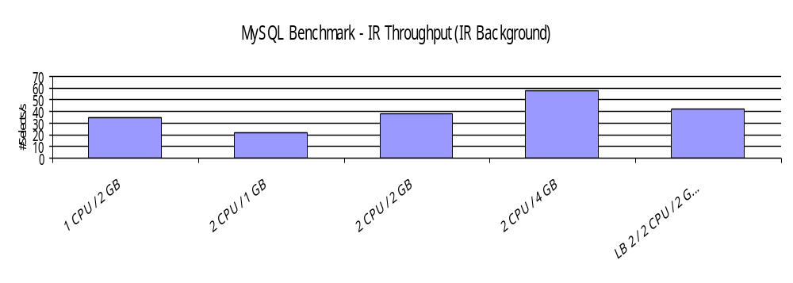
Tests: AMP Scalability
:Database
  Memory has great scale factor
  Must consider table type and configuration settings
  Considerable blocking
  Must understand database activity

Slide 18
What can I do now --
Developers:
  Understand application
  Easier to get projects approved – platform better understood.
  Migration to latest versions less problematic
  Greater overall recognition of AMP as a credible platform
Sys Admin/Capacity Planners
  Understand users
  Head start on capacity planning

Slide 19
Discussion and Questions
SourceLabs Corporate Overview
March 2005

Slide 20
Next Steps

