Slide 1


PHP
R
IBM Software Group
David Boloker, Dan Gisolfi
Stewart Nickolas, Adam Peller
IBM Software Group
©2005 IBM Corporation

Slide 2
Agenda
What is PHP?
Why PHP?
Who is using PHP and where?
Why is IBM interested in PHP today?
What is IBM’s Relationship with Zend?
Zend Core for IBM Overview
Composite Applications - a Demo
What’s next
Notes:
Thank you for joining this webcast on “Building Dynamic Data-Driven Web Applications with PHP and DB2 UDB v8.2 and Cloudscape”
We have a full agenda for the webcast today, so let’s get started.
Overall, we will be examining the development and deployment of web applications that utilize either:
Cloudscape v10, a commercially supported version of the open source Apache Derby database or
the DB2 UDB family of relational database servers available from IBM.
The web application environment we will be covering today is known as PHP.
PHP is a very robust and scalable open source scripting language that enables developers to rapidly build and deploy web applications. These applications usually require data stored in database systems. These database systems could be based on open source or commercial products.
Today, we will cover some of the PHP language basics to give you a feel for the language and then we will provide an quick review of Cloudscape and DB2. We will examine the three currently available PHP extensions that support developing web applications for both DB2 and Cloudscape. The advantage of this is that a single API can be used for Cloudscape and as you database servers scalability needs grow and you consider using DB2 your application will not need to change.
We will then describe a new product that has been developed by Zend technologies. The product is called Zend Core for IBM and we will describe it’s capabilities and how you can try it out.
First, Let’s take a look at the PHP language …

Slide 3
What is PHP

Slide 4
What is PHP?
PHP is an open source, platform independent scripting language that is designed for web application development
Originally created by Rasmus Lerdorf in 1995
  Set of Perl scripts for tracking accesses to his online resume
  Original name was 'Personal Home Page Tools‘
PHP 3.0 was a completed rewrite in 1997
Number of PHP developers has been growing ever since
It is one of the most widely deployed web languages in the world today .
Oh yes, PHP means (PHP Hypertext Preprocessor)
Notes:
Unlike many other languages, the PHP language has been designed specifically for web applications. PHP is an HTML-embedded scripting language so there is no need to compile applications. It is available on all popular operating platforms and since it is open source it is readily available. The main site for the PHP community is php.net.
PHP was originally created in 1995 as a set of Perl scripts. Perl is another open source scripting language that has a wide following and there are Perl APIs for DB2 available (you can find more information on Perl and DB2 on the IBM developerWorks site). PHP was original known as the Personal Home Page Tools. PHP was rewritten in 1997 and release as PHP 3.0. At this point the performance and functionality was dramatically improved. The PHP acronym was then re-swizzled to become a recursive acronym in true software developer fashion.
Now, PHP is known as “PHP Hypertext Preprocessor.”
Since the release of PHP 3 in 1997 the popularity of PHP has grown rapidly. It is primarily a procedural language, but with the latest release of PHP 5 many object oriented features have been added. Therefore, there is no requirement to be an object-oriented architect or developer to use PHP. PHP 5 has also introduced web services and simple XML interfaces. The PHP language continues to evolve in an open source environment, with PHP 5.1 soon to be released with new features.

Slide 5
What is PHP…?
Server-side, HTML-embedded, Web Scripting Language
Very powerful – supports most protocols and data sources, data manipulation
Platform & Web Server independent
Examples:
  e-Commerce
  Content management
  Transactions
  Web Services

Slide 6
Why PHP?

Slide 7




Why PHP ?
Low Learning Curve
Rapid
Development
Easy Integration into
Heterogeneous Environments
Run an
Agile
Business
Robust, Multi-Platform,
High-Performance, Scalable, Secure
Vibrant Community
Proven
Deployment
Notes:
There are a number of reasons why PHP is so popular.
First off, building your first PHP application is very simple and making rapid iterative changes is simple. PHP modules are basically files that are preprocessed by a high performance scripting engine known as the Zend engine.
PHP is Flexible, you can develop your application on a Linux environment at home and deploy on highly scalable servers such as IBM’s pSeries platform. Recently with the addition of web services interfaces PHP modules can easily interact with other application modules written in other languages such as Java or .NET base web services.
PHP is used by many people including more and more large companies as it meets their needs for rapidly deploying web applications to provide valuable services to their customers.
As with any programming language it is up to the developer and designer to consider key aspects of good software construction including:
Designing for scalability, reliability and security…PHP does provide all of the tools and features, it is important to use the features
And PHP enjoys a VERY large and committed community that has helped to drive widespread adoption and usage making it a proven technology

Slide 8
PHP Status on the Internet

Slide 9
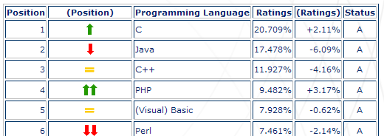

PHP: Programming
Language of the Year 2004
TIOBE Programming Community Index, January 2005
“PHP has earned the title ‘Programming Language of the Year 2004’ with a positive delta of more than 3 percent within 1 year. The launch of PHP version 5 is generally regarded as a further step to maturity.”
Source: http://www.tiobe.com/tpci.htm

Slide 10
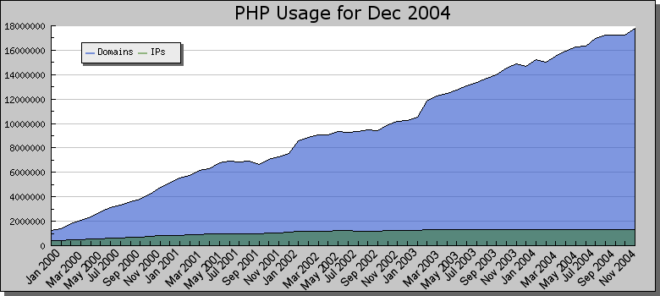



PHP Momentum
Source: Netcraft
Chad Dickerson
CTO, InfoWorld
Rod Smith
VP Emerging Technologies
November 19, 2004
“IT managers who look only as far as J2EE and .Net when developing scalable Web apps are making a mistake by not taking a second look at scripting languages -- particularly PHP.”
“the simplicity of PHP is one of its greatest assets.”

Slide 11
Who is using PHP?

Slide 12




Who is using PHP?
eBusiness
Banks, Education and Gov.
eCommerce
  – running various PHP apps such as: lycos-shopping, lycos-ecommerce, lycos-search and lycos-news. Running 38 PHP servers.
  – running family and fun sites, online shop and product purchases. Running 16 PHP servers.
  – a Celco company running their online shop using the PHP technology. Running 8 PHP servers.
On-line games
  EA – providing online games and online shop for purchasing games using PHP apps. Running 12 PHP servers.
Online banking
  Deutsch Bank – using PHP for financial transactions between the bank agencies. Running 12 PHP servers
  Dresdner Bank – providing financial services and information to their clients. Running 8 PHP servers
Online information
  JAG – Judge Advocate General is running a PHP application for documentation and recording of legal information for the army.

Slide 13
Who is using PHP?
Portals
Projects
Financial
  Wallstreetonline – providing financial information and stock purchases over the web. Running 30 PHP servers.
  OnVista – provide real time financial information, brokerage for the German market. Running 42 PHP servers.
Dating Portals
  Ilius – one of the growing dating sites in Europe. Running 22 PHP servers.
SMS and Subscription Management
  Orange – using PHP for managing all SMS transactions and records, reporting to their billing system and CC.
Vendor supplements
  Siemens – running a management and communication PHP system for their customer care.

Slide 14
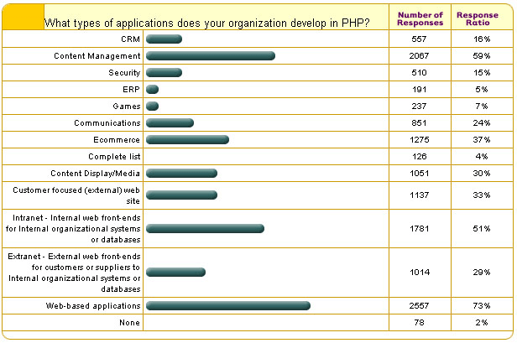
What type of apps do you develop in PHP?

Slide 15
Why is IBM interested in PHP Today?

Slide 16
Why is IBM interested in PHP Today?
Simply - our customers are demanding solutions using PHP
  In the SMB Space
  In the Enterprise Space

Slide 17
What is IBM’s Relationship with Zend and the PHP Community?

Slide 18
Zend is the Heart of PHP
Co-Founders:
Architects
of PHP
Zend Engine:
Must-have with
Every PHP Distribution
Making PHP
“Industrial Strength”
in Business-Critical Applications
Notes:
Why Zend?
Because we are the PHP company
My co-founders Zeev Suraski and Andi Gutmans are the original architects of PHP, beginning their efforts in PHP in 1997. And their involvement continues to today.
The Zend Engine is the kernel of PHP, the heart of PHP which Zend writes and maintains and contributes back to the PHP community. It is a part of every PHP distribution.
Zend’s commercial role wrt PHP is delivering the products and services to help develop, deploy and manage PHP applications. More and more companies are using PHP for business-critical applications, Zend is making them industrial strength.

Slide 19
What is IBM doing in the PHP Community?
Working with Wez Furlong on PHP Data Objects
  Provide a lightweight, clear, convenient API
  Unify the common features of the various RDBMS libraries, but don't exclude the more advanced features
  Bundled with PHP 5.1
Why PDO?
  Performance (leverages latest features of PHP 5 and thoroughly designed code)
  Power (doesn’t hide unique RDBMS features)
  Easy (simple and straight forward API)
  Extensible (very easy to add another database driver)

Slide 20
What is IBM doing in the PHP Community…?
What drivers is IBM working on:
  PHP 4
    DB2 CLI
    Pear::db
  PHP 5
    PDO Specification
    PDO ODBC
    PDO IDS
    PDO DB2
    PDO Test Suite

Slide 21
SOAP in PHP 5
Working with Zend to achieve WS-I Compliance (Basic Profile 1.0)
Possible future enhancements:
  SOAP attachments - MIME
  SOAP routing and WS-Security
SOAP enabling development tools…

Slide 22
SDO (Service Data Objects)
Originally Java-based spec by BEA & IBM
Key motivation:
  Unified data access to heterogeneous data sources on client & server
    Databases, Web Services, XML
  Support for disconnected programming models
    Web-based applications
Will reflect data as native PHP 5 objects
SDO is likely to use PDO for underlying database access mediator

Slide 23
Future Directions (PHP 5.1 and beyond)
  Future PDO (PHP Data Objects) work – Community driven
  Zend Engine performance boost
  Improved security
  Better i18n support – Unicode – Led by Yahoo! w/ Zend
  Accessiblity
  Lots more…

Slide 24
What is Zend Core?
Zend Core is:
A seamless out-of-the-box supported PHP development and production environment
For:
Business-critical web applications
Delivering:
  Reliability, Productivity and Flexibility
  needed for running PHP applications

Slide 25
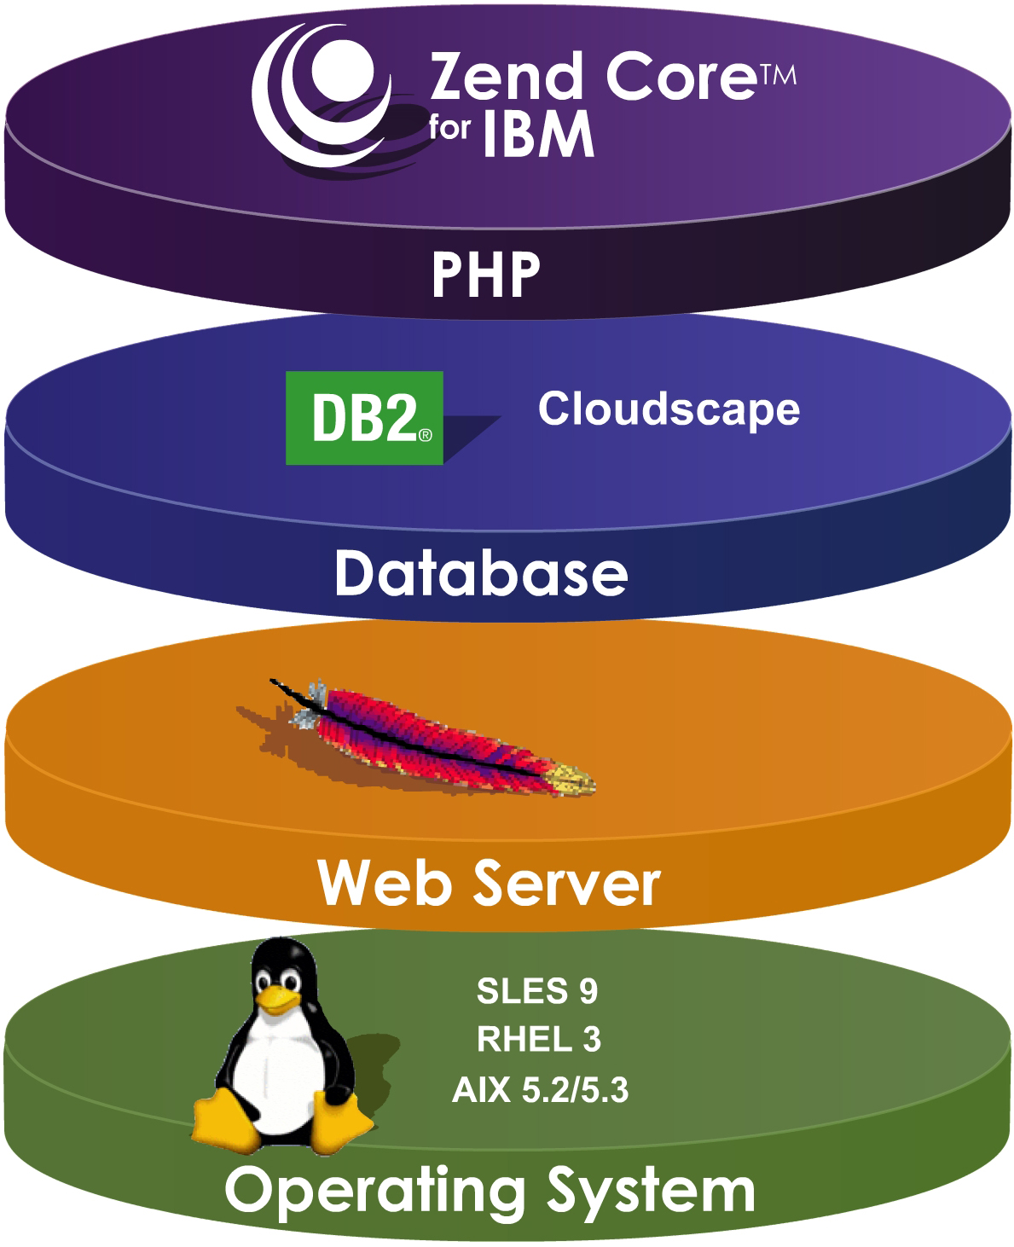
Simple and Robust Functionality for Web Applications
Notes:
IBM and Zend’s partnership has far reaching implications, it is about building a web stack.
There are three stacks being used to deploy applications today, J2EE focused on heavy-duty transactional types of applications, ASP.NET supporting MSFT only technology and the web stack focused on simplicity and robust functionality for web applications.

Slide 26
Features and Benefits
Reliability
  Certified PHP
  Standard PHP
  Ongoing Maintenance
  Online and Offline Updates
  Support
Productivity
  Instant PHP Setup
  Documentation
  PHP 5
Flexibility
  PHP Configuration Control
Thoroughly tested PHP
Ensures your issues are not unique
Bug and security HotFixes
Integrity checking and ease of update
Various support programs
Easy-to-install and configure
The best of PHP 5 with DB2 & Cloudscape
support, XML, OOP, and open-standards
PHP & Cloudscape documentation included
Web-based management for controlling and
optimizing of PHP configuration

Slide 27
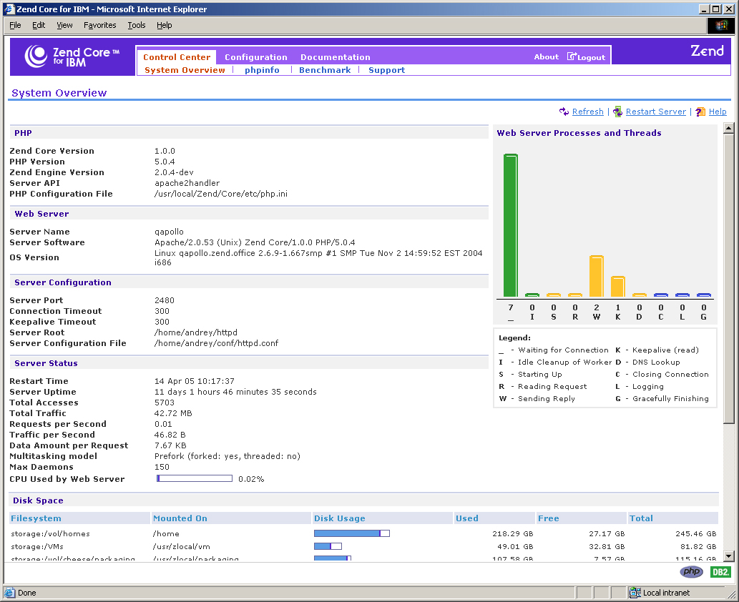
Zend Core Management & Control

Slide 28
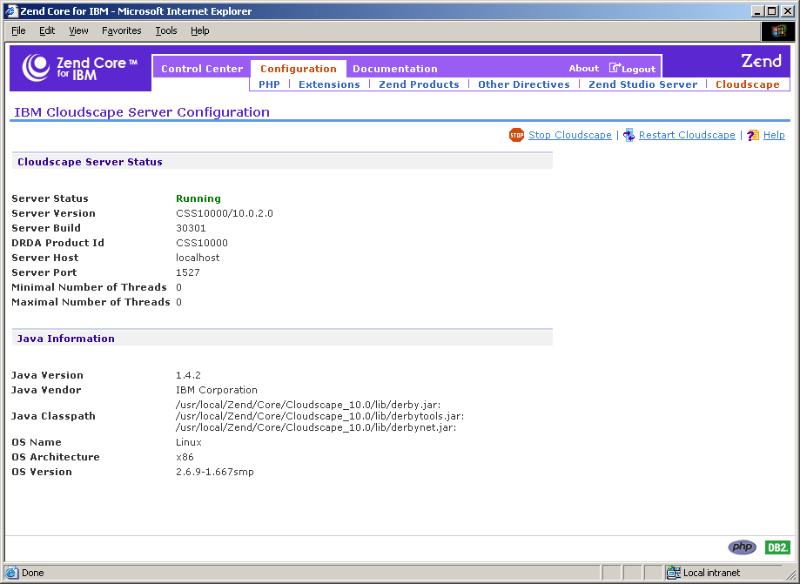
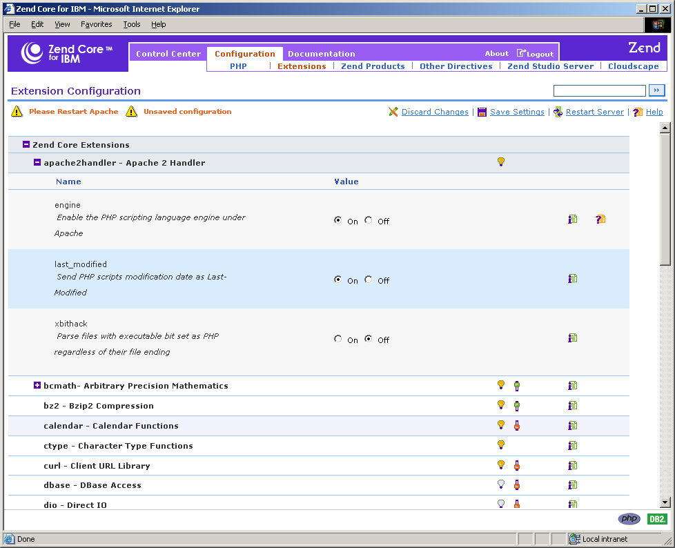
Zend Core PHP Configuration

Slide 29
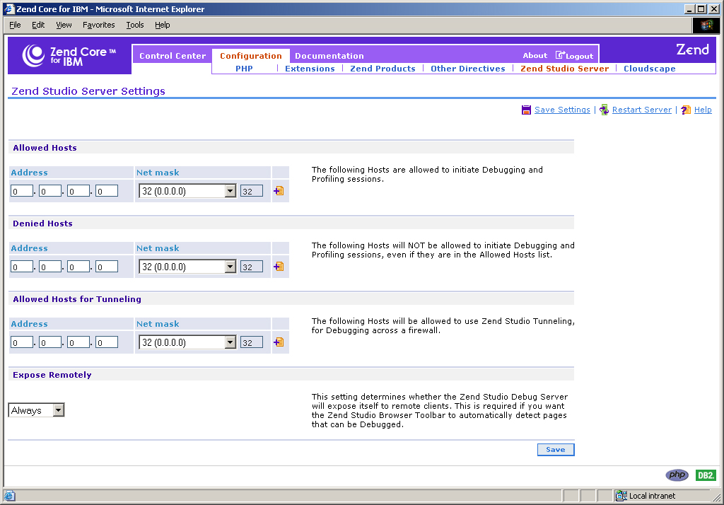
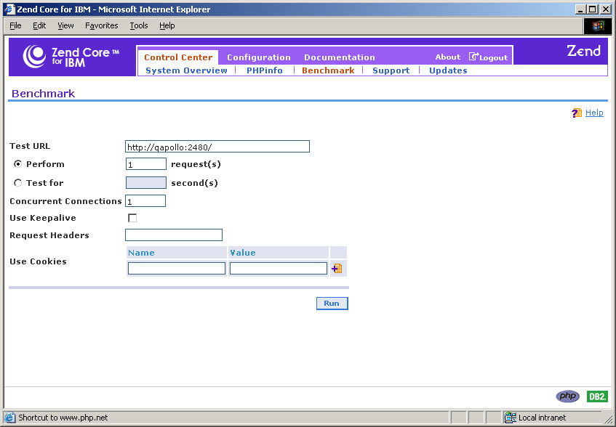
Zend Core Remote Debug & Benchmark

Slide 30
Introducing the Zend Core Network
Subscribers benefit from the following management features:
  Account information at a glance
  Product downloads including current and previous versions
  Software updates and information
  Bug database
  Web-based support interface and support information

Slide 31
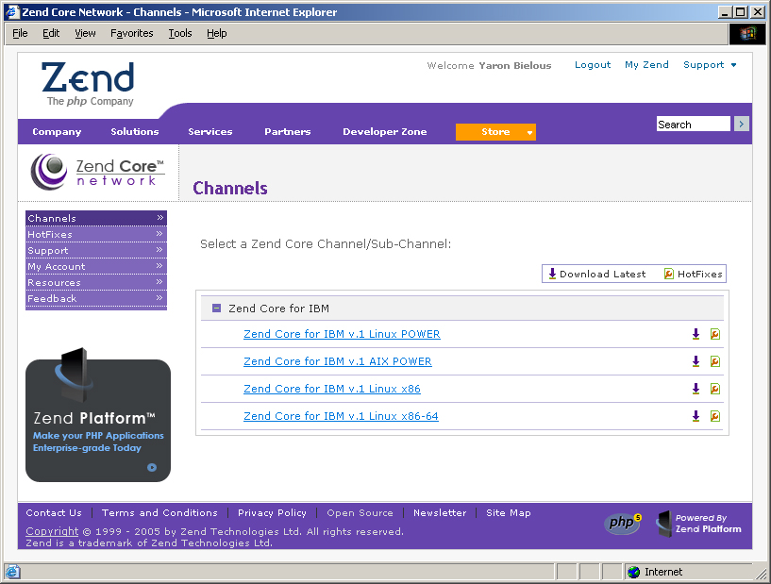
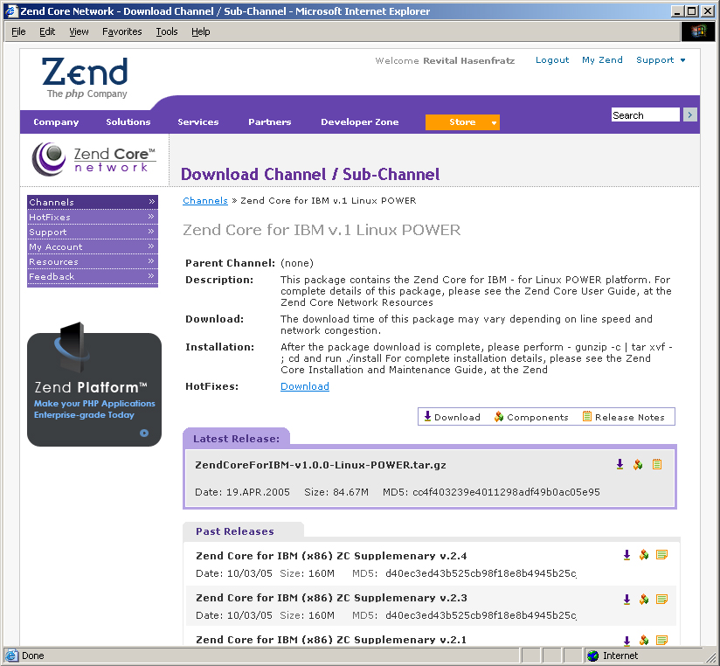
Software Delivery & Support Center

Slide 32
Zend Support Offering
Basic
Gold
Platinum
Zend Support Subscription Period
1 year
1 year
1 year
Web-based Support
Web Response Time/SLA
3 days
1 business
day
1 business
day
North American Phone Support
M-F 6am-6pm PST
Global Phone Support
M-F 6am-6pm GMT
Phone Response Time/SLA
4 business hours
4 business hours
7x24 P1 Issues Phone Support
7x24 P1 Issues Response Time/SLA
2 hours

Slide 33
Getting and Using
Zend Core for IBM
Registration
  http://www.ibm.com/software/data/info/zendcore
Supported platforms
  Linux (SLES 9, RHEL 3) on x86, x86-64 & POWER
  IBM AIX 5.2, 5.3 pSeries
Supported Web Servers
  Apache 1.3.x, 2.0.x
Schedule
  Beta – May, 2005
  GA – July, 2005

Slide 34
I-Series and PHP

Slide 35
PHP on iSeries
A good match for iSeries application writers
Simple-to-program, simple-to-deploy
  Web-enable lots of data in iSeries DB2/400
Allows lots of ‘off the web shelf’ applications to compliment existing logic
Runs in the integrated PASE environment with i5/OS
Integrates with DB2 and Apache included with i5/OS
Intend to integrate with RPG
  RPG launch of PHP
  PHP call of RPG procedure
Intend to GA late 2005/early 2006

Slide 36
Composite Applications - An Experiment

Slide 37
Experiment
Overview
  Evaluate open source content management technologies that would be applicable to entry level market segments (SMB)
Premise
  SMB ready means
    “just-good-enough” function
    Simplicity of installation and operation
    Adherence to widely adopted frameworks and standards
Challenge
  Use Open source based set of technologies and provide portal – Content Management Solution (CMS) environment for SMB

Slide 38
Objectives
Create a Content Management Solution by packaging together a collection of open source components with limited integration that provides
  Rich internet application based solution
  Based solely on FREE open source components and open standards
  Zero-footprint browser model
  Not require a complex programming model
  In the process Understand and Assess
  Time it takes for deployment (Goal – Minimal)
  Technical skills required (Goal – limited)

Slide 39
Evaluated Technologies: Demo Components
Client Desktop
  Firefox or IE
Server
  Mambo Open Source CMS
  Mail
    Pop3 Mail
Calendaring
  ExtCalendar2/phpgroupware
Collaboration
  Jabber Chat (IM & SIP )
  Blogging (WordPress)
Document Management
  Remository
  phpgroupware

Slide 40
Experiment Scenario
Application Domain - SMB Company Inter/Intranet Presence
  Day-to-day Collaboration & personal information management software
  Company Presence
    Virtual Storefront
    Job listings, contact, …
Company
  Techno City Garden Center (TCGC) is an example of an SMB that has is leveraging a virtual store-front to compliment its brick-and-mortar hardware business
Demo Goals
  Collaboration: Email, Chat, Calendar
  Content Management
  Document Management
  Private/Public Access Control
  Ecommerce

Slide 41
Conclusions Derived from Experiment
Open Source components can be easily assembled to create a content management solution
Requires limited technical skills
Many of the components are turnkey solutions with simple installation and configuration
  Ex: Mambo ecosystem centered around “consumability”
Loosely coupled components can be integrated with minimal effort to create custom and stock solutions

Slide 42
PHP & Java

Slide 43
PHP & Java
Integration/Interoperability
  We see 2 models: Tightly or Loosely Coupled?
    Tightly
      Customers like PHP Language and want to use it in Java Environment
    Loosely
      Call via Web Services from PHP Runtime to Java Runtime
  What do you think?

Slide 44
In conclusion

Slide 45
In Conclusion
IBM is working with the PHP Community on PHP futures
IBM is working with Zend to deliver a “Class A” Runtime that interoperates with IBM’s Databases (DB2, Cloudscape and IDS)
IBM will be delivering a PHP solution on I-Series

