Slide 1
Introducing the Joomla! 1.5 API
NYPHP
July 25, 2006

Slide 2
The Presenter
Mitch Pirtle
Joomla! contributor
CEO, JamboWorks

Slide 3
A Quick Security Update
JamboWorks defaced
Mass automated attacks on web
What to do?
  Subscribe to security sub-forum
  Buy Hardening Apache, by Tony Mobily
    Do what he says!
  Portsentry, and be aggressive
  Logwatch, and be aggressive
  Regular audits

Slide 4
Background
Joomla! was born in September 2005
Joomla! 1.0.0 <-- Mambo 4.5.2.4 (plus some goodies)
Initially was a rebranding effort

Slide 5
The Problems
Still had old Mambo references (yuck)
Procedural legacy code (double yuck)
Brittle, difficult to improve without significant effort (triple yuck)

Slide 6
The Challenge
International community throws down the gauntlet: “Give us internationalization, or lose us forever!”

Slide 7
The Plan
Implement UTF-8
Refactor where possible

Slide 8
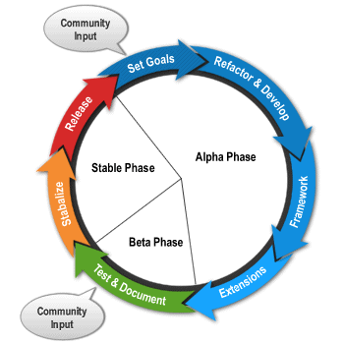
The Process

Slide 9
The Result
UTF-8 support, mission accomplished!
Complete core refactor
Modification of 3PD libraries, some required replacement outright
Tick, tock, tick, tock...

Slide 10
Enter Joomla! 1.5
The result of the i18n efforts, as well as the total refactor of the core
Dedicated to OO benefits and advancements in functionality
Much better naming consistency
More flexible
More power
More simplicity

Slide 11
1.5 Developer Features
FTP Filesystem Layer
Database Drivers
Tiered application architecture
Registry class
Installer cleanup
Plugin system (observer)
Document class

Slide 12
1.5 API – Flexibility
Focus on moving to objects/classes
Dedication to patterns
Less core modifications necessary

Slide 13
1.5 API – Power
More methods
Events
Extended plugin architecture
Error handler
Yes, I said ERROR HANDLER
XML-RPC

Slide 14
1.5 API – Simplicity
Rationalized API
Core apps provide reference implementation
Easier to keep your customization in one place

Slide 15
1.5 Surprises
Joomla! 1.5 and accelerators are a perfect pair for performance and scaling
Base architecture for all the missing features is now in place – next up, all the other missing pieces
We did what a lot of developers were wanting in the first place

Slide 16
Developer Resources
Joomla! Developer Portal
(http://developer.joomla.org)
Joomla!Forge Developer Platform
(http://forge.joomla.org)
Joomla! API Documentation
(http://api.joomla.org)
Joomla! Extension Directory
(http://extensions.joomla.org)
Joomla! IRC Channel

Slide 17
Commercial Experiences
JamboWorks
  JamboZine
  JamboCommerce
Lessons learned
  Life as a commercial 3PD
  Implementing larger sites
  Close up experience satisfying sophisticated clientele

Slide 18
Community Questions
How to customize without breaking upgrade compatibility?
Available add-ons?
SEF/SEO?
Minimal install?
Importing a static site?
One instance, multiple domains?

Slide 19
Open Discussion
“Stump the Geek”

