Slide 1
The MySQL Database
The Number One Open Source Database and How it Got That Way
Presented to Unigroup by New York PHP
March 16, 2006
Hans Zaunere
President and Founder

Slide 2
About New York PHP
New York PHP Community
  http://www.nyphp.org
  2000+ members worldwide
  Supporting PHP and open source
    Mailing lists and SIGs
    Free meetings that are a timeline and who's who of PHP and the open source communities
    PHundamentals (http://www.nyphp.org/phundamentals)
New York PHP
  http://www.nyphp.com
  Open source support and strategy
  Uniting the strengths of dot-com and dot-org, providing the next generation of technology support, service and product

Slide 3
The Number One Open Source Database...
Thousands of downloads a day
Millions of active installations
Provides the date store for the AMP Vertical and other open source stacks
Available under the GPL license and a commercial license
Complementary products, such as client administration tools and MySQL Cluster
MySQL AB founded in 1995
  Now with operations around the world
  Providing consulting, support, training and licensing

Slide 4
…and How it Got That Way
Free to download and use
Extremely easy to setup, use and maintain
  Created the “personal” RDBMS trend that is now followed by the large proprietary databases
Open code base, API and documentation
  Easy for communities to develop language bindings, such as PHP and Java
New thinking
  Fresh code base, written from scratch to fulfill a specific need
  Defined new parameters of what an RDBMS is, and should do
Brought the RDBMS to the masses
  MySQL has been belittled as a “SQL enabled file system”
  That’s not necessarily always a bad thing

Slide 5
So What About XYZ?
Many open source databases are older
  Complexity in setup and maintenance
  Based on some older code that doesn’t provide evolution in storage technology
New open source databases
  It’s not easy – good storage engines are hard to write
  It’s not easy – finding support and visibility in light of open source giants MySQL and PostgreSQL isn’t easy
“If it ain’t too broke, don’t fix it”
  MySQL has limitations, but can generally deliver in many situations
  The 80/20 rule

Slide 6
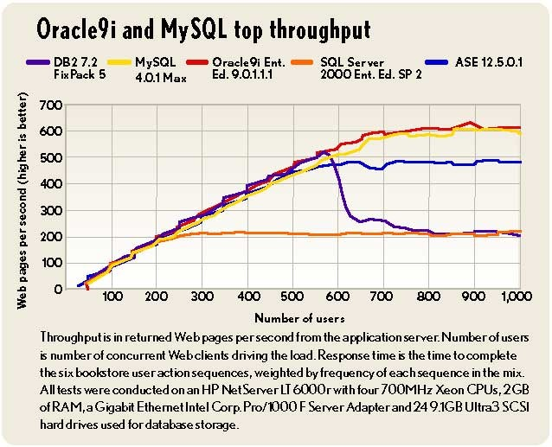
And There’s Performance
A big win for MySQL has been performance – in most cases
eWeek’s Database Benchmark
  MySQL had top performance, including scalable tuning and configuration options
MySQL excels at rapid queries
  Perfect fit for many applications, especially request/response (web)
  Simpler queries scale better than complex queries
  Mostly read or mostly write concurrency performs best
  Large datasets usually perform well
MySQL performance restrictions
  Large complex queries can cause SQL optimization problems
  Read/write concurrency can have severe impact
  MySQL needs to be tuned for production

Slide 7
Features from 60,000 Feet
Multiple storage-engine architecture
ACID compliant transactions
Standards based SQL, aiming for SQL-2003
Syntax based query caching
Master/Slave replication
Compile and runtime feature flexibility to conserve resources
  Embedded in hardware
  Extremely high load applications
Written in C, C++ and ASM
  80% in C
  Parse tree and optimizer in C++
  String functionality in ASM on some platforms

Slide 8
Languages, Hardware and Operating Systems
Languages
  C API: libmysql (MySQL AB)
  PHP extensions and PDO (community)
  Connector/JDBC (MySQL AB)
  Connector/.NET (MySQL AB)
  Connector/ODBC (MySQL AB)
  Perl DBD::DBI (community)
Operating Systems
  Red Hat, SuSE, your Linux here
  FreeBSD, OpenBSD, NetBSD
  Windows, Mac
  Solaris, HPUX, AIX
Hardware
  Xeon, Opteron, Itanium, Nacona
  PowerPC, SPARC, RS 6000

Slide 9
Under the Hood
Multithreaded - 1 connection means 1 thread
  Decrease in overhead – increase in performance
  Configurable per-thread parameters
    read_buffer_size - I/O per thread
    read_rnd_buffer_size - for ORDER BY
    sort_buffer_size - rows in memory for ORDER BY and GROUP BY
    tmp_table_size – memory temporary tables for GROUP BY
Multithreaded – 1 server means 1 process
  Limited addressable space, especially under 32bits
  64bit platforms are a must for even moderate datasets
  64bit platforms are a must to take advantage of buffers
  Pay attention to the operating system’s kernel/user memory split in a process

Slide 10
Pluggable Storage Engine Architecture
Storage engines are the heart of a database
  Provide the data structures and functionality for reliable data persistence and fast data access
  They are very complex and it’s exponentially difficult to design one that fits all use cases (dataset size, query modeling, traffic patterns)
MySQL can use multiple storage engines simultaneously
  Each table can be implemented using a different storage engine
  An SQL query can operate transparently across storage engines
  Can cause issues with SQL optimization
Developers can create their own storage engine for a specific use case

Slide 11
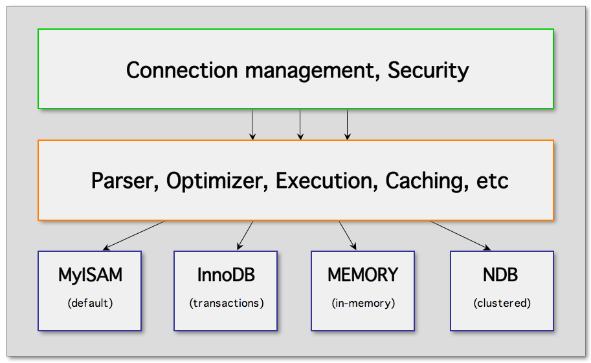
PSEA Diagram
Detailed diagram: http://www.mysql.com/common/images/PSEA_diagram.jpg

Slide 12
Storage Engine: Memory
RAM based storage engine
  Data is stored only in system memory
  Schema persists on disk
Very fast
  No disk I/O
  Basic data structures
Quite limited
  Fixed column widths – no VARCHAR
  Limited indexes available

Slide 13
Storage Engine: MyISAM
File based storage
  .MYD – table data
  .MYI – index data
  .FRM – table definition (schema)
Easily maintained
  Architecture-independent data
  Files can be copied across platforms
Low overhead
  No transactions
  Large grained table level locking
  Excels at mostly-read applications
  One third the memory/disk footprint of transactional engines
Limited
  Write concurrency
  Potential for corruption with limited recovery (no transactions)
  Limited data dictionary (reduced optimizations)
  Enjoys smaller datasets and simpler queries
Made MySQL…
  A “SQL enabled file system”
  Belittled as a being a toy
  Number one

Slide 14
Storage Engine: InnoDB
ACID Compliant
  Atomicity/Consistency/Isolation/Durability
  Full transactional support and multi-versioning
  Read Uncommitted, Read Committed, Repeatable Read, Serializable
  Foreign keys constraints
Locking and logging
  Row-level and next-key locking
  Consistent non-locking reads
  Commit and rollback segments
Fault tolerance and table spaces
  Large datasets, raw partitions
  Online backups
Next generation indexing and data storage
  Clustered and B-tree indexes
Higher overhead
  Substantial memory/disk footprint
  Administration and maintenance
Made MySQL…
  Competitive in the enterprise database market
  Ready to break out of commodity RDBMS use
  A target…

Slide 15
Storage Engine: NDB (Cluster)
Designed to eliminate any single-point-of-failure
  The Five-Nines of MySQL
Shared-nothing data distribution
  Data redundancy with synchronous replication
  Transparent sub-second fail-over
  Available even with multiple node failures
  Network partitioning and load balancing algorithms
  Hot backup and restore
Acquisition of Ericsson’s IP and staff
  Implemented as a pluggable storage engine
  Memory resident with disk persistence

Slide 16
Server Roadmap
Most common: MySQL 3.23.x, 4.0 and 4.1
Just out: MySQL 5.0
This year: MySQL 5.1

Slide 17
Features from 30,000 Feet
Transactions, foreign keys, multi-versioning
  InnoDB included by default since 4.0
Query cache
Dynamic configuration variables
Replication
  Master-slave architectures
  Master-master possible, but with caveats
  Dual threaded replication - One thread to read updates from the master and another to apply them locally
FULLTEXT indexing enhanced and tuned
Embedded server, libmysqld
Sub-queries and derived tables
Prepared statements, binary client/server protocol
  Text protocol prior to 4.1
OpenGIS (Geographical data)
Internationalization, UTF-8
  Character set and collation specified at column level

Slide 18
Features With 5.0
The enterprise release
  Further standardization on SQL-2003 features and syntax
  Stored Procedures (PSM)
  Views
  Triggers
  Data dictionary
  R-Tree indexes for non-spatial tables
  Server-side cursors
  Precision math
  XA support
  Additional storage engines: Federated and Archive

Slide 19
Features Beyond 5.0
Comprehensive comparison and feature list:
  http://lists.nyphp.org/pipermail/talk/2006-January/017488.html
Continuing Support for SQL-2003
Enhanced trigger/view/cursors/stored procedures
  MySQL 5.0 has some limitations and quirky behavior with these new features
  Events
Row-based replication, opposed to statement-based replication
Enhanced management API and toolset
XML/XPath querying
Partitioning
Read more:
  http://dev.mysql.com/doc/refman/5.1/en/roadmap.html
  http://dev.mysql.com/doc/refman/5.1/en/mysql-5-1-nutshell.html

Slide 20
Concerns Beyond 5.0
MySQL AB has broken new ground in the industry
MySQL AB has become a target
  Oracle acquired InnoBase, the makers of the InnoDB storage engine
  MySQL considered an affirmation of their strategy and technology
  MySQL stressed the use of a formally deprecated storage engine, BDB
  Oracle acquired Sleepycat, the makers of the BDB storage engine
Some powerful friends
  MySQL is closely partnered with SAP
  MySQL/SAP co-develop MaxDB, which has in the past been targeted towards at the SAP market
Interesting future

Slide 21
Resources and Support
New York PHP
  http://www.nyphp.com
New York PHP Community
  http://www.nyphp.org
New York PHP Community MySQL SIG
  http://www.nyphp.org/lists
MySQL Community
  http://dev.mysql.com
MySQL AB
  http://www.mysql.com
Contact: hz@nyphp.com

