Slide 1
PHP 5.3 Feature Review and Discussion Late static binding, namespaces, and closures
New York PHP User Group
July 27th, 2010
Hans Zaunere, Managing Member

Slide 2
Overview
PHP 5.3 Overview
It’s been a pretty nice release
Shedding legacy – grounding for the future
Extension and PECL cleanup
Numerous bug fixes
Performance improvements – internal API cleansing
mysqlnd goes mainstream
Improved Windows support
And of course…

Slide 3
The Three Amigos
Late static binding, namespaces, closures
New language features
May change some programming paradigms for PHP
But how – and why?

Slide 4
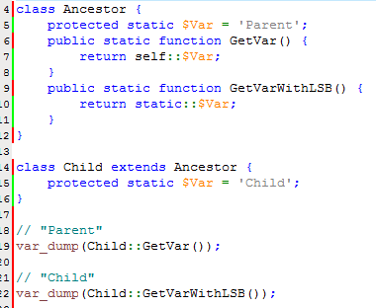
Late Static Binding
Static “Inheritance”
Provides "inheritance" for static properties/methods
Not full inheritance
self:: references static members in the class defined
static:: references static members in the class called
This is late static binding - resolves the reference “late” – during runtime

Slide 5
Late Static Binding
So... What?
Provides flexible static class hierarchies
Static in an object sort of way
Singletons, factories, etc.
Can add complexity and confusion
Resolved at runtime – performance?
forward_static_call() required for LSB behavior with static methods

Slide 6
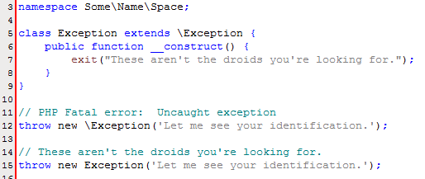
Namespaces
A File System In Your Code
PHP’s namespaces model file system paths
namespace Some\Name\Space;
Classes, constants, and functions of the same name can exist at different “paths”.

Slide 7
Namespaces
Applications?
Encapsulate code libraries
Override internal PHP functions and classes
Minimize lengthy naming conventions
use \my\framework; class Exception { } instead of class my_framework_Exception { }

Slide 8
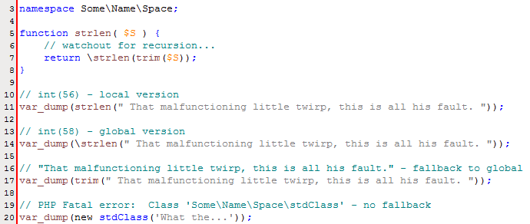
Namespaces
namespace Pitfalls\Caveats;
Resolution rules can get complex
Fully read resolution rules – and then keep things simple
Avoid dynamic namespaces
Different rules for classes vs. functions/constants
or When a slash makes all the difference.

Slide 9
Namespaces
namespace \Pitfalls\Caveats\More;
Porting – namespaces don’t drop-in
Non-namespaced code probably won’t work
Be prepared for porting effort
Performance
Fully qualified namespaces are resolved at compile time
Runtime resolution showed signs of performance impact
Although you likely won’t be instantiating 1 million classes
KISS
Don’t be too clever – avoid dynamic language features
Easy to get un-maintainable code

Slide 10
Thank You
hans.zaunere@nyphp.com
…oh right…

Slide 11
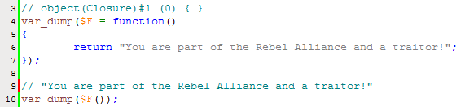
Closures
Traitor Functions
Where the functions have no names
Lambda or anonymous functions…
…or inline – just-in-time – ad-hoc – hack?
Functions that can be assigned to a variable
Implemented in PHP 5.3 using the final class Closure

Slide 12
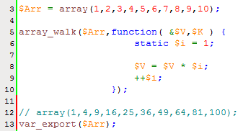
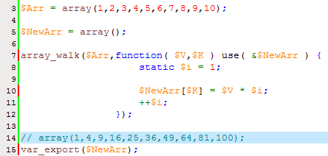
Closures
$Function = function() { return ‘Why?’; };
Just like other functions
Pass variables as references
Static variables
And not really
Inherit declared scope

Slide 13
Closures
Getting Closure On You Know What
Often used as callbacks
Great for asynchronous languages
PHP use cases
Form/request validation
Template data filtering and transformation
The invisible man may have had fun at first…
But no one knows you exist (code reuse)
No one can see you (side-effects)
Be aware of surroundings at all times (encapsulation)

Slide 14

Late static binding, Namespaces, and Closures
Oh My
What does this mean for PHP development?
Encapsulation – Complexity – Reusability?
What about for frameworks?
The quest to see the Wizard of Object Orientated Perfection?
Or a new paradigm that’s perfect for web dev?
WordPress
Drupal
noSQL
Memcache

Slide 15
Thank You
hans.zaunere@nyphp.com
…seriously.

