Slide 1
PHP code profiling using XDebug
By
Gennady Feldman
June 16, 2009

Slide 2
Overview
Introduction
Profiling with Xdebug
Enabling Profiling in Xdebug
Summary
Q & A

Slide 3
Introduction
Xdebug is a powerhouse extension for PHP.
It has a ton of features like debugging, tracing, profiling and analyzing problems with PHP code.
Today we will focus on some of it’s profiling abilities.

Slide 4
Profiling with Xdebug
Xdebug can generate cachegrind files that contain profiling information.
It can be used to find bottle-necks in your scripts.
You need a tool to read these files.
Some of your options are: WinCacheGrind, KCacheGrind, webgrind.
These tools allow you to analyze script execution (execution time breakdown, # function calls, etc).

Slide 5
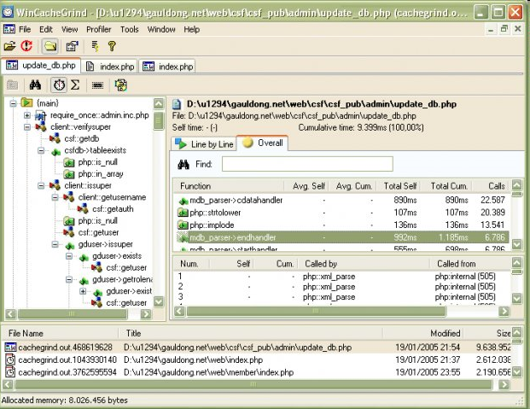
WinCacheGrind

Slide 6
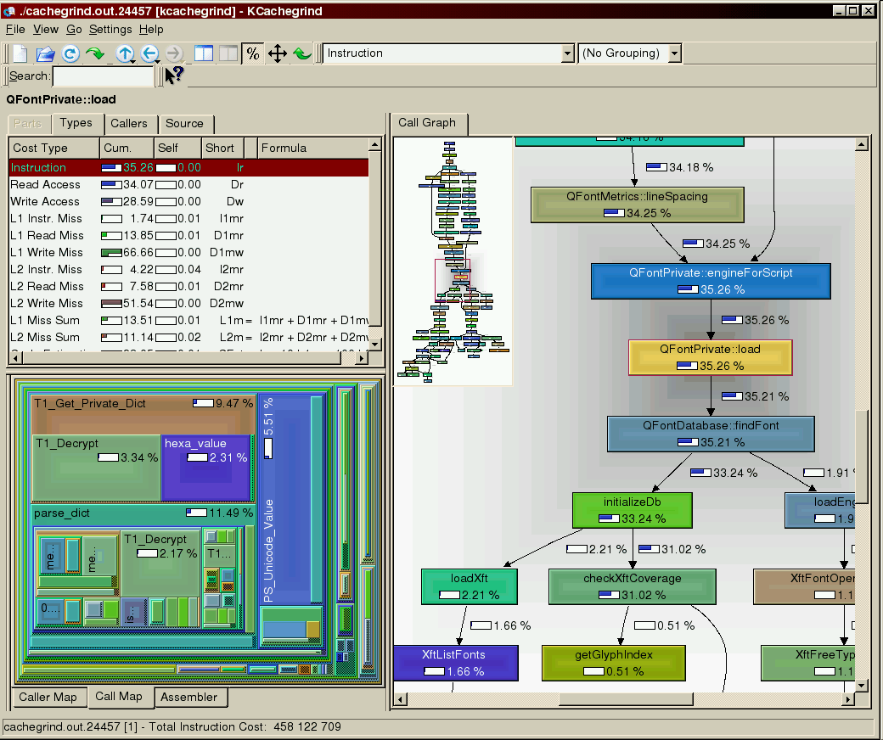
KCacheGrind Screenshot

Slide 7
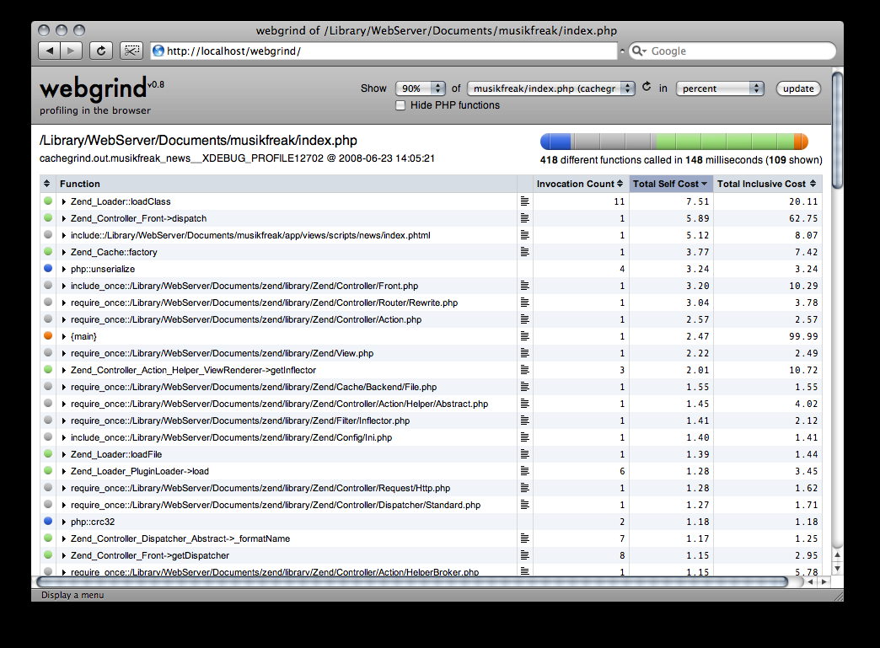
WebGrind Screenshot

Slide 8
Enabling Profiling
  xdebug.profiler_append
    Default: 0
  xdebug.profiler_enable
    Default: 0
  xdebug.profiler_output_dir
    Default: /tmp
  xdebug.profiler_output_name
    Default: cachegrind.out.%p

Slide 9
Summary
Xdebug is a very powerful extension with a ton of great features.
We only covered one tiny thing that this extension can do.
This is a MUST in development environment.
Come see me speak at NYPHP August 25, 2009 covering Xdebug from A to X.

Slide 10
Resources
Xdebug: http://www.xdebug.org
WinCacheGrind: http://sourceforge.net/projects/wincachegrind/
KCacheGrind: http://kcachegrind.sourceforge.net/
WebGrind: http://code.google.com/p/webgrind/
My blog: http://www.gena01.com/blog/

Slide 11


Slide 12
Q & A

