Slide 1
Attacking the PHP Market
Daniel Kushner
Director of Education
Zend Technologies, Inc.
daniel@zend.com

Slide 2
Today’s Topics
Market Trends
Market Size
PHP in the Enterprise
Who’s Hiring
Who’s Looking
The Solution

Slide 3
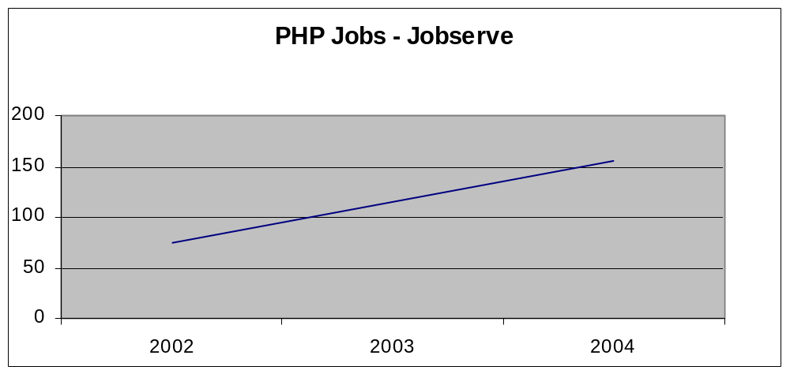
Market Trends
PHP is in demand with a steady increase in Jobs
Source: SitePoint.com / Harry Fuecks

Slide 4
Market Trends
Searched on Dice.com
Keyword | February
Java | 82,285 | 65.21%
ASP | 24,072 | 19.08%
HTML | 10,847 | 8.60%
PHP | 6,513 | 5.16%
MySQL | 1,605 | 1.27%
Web Master | 543 | 0.43%
CGI | 322 | 0.26%
Total | 126,187 | 100.00%
Source: Dice.com Sales Department

Slide 5
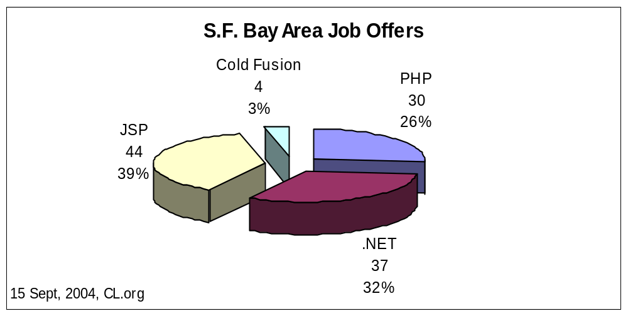
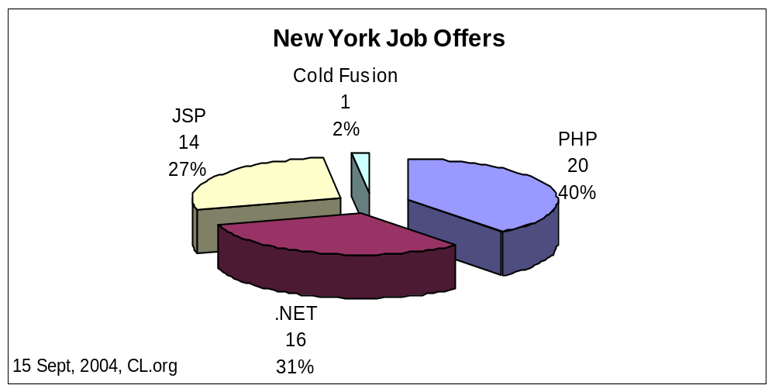
Market Size
Source: Dice.com Sales Department

Slide 6
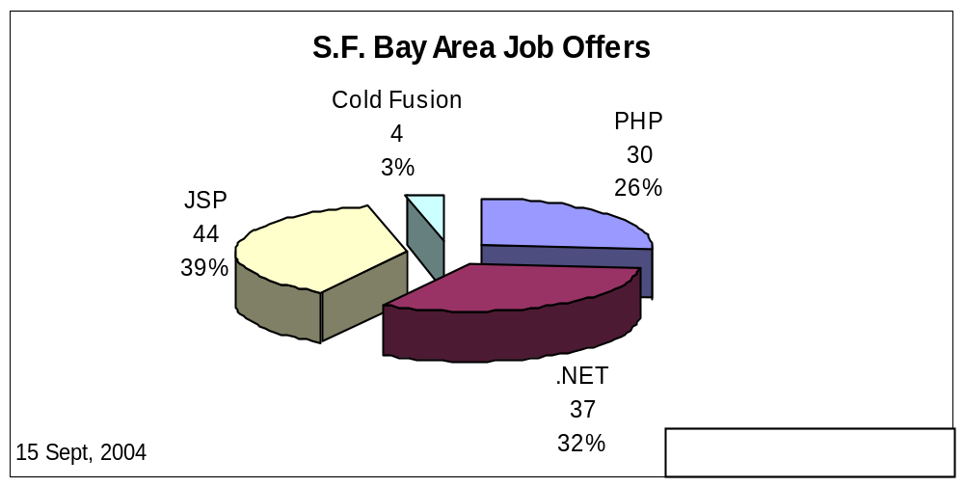
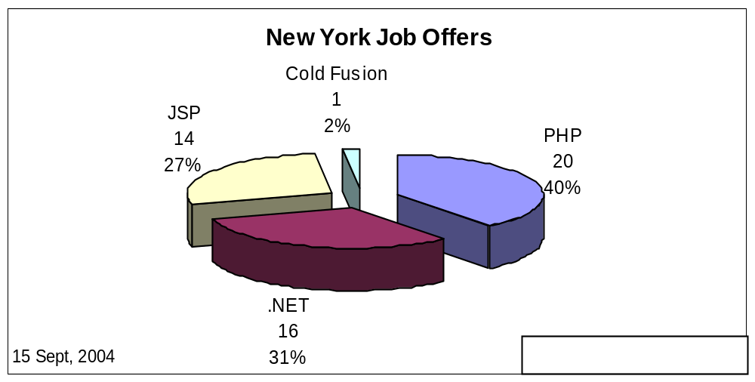
Market Size
Source: Dice.com Sales Department

Slide 7
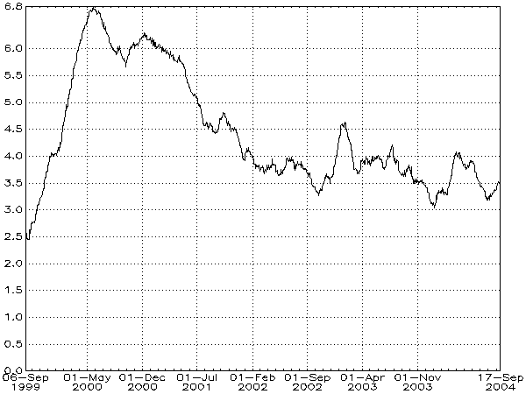
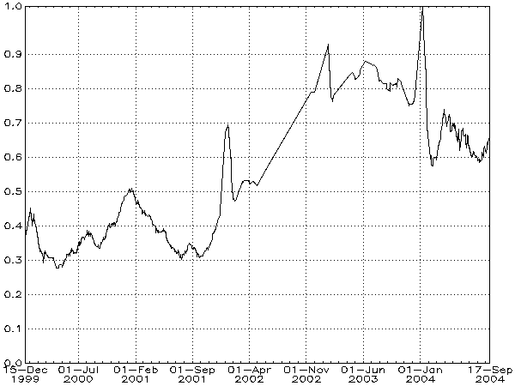
Market Size
Demand for skill as a proportion to the total demand for staff
ASP
PHP
Source: jobstats.co.uk

Slide 8


PHP in the Enterprise
eCommerce
  running various PHP apps such as: lycos-shopping, lycos-ecommerce, lycos-search and lycos-news. Running 38 PHP servers
  running family and fun sites, online shop and product purchases. Running 16 PHP servers.
  a Celco company running their online shop using the PHP technology. Running 8 PHP servers.

Slide 9


PHP in the Enterprise
On-line games
  providing online games and online shop for purchasing games using PHP apps. Running 12 PHP servers.
  providing online games and online shop for purchasing games using PHP apps. Running 16 PHP servers.
eTicketing and Tourism
  the entire Lufthansa PHP website includes eTicketing, backend system for the agencies, booking and frequent flyer club. Running 50 PHP servers.

Slide 10

PHP in the Enterprise
Online banking
  using PHP for financial transactions between the bank agencies. Running 12 PHP servers
  Dresdner Bank – providing financial services and information to their clients. Running 8 PHP servers
Online information
  JAG – Judge Advocate General is running a PHP application for documentation and recording of legal information for the army.
  UCLA, MIT, Georgia Tech – running Webmail application based on PHP providing services for the students, including access to information and libraries.

Slide 11







PHP in the Enterprise

Slide 12


Who’s Hiring?
Principal Software Engineer
Position Description:
• Work on Gateway.com E-Commerce applications.
• Application software architecture, design, and development.
• Work on the new design and implementation using the latest LAMP technologies (Linux, Apache, MySQL, and PHP 5).
• Design and develop integration solutions for E-Commerce platform and back-office applications.

Slide 13

Who’s Hiring?
Sr. Software Engineer
“as a Sr. Software Engineer in the wireless development team you will be building wireless platform applications for The Walt Disney Company’s properties, including Disney.com, ABCNEWS.com, Movies.com and others.”

Slide 14
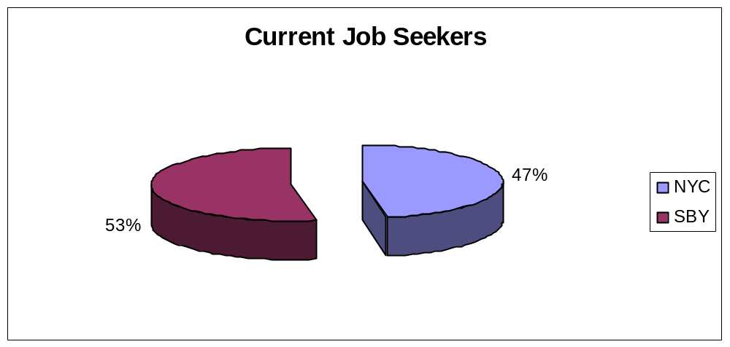
Who’s Looking?
Posted job offering on Craigslist NYC and SBY to determine the “other side” of the market.

Slide 15
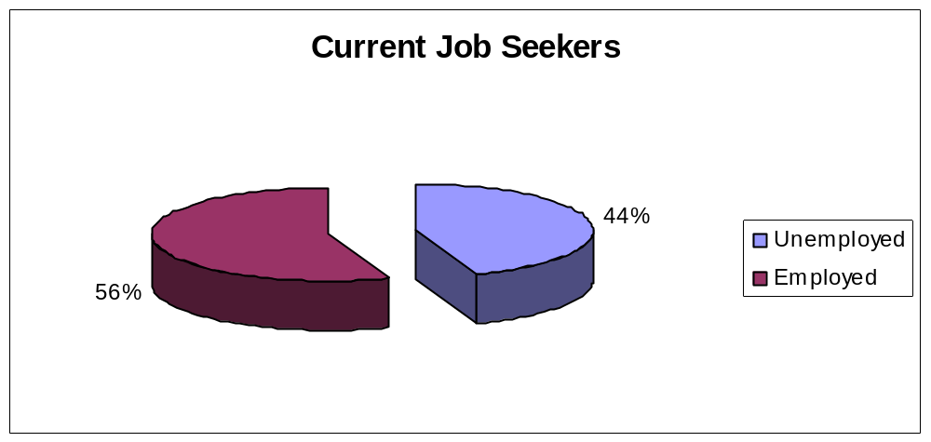
Who’s Looking?

Slide 16
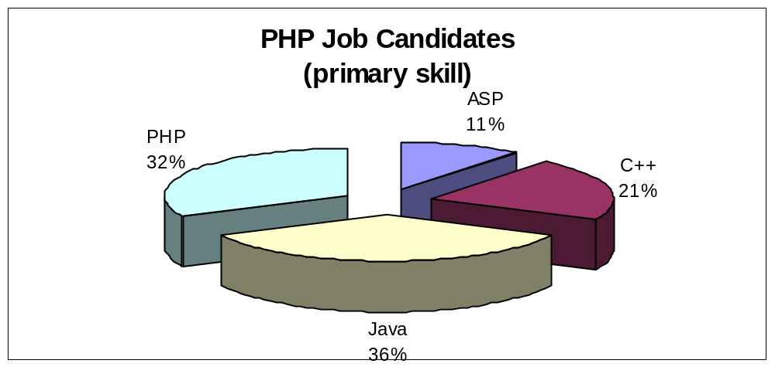
Who’s Looking?

Slide 17
Who’s Looking?
7
8

Slide 18
Who’s Looking?
50 PHP job positions in NYC and SBY
Only 15 potential candidates
Conclusion: There are not enough GOOD PHP programmers in the market !

Slide 19
The Solution …

Slide 20
The Solution
Training
CATCH 22
Certification

Slide 21
Certification
Easily identify PHP Experts
Resume filter
Lower fallout rate
Higher quality development
Industry recognition of proficiency with PHP

Slide 22
Training
Still in early adopters stage
Low demand
Online vs. Classroom
What to teach?
Who are the experts?

Slide 23
The Zend Solution
Community
Certification
Training
Zend Education
Advisory Board
Zend PHP
Certification
Zend Approved
Training Partners

Slide 24
The Zend Solution –How?
Mobile Testing Center (IBM)
Training Partners
Universities
Community Effort
PHP Magazines
Placement Agencies

Slide 25
Certification Development
Final Exam
Beta Analysis
Beta Test
Technical Review
Item Writing
Blueprint
JTA

Slide 26
Good Time to Say
THANK YOU !
Marcus Boerger
John Coggeshall
Marco Tabini
Andi Gutmans
George Schlossnagle
David Sklar
Derick Rethans
Chris Shiflett
Martin Jansen
Damien Seguy
Zeev Suraski

Slide 27
Why did I become a Zend Certified Engineer?
“I am a PHP consultant. Having a document that proves my PHP knowledge is something my clients favor.”

Slide 28
Why did I become a Zend Certified Engineer?
“I’ve been using PHP since 1998 and don’t need certification. I did the exam just to show my commitment to PHP as a language– an asset when interviewing for a job.”

Slide 29
Why did I become a Zend Certified Engineer?
“We hire many PHP developers. Using the PHP Certification in the hiring process saves both time and money.”

Slide 30
Why did I become a Zend Certified Engineer?
“I don’t know much about PHP, but I do know we have the best PHP developers. Sending them to the exam gives us a ‘piece of mind’ that they are all up-to-speed on the technology.”

Slide 31
What’s next?
As a community effort, we need to show the enterprise that PHP is ready for mission critical applications.
A well formed certification program is one piece of the puzzle.

Slide 32
What’s next?
Ask the conference organizers where YOU can take the PHP Certification exam TODAY!

Slide 33
Thank You!

