Slide 1
Coding considerations for developing Web-Apps for SmartPhones
Trevor Seeney
March 23rd 2010
NY PHP

Slide 2
Introduction
Me and PHP
The System i (aka IBM i)
A video clip demonstrating mobile computing using an iPhone

Slide 3
Agenda
SmartPhones
The iPhone as a web-client
Optimizing web-pages for the iPhone
The Differing Rendering Options Available
Supporting Technologies
Access Security
A PHP example
An Order-Entry example
Summary

Slide 4
SmartPhones
Defined to be a phone with a browser.
iPhone, Blackberry, Android, Nokia, etc.
Market share:-
    Nokia 44.3%
    Blackberry 20.9 %
    iPhone 13.7%
As at 2ndQ 2009, according to Canalys, a British company that provides expert analysis for the High Tech industry

Slide 5
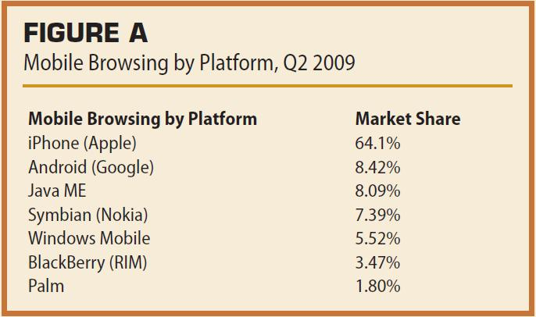
Mobile browsing by platform
Source Canalys

Slide 6
SmartPhone Internet Access
Two out of three people accessing the Internet from a SmartPhone use an iPhone.
The BlackBerry browser is difficult to use and provides inconsistent renderings of web pages.
Will Blackberry improve its browser before the iPhone gains corporate acceptance, or will its corporate market share diminish?

Slide 7
The iPhone as a web-client
Safari browser
Most standard browser features available, e.g., JavaScript, Cookies, Forms, DOM
Not available, events such as onMouseOver, onBlur, etc (no mouse!)
Finger Movements “tap”, “flick” and “pinch”.
Orientation change, 90°

Slide 8
Optimizing web-pages for the iPhone
Focus on Width and Height.
Maximizing Screen Space
Device Specific Rendering
Conditional CSS
Redirection

Slide 9
Focus on Width and Height
The iPhone's screen is 320x480 in portrait mode, 480x320 in landscape mode.
Some say - Pages should scale down to 320 pixel-width when in portrait mode, rather than being styled with 320 pixel-width initially then having to be stretched to 480 pixel-width for landscape mode.
<meta name = "viewport" content = "width = device-width">
<meta name = "viewport" content = "height = device-height">

Slide 10
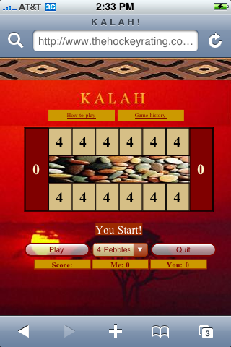
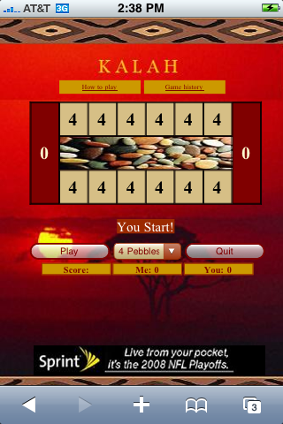
Rolling Up the URL input field
<body onload="setTimeout(function() { window.scrollTo(0, 1) }, 100);">

Slide 11
Conditional CSS
It is possible to use a different external CCS file depending on the device
<link href='PCTHRStyle.css' type='text/css' rel='stylesheet' >
<!--[if !IE]->
<link media="only screen and (max-device-width: 480px)“
href="iTHRStyle.css" type="text/css" rel="stylesheet" />
<!–<![endif]–>

Slide 12
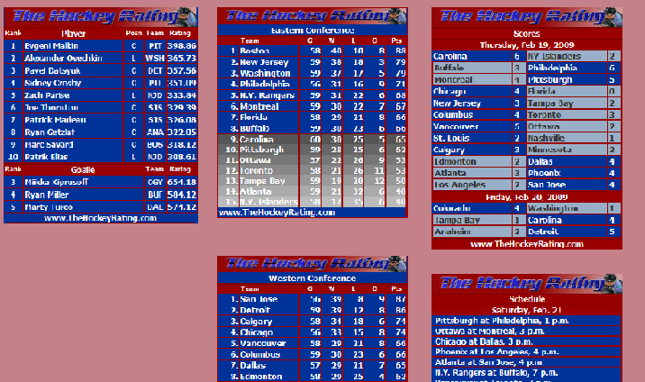
Using the Default .css File
Conditional CSS Example

Slide 13
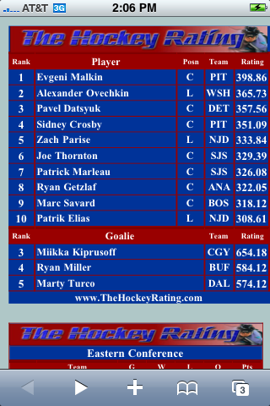
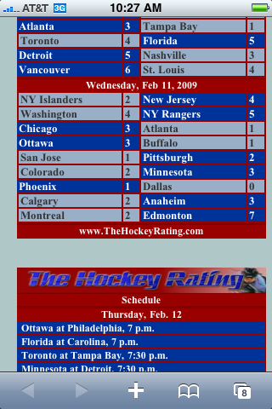
Using the iPhone Specific .css File

Slide 14
The Default .css File
body {
background-color: #C48189;
}
.column1 {
position:absolute;
top: 20;
left:20;
width:290;
}
.column2 {
position:absolute;
top: 20;
left:350;
width:290;
}
.column3 {
position:absolute;
top: 20;
left:680;
width:290;
}

Slide 15
The iPhone Specific .css File
body {
background-color: #AFC7C7;
}
.column1 {
position:absolute;
top: 20;
left:10;
width:290;
}
.column2 {
position:absolute;
top: 360;
left:10;
width:290;
}
.column3 {
position:absolute;
top: 1040;
left:10;
width:290;
}

Slide 16
Device Detection and Redirection
An alternative to Conditional CSS
Instead of pointing to a different style sheet, transfer to a different HTML document.
Detect device from an environment variable known as User-Agent

Slide 17
Device Detection and Redirection
<script>
if (navigator.userAgent.match("Blackberry") != null) {
window.location="Blackberry.html"
}
else {
if (navigator.userAgent.match("iPhone") != null) {
window.location="iPhone.html"
}
else {
window.location="Laptop.html"
}
}
</script>
http://www.sentinex.com/Mobile2.html

Slide 18
iPhone Orientation
Environment variable window.orientation
An event window.onorientationchange
Orientation expressed as degrees:
0 = Portrait mode
90 = Landscape Left
-90 = Landscape Right

Slide 19
On Orientation Change
window.onorientationchange = function() {
/*window.orientation returns a value that indicates whether iPhone
is in portrait mode, landscape mode. */
var orientation = window.orientation;
switch(orientation) {
case 0:
/* Portrait mode */;
document.getElementById("main").style.top = 160;
document.getElementById("main").style.left = 8;
document.getElementById("graph").style.top = 570;
document.getElementById("graph").style.left = 2;
......
break;
case 90:
/* Landscape Left mode */
break;
case -90:
/* Landscape Right mode */

Slide 20

Making WebApps look like iApps
Save your WebApp onto the iPhone using
“data URLs”
1. Type in a URL
2. Tap "Save It Now"
3. When your website appears choose "Add to Home Screen"

Slide 21
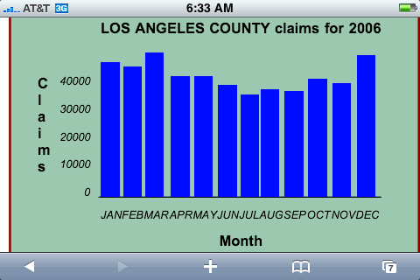
Rendering Options
Tables
Graphs

Slide 22
Graph Builder by Netscape
<script src="graph.js"></SCRIPT>
<center>
<fieldset style="background-color: #9bc8af; padding-left: 5px; width: 350;border: 2px solid #900000;">
<script>
var g =new Graph(210,130);
g.title = "LOS ANGELES COUNTY claims for 2006 ";
g.xLabel = "Month";
g.yLabel = "Claims";
g.scale = 10000;
g.addRow(47210, 45615, 50562, 42646, 42712, 39657, 35958, 37735, 37116, 41283, 39847, 50003);
g.setXScaleValues("JAN","FEB","MAR","APR","MAY","JUN","JUL","AUG","SEP","OCT","NOV","DEC");
g.build();
</script>
</feildset></center>

Slide 23
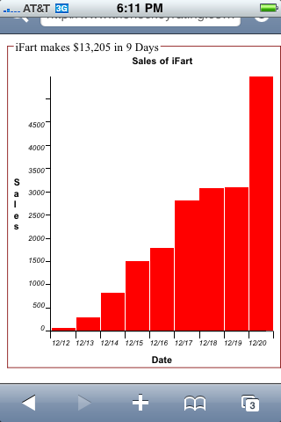
Rendering Options (cont.)
Another Netscape Graph with a story
$78,000 from 12/12 to Christmas day.

Slide 24
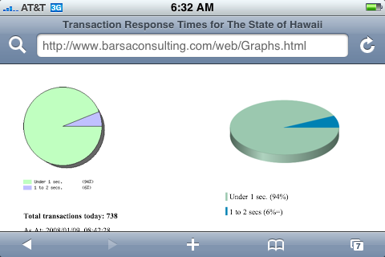
Rendering Options (cont.)
Java Script Pie Charts
Google Pie Charts

Slide 25
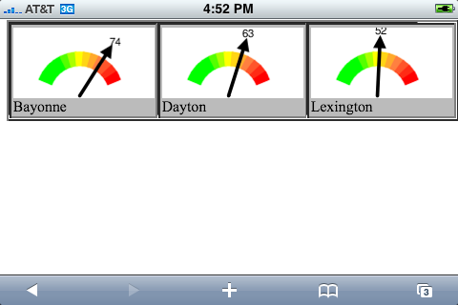
Rendering Options (cont.)
Google Gauges

Slide 26
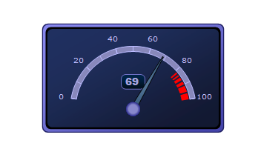
Rendering Options (cont.)
Bindows Gauges

Slide 27
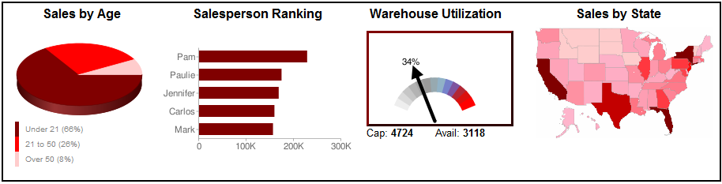
Executive Dashboards
Each element is a Google Chart

Slide 28
WidJets
Yahoo has Widgets, Google has Gadgets
I call them WidJets where the ‘J’ represents JavaScript
Construction: CGI program writes a JavaScript function anew each day.
Implementation:
<script type='text/javascript' src='http://www.TheHockeyRating.com/TheHockeyRating.js'></script>
<script>THRScores();</script>

Slide 29
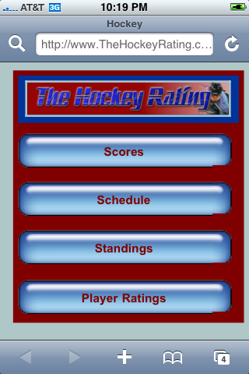
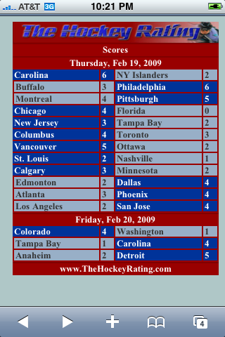
iPhone WidJets

Slide 30
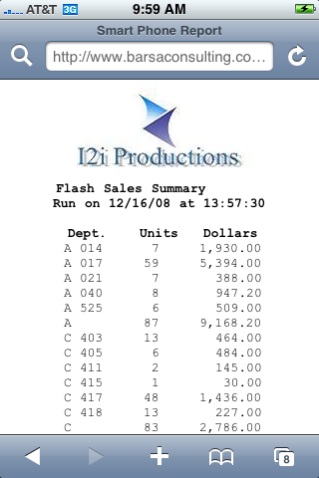
Rendering Options (cont.)
Reports
A simple ‘flash’ report optimized for the SmartPhone

Slide 31
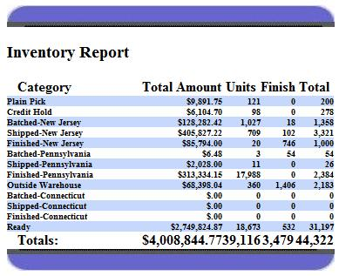
Reports (cont.)

Slide 32
Supporting Technologies
PHP is ubiquitous I
AJAX (Asynchronous JavaScript and XML), is a technique used to create interactive web pages.
Prototype, a JavaScript Framework; makes implementing AJAX easy.
http://www.PrototypeJS.org
Bindows, another AJAX Framework
http://www.bindows.net/

Slide 33
Ajax using Prototype to execute a JavaScript function
Specify Prototype.js in HTML document
Write the JavaScript function to be executed
Use Ajax.Update with evalScripts: true
Response should be of the form: runThisFunction(parm1,parm2,parm3);
Finally, apply Ajax.PeriodicalUpdater to achieve continuous, automatic update.

Slide 34
Access Security Process
On initial page load, check for a cookie containing the user name.
If not found, issue panel to accept User Name and Password.
Issue AJAX request to validate same.
Server verifies credentials.
Client retrieves server response and creates Cookie, hides SignOn panel and shows the page’s main panel.

Slide 35
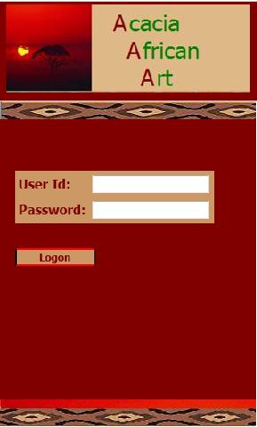
Access Security

Slide 36
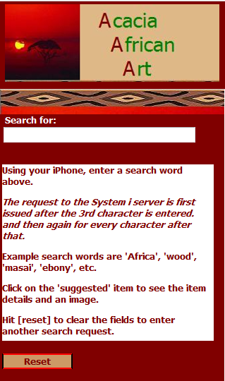
Access Security
Application with Logon

Slide 37
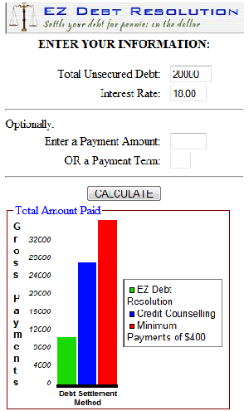
A PHP example
A Debt Reduction Calculator
Accepts Total Debt and Interest rate
Optionally Payment Amount and Term
Uses Netscape’s Graph-Builder
http://www.sentinex.com/EZDebtCalculator.php

Slide 38
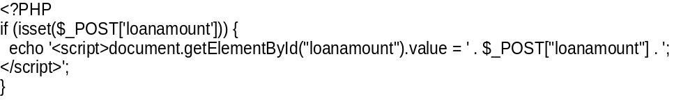
Code snippets

Slide 39
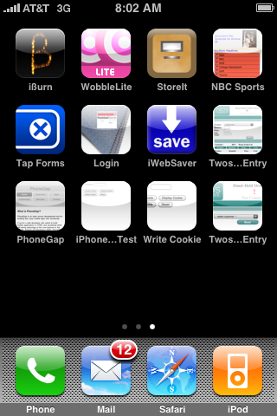
The Mobile Challenge
Signal:
Safari to Host
Online updates
No Signal:
HTML data
encapsulation
on iphone
email updates

Slide 40
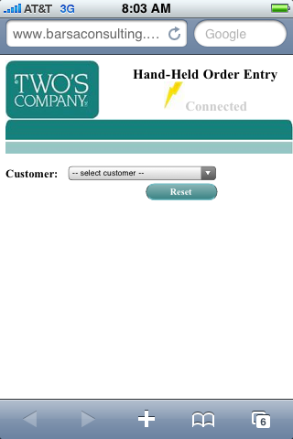
A Case Study
Order Entry – No Signal
Select a customer

Slide 41
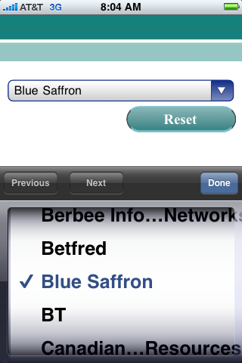
Select a customer (cont)
Drop down select
list is presented

Slide 42
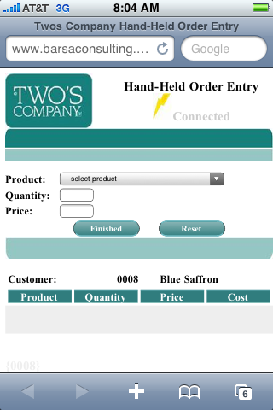
Select a customer (cont)
Press [done]
Double [tap] to resize display
Product select screen displayed.
[tap] Product select dropdown select list.

Slide 43
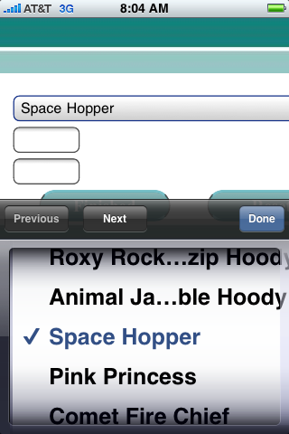
Select a product
[tap] the Product dropdown select list.
[tap] a product
[tap] [next] to enter quantity

Slide 44
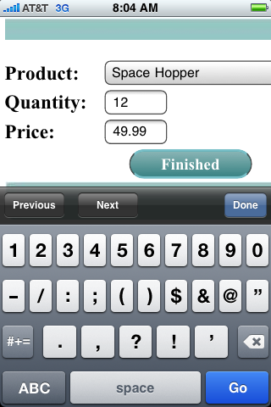
Select a quantity
Enter a quantity then [tap] [done]

Slide 45
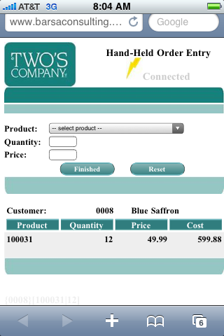
Select a product (cont)
The order begins to take shape.
Add another item

Slide 46
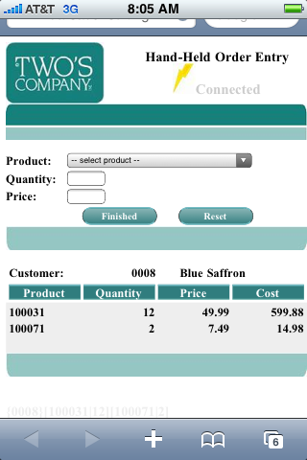
Select a product (cont)
Continue to add products.
Press [Finished] when done.

Slide 47
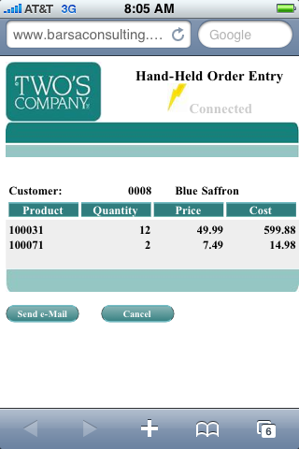
Completed Order
Press [Send e-Mail] to transmit the order to System i Host

Slide 48
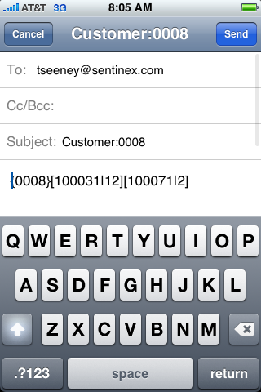
The e-Mail
Encoded data stream
Designed to minimize the number of characters and to ease processing by the host
Press [Send]

Slide 49
A Case Study
Order Entry – With a Signal
Auto-Suggest using AJAX to access entire customer file
A server-side query returns a block of HTML representing a number of suggested items
Will accept names or numbers
Example using AJAX

Slide 50
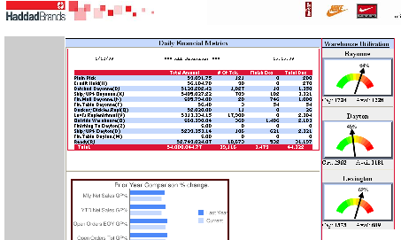
Another Case Study
Reporting & Business Intelligence
An Executive Dashboard

Slide 51
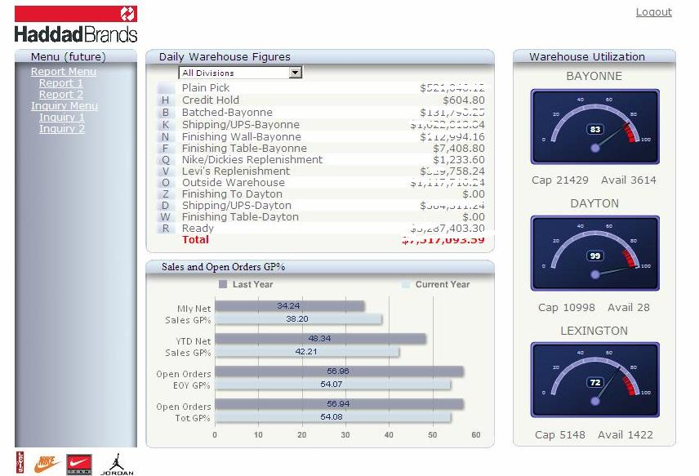
Another Case Study
Reporting & Business Intelligence
An Executive Dashboard

Slide 52
Summary
Nothing Magical
        Client / Server
Optimization for Smart Phone to be considered
A variety of format options
Security can and should be built in

Slide 53
GO MOBILE!
Trevor Seeney
tseeney@sentinex.com
201-681-9301
www.sentinex.com

