Slide 1
Overview
Introduction
The Mission
Challenges
The Solution
The Implementation
Conclusions

Slide 2
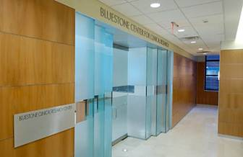

Introduction
New York University College of Dentistry
  Largest Dental school and third oldest in the country
A New Goal: Research
  Bluestone Center for Clinical Research (BCCR)
  New York’s diversity allows for a unique research population
  NYUCD’s existing patient roster adds significant value

Slide 3
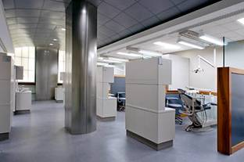

The Mission
Utilizing the 100+ daily new patients, and existing 150k patient base of NYUCD, build a web application to track, monitor and manage studies, participants and research subjects.

Slide 4


Challenges
All existing and new patient data must reside in monolithic Oracle-based Dentrix system
  Proprietary Windows fat-client architecture
  Poorly documented and supported database schema
  SELECT only access
  Not extensible
    No API
    Unable to store additional data
  ISV’s add-on solution inflexible and cost prohibitive
Notes:
Because of HIPPA Regulation, per below
SELECT only access because of licensing issues

Slide 5

Challenges
All studies and study specific data must be stored externally, yet in relation to Dentrix
  Asynchronous metadata
    Dentrix isn’t aware of external data
  Critical medical data
    Data must remain reliably linked across systems
  Simultaneous tracking of multiple participants, subjects and studies
  Database schema
    Mechanism to record medical, medication and dental history events and multiple layers of user comments
  Accommodate reporting needs

Slide 6

Challenges
All functionality available via the browser
  Role-based user authorization and authentication
  Highly sensitive data integrity checking
    All user inputted data must be strictly validated and recorded
  Presentation of data from two disjoint database schemas
    Data needs consistent formatting
  Printable as paper charts
Security - Integrity - Security

Slide 7

Challenges
All system procedures and processes must adhere to strict HIPAA Regulation
  Health Insurance Portability and Accountability Act of 1996
  Restriction on identifiable data
    Names, Social Security, Charts, Addresses, etc.
  Auditing and accountability
    Every read, write and change
    Who made the action
    Tracking of prior and new data values
  Consistent coding standards
    All diagnoses (ICD9), treatments (CDT/CPT) and drugs (NDC) must be recorded using standard code sets

Slide 8


The Solution
AMP Technology
Open Source Flexibility
Prior Success
Performance
Return on Investment
Style

Slide 9

AMP Technology Overview
The World's Most Popular Open Source Database

Slide 10
AMP Technology
‘A’ is for Apache
  Highly stable, flexible and recognized web server
  De facto industry standard
  Easily extended, supported and maintained
  Free

Slide 11
AMP Technology
‘M’ is for MySQL
  Particularly suited for providing rapid query responses
  Nimble setup, operation and performance perfect for storage of metadata, and complementing large, legacy databases
  Small footprint on multi-purpose servers
  Free, with commercial support available
The World's Most Popular Open Source Database

Slide 12
AMP Technology
‘P’ is for PHP
  Fast, native APIs for MySQL and Oracle
  Excellent integration with Apache
  Highly extensible, reusable and modular
  Key functionality part of standard distribution
  Clean and concise coding style
  Quickly becoming de facto programming language for Internet applications
  Already in use for data mining and processing
  Commercial support and solutions available

Slide 13
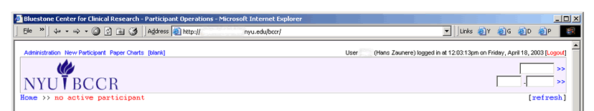
The Implementation
Bluestone Center for Clinical Research
Digital Charting and Tracking System
Dentrix Aware
Integrates Metadata
HIPAA Compliant
Validating Web Application

Slide 14
BCCR DCTS
Solved: All existing and new patient data must be stored in monolithic Oracle-based Dentrix system
  Participant
    A physical person represented by a chart number in Dentrix
    Related by bchart and represented by pid in BCCR DCTS
MySQL Table: participant
pid | integer | Primary Key
itimestamp | integer | Insertion Timestamp
bchart | char (8) | Dentrix Primary Key

Slide 15
BCCR DCTS
Solved: All studies and study specific data must be stored externally, yet in relation to Dentrix
  Subject
    A study enrolled participant represented by a bccrchart in BCCR DCTS
MySQL Table: subject
subid | integer | Primary Key
itimestamp | integer | Insertion Timestamp
R_pid | integer | Referring Participant ID
R_sid | char(8) | Referring Study ID
bccrchart | char(16) | Study Specific Chart Num.

Slide 16
BCCR DCTS
Solved: All functionality available via the browser
  Cascading Style Sheets (CSS) provide consistent presentation across digital and print media
  Utilitarian functions provide formatting across systems
  User Request Processor (URP)
    Assures proper data types and formatting
    Handles form processing, filling and validation
    Prevents back-button and reload incongruities
    Provides centralized flow control mechanism
    Prevents request string tampering

Slide 17
BCCR DCTS
Solved: All system procedures and processes must adhere to strict HIPAA Regulation
  Minimal identifiable data presented on a ‘need-to-know’ basis
  Read, Write and Change Auditing
MySQL Table: audit
auditid | integer | Primary Key
itimestamp | integer | Insertion Timestamp
action | integer | URP Action
R_uid | integer | Referring User ID
curstate | blob | Current Application State
newstate | blob | New Application State

Slide 18




BCCR DCTS
  Over 50,000 codes stored in searchable full text repository
MySQL Table: codeset
codeid | integer | Primary Key
code | varchar(15) | Standardized Code
description | varchar(255) | Full Text Description

Slide 19
Conclusions
AMP Technology Delivers
  The flexibility to extend legacy proprietary systems
  The stability to support crucial medical data
  The value of publicly supported and developed software
A Complete Open Source Solution for the Academic Enterprise

Slide 20
Resources
http://nyu.edu/dental/
http://nyu.edu/dental/research/
http://apache.org
http://mysql.com
http://php.net
http://newyorkphp.org

Slide 21
Thank You

