Slide 1
The Aphrodisias Project, Humanities Computing and PHP @ NYU
Matthew Zimmerman
New York University
PHP ConEast 2003
April 25, 2003

Slide 2
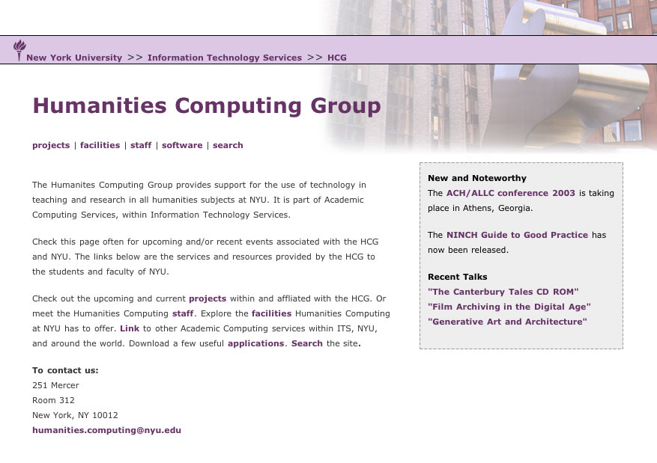
Humanities Computing Group http://www.nyu.edu/its/humanities/

Slide 3
HCG Projects http://www.nyu.edu/its/humanities/projects.html
Aphrodisias Project (archeology)
Margaret Sanger Papers (online edition)
Hemispheric Institute Video Archive (performace studies)
Franklin Furnace Video Archive (performance studies)

Slide 4
Projects to Convert to PHP
Aphrodisias Project
Hemispheric Institute Archive
Franklin Furnace Archive
Verdi Studies Database

Slide 5
New PHP Projects
Margaret Sanger Papers
Clerk’s Tale (Canterbury Tales Project)

Slide 6
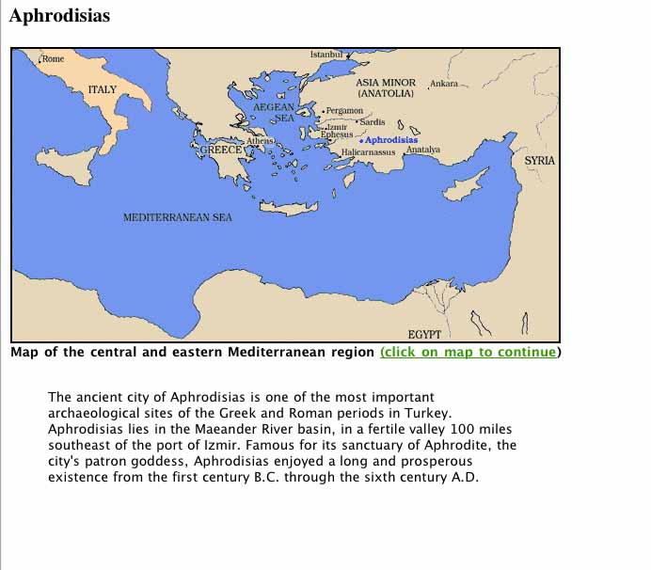
Aphrodisias Project

Slide 7
Aphrodisias Project
40 years in Turkey.
Sponsored by NYU and IFA.
10,000 slides of sculptures and other objects.
Want to create a digital archive.

Slide 8
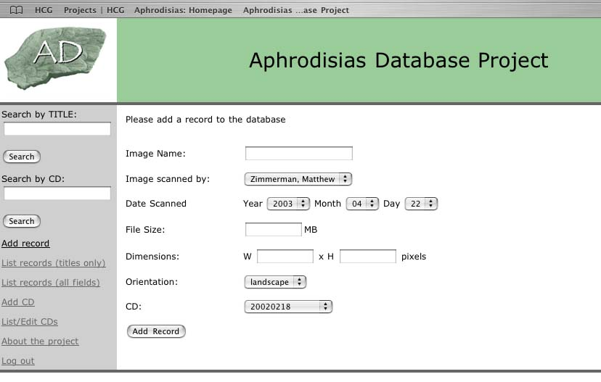
Login

Slide 9
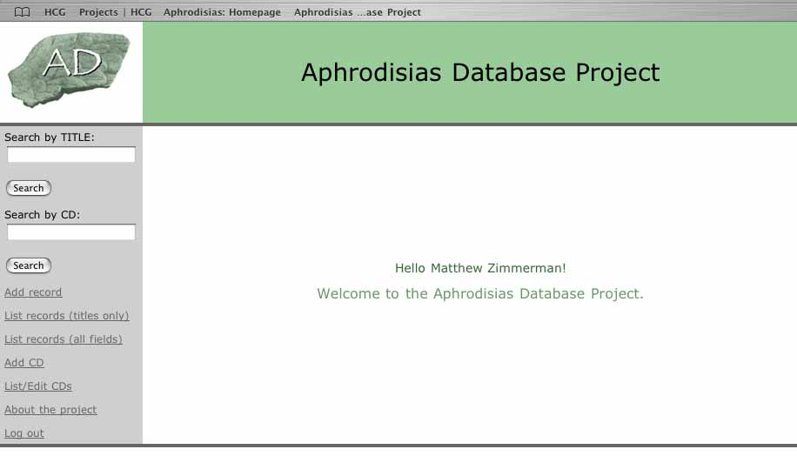
Menu

Slide 10
Add record

Slide 11
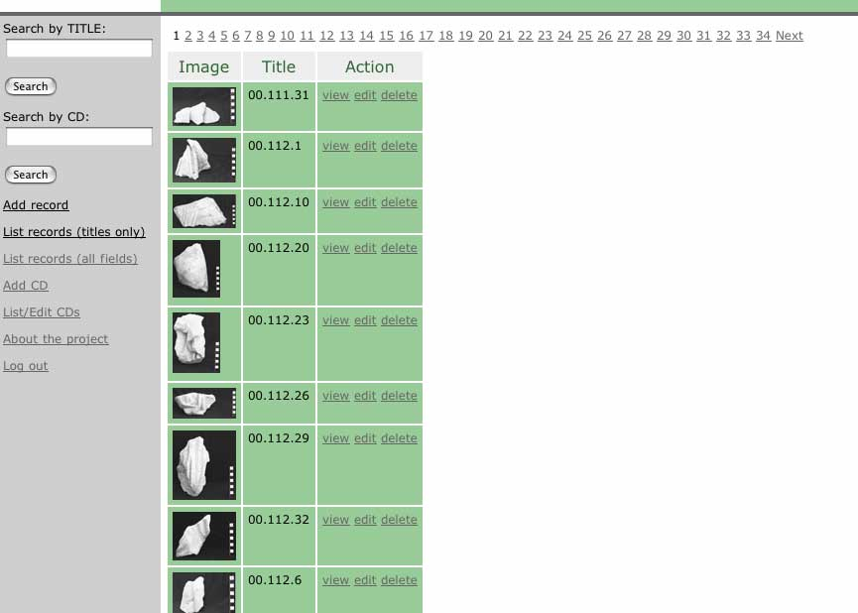
List

Slide 12
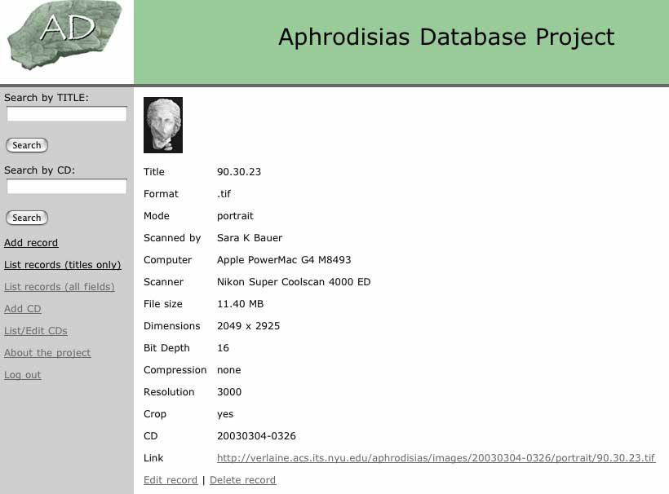
View Record

Slide 13
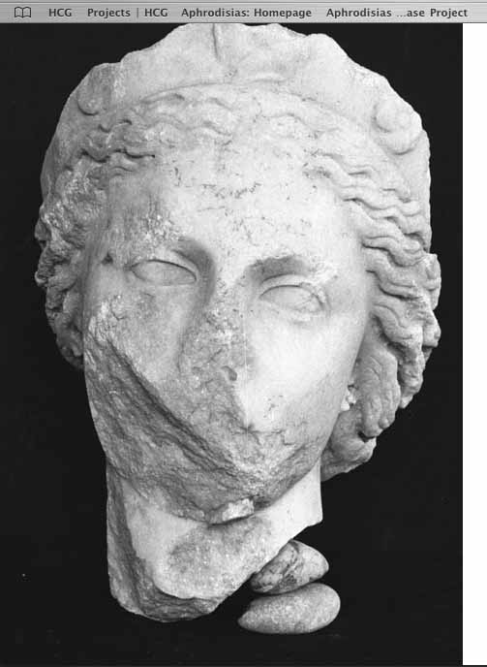
Image

Slide 14
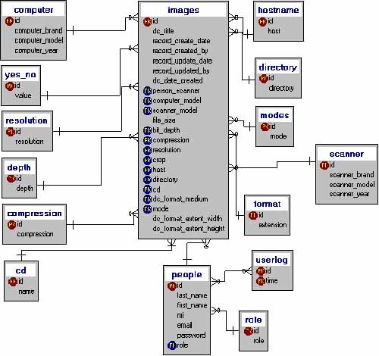
Database Structure

Slide 15
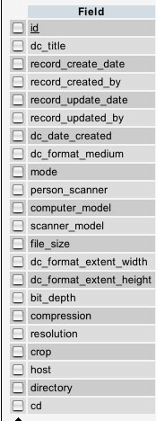
Image table

Slide 16
PHP
Sessions for userid and password.
Includes for static data.
Includes for header and menu.
Standard MySQL related functions.

Slide 17
Other technical info
Mac OS X Server 10.2.4
Apache 1.3.27
MySQL 3.23.53
PHP 4.1.2
PHPMYADMIN 2.2.6

Slide 18
My information
Matthew Zimmerman
Humanities Computing Specialist
New York University
matthew.zimmerman@nyu.edu
http://www.nyu.edu/its/humanities

