Slide 1
Build Business Web Applications with PHPOpenbiz framework
Rocky Swen
Rockyswen@phpopenbiz.org
Architect, phpopenbiz.org

Slide 2
Agenda
What is PHPOpenbiz?
PHPOpenBiz Goals
PHPOpenbiz Advantages
PHPOpenbiz Architecture Overview
PHPOpenBiz Development Cycle
Demos
Questions

Slide 3
What is PHPOpenbiz
A little history
  Project was started in 2003 with the goal to minimize the coding efforts in business application development.
A PHP business application framework featured with
  Metadata-driven design principal. Developers declare business logic as metadata (zero-coding)
  Model-View-Controller
  Object Relational Mapping
  AJAX browser client
  Eclipse integrated authoring tool

Slide 4
What is PHPOpenbiz (cont)
Target User Community
  Professional software developers
  IT consultants
  Software Houses
Target applications
  Management/Administration System (i.e. CRM, HRM)
  Company home-grown internal management systems
  Migration from desktop application to rich client web application
  Will satisfy the need for most of the database driven web applications

Slide 5
PHPOpenBiz Goals
Speed up development of business applications by providing standard development structures that allow producing database driven web interfaces in less or no time.
Minimize Application Supportability & Maximize Application Upgradeability by:
  providing centralized & complete application framework.
  minimizing application coding requirements.
  clear separation of technology from business

Slide 6
PHPOpenbiz Advantages
Easy and powerful
  Editing XML metadata instead of coding
  Rich features – AJAX, MVC, ORM, Security …
  Build upon Zend Framework, but more focus on application logic
Quick development
  Framework provides common functions/services
  Customer logic is extended on core objects
Low maintenance cost
  Managing metadata is cheaper than managing code

Slide 7
Architecture Overview
Metadata-driven design principal
  Openbiz objects are defined with XML metadata
  Metadata describes the properties and behaviors of an object
  Metadata describes the relationship between objects
  Objectfactory creates objects on the fly
  Openbiz core objects are the base of the framework
  All objects are extensible with customer classes

Slide 8
Architecture Overview (cont)
Multi-layer Object Oriented design
AJAX Client – AjaxForm, jsForm
Presentation – BizView / BizForm
Authoring:
Openbiz
Eclipse
Plugin
Business logic – BizDataObj, Plugin Service
Data Integration – Zend_DB
Openbiz stack
MySQL
Oracle
MS SQL
Sybase
…
PHP Runtime
DB Vendor

Slide 9
Architecture Overview (cont)
Architecture stack
Metadata
Objects
BizView
BizForm
BizDataObj
Extended object
Common
Services
Report Service
I/O Service
Email Service
Customer Service
MVC
Object Factory
Data Validation
DataObj
Trigger
Smarty
Common
Application
Infrastructure
ORM
XML Metadata
Session Context
Security
Zend_DB
Runtime
PHP 5.x + Extensions
Platforms
Windows
Linux
Others

Slide 10
Architecture Overview (cont)
Model-View-Controller
  Openbiz MVC is more like JSF because both are component based architecture
  Event/Action handling on BizForm methods
Controller
View
Model
BizDataObj +
PluginService
Clients
BizController
BizView+BizForm
Data
Web Server running PHP

Slide 11
Architecture Overview (cont)
Object Relational Mapping
  Support 1-M, M-1, 1-1 and M-M mappings between Data Objects (BizDataObj) and DB Tables / Views
  SQL-like query expression language
Stateful objects
  Objects states are stored in session context
  Objects keep persistency across session
  Objects can be configured as stateless
Notes:
SDO can do FAR more than this simplistic example shows. It can actually perform joins across database tables and build complex graphs of objects from the resulting information.
The ability to automatically extract much of this information from the database schema is a known requirement.

Slide 12
Architecture Overview (cont)
Eclipse integrated authoring tool
  Wizards to create objects metadata xml files
  GUI editor to modify elements of metadata
  Leverage the power of Eclipse platform – PHP Eclipse IDE, database tools, UML designer, Web designer …
Plugin services
  Customer logic can added in plugable services
  Service metadata allows change of implementation class
  Framework provides common services – email, export/import, log, BIRT/report, excel, authentication, access control, audit trail…

Slide 13
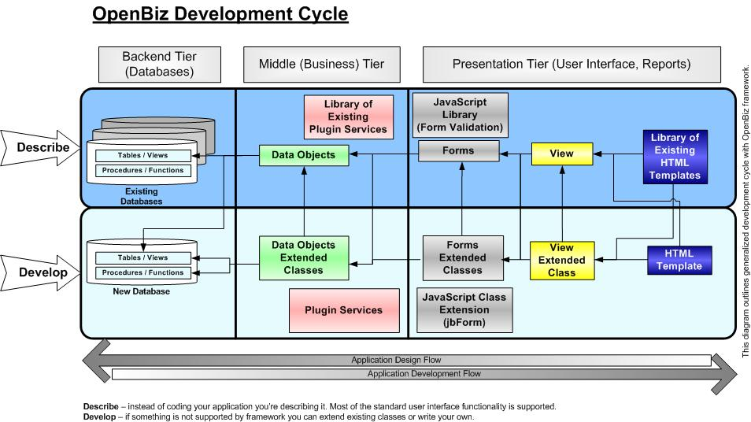
Development Cycle

Slide 14
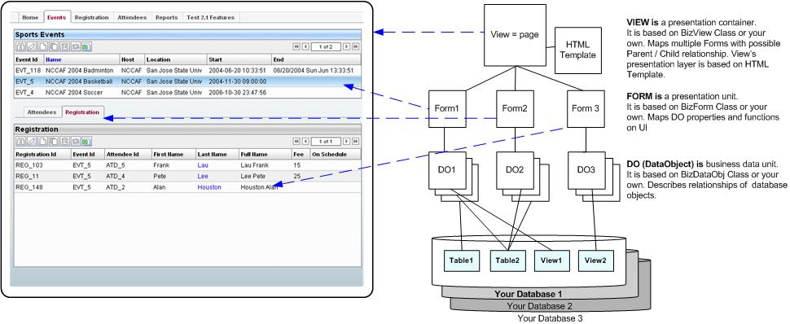
Development Cycle (cont)

Slide 15
Development Cycle (cont)
Development steps with PHPOpenbiz
Requirements
Data model
Create BizDataObj
Openbiz
Eclipse
Plug-in
User Interface
Create BizForm
Create BizView
Create Templates

Slide 16
Development Cycle (cont)
Publish a single table – build a page that manages event attendees
  Flash url of the demo is at http://www.phpopenbiz.org/document/openbiz_flash.htm
Work on table relationship tutorial can be found at project’s site
Notes:
Note that we’ve made the TrainingTracker class into a service as well. We could take this a step further and wrap the database access in a service as well if it were useful to do so.

Slide 17
Why OpenBiz?
“The ability to simplify means to eliminate the unnecessary so that the necessary may speak.”
Hans Hofmann
  Technology can solve a lot if not the most of business problems, but at the same time can create additional very complex link that can stumble development of business applications. By providing organized way of describing and presenting complex business structures OpenBiz “eliminates the unnecessary” complexity “so that the necessary” (business) “may speak.”
“Everything should be made as simple as possible, but not simpler.”
Albert Einstein
  OpenBiz is simple and straightforward but at the same time provides clear pathway for solving complex business problems.

Slide 18
Demos
PHPOpenbiz demoapp
UniqueAid Home Health Care
Camp management (mycamp.net)

Slide 19
Your Comments
If you have any comments, advice, questions or testimonials we’re looking forward to hear from you. Please post them on our web site or send us via email.
“Action may not always bring happiness; but there is no happiness without action.”
  Benjamin Disraeli

Slide 20
Contacts
Project website
  http://www.phpopenbiz.org
Emails
  rockswen@phpopenbiz.org
  support@phpopenbiz.org

