Slide 1
Faculty Database Demo
Weizhen Tu and Larry Polly
Educational Communications
SUNY Upstate Medical University

Slide 2
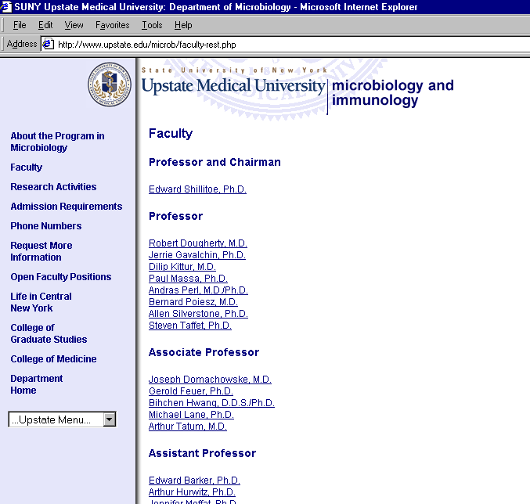
Department View
Indexed By Title

Slide 3
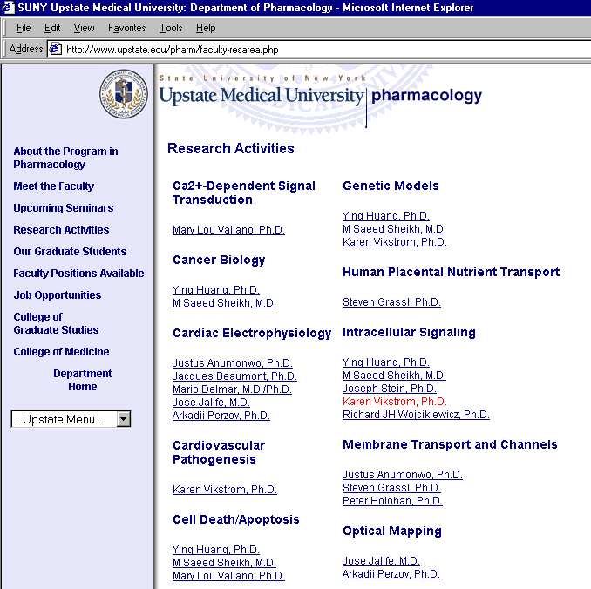
Department View
Indexed By Research Area

Slide 4
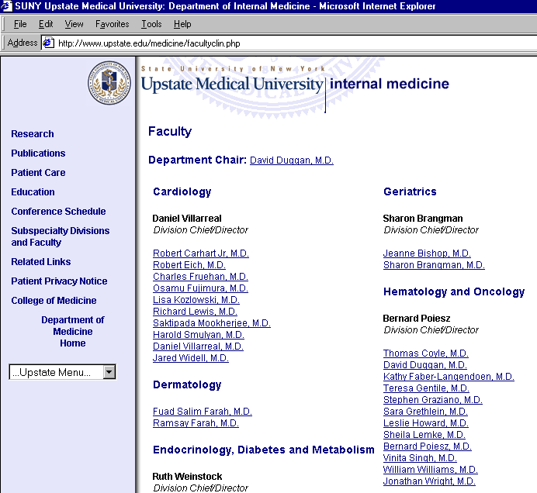
Department View
Indexed By Clinical Section

Slide 5
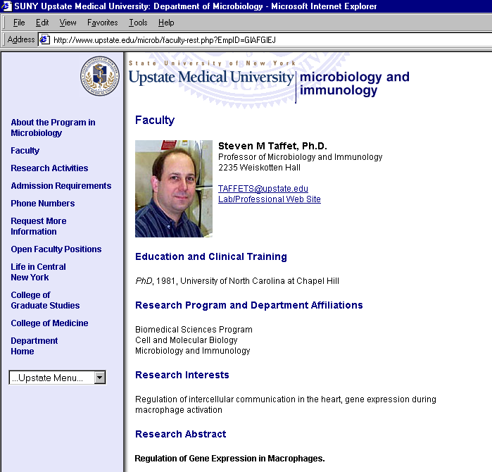
Department View
Profile

Slide 6
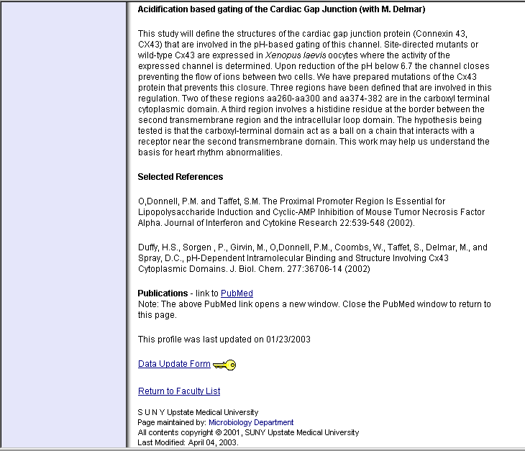
Department View
Profile (cont.)

Slide 7
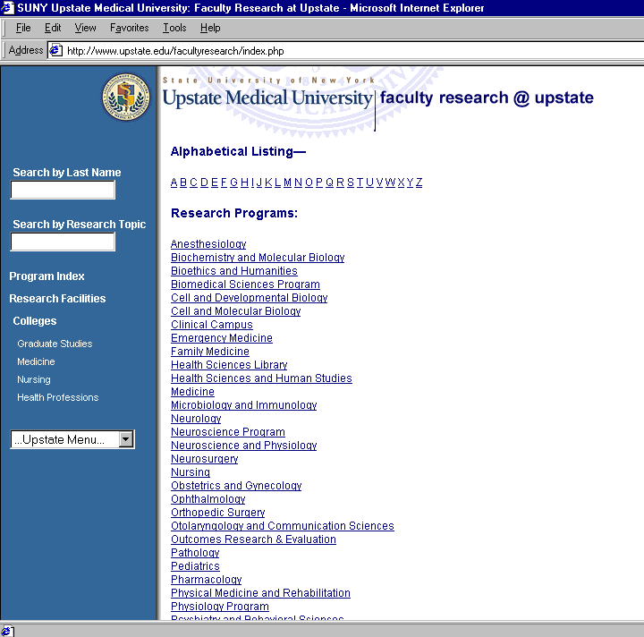
Research
View

Slide 8
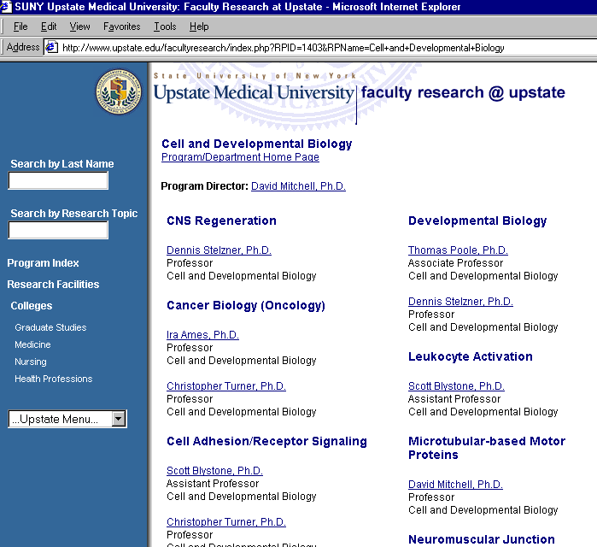
Research
View

Slide 9
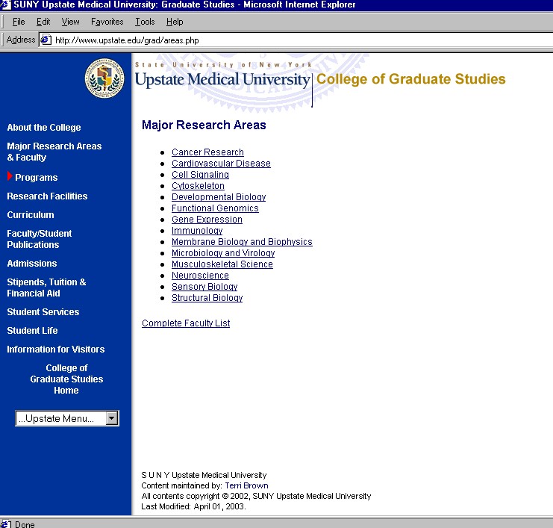
Research
View

Slide 10
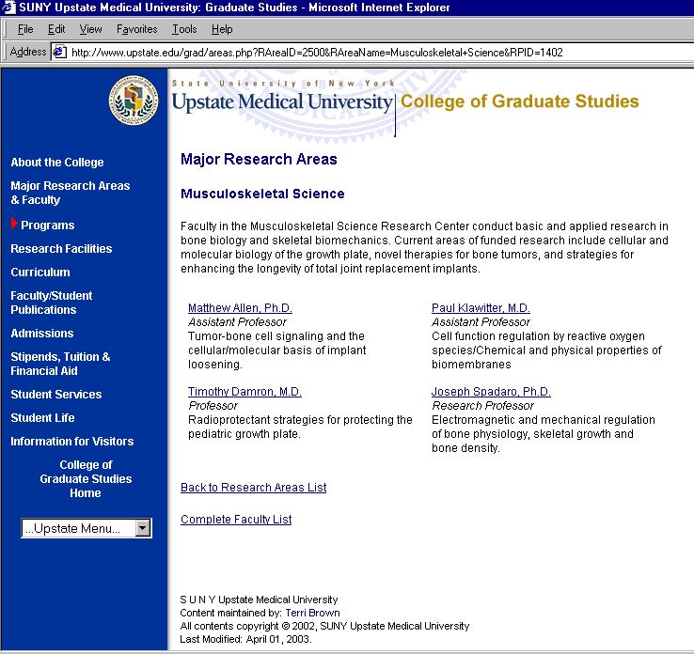
Research
View

Slide 11
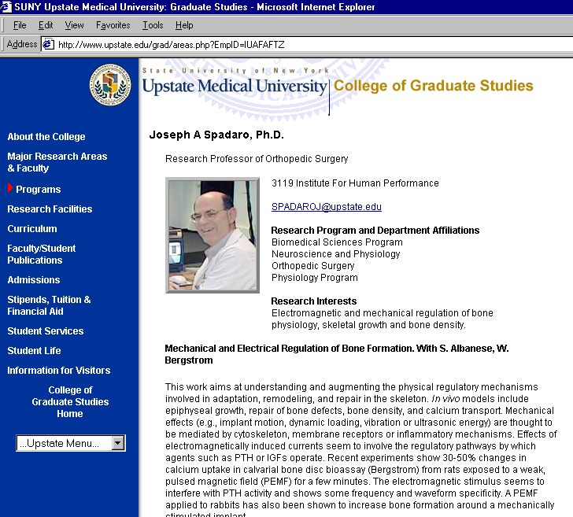
Research View
Profile

Slide 12
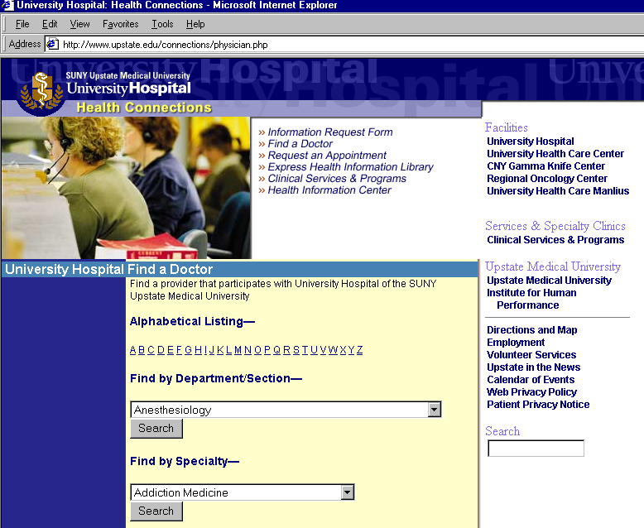
Clinical
View

Slide 13
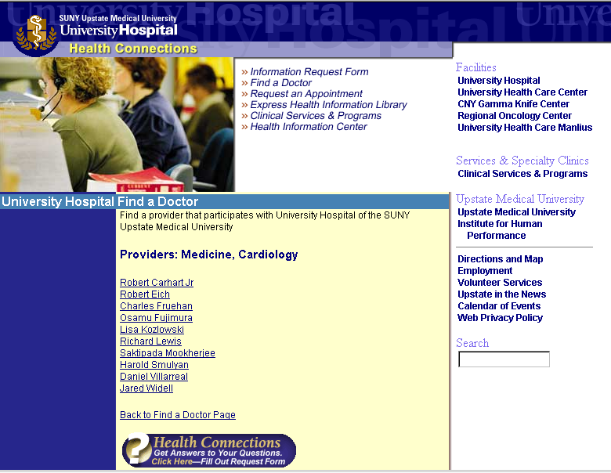
Clinical View
Clinical Section

Slide 14
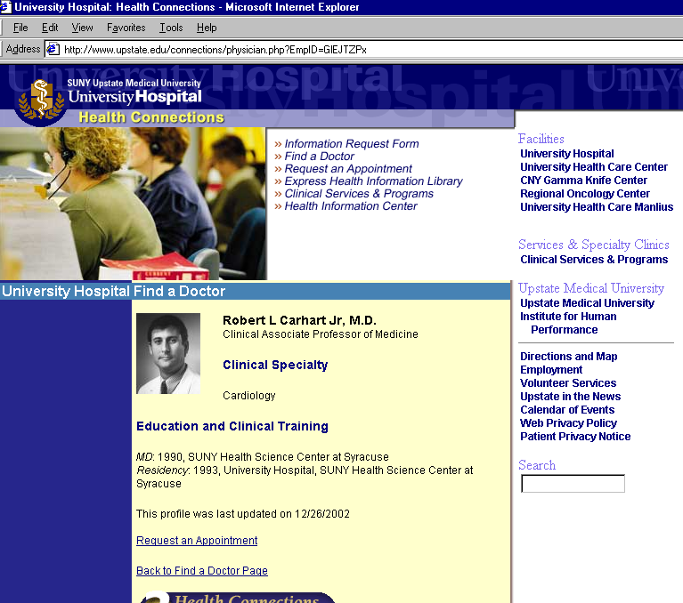
Clinical View
Profile

Slide 15
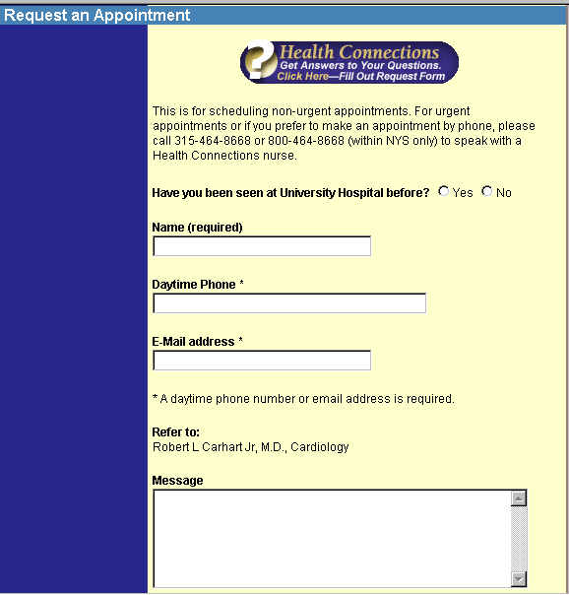
Clinical View
Request an Appointment

Slide 16
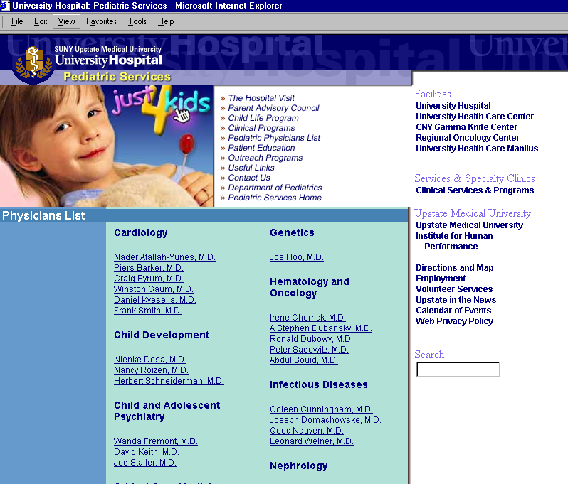
Clinical View
Pediatric Services

Slide 17
The End

