Slide 1
Faculty Database System for the Internet
Weizhen Tu and Larry Polly
Educational Communications
SUNY Upstate Medical University

Slide 2
Outline
Faculty Database System Overview
Design and Implementation Issues
  Background Info
  Database Design
  PHP Implementation
  Templates, CSS and PHP code
  Data Update Tools
  Security

Slide 3
Faculty Database Overview
Profiles of Upstate Faculty
  Name, Degree, Title, Department
  Research/Clinical Interests
  Education/Clinical Training
  Clinical Certification
  Research Abstract
  Publications (link to PubMed)

Slide 4
Faculty Database Overview
Three Views for Internet Audiences
  Department: indexed by title, research area, or clinical section
  Research: for graduate students or researchers in other institutions
  Clinical: for patients
PowerPoint Demo
http://www.upstate.edu/webDB/demo/

Slide 5
Faculty Database Overview
Search Functions
  Last Name
  Full Text Search
    Research interests (SQL)
    Research abstract (file system)
    Combined via PHP code

Slide 6
Faculty Database Overview
Data Update Tools
  Individuals
  Department Managers
  Web Administrators
Domain Protected
Require Username/Password

Slide 7
Faculty Database Overview
Back End: Oracle
Web Server: Apache
Web Implementation: PHP

Slide 8
Design and Implementation

Slide 9
Why - Background Info
Three separate data sources for faculty profiles
  Research Faculty (FileMaker Pro)
  Find a Doctor (MS Access)
  Various department pages
Data inconsistency
Maintenance nightmare

Slide 10
Why Oracle/PHP
Core data from Human Resource Oracle Database
Oracle available under the SUNY License
Table space on central Oracle server to store other non-HR info
PHP is free

Slide 11
Database Design
Good data model is important
  Flexible to accommodate all existing faculty pages
  Expendable so future applications (such as clinical trials) can be added
  Easy to maintain and update
Use views for database query

Slide 12
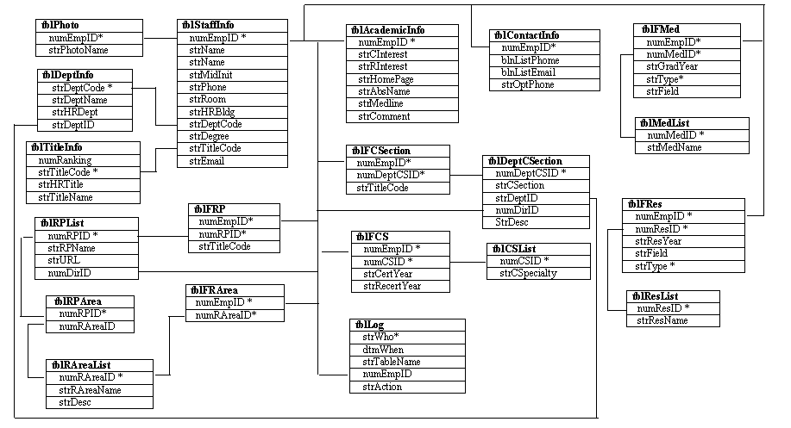
Basic Database Structure

Slide 13
Database Views
viwDeptCS
  for “indexed by clinical specialty”
viwDeptCSestion
  for “indexed by clinical section”
viwDeptRArea
  for “indexed by research area”
viwDeptTitle
  for “indexed by title”
viwRProgArea
  for “indexed by research program/area”

Slide 14
PHP Implementation
  Presenting to the Internet
  Data Update Tools

Slide 15
Program Directory Structure
WebDB Root
(WebReadOnly)
(WebUpdate)
Protected Area
dev
Public Area
...
...
...
includes
javascript
secure
lib
admin
manager
update
includes
lib
abstract
photo

Slide 16
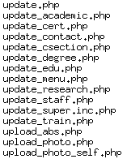
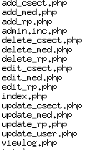
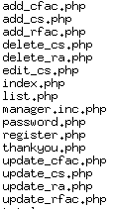
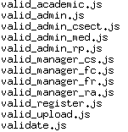
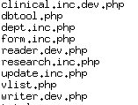

Basic File Structure
Protected
update
admin
manager
javascript
lib
Public

Slide 17
Templates, CSS and PHP
Layout, look/feel and style
  Controlled by templates and CSS
PHP code -
  Connect to the remote database
  Fetch data between DB & the Web
Minimal formatting within PHP code
Example: Microbiology faculty

Slide 18
Example
<?php
$page=$_SERVER{'PHP_SELF'};
$DeptName=urlencode('Microbiology and Immunology');
if ($EmpID){
include ("http://www.upstate.edu/webDB/dept-list.php?EmpID=$EmpID&page=$page");
echo "<p><a href=\"$page\">Return to Faculty List</a>\n";
}else{
include ("http://www.upstate.edu/webDB/dept-list.php?DeptID=128&DeptName=$DeptName&ByType=Title&page=$page");
}
?>

Slide 19
Update Tools
A set of Web forms
One Web form per database table
Maintain database integrity
  Effective input error checking
    Javascript
    PHP
  Avoid free text input if possible

Slide 20
Security
All update forms are domain-protected
All update forms require login
Login tool: customized phpSecurePage
  www.phpSecurePages.com (by Paul Kruyt)
Individuals - their own data
Managers - all faculty in his/her dept
Web Admin - all data
PowerPoint Demo
http://www.upstate.edu/webDB/demo/

Slide 21
Summary
Start with a good data model
Use templates and CSS
Data update forms should
  Match database tables
  Have effective input error checking
  Avoid free text input if possible
  Be well-protected

Slide 22
The End
Thank You!
Any questions?

