Slide 1
Update Tools Demo
Weizhen Tu and Larry Polly
Educational Communications
SUNY Upstate Medical University

Slide 2
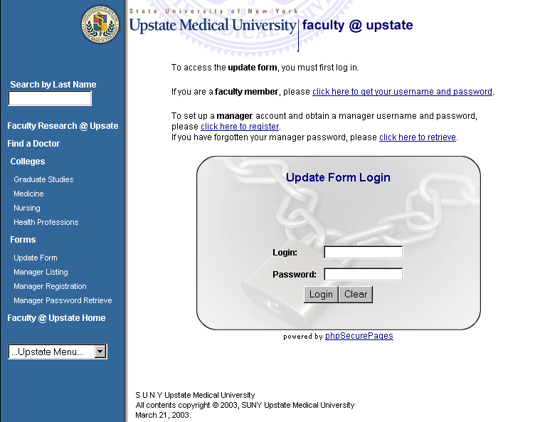
Update Form
Login

Slide 3
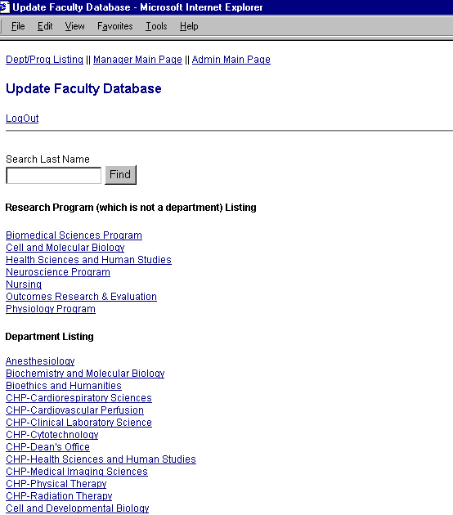
Update Form
WebAdmin View

Slide 4
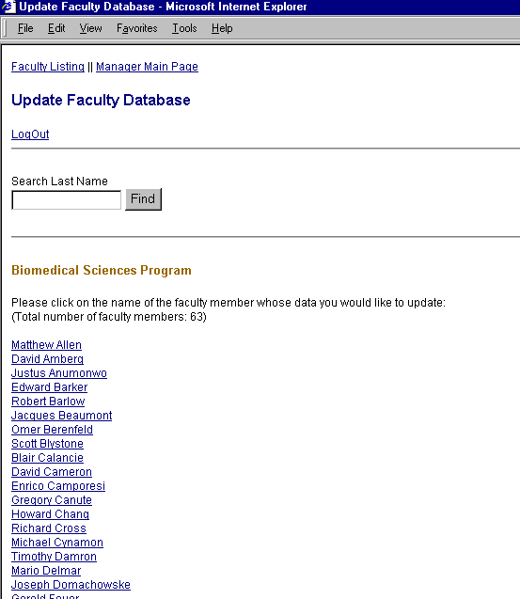
Update Form
Dept Manager View

Slide 5
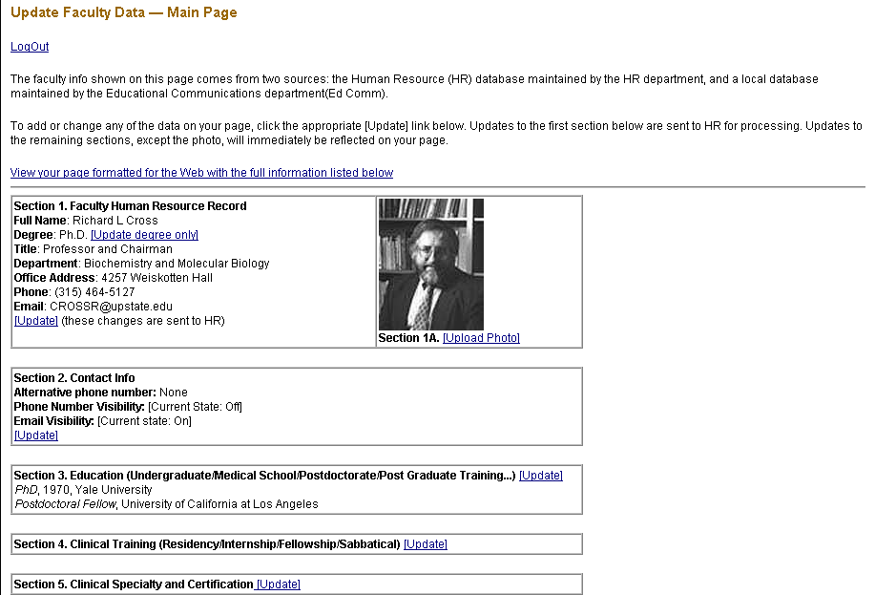
Update form: Individual View

Slide 6
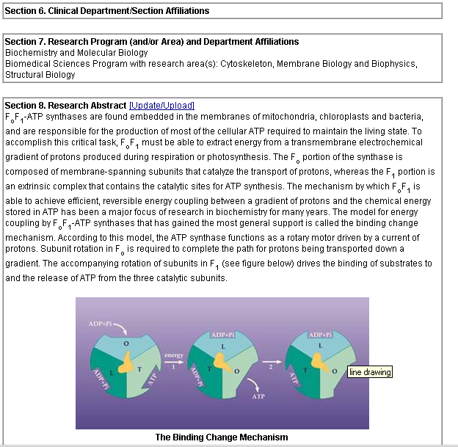
Update Form: Individual View (cont.)

Slide 7
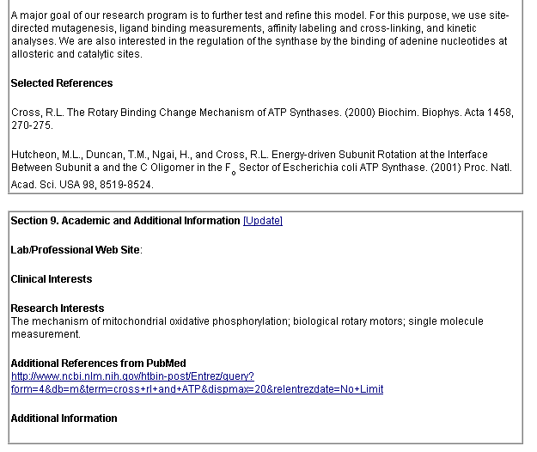
Update form: Individual View (cont.)

Slide 8
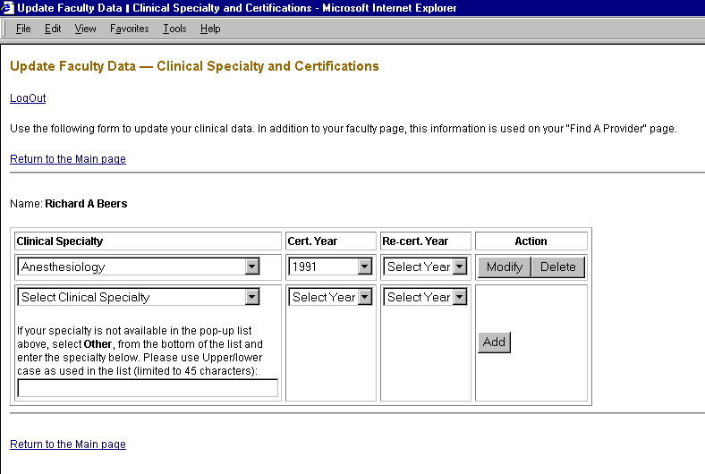
Update Form: One Example

Slide 9
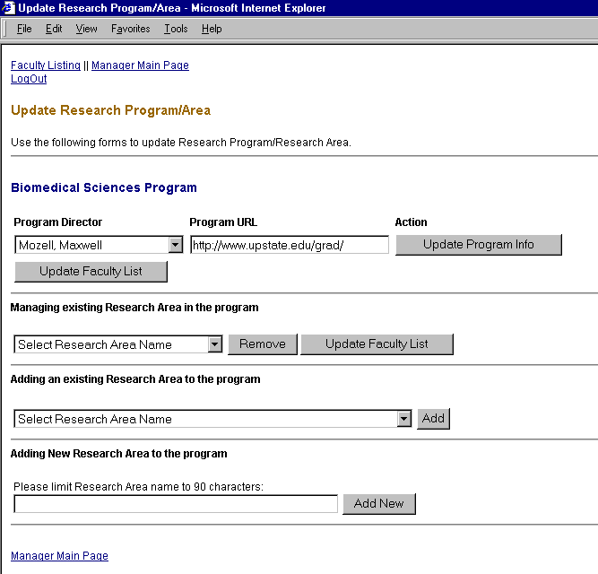
Update Form (manager)
Example

Slide 10
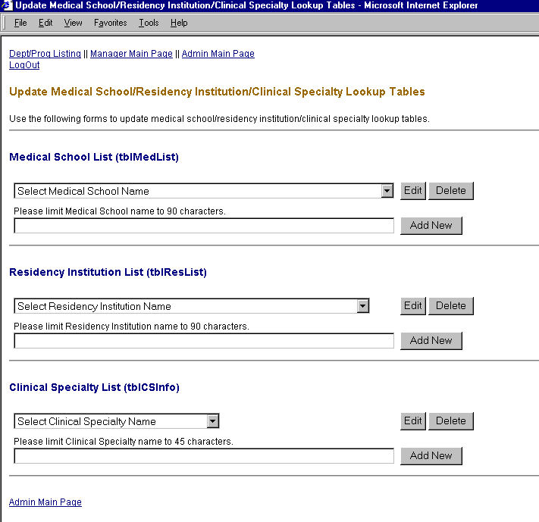
Update Form (WebAdmin)
Example

Slide 11
The End

