Slide 1
8 White Hat
SEO Methods for
PHP Developers
David Fischer
Avity LLC

Slide 2
The Spectrum of SEO Techniques
1
Know the Game
White hat, black hat
The three legs of the white hat SEO stool
    Inbound links
    Keyword-rich text
    Technical aspects

Slide 3
Cross-Browser Websites
1
Know the Game

Slide 4

Cross-Browser Websites
1
Know the Game

Slide 5

Cross-Browser Websites
1
Know the Game

Slide 6
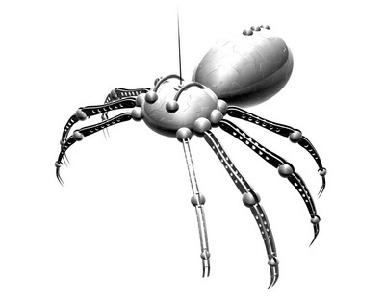
Cross-Browser Websites
1
Know the Game

Slide 7
2
SEO-Friendly Architecture
A common misconception:
There are two steps in building a
search engine friendly website:
1) Build website
2) Do SEO stuff

Slide 8
2
SEO-Friendly Architecture
From the start:
Limit reliance on JavaScript, Flash, and images that display text
Use SEO-friendly HTML
    Unique, meaningful title and meta tags
    W3C compliance
    Alt attributes on non-text content
Structure your content wisely & develop a corresponding URL schema early on
Register your domain for the maximum term

Slide 9
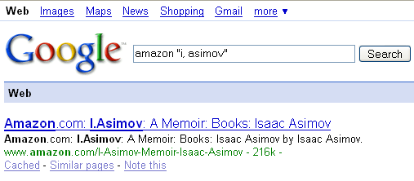
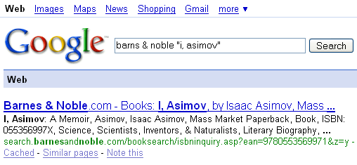
3
URLs Matter
Please compare:
Keyword-rich URLs help rankings
Human factor
    Clean URLs look professional
    Messy URLs look spammy
  “The mere presence of a question mark in the URL will introduce a delay in Google's indexing a page.”
  -- Daniel Dulitz, Google engineer

Slide 10
4
The Duplicate Content Trap
Repetitive content
    annoys users
    dilutes page equity
    wastes crawler resources
    looks like spam
    can be an indication of content theft
As a result, search engines penalize duplicate content

Slide 11
4
The Duplicate Content Trap
Sometimes you can't entirely avoid having duplicate content on your site...
    Printer-friendly pages
    Same product, different color
    Duplicate title & meta tags for different pages
    URL-based session IDs implemented by the guy who worked on the project before you
    Your boss's poor content organization skills
Minimize indexing of duplicate content using robots.txt & mod_rewrite

Slide 12
5
Content Relocation & Error Codes
1xx: Provisional response – don't use
2xx: Successful request – return by default on success
301: Permanent move – OK
    Page equity retained with delay and possible penalty
302: Temporary move – avoid
404: Permanent remove – OK
    Spiders will not index
    Warning: spiders will DEINDEX if previously indexed
500: Correct code for temporary technical difficulties
    If you want to commit SEO suicide, feed a spider non-5xx codes while your web or database server is down

Slide 13

6
Graphical Text: An Ancient Evil
style.css
.nytimes {
font: old-english-txt;
font-size: 48;
}
?
Site designs sometimes require more elaborate text formatting than CSS can provide, right?
  Shortest and best answer (for SEO & maintainability at least): No, stick with CSS only!
  Short and acceptable answer: Okay, we can put in a few images for text, but no more than, say, three!
  But if you absolutely need more typesetting options...

Slide 14
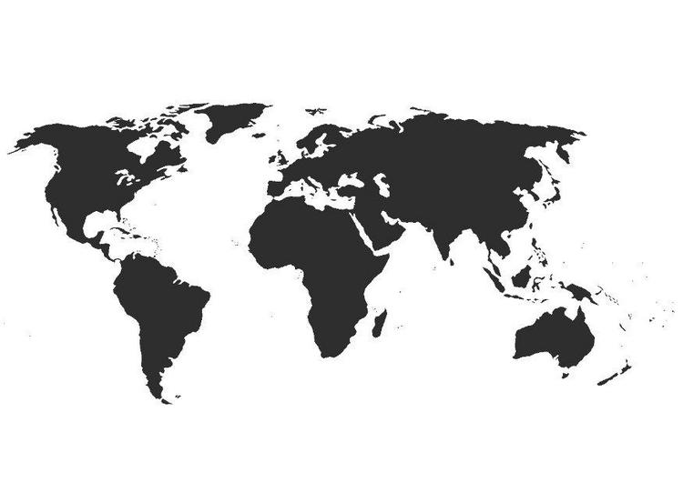
7
Sitemaps
User sitemaps
Google XML sitemaps & Yahoo urllists
Dynamically generating sitemaps

Slide 15
8
Black Hat & Defensive Measures
Why not use black hat SEO techniques?
Why address them now then?
    Protect your site's security
    Understand the competition
    Learn to think like Google
Insertion & comment attacks
Content theft
Cloaking
Buying & trading links
IMPORTANT: employ common sense

Slide 16
Questions?

