Slide 1
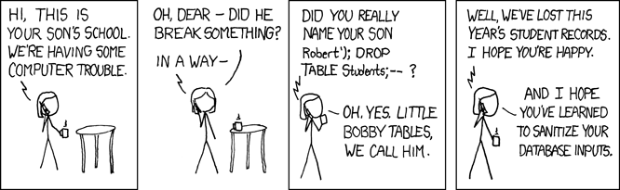


Slide 2
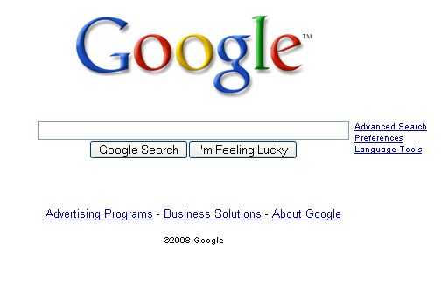
1
Know the Game

Slide 3
2
SEO-Friendly Architecture
Example of Good Organization & Content: This Presentation
NOT reliant on Flash or JavaScript
Keyword-rich
Fully compliant with .ppt standards
Excellent Structure & Organization
    Comic→1→2→3→4→5→6→7→8→Questions?

Slide 4
3
URLs Matter
.htaccess
RewriteEngine On
#RewriteRule <pretty url> <useful url>
#A few substitutions for a tiny site like ours
RewriteRule ^links/$ /index.php?option=com_weblinks&Itemid=23
RewriteRule ^files/$ /index.php?option=com_content&task=view&id=12&Itemid=27
RewriteRule ^contact/$ /index.php?option=com_contact&Itemid=3
#Better solution for an e-commerce site
RewriteRule ^products/cat([0-9]+)/$ product.php?cat=$1
RewriteRule ^products/cat([0-9]+)/id([0-9]+)/$ product.php?cat=$1&id=$2

Slide 5
3
URLs Matter
.htaccess
#A more general solution
RewriteMap clarify-url prg:/home/dff/clarify.php
clarify.php
<?php
#include includes/clarification-tools.inc.php
$clr = new Clarifier();
$url = $HTTP_HOST.$PATH_INFO;
for ($i=0; $i < $DESIRED_CLARIFICATION_LEVEL; $i++)
{
$clr->clarify($url);
}
echo($url);
?>

Slide 6
4
The Duplicate Content Trap
robots.txt
User-agent: *
Disallow: /administrator/
Disallow: /cache/
Disallow: /images/
Disallow: /includes/
Disallow: /media/
Disallow: /modules/
Disallow: /templates/
.htaccess
#Only use “/” for the index page.
RewriteRule index.(php|html)$ / [R=301, L]
#Make sure this file gets indexed as
#belonging to only one domain
RewriteCond %{HTTP_HOST} !^seo.avity.net
RewriteRule ^(.*)$ http://seo.avity.net/$1
[R=301, L]

Slide 7
5
Content Relocation & Error Codes
foo.php
<?php
header('HTTP/1.1 301 Moved Permanently');
header('Location: bar.php')
?>
.htaccess
RewriteEngine On
RewriteRule ^foo\.php$ /bar.php [R=301,L]

Slide 8
6
Graphical Text: An Ancient Evil
Long answer: sIFR – vanquish the foe
(Scalable Inman Flash Replacement)
  You publish plain CSS-driven content
  sIFR checks if the client browser has JavaScript & Flash enabled (If not, it sIFR stops here – the normal CSS-only site is displayed.)
  If JS and Flash are available, sIFR reads class attributes and overlays flash animations of the desired font.
  Spiders don't parse JavaScript or Flash.
  Minimal maintenance required.
  mikeindustries.com/sIFR

Slide 9
7
Sitemaps
urllist.txt (a simpler format, supported by Yahoo)
http://seo.avity.net/
http://seo.avity.net/files/
http://seo.avity.net/links/
http://seo.avity.net/contact/
sitemap.xml (example Google sitemap)
<?xml version=“1.0” encoding=“UTF-8”?>
<urlset xmlns=“http://www.google.com
/schemas/sitemap/0.84”>
<url>
<loc>http://seo.avity.net/</loc>
<lastmod>2008-02-26</lastmod>
<changefreq>monthly</changefreq>
<priority>1.0</changefreq>
</url>
<url>
<loc>http://seo.avity.net
/files/</loc>
<lastmod>2008-02-26</lastmod>
<changefreq>weekly</changefreq>
<priority>0.8</changefreq>
<url>
<url>
...
</url>
</urlset>
Generate sitemaps
Google's sitemap_gen.py
sitemappro.com
Custom dynamic sitemap generation from database content

Slide 10
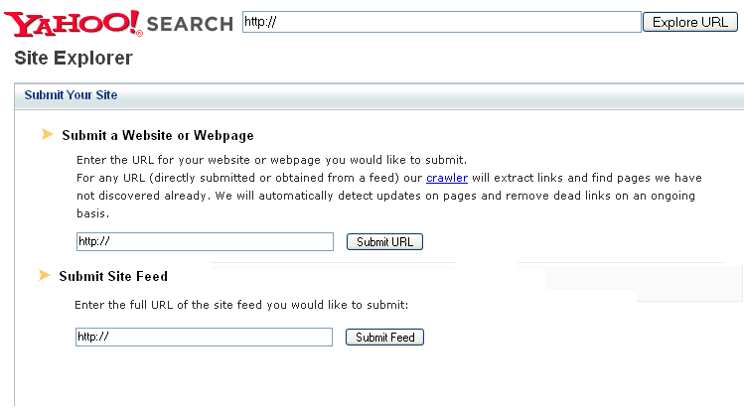
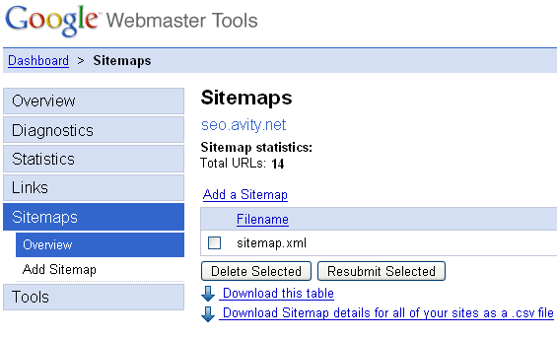
7
Sitemaps
  And submit.

Slide 11

8
Black Hat & Defensive Measures

