Slide 1
It’s a small world.
Code applications for it
NYPHP - Presentations
Carlos Hoyos

Slide 2
Agenda
Internationalization
  Understanding character sets
  Support in PHP
Localization
Time zones
A peek at php 6
Notes:
Unicode is a character set that includes all character in every written system in the planet.
Unicode is not DBCS, i.e. it’s not a 16 bit representation. There are more than 65535 characters in Unicode.
UTF-8 (and encodings in general) encode characters and not glyphs

Slide 3
Disclosure
There are many aspects required for internationalization, the discussion about to follow is a simplified version; you can see it as the basics every programmer should know about
Code featured in this presentation has been simplified to present certain features of the language, and does not include mandatory best practices (i.e. security, documentation). Don’t use at your own risk
Notes:
Unicode is a character set that includes all character in every written system in the planet.
Unicode is not DBCS, i.e. it’s not a 16 bit representation. There are more than 65535 characters in Unicode.
UTF-8 (and encodings in general) encode characters and not glyphs

Slide 4
L10n and I18n
Internationalization is the adaptation of products for potential use virtually everywhere, while localization is the addition of special features for use in a specific locale.
Internationalization (i18n): Translation (language)
Localization (l10n): Adaptation of language, content and design to reflect local cultural sensitivity
  One application for multiple regions
  Support correct formats for dates, times, currency for each region
  Images and colors (cultural appropriatness)
  Telephone numbers, addresses
  Weights, measures
  Paper sizes
Notes:
Because in British English this term is spelled "Localisation", and in US English "Localization", the word is occasionally abbreviated as "l10n" (the number ten between the letters l and n) because there are ten letters between its first and the last letters

Slide 5
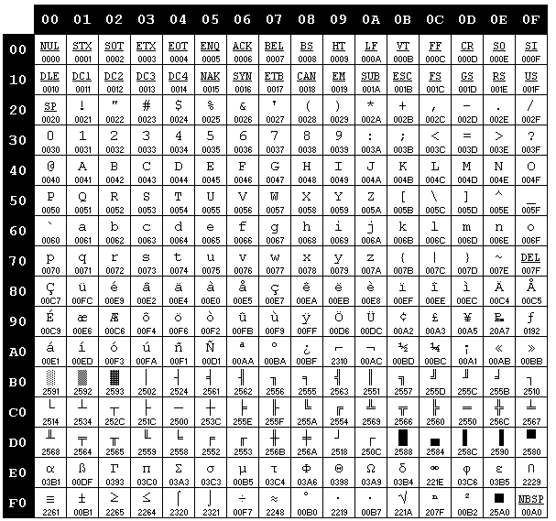
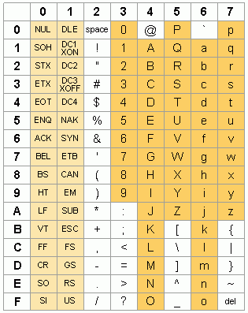
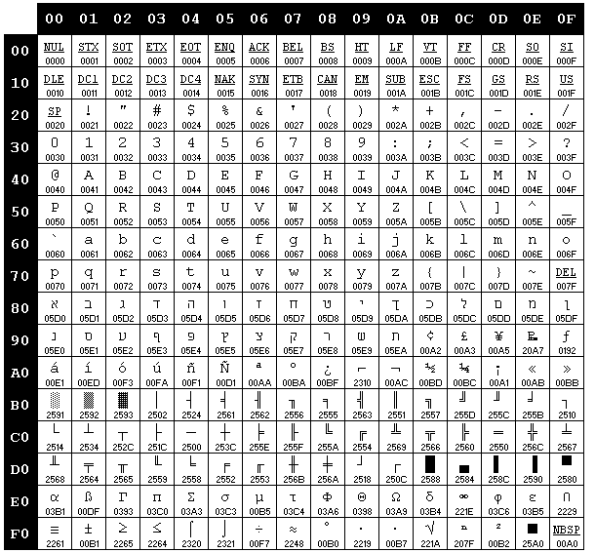
What are character sets?
First there was ASCII: A mapping of 128 characters (95 printable)
Since characters where stored in 1 byte, that left 1 bit (128 characters) available.
OEM character sets are born left & right
They were finally standardized (ANSI standard), code pages are born.
Meanwhile in Asia, DBCS is brewing
Notes:
The days of early UNIX and C (K&R): Unaccented western letters is all that’s used; ASCII is the standard representation.
ASCII maps 128 characters, 95 printable and 33 control characters: 0-31 are control, 32 is space, 65 is “A”, and it only requires 7 bits.
The 8th bith is used to define different sets based on different languages needs. These get standardized at the end (ANSI)
In the graph: MS windows 437 (US) and 862 (Hebrew) OEM code pages

Slide 6
What are character sets?
A character is a textual unit, such as a letter, number, symbol, punctuation mark
A glyph is a graphical representation of a character
A character set is a group of characters
  Some examples are: Cyrillic (i.e. Russian) or Latin (i.e. English)
Unicode: A character set that includes all characters in every written system
  Mapping of each character into a number: a => U+0061
PHP => U+0050 U+0048 U+0050
Encoding: Rules that pair each character with a number and determine how to store it and manipulate it.
Notes:
Unicode is a character set that includes all character in every written system in the planet.
Unicode is not DBCS, i.e. it’s not a 16 bit representation. There are more than 65535 characters in Unicode.
UTF-8 (and encodings in general) encode characters and not glyphs

Slide 7
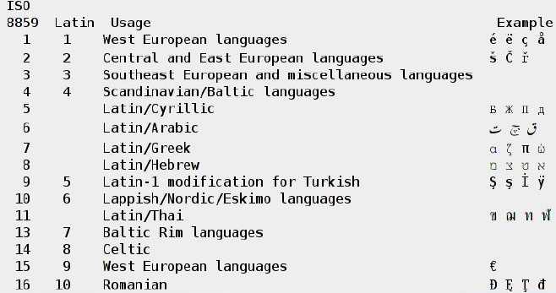
The iso-8859-x character sets
Most often used character sets
Contain most of Europe’s characters.

Slide 8
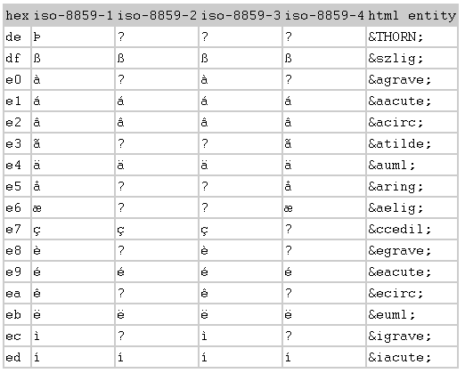
The iso-8859-x convertions
Not all characters are in all iso sets
Converting between sets will result in broken text
Here’s where all those ‘?’ come from.

Slide 9
Unicode and the UCS (universal char set)
They are both character sets.
Difference between Unicode and ISO 10646 (UCS)
  ISO 10646 is simply a character map
  Unicode adds rules for collation, bidirectionality (think hebrew), etc..
Contains all known characters (has over 1.1 million code points)
The first 256 bytes are equal to ISO-8859-1
  => The first 128 bytes are equal to ASCII
Unicode 3.0 (1999). Covers the first 16 bits, defines what’s known as the BMP (Basic Multilingual Plane).
Encoding: multiple encodings, divided in UCS and UTF.
Notes:
The UCS has over 1.1 million code points, but only the first 65,536 (the Basic Multilingual Plane, or BMP) had entered into common use before 2000.

Slide 10
What’s all that fuzz about encodings?
For the earlier character sets, since their range was <1 byte, there is a natural association between strings and bytes.
Hello PHP
48 65 6C 6C 6F 20 50 20
But how to encode Unicode with it’s millions of points?
Hello PHP
U+0048 U+0065 U+006C U+006C U+006F U+0020 U+0050 U+0020
There are multiple ways to encode Unicode characters
  UCS-2: Uses two bytes; only covers the Basic Multilingual Plane
  UTF-16: Similar as UCS-2, but variable bit encoding
  UCS-4 and UTF-32: 32 bits fixed-width encoding
Notes:
UCS-2 is obsolete now
UTF-16 is the standard format for the Windows API (though surrogate support is not enabled by default) and for the Java and .NET bytecode environments
UCS-2 and UTF-16 are identical for the BMP.

Slide 11
Understanding UCS-2 and UTF-16
UCS-2 is a fixed-width 16 bit encoding.
Limited to the Basic Multilingual Plane (65536 characters)
PHP
00 50 00 48 00 50 (big endian)
50 00 48 00 50 00 (little endian)
The Byte Order Mark (FF FE) pre-fixes all unicode strings to determine endian.
PHP FF FE 50 00 48 00 50 00
(note, this secuence converted to ascii looks: ÿþphp)
UTF-16 is a variable-width encoding.
Characters in the BMP are encoded as-is (UCS-2)
Characters above 0xFFFF are encoded as a surrogate pair.
Bottom line: Characters in BMP need 16 bits, characters outside need 32 bits.
Notes:
UCS-2 is obsolete now
UTF-16 is the standard format for the Windows API (though surrogate support is not enabled by default) and for the Java and .NET bytecode environments
UCS-2 and UTF-16 are identical for the BMP.
Unicode and ISO/IEC 10646 do not assign characters to any of the code points in the D800–DFFF range, so an individual code value from a surrogate pair does not ever represent a character.
UTF-16 represents a character above hexadecimal FFFF as a surrogate pair of code values from the range D800–DFFF. For example, the character at code point hexadecimal 10000 becomes the code value sequence D800 DC00, and the character at hexadecimal 10FFFD, the upper limit of Unicode, becomes the code value sequence DBFF DFFD
These code values are then serialized as 16-bit words, one word per code value. Because the endianness of these words varies according to the computer architecture, UTF-16 specifies three encoding schemes: UTF-16, UTF-16LE, and UTF-16BE.

Slide 12
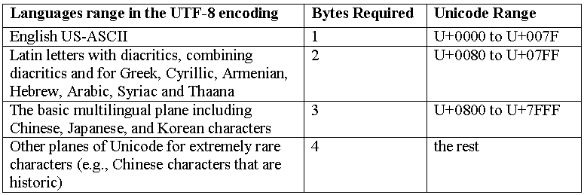
Why utf-8 rocks
utf-8 is a variable length encoding
Uses 1 to 4 bytes
Is backward compatible with ASCII.

Slide 13
What should I take away from this?
A string is meaningless if you don’t know it’s encoding
Browsers do a good job guessing the encoding, buyt
You can help them:
  Headers
  Content-Type: text/plain; charset="UTF-8“
  Html content
  <head>
  <meta http-equiv="Content-Type" content="text/html; charset=utf-8">

Slide 14
And how does this impact me?
Your browser will send / receive data using the different encodings.
Sample 1: simple application without setting any character sets
<html>
<head>
<title>Test 8. default encoding</title>
</head>
<body>
<?php
if(isset($_POST['save'])){
echo "<br/><b>Input</b>: ".$_POST['comment'];
echo "<br/><b>string length (strlen)</b>: ". strlen($_POST['comment']);
echo "<br/><b>first 3 characters (substr)</b>: ". substr($_POST['comment'], 0, 3);
echo "<br/><b>wordwrap</b>: ". wordwrap($_POST['comment'], 2, '|', 1);
}
?>
<form action="/playground/loc/08.php" method="POST">
<input type="text" name="comment" value="" size="40" maxlength="40"/>
<input type="submit" name="save" value="save"/>
</form>
</body>
</html>

Slide 15
Sample 1: inputs and outputs
Input: This is a test
string length (strlen): 14
first 3 chars (substr): Thi
wordwrap: Th|is|is|a|te|st
Input: Česky Français
string length (strlen): 19
first 3 characters (substr): _x0002_
wordwrap: &#|26|8;|es|ky|Fr|an|ça|is
Input: カタカナ
string length (strlen): 32
first 3 characters (substr): _x0001_
wordwrap: &#|12|45|9;|&#|12|47|9;|&#|12|45|9;|&#|12|49|0;

Slide 16
Sample 2. xhtml using utf-8
<?php
header("Content-Type: text/html; charset=utf-8");
?>
<!DOCTYPE html PUBLIC "-//W3C//DTD XHTML 1.1//EN" "http://www.w3.org/TR/xhtml11/DTD/xhtml11.dtd">
<html xmlns="http://www.w3.org/1999/xhtml" xml:lang="en" lang="en">
<head>
<title>Test 9. xhtml document, utf-8 encoding</title>
</head>
<body>
<?php
if(isset($_POST['save'])){
echo "<br/><b>Input</b>: ".$_POST['comment'];
echo "<br/><b>string length (strlen)</b>: ". strlen($_POST['comment']);
echo "<br/><b>first 3 characters (substr)</b>: ". substr($_POST['comment'], 0, 3);
echo "<br/><b>wordwrap</b>: ". wordwrap($_POST['comment'], 2, '|', 1);
}
?>
<form enctype="multipart/form-data" action="/playground/loc/09.php" method="POST">
<input type="text" name="comment" value="" size="40" maxlength="40"/>
<input type="submit" name="save" value="save"/>
</form>
</body>
</html>

Slide 17
Sample 2: inputs and outputs
Input: This is a test
string length (strlen): 14
first 3 chars (substr): Thi
wordwrap: Th|is|is|a|te|st
Input: Česky Français
string length (strlen): 16
first 3 characters (substr): Če
wordwrap: Č|es|ky|Fr|an|ç|ai|s
Input: カタカナ
string length (strlen): 12
first 3 characters (substr): カ
wordwrap: �|��|��|�|��|��

Slide 18
Sample 3. Using mbstring functions
<?php
header("Content-Type: text/html; charset=utf-8");
mb_internal_encoding('UTF-8');
?>
<!DOCTYPE html PUBLIC "-//W3C//DTD XHTML 1.1//EN" "http://www.w3.org/TR/xhtml11/DTD/xhtml11.dtd">
<html xmlns="http://www.w3.org/1999/xhtml" xml:lang="en" lang="en">
<head>
<title>Test 9. xhtml document, utf-8 encoding</title>
</head>
<body>
<?php
if(isset($_POST['save'])){
echo "<br/><b>Input</b>: ".$_POST['comment'];
echo "<br/><b>string length (strlen)</b>: ". mb_strlen($_POST['comment']);
echo "<br/><b>first 3 characters (substr)</b>: ". mb_substr($_POST['comment'], 0, 3);
}
?>
<form enctype="multipart/form-data" action="/playground/loc/09.php" method="POST">
<input type="text" name="comment" value="" size="40" maxlength="40"/>
<input type="submit" name="save" value="save"/>
</form>
</body>
</html>

Slide 19
Sample 3 using mbstring functions
Input: this is a test
string length (strlen): 14
first 3 characters (substr): thi
Input: Česky Français
string length (strlen): 14
first 3 characters (substr): Čes
Input: カタカナ
string length (strlen): 4
first 3 characters (substr): カタカ

Slide 20

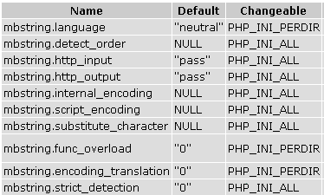
Multibyte functions & considerations
PHP supports multi byte in two extensions: iconv and mbstring
  iconv uses an external library (supports more encodings but less portable)
  mbstring has the library bundled with PHP (less encodings but more portable)
Some of these functions require OS support for the used character set
Setting a content-type header:
  <?php header("Content-Type: text/html; charset=utf-8"); ?>
  php.ini setting: default_charset = “utf-8”
The behaviour of these functions is affected by settings in php.ini
Notes:
Configuration option iconv.input_encoding is currently not used for anything.
mbstring.language string
The default national language setting (NLS) used in mbstring. Note that this option automagically defines mbstring.internal_encoding and mbstring.internal_encoding should be placed after mbstring.language in php.ini
mbstring.encoding_translation boolean
Enables the transparent character encoding filter for the incoming HTTP queries, which performs detection and conversion of the input encoding to the internal character encoding.
mbstring.internal_encoding string
Defines the default internal character encoding.
mbstring.http_input string
Defines the default HTTP input character encoding.
mbstring.http_output string
Defines the default HTTP output character encoding.
mbstring.detect_order string
Defines default character code detection order. See also mb_detect_order().
mbstring.substitute_character string
Defines character to substitute for invalid character encoding.
mbstring.func_overload string
Overloads a set of single byte functions by the mbstring counterparts. See Function overloading for more information.
mbstring.strict_detection boolean
Enables the strict encoding detection.

Slide 21

Putting it all together.
Application to submit and save comments in a database
Implementing this application with default (out of the box php 5, mysql 4)
First version: Create a table for the comments:
CREATE TABLE comments (
id INTEGER UNSIGNED NOT NULL AUTO_INCREMENT PRIMARY KEY,
comment VARCHAR(45) NOT NULL
);
Add a submit form similar to sample # 1 and insert the data.

Slide 22
Sample 4. Default character set
Data outside of iso-8859-1 is saved as a numerical character reference.
mysql> select * from comments;
+----+-----------------------------------------------+
| id | comment |
+----+-----------------------------------------------+
| 1 | test number 1 |
| 2 | test 2 |
| 3 | test 2 |
| 4 | here's a more interesting test &#12459;&#1247 |
| 5 | &#24418;&#12363;&#12394; |
| 6 | &#268;esky Franτais |
+----+-----------------------------------------------+
6 rows in set (0.00 sec)
Application will work, but some string functions will not work, characters will be truncated.

Slide 23
Sample 5. Using utf-8
Same application (submit and save comments in database)
Implementing this application with default (out of the box php 5, mysql 4)
Create a table for the comments:
CREATE TABLE comments_utf (
id INTEGER UNSIGNED NOT NULL AUTO_INCREMENT PRIMARY KEY,
comments VARCHAR(45) NOT NULL
) CHARACTER SET utf8 COLLATE utf8_general_ci;
Add a submit form similar to sample # 3 and insert the data.
Don’t forget to set default encoding (through headers or php.ini)
Also, tell mysql you’re using utf-8: $mysqli->query("SET NAMES 'utf8'");

Slide 24
Sample 5. Submit form
<?php
header("Content-Type: text/html; charset=utf-8");
?>
<!DOCTYPE html PUBLIC "-//W3C//DTD XHTML 1.1//EN" "http://www.w3.org/TR/xhtml11/DTD/xhtml11.dtd">
<html xmlns="http://www.w3.org/1999/xhtml" xml:lang="en" lang="en">
<head>
<title>Test 1. default encoding</title>
</head>
<body>
<form enctype="multipart/form-data" method="post" action="05.php">
<textarea name="comment" rows="10" cols="50" wrap="off"></textarea> <input type="submit" name="save" value="save"/></form>
</body>
</html>

Slide 25
Sample 5. Insert data using utf-8
<?php
header("Content-Type: text/html; charset=utf-8");
// open a db connection
$mysqli = new mysqli('localhost', 'root', '', 'nyphp_pres');
if (mysqli_connect_errno()) {
printf("Connect failed: %s\n", mysqli_connect_error());
exit();
}
// set utf encoding
mb_internal_encoding('UTF-8');
$mysqli->query("SET NAMES 'utf8'");
// insert posted object
if(isset($_POST['comment'])){
$mysqli->query("SET NAMES 'utf8'");
$query = "INSERT INTO comments_utf (comments) values ('“
.$mysqli->real_escape_string($_POST['comment'])."')";
if (!$mysqli->query($query)){
echo "error inserting $query”;
}
}
?>

Slide 26
Localization
A locale is a set of parameters that defines the user's language, country and cultural rules.
They determine special variant preferences that the user wants to see in their user interface.
PHP supports the following locales:
  LC_COLLATE for string comparison and collation
  LC_CTYPE for character classification and conversion
  LC_MONETARY for localeconv()
  LC_NUMERIC for decimal separator (See also localeconv())
  LC_TIME for date and time formatting with strftime()
  LC_MESSAGES for system responses

Slide 27
Example 1: LC_TIME
<?php
setlocale(LC_TIME, 'en_US');
echo strftime('%c'), "<br/>";
setlocale(LC_TIME, 'nl_NL');
echo strftime('%c'), "<br/>";
setlocale(LC_TIME, ‘fr_CA');
echo strftime('%c'), "<br/>";
?>
Output:
  Tue 25 Apr 2006 05:48:09 PM EDT
  di 25 apr 2006 17:48:09 EDT
  mar 25 avr 2006 17:53:06 EDT
Note: This functionality is OS dependent and not always available

Slide 28
Example 2: LC_CTYPE
<?php
// standard "C" locale
setlocale(LC_CTYPE, 'C');
echo strtoupper('åtte'), "\n";
// Norwegian
setlocale(LC_CTYPE, 'no_NO');
echo strtoupper('åtte'), "\n";
?>
Output:
  åTTE
  ÅTTE

Slide 29
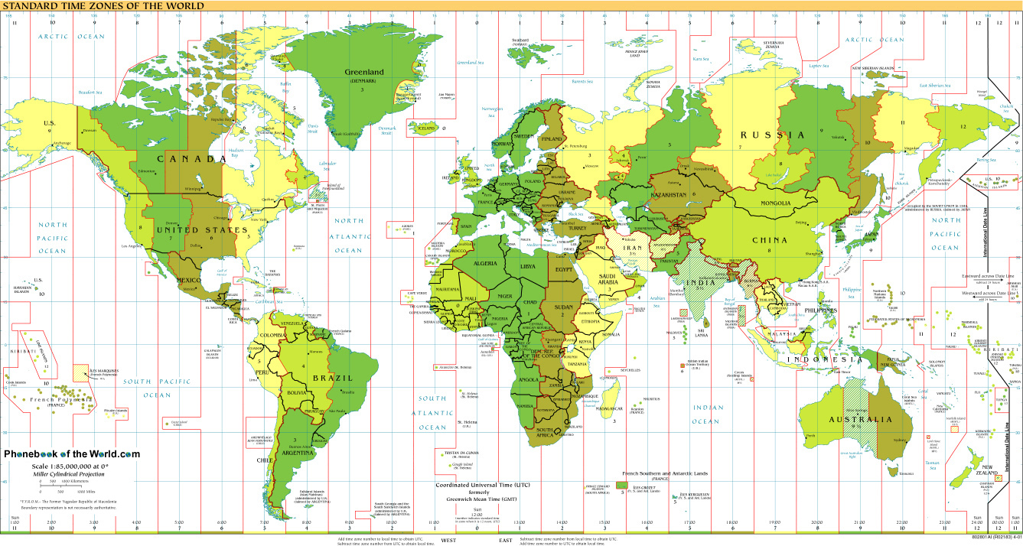
Timezones
Artificially created zones to manage time
Some places change timezones during the year
Some places have offsets
Daylight saving time yield multiple exceptions

Slide 30
Example: Using server environment
PHP < 5.1 (i.e. 4.x, 5.0). No proper timezone support.
<?php
putenv("TZ=America/New_York");
echo "time in NY: " . strftime('%b %d, %Y %H:%M %Z', time());
putenv("TZ=Europe/Stockholm");
echo "<br/>time in Stockholm: " . strftime('%b %d, %Y %H:%M %Z', time());
?>
Output:
time in NY: Apr 25, 2006 18:23 EDT
time in Stockholm: Apr 26, 2006 00:23 CEST
This trick depends on the OS, uses the TZ variable.
PHP 5 has better support of timezones:
(i.e. date_default_timezone_set)

Slide 31
Missing in PHP today
PHP only deals with bytes, not with strings. No encoding awareness
iconv and mbstring don’t support localization, sorting, searches, encoding detection
Unicode support must be configured manually
Native Unicode strings
A clear separation between Binary / Native (Encoded) Strings and Unicode Strings
A clear separation between Binary / Native (Encoded)
Strings and Unicode Strings
Notes:
http://php.net/~derick/meeting-notes.html

Slide 32
What’s new in PHP 6
PHP 6 will provide this Unicode support natively, with backwards compatibility to the functions and data types already existing.
Basic Unicode string support
Simple output of Unicode strings via 'print' with appropriate output encoding conversion
String functions will be aware of encoding, i.e. determining length of string with “strlen”
Conversions of strings through encode / decode functions
Comparison (collation) of Unicode strings with built-in operators Support for Unicode identifiers
A fallback encoding flag can be set for defaulting encodings
Unicode switch allows to turn unicode support on/off
Internals will run in utf-16 (just like java)
Notes:
http://php.net/~derick/meeting-notes.html

