Slide 1
Xdebug from A to X
By
Gennady Feldman
Aug 25, 2009

Slide 2
Agenda
Installation
Error Handling
Debugging
Profiling
Function Traces

Slide 3
Xdebug Features
Variable display
Stack Traces
Profiling PHP Scripts
Remote Debugging
Function Traces
Code Coverage Analysis*
* Not covered in this presentation.

Slide 4
Installing
Xdebug is a PHP extension. (written in C)
Xdebug is Open Source so you could download and build/install it yourself.
Almost every Linux distro today provides an Xdebug binary package.
Binaries are also available for Windows from http://xdebug.org website.

Slide 5
Installing (Part 2)
On Ubuntu 9.04:
  apt-get install php5-xdebug
On Mandriva:
  urpmi php5-xdebug
Using PEAR/PECL:
  pecl install xdebug
  pecl upgrade xdebug

Slide 6
Installing (Part 3)
To enable xdebug add the fullpath to xdebug.so:
  zend_extension=/usr/lib/php5/20060613+lfs/xdebug.so
  To php.ini or
  To conf.d/xdebug.ini file
You could also setup system wide defaults as well through the ini file.

Slide 7
Installing (Part 4)
Check that Xdebug is installed via:
  php –v
  php –m
  php –ri xdebug
Check phpinfo() report and look for xdebug section.
You might need to restart your web server.

Slide 8
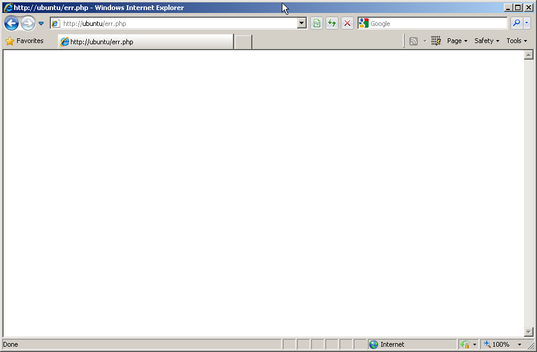
Error Handling (display_errors off)

Slide 9
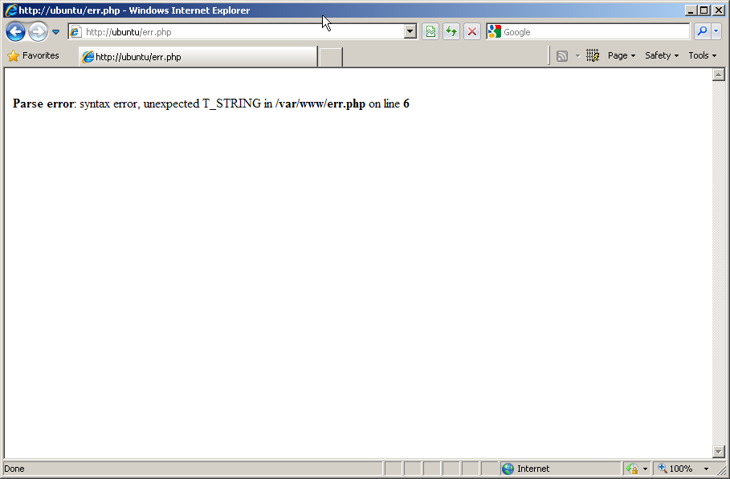
Error Handling (display_errors on)

Slide 10
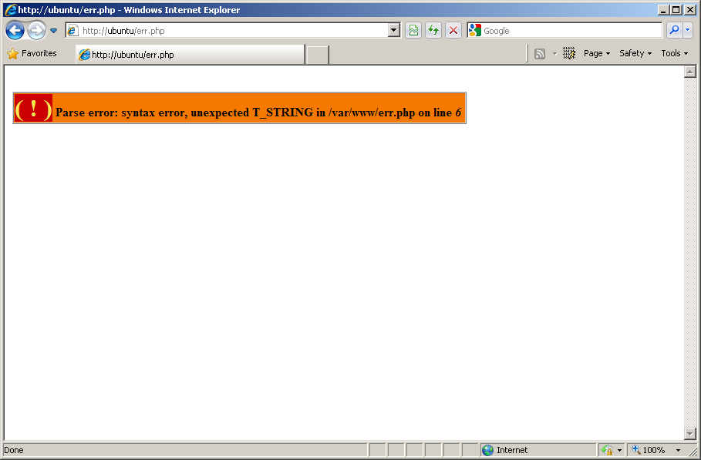
Error Handling (display_errors On w/ xdebug)

Slide 11
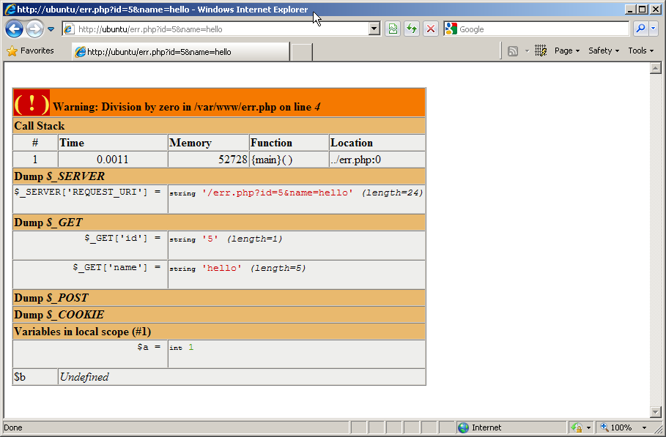
Error Handling (display_errors on w/ Xdebug)

Slide 12
Error Handling (My .htaccess)
  php_flag xdebug.collect_vars on
  php_value xdebug.collect_params 4
  php_flag xdebug.dump_globals on
  php_value xdebug.dump.SERVER REQUEST_URI
  php_value xdebug.dump.GET *
  php_value xdebug.dump.POST *
  php_value xdebug.dump.COOKIE *
  php_flag xdebug.show_local_vars on
Documentation: http://www.xdebug.org/doc/
Also check phpinfo(), specifically Xdebug section

Slide 13
Remote Debugging
XDebug has Remove Debugging support through GDB (old) and DBGP (new) protocols.
You will need a client that can speak one of these protocols.
You will need to adjust Xdebug settings on the server to enable remote debugging.
You can also debug CLI scripts.

Slide 14
Remote Debugging (Clients)
Dev-PHP (IDE: Windows)
Eclipse plugin, which has been submitted as an enhancement for the PDT (IDE).
Emacs plugin (Editor Plugin).
ActiveState's Komodo (IDE: Windows, Linux, Mac; Commercial).
MacGDBP - Standalone Mac client.
NetBeans (IDE: Windows, Linux, Mac OS X and Solaris.
Notepad++ plugin (IDE: Windows).
WaterProof's PHPEdit (IDE, from version 2.10: Windows; Commercial).
Anchor System's Peggy (IDE: Windows, Japanese; Commercial).
MP Software's phpDesigner (IDE: Windows, Commercial).
PHPEclipse (Editor Plugin).
Protoeditor (Editor: Linux).
tsWebeditor (Editor: Windows).
Xored's TrueStudio IDE (IDE; Commercial).
VIM plugin (Tutorial) (Editor Plugin).
jcx software's VS.Php (MS Visual Studio Plugin; Commercial).
XDebugClient - Standalone Windows client.
* Source: http://www.xdebug.org/docs/remote

Slide 15
Remote Debugging (Server)
Need to enable remote debugging on the server:
  php_value xdebug.remote_enable 1
  php_value xdebug.remote_host 192.168.1.105
  php_value xdebug.remote_port 9000
  php_value xdebug.remote_mode req
remote_host - takes a hostname or IP address (There’s a patch from Facebook devs to remove this restriction)
remote_mode – controls when the remote debugging starts:
  req - at the beginning of the script
  jit - upon an error condition

Slide 16
Remote Debugging (Starting)
xdebug_break( )
XDEBUG_SESSION_START variable passed via GET or POST sets XDEBUG_SESSION cookie.
XDebug Helper Firefox Addon: https://addons.mozilla.org/en-US/firefox/addon/3960

Slide 17
Profiling
Xdebug's built-in profiler generates cachegrind files.
You will need a tool that can read and visualize cachegrind files.
You will need to adjust some XDebug settings in order to enable profiling on the server.

Slide 18
Profiling (Starting)
Need to enable profiling on the server:
  php_value xdebug.profiler_enabled 1
  php_value xdebug.profiler_append 1
  php_value xdebug.profiler_enable_trigger 1
  php_value xdebug.profiler_output_dir /tmp
  php_value xdebug.profiler_output_name cachegrind.out.%p
You need to set xdebug.profiler_enable_trigger if you want to trigger the profiling yourself.
You can trigger profiling via XDEBUG_PROFILE variable passed via GET or POST (or via XDebug Helper Firefox Addon) sets XDEBUG_PROFILE cookie.

Slide 19
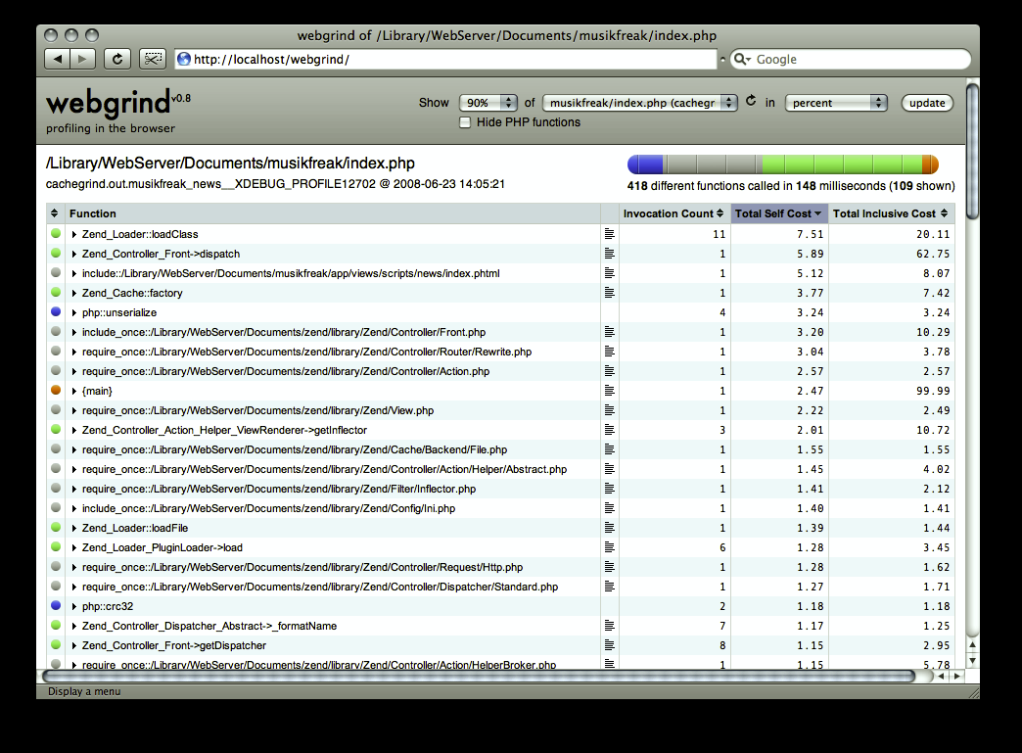
WebGrind
http://code.google.com/p/webgrind/

Slide 20
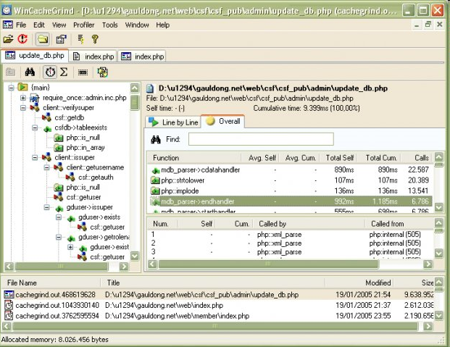
WinCacheGrind
http://sourceforge.net/projects/wincachegrind/

Slide 21
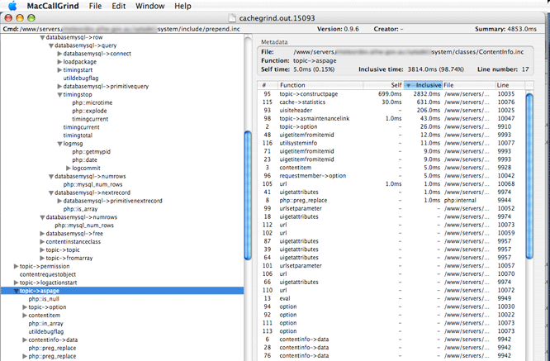
MacCallGrind
http://www.maccallgrind.com/

Slide 22
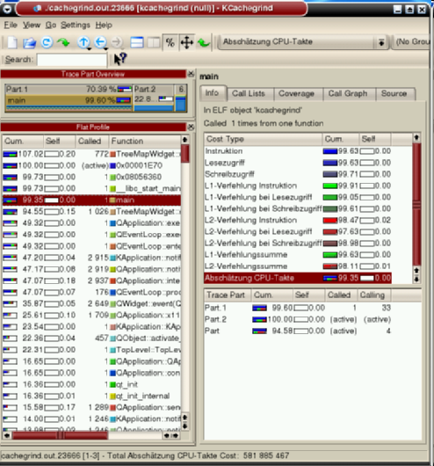
KCacheGrind
http://kcachegrind.sourceforge.net/

Slide 23
Function Traces
Xdebug allows you to log all function calls, including parameters and return values to a file in different formats.
Function trace files contain a timeline and record of each function call in PHP including file and line number.
It’s a great way to see exactly what’s going on. (At times a bit too much detail)

Slide 24
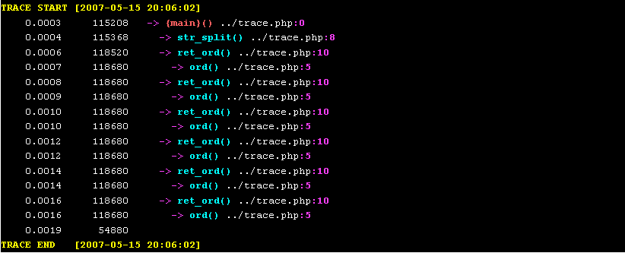
Function Traces

Slide 25
Function Traces (VIM Syntax)
Xdebug package comes with a VIM syntax highlight file.
Copy the xt.vim file to ~/.vim/syntax
Edit, or create, ~/.vim/filetype.vim and add the following lines:
    augroup filetypedetect
    au BufNewFile,BufRead *.xt setf xt
    augroup END
* Xdebug Documentation: http://www.xdebug.org/docs/execution_trace

Slide 26
Function Traces
Function trace files come in two formats:
  Human readable (lots of options here)
    php_value xdebug.show_mem_delta 1
    php_value xdebug.collect_return 1
    php_value xdebug.collect_params 4
  Machine readable
    php_value xdebug.trace_format 1
  HTML format.

Slide 27
XDebug Trace Options
php_value xdebug.auto_trace 0
php_value xdebug.collect_includes 1
php_value xdebug.collect_return 1
php_value xdebug.collect_params 4
php_value xdebug.show_mem_delta 1
php_value xdebug.trace_options 0
php_value xdebug.trace_output_dir /tmp
php_value xdebug.trace_output_name trace.%c

Slide 28
Function Traces (Tips)
Be careful when using auto_trace option for big projects.
Files can get very big. I saw cases of >1 Gig
Turn Off VIM syntax highlighter for very big files.
You can also trigger start/stop of tracing via PHP.

Slide 29
Function Traces (Starting)
xdebug_start_trace($filename, $options);
  XDEBUG_TRACE_APPEND (1)
    makes the trace file open in append mode rather than overwrite mode
  XDEBUG_TRACE_COMPUTERIZED (2)
    creates a trace file with the format as described under 1 "xdebug.trace_format".
  XDEBUG_TRACE_HTML (4)
    creates a trace file as an HTML table
xdebug_stop_trace();

Slide 30
Contact Me
Gennady Feldman
E-mail: gena01@gena01.com
Website: http://www.gena01.com
Blog: http://www.gena01.com/blog
Twitter: http://twitter.com/gena01

