Slide 1
Advanced Application Deployment with Puppet
John Coggeshall

Slide 2

About Me
CTO, Individual Digital, Inc. (Startup)
Author of ext/tidy, PHP 5 Unleashed, Zend Ent. PHP Patterns
Twitter: @coogle

Slide 3
What’s Puppet?
Puppet is …
A deployment tool
Client/Server
Declarative
Resource based
Puppet is not.. But can leverage
Ant
Make

Slide 4
What makes Puppet cool?
Centralized, Scalable configuration management for server farms
Abstracted from underlying OS (to a point)
Configurations can be stored in a VCS (i.e. Subversion) for historical tracking of changes
Automated configuration of individual machines based on configuration
Auditing of configuration of individual machines

Slide 5
It’s about knowing
Puppet helps bridge the gap between system administration and development teams
Developers: Virtual machines managed by local Puppet
Need new extension? Update Puppet configurations
System Admins: System changes are tracked through commits, can be reviewed easily
Same Puppet system used as locally
Result: Consistent platforms throughout with minimal pain

Slide 6
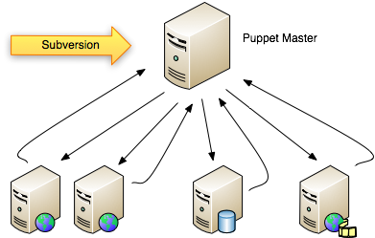
Puppet from 10,000 feet
Communication over HTTPS with signed certificates
Reporting from clients back to master / Dashboard ability

Slide 7
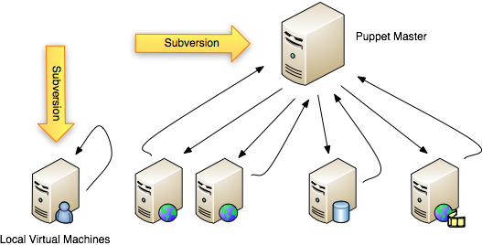
Including Development
Same Puppet can run as a stand-alone executable, running off of local checked-out manifests

Slide 8
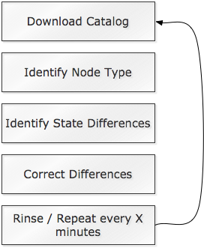
From Zero to Puppet
Setup Puppet Master (Kickstart, etc.)
Write Puppet Modules (apache module, etc.)
Deploy modules to server
Setup puppet client with master
Process Catalog

Slide 9
Installing Puppet (Debian)
Installing Puppet is easy:
(note: ‘puppetmaster’ package also available stand-alone)
For client/server configurations, you’ll also need to sign your client’s certificate
Step 1: Attempt to connect to puppet master from client (rejected)
Step 2: Use the puppetca tool to sign certificates on master:

Slide 10

About Certificates
Certificates are very important to puppet, it’s basically the way authentication is performed
Puppet does support the ability to auto-sign certificates of new clients
Not Recommended – potentially this would allow anyone to sign-in to your puppet master and potentially acquire configuration files, etc. - a big security risk

Slide 11
Things you need to know
Nodes – A machine being configured, identified generally by its hostname
Modules – A collection of classes and files all related to each other
Class – A collection of resources related to each other
Resources – Things like software packages, files, users, etc.
Defines – A function-like construct for resources

Slide 12

Resources: Implementation Abstraction
Puppet is based on resources
Think in terms of a “user”, not the /etc/passwd file
Declare what you want done, let puppet worry about how that happens

Slide 13
Resource Types (some)
Augeas
Computer
Cron
Exec
File
Filebucket
Group
Host
Mailalias
Nagios
Package
Service
SSH Key
User
VCS Repo
Zone
More At:
http://docs.puppetlabs.com/references/stable/type.html

Slide 14
Getting Started
Basic idea:
The global master manifest is site.pp which typically defines the node types puppet can configure
Step 1: Define a node by hostname
Step 2: Include / declare any configuration to be done to that node
Puppet supports includes and modules, making things a lot easier to organize

Slide 15
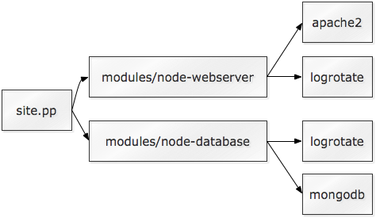
How I organize puppet
You can organize puppet in many ways to suit your needs
Can be a bit confusing when getting started
How I organize my puppet manifests:

Slide 16
Puppet Modules
Puppet Modules are designed to encapsulate a logical segment of the machine’s setup
Example modules:
MongoDb
Users
Apache
Webserver

Slide 17
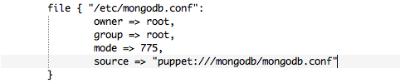
Puppet Modules
Modules also have access to a simple file service, allowing you to store entire configuration files within the module then transfer those files to the machine

Slide 18
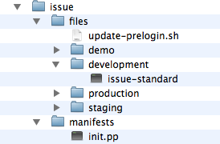
Puppet Module Structure
manifests/ - declarations
files/ - hosted files
init.pp –processed when module is included

Slide 19
How I organize puppet modules
Puppet modules have a simple “class” structure
I typically create one or more of the following classes for each module:
Module::install
Module::config
Module::service
Then, include these modules in the proper order with the base module’s class
Every “package” should be a module to avoid dependency problems

Slide 20
Example: Custom login message
Task: Update the /etc/issue-standard file so it always displays the IP address of the machine when you connect to it
Useful for VMs, inconsequential to deployed boxes
While we’re at it, put a scary warning up at login
What we need to do:
Create a /etc/issue-standard we want to use
Create a update-prelogin.sh script to determine IP address and update /etc/issue as necessary
Install new standard, as well as pre-login script

Slide 21
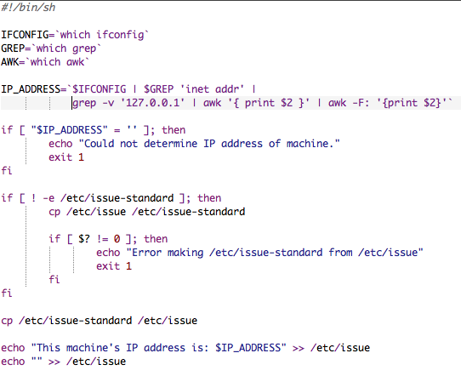
Our update script

Slide 22
Creating modules/issue
Now we need to create a modules/issue that performs the necessary tasks
Step 1: Create issues/files/update-prelogin.sh
Step 2: Create init.pp
Step 3: Profit

Slide 23
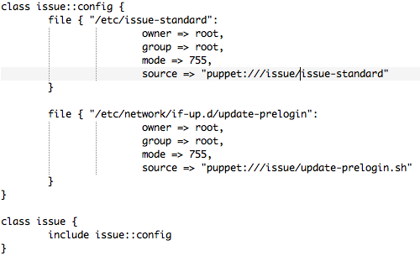
modules/issue/init.pp

Slide 24

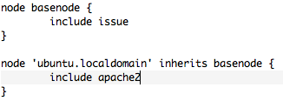
Using our module
To use our new module for a specific node type, simply include it in the node declaration of site.pp:
Inheritance works great too:

Slide 25
Dependencies, Notifications and Subscriptions
Resources support the notion of dependencies, notifications, and subscriptions
Dependencies – indicate things that have to happen first before the requested resource is processed
Notifications – Trigger the activation of another resource after the requested resource is processed
Subscriptions – Subscribe to another resource, and process itself when the target resource is processed

Slide 26
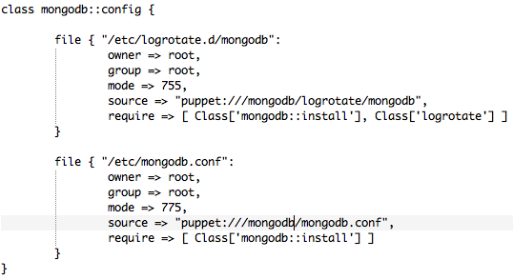
Requiring Resources

Slide 27
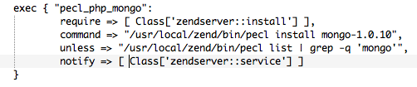

Notifications / Subscriptions

Slide 28
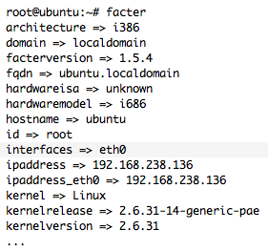
System Facts with Facter
Puppet provides access to a number of variables defining things about the system being configured through Facter

Slide 29

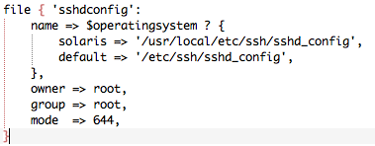
Variables / Conditionals
Puppet also supports simple variable/conditional abilities

Slide 30
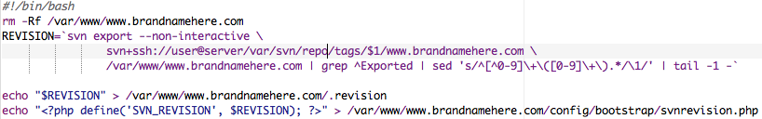
Installing websites
When specifically dealing with websites, you can use a little shell scripting to install your site, then leverage that

Slide 31
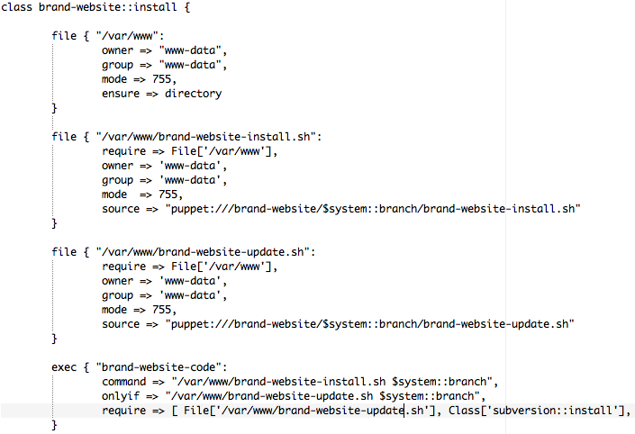
Installing Web Apps from VCS

Slide 32
From Source..
Like web sites, you can use similar techniques of copying/running shell scripts for compiling software
Easier to get going, but best answer would be to create custom packages in both cases

Slide 33
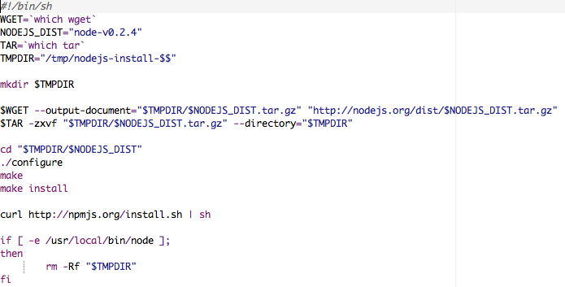
Installing Node.js

Slide 34
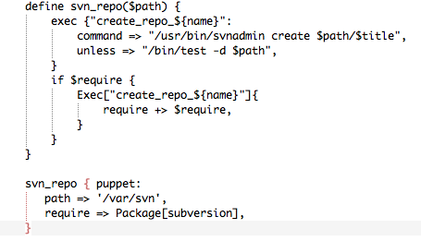
Defines
Defines can be thought of in some ways as functions for resources
Allows you to factor out common tasks into a single location for maintainability, etc.

Slide 35
Summary and Thank you!
This is by no means a complete dissertation, merely an introduction to an advanced deployment technique
Further reading:
http://docs.puppetlabs.com/guides/language_guide.html
http://docs.puppetlabs.com/references/stable/type.html
http://projects.puppetlabs.com/projects/puppet/wiki/Puppet_Patterns
These slides will be available on SlideShare.net
Feedback Welcome: http://joind.in/2908

