Slide 1
eZ Publish
NYPHP
10/25/2005
Andrew Yochum
Michael DeWitt

Slide 2
eZ Publish
Opensource CMS
Product of eZ Systems of Norway
EZ Systems founded 1999
Object oriented
Custom Template language
Current Version 3.7.0 (regular releases)
Sophisticated (complex)

Slide 3
Requirements
PHP 4 (next major version to support PHP 5)
Apache (1.3.X support, 2.0.X works well)
Database
  MySQL
  Postgres
  Oracle (requires connector)
  MS SQL (requires connector)

Slide 4
Additional Components
Online Editor (WYSIWYG)
Database connectors
Community Contributions
Commercial Products

Slide 5
Security
Audit trail/ Version control
Content approval
E-mail verification
Granular privileges/ Role based permission system
LDAP authentication
Pluggable authentication
Staging
Session management
SSL compatibility
Versioning

Slide 6
Support
Commercial support & training
Developer community
Pluggable API
Professional hosting
Public forum
Public mailing list
Third party developers
User conferences

Slide 7
Ease of use
Friendly URLs
Image resizing
Rapid Prototyping
Workflow
Powerful Template language
Undo
WYSIWYG editor (Online editor)

Slide 8
Management
Asset management
Content scheduling
Content staging
Inline administration
Online administration
Package deployment
Sub-sites / roots / multi-sites
Themes / skins
Trash
Web-based style/template management
Workflow engine

Slide 9
Interoptability
Content syndication (RSS)
UTF-8 support
WAI compliance
WebDAV support
XHTML compliance

Slide 10
Flexibility
CGI-mode support
Content reuse
Extensible user profiles
Interface localization
Metadata
Multi-lingual content/Translations
Multi-lingual content integration
Multi-site deployment
URL-rewriting

Slide 11
Built in applications
Blog
Contact management
Discussion/forum
File distribution
Form creator
Link management
Photo gallery
Polls
Product management
Search engine
Site map
User contributions

Slide 12
Achieving High Performance
PHP bytecode cache is a must
Granular cache control
  Template, Content, View, Database, etc
Database replication
Load balancing
Page caching
Static content export

Slide 13
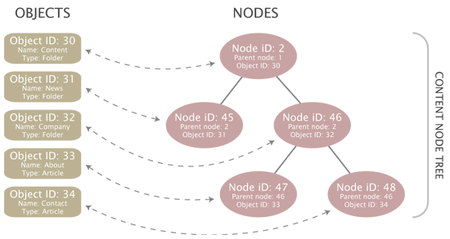
Basic eZ publish definitions
Content class
Content object
Content tree
  Maps Objects to Nodes
Template operator
Extension
Administrative Interface

Slide 14
Give it a try
Demo
  http://ez.no/products/ez_publish_cms/demo

