Slide 1

The modx CMS and framework
Jayesh Sheth
NYPHP - Sept. 28, 2010
Hive at 55,
55 Broad Street, New York, NY

Slide 2
Why modx?
CMS + framework
Open Source + PHP
Flexibility (no framework “straight-jacket”)
Graphical approach
Simple & accessible, yet powerful (like PHP)
Active community

Slide 3
A little history ...
The beginnings: fork of Etomite
Main modx guys: Ryan Thrash, Jason Coward, Shaun McCormick
modx Evolution: the beginning
modx Revolution: the re-write

Slide 4
Requirements
PHP 5.1.1+
Apache 1.3.x+ / IIS / lighttpd / Zeus
MySQL 4.1.20+
Linux / Mac OS X / Windows

Slide 5
Documents / Resources
Basic unit of information
Document == Resource == “Page”
Document: File or Folder

Slide 6
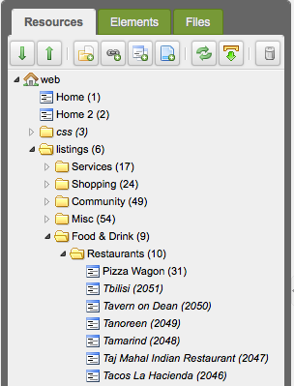
Documents as folders

Slide 7
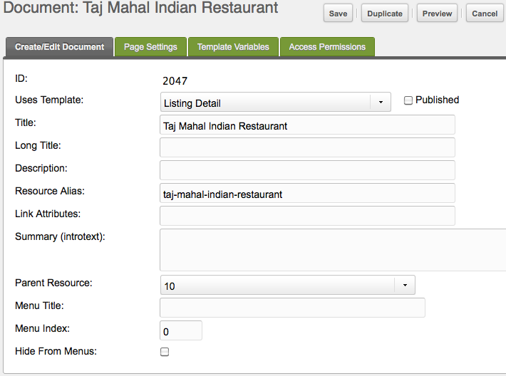
Documents as files

Slide 8
Templates
At the foundation of every modx site
Basic “glue” for all site elements
Determine every document’s look
Help to classify documents based on their type / purpose

Slide 9
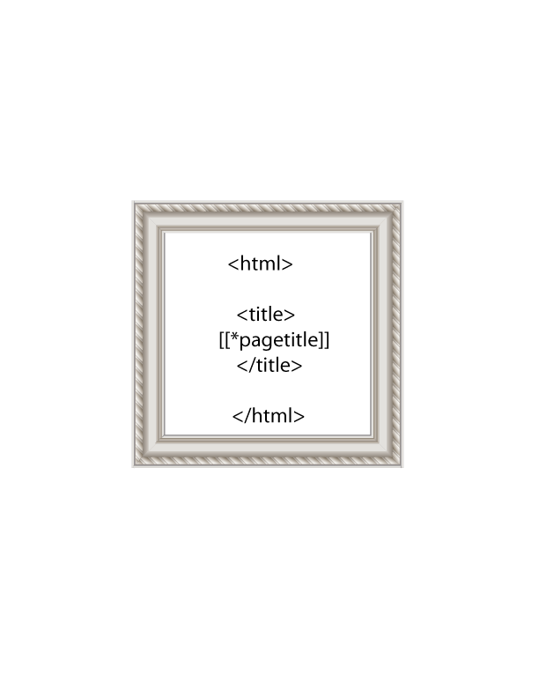



Documents Templates
Template Variables
(a.k.a. TVs)

Slide 10
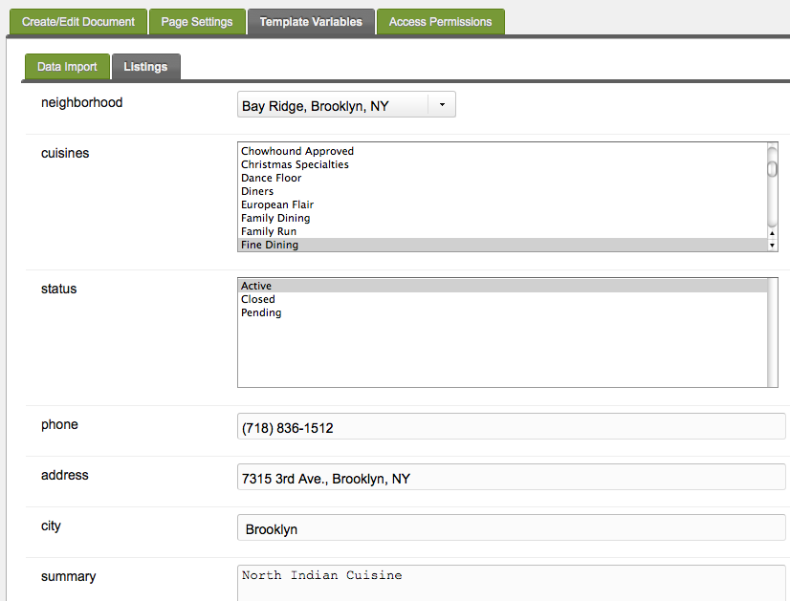
Template Variables

Slide 11
Snippets
contain PHP code
act like functions
can be called by documents & templates
In an MVC architecture, the “M” (model)

Slide 12

Document
Template
Snippet

Slide 13
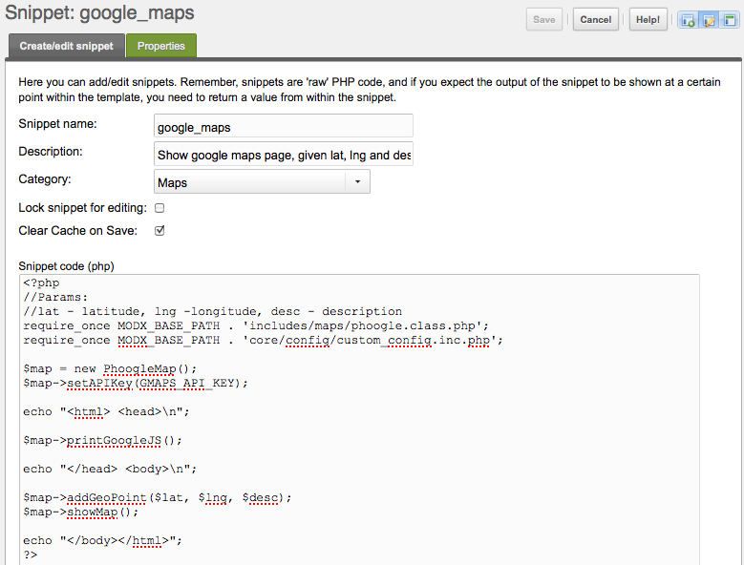
Snippet: definition (#1)

Slide 14
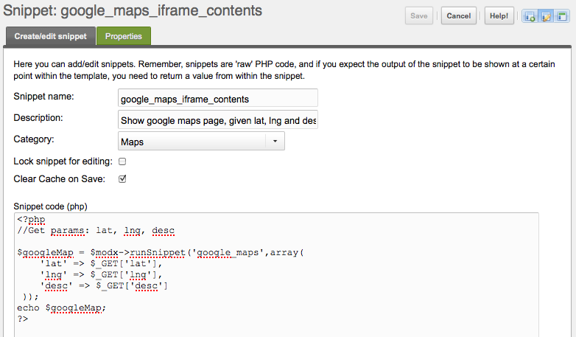
Snippet: definition (#2)
Side-note: this is a little sneak peak at the modx API!

Slide 15
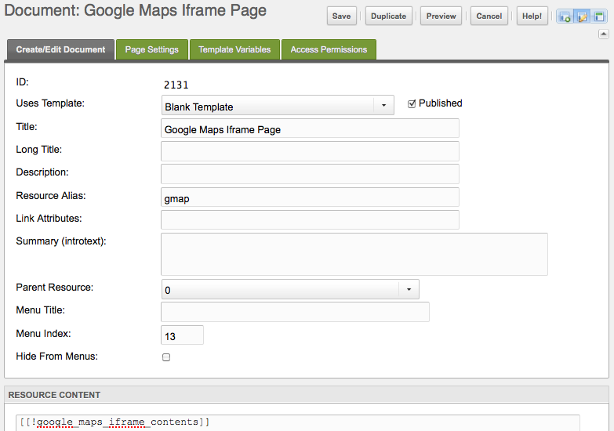
Snippet: calling it (from a document)

Slide 16
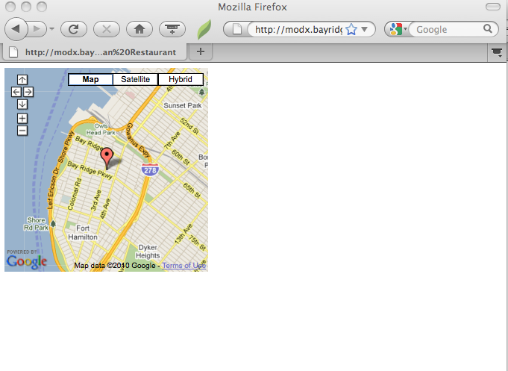
And the result is ...
http://modx.bayridge-business.com/gmap.html?lat=40.6323290&lng=-74.0270810&desc=Taj%20Mahal%20Indian%20Restaurant

Slide 17
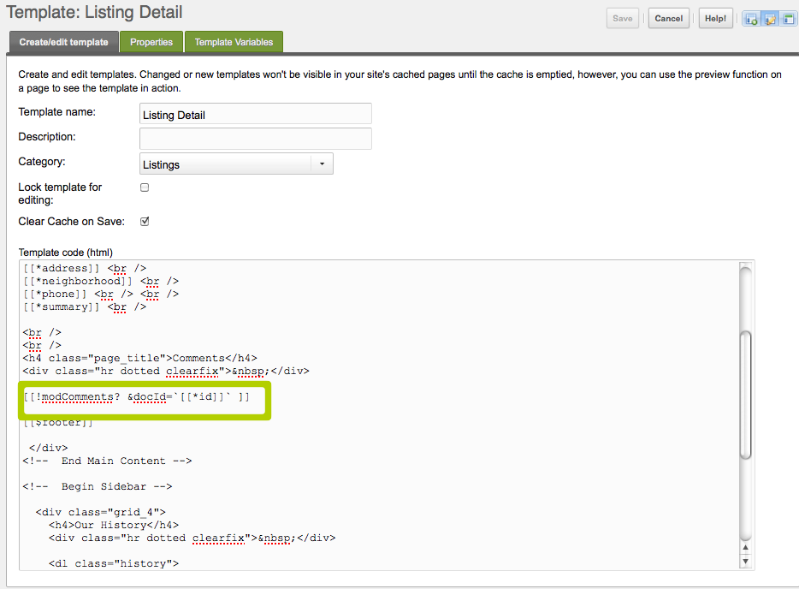
Snippet: calling it (from a template)

Slide 18
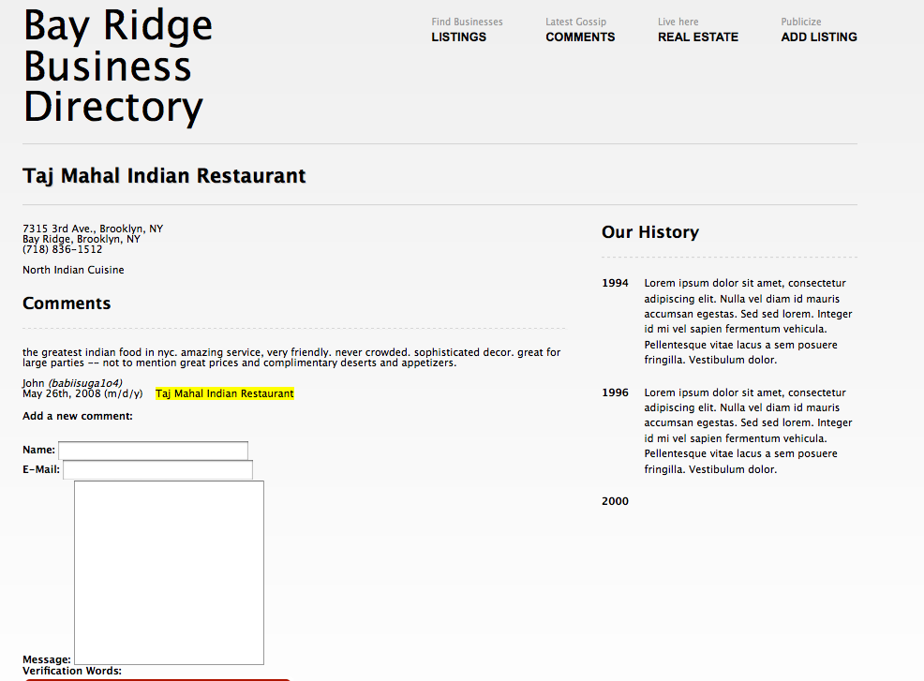
Snippets in a template affect all documents using that template!

Slide 19
Chunks
Pieces of HTML, with placeholders
Think of them as simplified Smarty templates
Used by snippets, or templates to create HTML output
In an MVC architecture, the “V” (view)

Slide 20
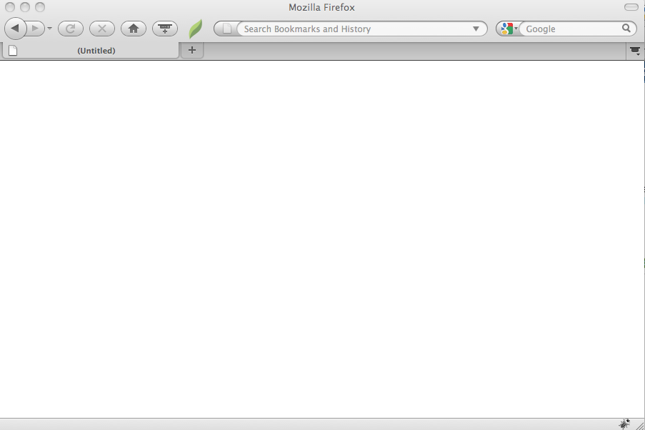
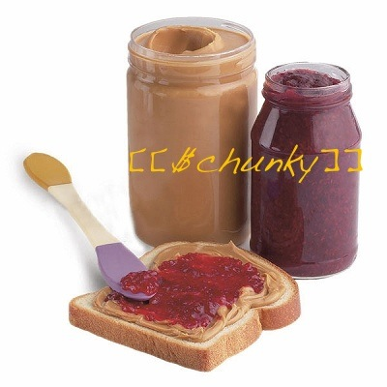
Document
<html>
<p>
All about
PB & J
</p>
</html>
Rendered
Page
Snippet
Chunk

Slide 21
Template
Document
<html>
<p>
All about
PB & J
</p>
</html>
Rendered
Page
Chunk

Slide 22
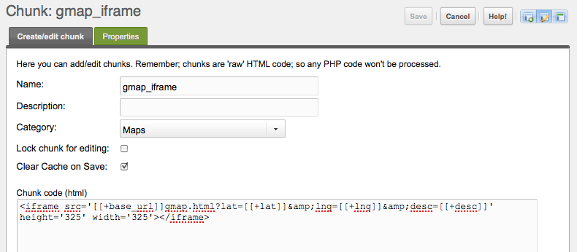
Chunk: definition

Slide 23
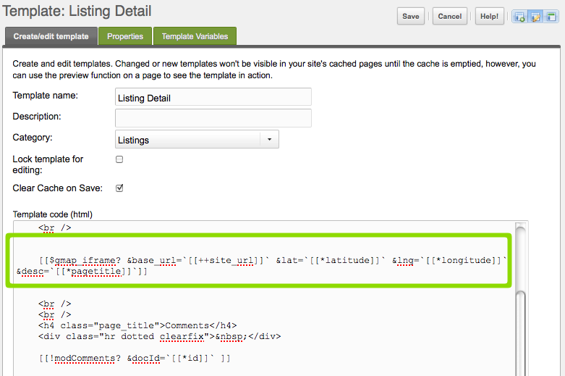
Chunk: calling it (from a template)
Chunks accept parameters
You can pass either system settings (site_url) or template variables (latitude,longitude,pagetitle) as parameters

Slide 24
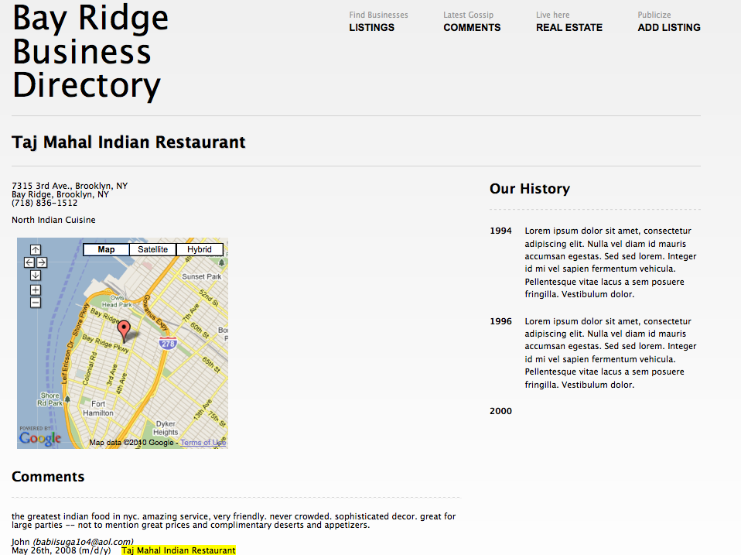
And the result is ...
http://modx.bayridge-business.com/listings/food-drink/restaurants/taj-mahal-indian-restaurant/

Slide 25
modx tag syntax
 | Evolution (old) | Revolution (new)
 | [*content*] | [[*content]]
 | [[amzn_book_srch]] | [[amzn_book_srch]]
 | [! amzn_book_srch!] | [[!amzn_book_srch]]
 | {{gmap_iframe}} | [[$gmap_iframe]]
 | [+latitude+] | [[+latitude+]]
Template Variable
Cached Snippet
Uncached snippet
Chunk
Chunk placeholders
More info.: http://rtfm.modx.com/display/revolution20/Tag+Syntax

Slide 26
“Hackable” URLs
Using aliases and folders to create, hackable, semantic URLs
E.g.:
http://modx.bayridge-business.com/listings/food-drink/restaurants/taj-mahal-indian-restaurant/
Organize your content in the same way that you think about it, and the URLs will reflect this semantic structure automatically!

Slide 27
Caching
Document-level caching
Snippet-level caching
Caching is essential for high-traffic sites!

Slide 28
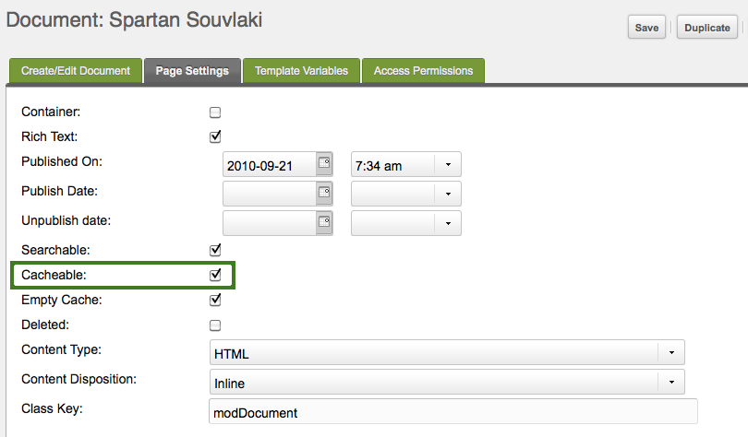
Document-level caching
Document are cacheable by default

Slide 29
Snippet- and element-level caching
Cached snippet: [[google_maps]]
Uncached snippet: [[!google_maps]]
Uncached chunk: [[!$chunk]],
Uncached placeholder: [[!+placeholder]]
Uncached template variable [[!*template_var]]

Slide 30
Page-level + snippet-level caching
Page | Snippet | Result (Page)
Cached | Cached | Cached
Cached | Uncached | If only 1 snippet / page: Uncached If > 1 snippet/page: Mixed
Uncached | Cached | Uncached
Uncached | Uncached | Uncached

Slide 31
Caching: summary
Page-level cache overrides snippet-level cache
Best practice: keep all pages cached, use uncached snippets for sections doing data processing, or needing instant updates
Page cache is automatically cleared when the page (or snippets it uses) is updated

Slide 32
Extending modx
snippets, plugins, packages (“add-ons”)
plugins: pieces of PHP code that affect how the modx manager and user-facing site operate
packages: collections of snippets and chunks available through the modx manager
Browse add-ons: http://modxcms.com/extras/repository/10

Slide 33
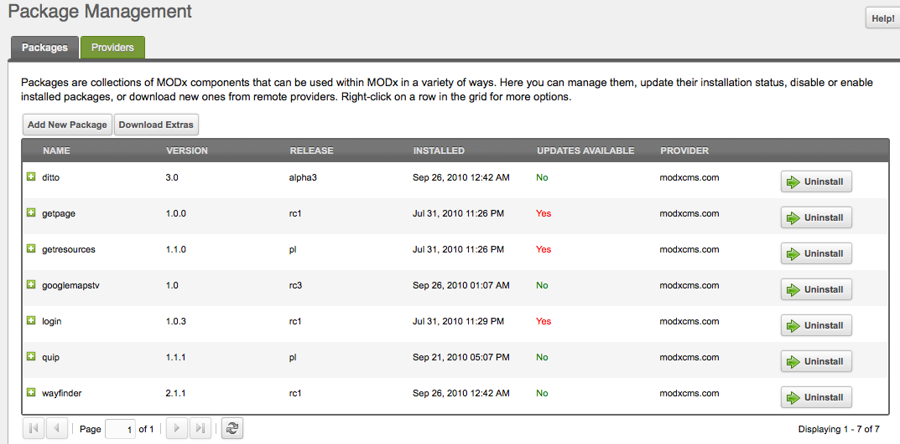
Extending modx: upgrading packages

Slide 34
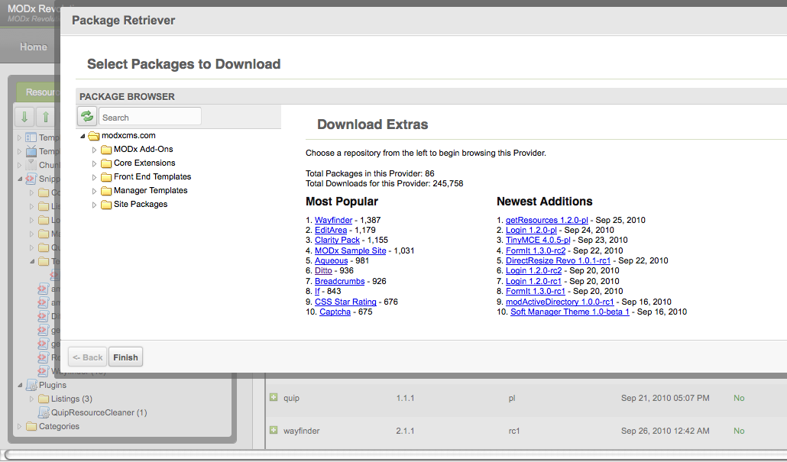
Extending modx: adding new packages

Slide 35
modx API
Call a snippet from a snippet
Parse a chunk, and return its output from a snippet
Cache the result of a function
Save data to the database using xPDO library
Why use the modx API?

Slide 36
Using the modx API
All snippets running within modx have access to the global $modx object
The $modx object is the main, and most important object
Call various methods of $modx
API Reference: http://rtfm.modx.com/display/revolution20/modX

Slide 37
modx API, snippets
Call a snippet from a snippet:
$googleMap = $modx->runSnippet('google_maps',array(
'lat' => $_GET['lat'],
'lng' => $_GET['lng'],
'desc' => $_GET['desc']
));

Slide 38
modx API, chunks
Parse a chunk, and return its output (from a snippet)
Snippet:
$row = array(‘name’ => ‘Tom Jones’, ‘email’ => ‘tj@tomjones.example.com’, ‘message’ => ‘hi there!’);
$formattedComment = $this->oModx->getChunk('show_comment', $row);
echo $formattedComment;
Chunk:
<p> [[+message]] <br />
[[+name]] <em>([[+email]])</em> </p>

Slide 39
modx API - accessing TVs
Get current document’s id:
$modx->resource->get(‘id’);
Get current document’s (built-in) “content” TV:
$modx->resource->get(‘content’);
Get the value of current document’s (custom) “latitude” TV:
$oTV = $modx->getObject( 'modTemplateVar', array( 'name'=>'latitude') );
$latitude = $oTV->renderOutput($modx->resource->get(‘id’));

Slide 40
modx API - running DB queries
PDO -> xPDO -> $modx ($modx inherits from PDO!)
Sample code:
foreach( $modx->query('SELECT cuisine_id, cuisine FROM cuisines LIMIT 5') as $row ){
echo $row['cuisine_id'] . ',' . $row['cuisine'] . '<br />';
}
Result
1,nocuisine
2,Christmas Specialties
3,Italian
...
(More on xPDO and PDO in the appendix)

Slide 41
Modx Plugins
Extend and modify core modx functionality
Example: create a custom routing system to serve “virtual pages”, using 404 handler

Slide 42
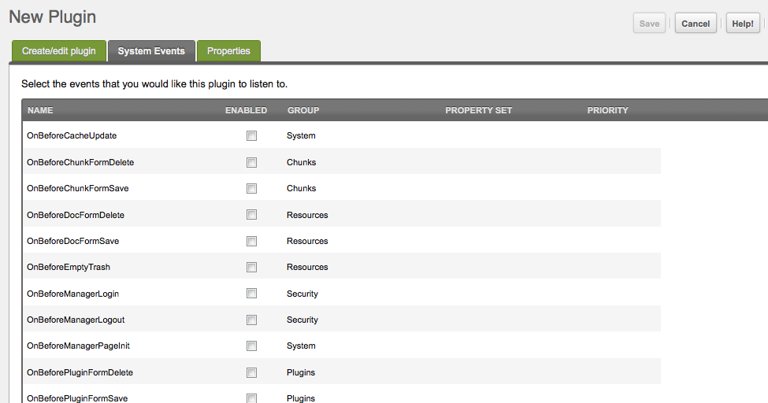
Modx Plugin Events

Slide 43
Questions? Comments?

Slide 44
Thank You!
See appendix for links, and more info.

Slide 45
Appendix
Main site: http://www.modxcms.com/
Forums: http://modxcms.com/forums/
modx Revolution documentation: http://rtfm.modx.com/display/revolution20/Home
Book: MODx Web Development (covers modx Evolution). https://www.packtpub.com/modx-web-development/book
Bob’s Guides: http://bobsguides.com/MODx.html
Start Here:

Slide 46
xPDO
xPDO is an object-relational mapping framework that stands
at the core of modx Revolution. It was written by modx core contributor
Jason Coward.
PDO reference: http://us3.php.net/manual/en/intro.pdo.php
xPDO intro.: http://rtfm.modx.com/display/xPDO20/Fundamentals
xPDO class ref.: http://rtfm.modx.com/display/xPDO20/Class+Reference
xPDO api docs: http://api.modxcms.com/xpdo/xPDO.html
xPDO forum: http://modxcms.com/forums/index.php/board,219.0.html
Blog Posts:
http://marcoraven.net/modx/modxrevolutionxpdo.html

Slide 47
Useful Packages
getResources:
http://modxcms.com/extras/package/?package=552
Ditto:
http://modxcms.com/extras/package/?package=96
Listing and Summarization:

Slide 48
Useful Packages
Wayfinder:
http://modxcms.com/extras/package/?package=487
Breadcrumbs:
http://modxcms.com/extras/package/?package=54
Menus:
For all packages, see: http://modxcms.com/extras/repository/10

